Slide 1
Recite WS-MAN Scripting Environment

Slide 2
Purpose
Fast, Readable, Simple WS-MAN
http://dell.to/recite-wsman

Slide 3
Features
WS-MAN command generation
Interactive mode
Script mode
Programmatic constructs
Python module
Multiple targets

Slide 4
Requirements
Windows – Winrm
Linux – Openwsman CLI
Python 2.4 – 2.6

Slide 5
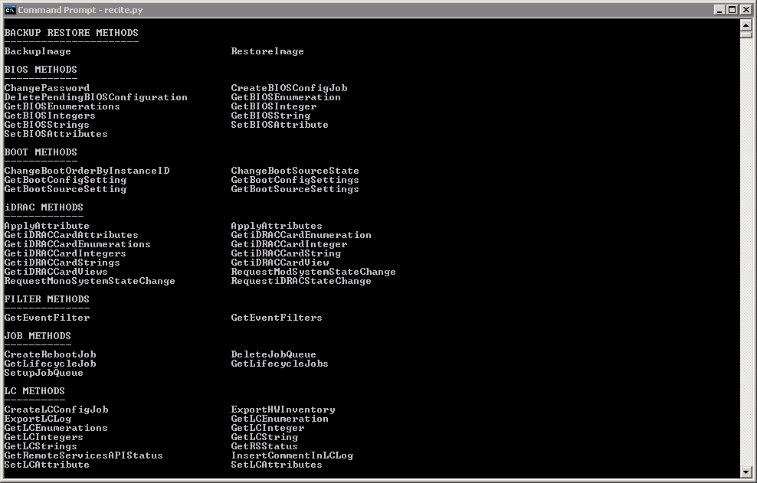
Interactive Help

Slide 6
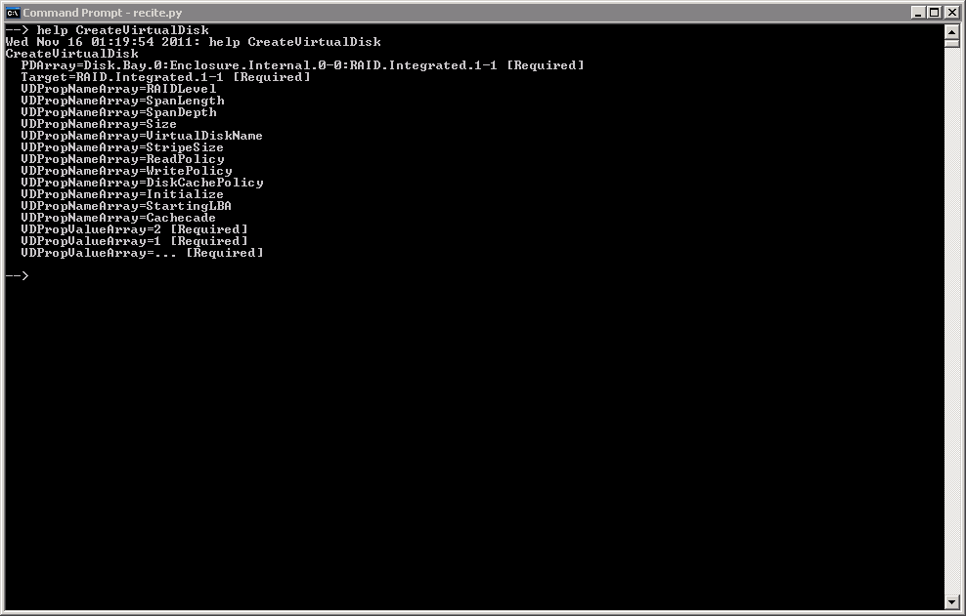
Interactive Help

Slide 7
Programming Constructs
COMMAND SHORTCUT DESCRIPTION
Batch Execute external script file Clear Clear screen Context // Find in specified context Count + Count number of contexts Find / Find value in name=value pair Findall /* Find all values in name=value pair Gosub >> Go to subroutine by label or line Goto > Go to label or line If ? If - then Log Start / stop logging screen output Print < Print line Report << Generate report output Return Return from subroutine Set $ Set a variable, list variables Sleep Sleep for specified seconds Unset ~$ Unset variable Until { Loop until name=value

Slide 8
Variables
$IP
IP or hostname of the iDRAC against which WS-MAN commands are to be executed. Default: ""
Set $IP 10.0.0.1
Set $IP idrac.dell.com
Set $IP username:password@10.0.0.1
Set $IP username@10.0.0.1 => prompts for password securely
$LOGIN
iDRAC username with WS-MAN privileges. Default: username
Set $LOGIN username
$PASS
iDRAC password. Default: password
Set $PASS dell

Slide 9
One liners
CreateRAIDConfigJob Target=$ctlr RebootJobType=3 {ReturnValue=4096 /$jid=InstanceID
Perform Until loop
On success, perform Find operation
GetRSStatus {Status=Reloading {Status=Ready
Perform Until looking for Status=Reloading
Perform Until looking for Status=Ready
GetLifecycleJobs +$njob ?$njob=1 >End
Count number of jobs
If only one job, Goto End

Slide 10
Reports
Report InstanceID,CurrentValue where IsReadOnly=false
InstanceID CurrentValue
NIC.Integrated.1-1-1:BlnkLeds 0
NIC.Integrated.1-1-1:ChapAuthEnable Disabled
NIC.Integrated.1-1-1:ConnectFirstTgt Disabled
NIC.Integrated.1-1-1:ConnectSecondTgt Disabled
NIC.Integrated.1-1-1:FirstHddTarget Disabled
NIC.Integrated.1-1-1:FirstTgtBootLun 0
NIC.Integrated.1-1-1:FirstTgtIpAddress 0.0.0.0
NIC.Integrated.1-1-1:FirstTgtTcpPort 3260
NIC.Integrated.1-1-1:IpVer IPv4
NIC.Integrated.1-1-1:IscsiTgtBoot Disabled
NIC.Integrated.1-1-1:IscsiViaDHCP Disabled

Slide 11
Scripts
# Create job, wait until job completion and refresh CreateRAIDConfigJob Target=$ctlr RebootJobType=3 {ReturnValue=4096 /$jid=InstanceID Until JobStatus=Completed GetLifecycleJob InstanceID=$jid GetRSStatus {Status=Reloading {Status=Ready
# Find current value of a specific NICEnumeration GetNICEnumerations Context AttributeName=NicMode Find CurrentValue $pval If $pval!=Disabled ...
# Delete all jobs in job queue :Loop GetLifecycleJobs +$njob ?$njob=1 >End Find InstanceID $jid 2 DeleteJobQueue JobID=$jid >Loop :End

Slide 12
Command Line
[NAME1=VALUE1 NAME2=VALUE2]
Set variable $NAME1 to VALUE1, $NAME2 to VALUE2 ...
["CMD1" "CMD2" ...]
Execute CMD1, CMD2 in order ...
[batch1.win batch2.win]
Execute batch scripts in order and exit ...
IP=idrac.dell.com,username:password@10.0.0.1,username@10.0.0.2
Spawn multiple instances of recite.py in separate windows
Set $IP, $LOGIN and $PASS with a single assignment
Skipping $PASS prompts for password securely
IP=IP.ini
Load IPs from file, one per line, # comments a line

Slide 13
Command Line Flags
[FLAGS]
q = exit after executing all commands
When multiple IPs specified:-
c = close instance foreground windows on exit
pX = maximum parallel instances at a time (default: 10)
s = run instances silently, output appended to $IP.log

Slide 14
Python API
Messages
# Get the current verbosity level print recite.get_verbosity()
# Set the verbosity level recite.set_verbosity(0)
# Set logfile to capture all WS-MAN data recite.set_logfile("filename.txt")
Environment
# Set IP details if recite.process("Set $IP username:password@10.0.0.1"): print "Succeeded"

Slide 15
Python API
Execution
# Execute a simple command if recite.process("GetRSStatus"): print "Succeeded"
# Execute a script file if recite.batch(filepath): print "Succeeded"
# Execute a list of commands commands = ""“ CreateBIOSConfigJob Target=BIOS.Setup.1-1 RebootJobType=3 {ReturnValue=4096 /$jid=InstanceID GetLifecycleJob InstanceID=$jid {JobStatus=Completed GetRSStatus {Status=Reloading {Status=Ready ""“ if recite.batch("workflow-name", commands): print "Succeeded"

Slide 16
Python API
Data
# Obtain the command line of the last WS-MAN command print recite.get_input()
# Obtain the input XML of the last WS-MAN command (if applicable) print recite.get_inputxml()
# Obtain the output of the last WS-MAN command print recite.get_output()
# Obtain the XML output of the last WS-MAN command import xml xmlout = recite.get_outputxml() x = xml.dom.minidom.parseString(xmlout)
# Get the full path to the script executing currently path = recite.get_curr_scriptpath()

Slide 17
Demo

