Slide 1

Campus Maps
Colin Hunt, Tri Lai,
Edwin Chung, Shane Murnaghan,
Mark Galloway, Josh Stagg, Kris Kushniruk

Slide 2
Product Overview

Slide 3
Summary
The Campus Maps team is striving to provide a real time, user-friendly path finding experience across all of the University of Alberta campuses.
Currently anyone who would like to find their way around using campus maps can do so, but the path provided does not give you directions directly to a door or specific service inside of a building.
One will also be able to add waypoints to a specific path.
Another example would be a disabled route, taking into account both stairs and elevators when planning the route

Slide 4
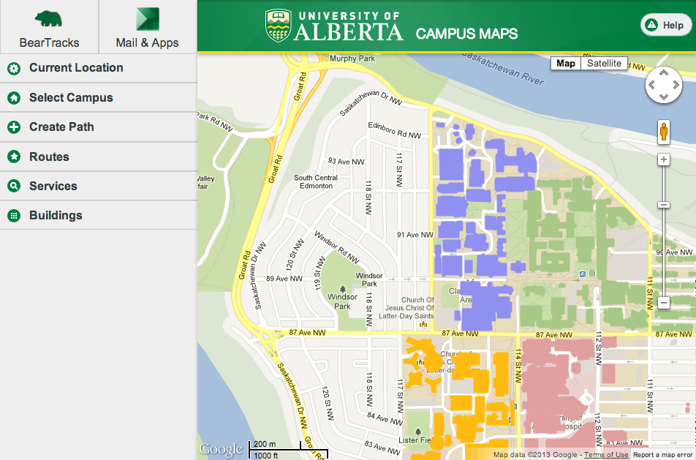
Desktop
We would like to see this service working on modern browsers, accessible by both HTML5 capable computers and mobile devices

Slide 5
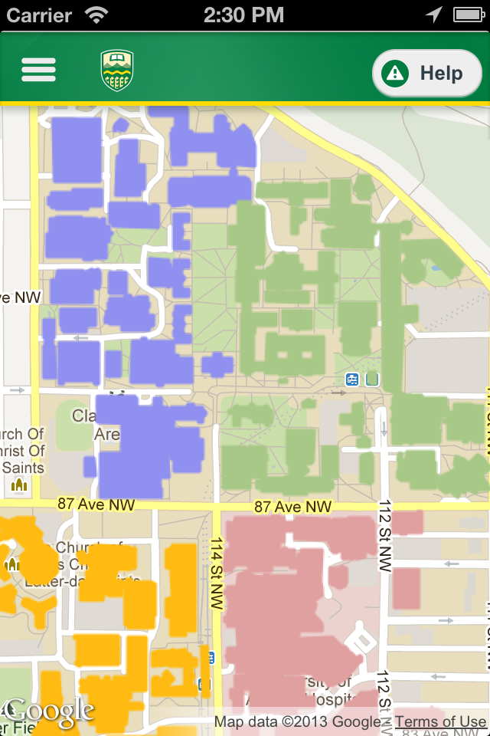
Mobile
Using phonegap the desktop version can be easily wrapped into native apps for both iOS and Android

Slide 6
Video and User Scenarios
Notes:
We made it

Slide 7
System Architecture

Slide 8
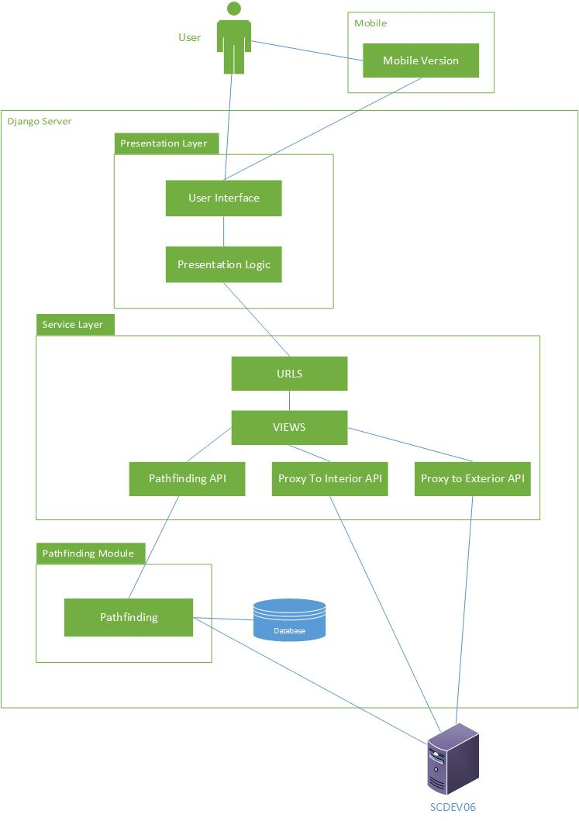

Slide 9
Implementation Issues
Frontend/Backend

Slide 10
IBM Worklight
Initially attempted to use IBM Worklight to create an integrated HTML5/JS application.
Pro: Recommended (strongly) by TA.
Pro: Integrated solution.

Slide 11
IBM Worklight
Con: First attempts at use of Eclipse IDE encountered bugs.
Con: Really, just a fancy IDE wrapper and for rapid deployment of enterprise applications using web technology.
Con: Most of IBM Worklight’s features are outside of the scope of our project, we really just need the Apache Cordova wrapper for mobile apps.
Major bug: We had trouble deploying our Worklight code onto our development server.

Slide 12
Solution – Back to basics
Our solution was to simply stop using this recommended technology, and start making a stand-alone HTML5/JS web application.
This gave us the freedom to start implementing without the overhead of Worklight.
We could still wrap our code in Apache Cordova, after implementation, and achieve our goals of cross-platform mobile apps. This made implementation simpler.

Slide 13
Conflicting Requirements
We were given two sets of requirements.
Our client, the University Digital Strategy, requested a simple indoor path finding addition to their current Campus Maps implementation.
Eleni, however, wanted us to remake and improve the current Campus Maps as well.
This caused thrashing with the initial development, as it was unclear which party we should be listening to.

Slide 14
Awkward requirements
A major requirement from Eleni was to have natural language, turn by turn directions.
A massive amount of work would be needed, after the pathfinding is complete, to create these turn by turn directions.
This is a really tough task, and could be a project on its own.
This requirement was cut due to time constraints.

Slide 15
Progress
After meeting with Eleni at the end of February, we found the route cause of the conflicting requirements. Eleni had originally elicited requirements from the UDS manager, Jennifer, whom was not one of our clients.
Therefore, we were able to just focus on Eleni’s requirements, and progress increased dramatically.

Slide 16
Implementation Issues
Pathfinding

Slide 17
API Limitations
The client wanted interior to exterior pathfinding, but the API did not support exterior door locations.
The client wanted paths between different floors, but stairwell coordinates did not line up.
The client wanted paths to use elevators, but again, Elevators coordinates did not match.
Furthermore, API docs contained syntax errors.

Slide 18
Overall pathfinding challenge
Challenge
Solution
We have hallway drawings (or navigable area) but they are just CAD drawings, we cannot do path finding on them. We need to produce an A*-friendly navigable graph.
We have room drawings with names but without doors.
We ended up using Voronoi diagram since this potentially allows us to produce paths that go in the middle of and along the hallways.
There is no door data returned from the API, so we decided to use the centre of rooms as room node to add to the navigable graph.

Slide 19
Path finding across floors of the same building
Challenge
Solution
We must find a path using stairs and elevators, and have the ability to switch between the two.
No stairs or elevator height data (distance weight), which is an issue in shortest path problem.
Again, lack of sufficient data.
We compute a building connection graph for each building.
We asked the client to temporarily provide a reference id to determine the connection between portals.

Slide 20
Building in Campus Graph
Room
Edge in Campus Graph
Exit
Edge in Building Graph
Stairs L3
Stairs L1
Path in Floor Graph
Pathfinding is done in a hierarchal way over three abstraction layers:
Campus Graph represents how doors on campus are connected
Edges represent paths in a building
Building Graph represents how rooms, stairs, elevators, and entrances are connected
Edges represent paths over a floor or between floors
Floor Graph represents how to navigate over a given floor in a building

Slide 21
Path finding across buildings on campus
Challenge
Solution
We must find the path between two rooms in two different building that consists of going up and down floors, getting in and out of buildings before reaching the destination room.
Interior distance is not scaled to the exterior.
Missing data.
For each entrance of a building, we find paths to every entrance of other buildings.
We find the shortest interior path between entrances of the same building using path finding between rooms in the same building algorithm.
We manually mapped some entrances with lat/lng coordinates.

Slide 22
Sample campus connection graph
Building 1
Building 3
Building 2

Slide 23
To be managed, or not to be managed?
Handling multiple clients

Slide 24
The plan
The team will be organized as a egoless, self organizing team. This allows for each member to work with collective ownership in mind while we are learning new languages and development methods. It also allows us to work by consensus so that the best ideas and solutions can be implemented while guaranteeing we meet our management requirements.
Notes:
Project Macro Structure
We are going to adopt an agile model using different agile principles.

Slide 25
The goals
Story points
Weekly sprints
Simple design
Collective ownership
Introduce any required redesigns and re-factorings constantly.
Test first driven development
Create and follow code reviews through GitHub
Continuous integration using the server, non-stop build/testing
Code commenting, simple, functional.
No overtime
Beer (team building)
Notes:
Extreme programming focus, rookie mistakes made here.
More on that later.

Slide 26
Multiple clients Conflicting requirements
Client
We want an interior pathfinding algorithm
Single path
It has to use our data
We don’t need a user interface
This is only a prototype
CMPUT 401
We need a visual interface to demo
Path with waypoints
Mobile applications
Worklight
This is a product
Turn-by-turn natural language directions
Notes:
Which leads to our first major problem…..

Slide 27
Not to be managed The result
Conflicting requirements caused confusion and lack of organization
Not having access to the client’s data stalled progress
Nobody knew what to do
Paperwork combined with the above scenario lead to thrashing
Lack of leadership, and direction
Needed help to get focused and gain access to required resources
Notes:
How that turned out and….

Slide 28
Feb 20th Code start
Have API access!
Set the server up and acquire data for pathfinding
IBM Worklight
Used up valuable time attempting to implement
In reality it was the wrong tool for the problem
Rotating product manager
New manager each sprint
Notes:
How we got there…

Slide 29
March 1st Houston we have a problem
“I'm unsure what to do next and cannot imagine how we'll finish the project”
“I feel I am not contributing as much as I should be”
“I think some people lost a lot of steam”
“I personally don't have any experience with anything we are doing”
Notes:
Highlights of our discussion on basecamp

Slide 30
To be managed Actually starting, March 2nd to April 2nd
Self organization isn’t working:
Split the team into three ‘focused’ teams
We don’t have any issues or tasks:
Issues were created and assigned to individuals
Dedicated manager:
Keep the project going, stay organized
Coding session every week:
Worked most Tuesday's and Thursday’s
Notes:
Fix this!
After this we all felt that we started to make progress

Slide 31
Issue creation Getting started
Notes:
Only really got focused and started after march 2nd and all the issues were created.
We are still improving the product

Slide 32
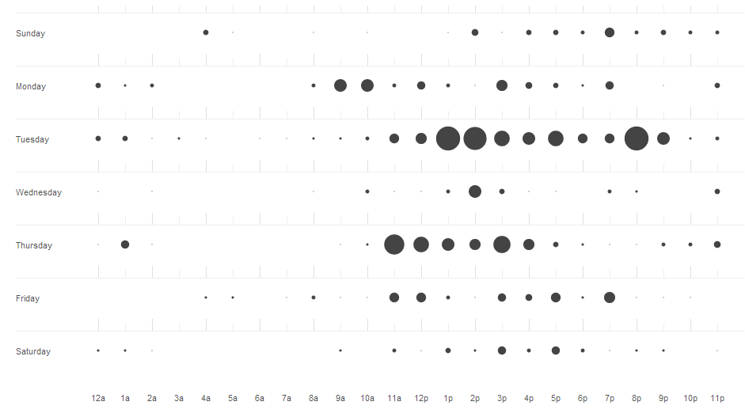
Tuesdays and Thursdays Teamwork, lots of hours to catch-up
Notes:
Had to play catchup, involved huge amounts of work. Dedication.

Slide 33
Closing issues A representation of progress
Notes:
11:59:59. Once the product was outlined and managed everyone knew what to do

Slide 34
Sprints and Milestones
Notes:
Focus breeds implementation

Slide 35
The goals (Recap)
Story points
Weekly sprints
Simple design
Collective ownership
Re-factorings constantly.
Test first driven development
Create and follow code reviews through GitHub
Continuous integration using the server, non-stop build/testing
Code commenting, simple, functional.
No overtime
Beer (team building)

Slide 36
The goals we didn’t accomplished
Story points
Weekly sprints – ~2 week sprints
Simple design
Collective ownership
Re-factorings constantly – Where was the time?
Test first driven development – Did not have time for the learning curve
Create and follow code reviews through GitHub – We need it working now!
Continuous integration using the server, non-stop build/testing
Code commenting, simple, functional. – Post-implementation commenting
No overtime – Right.
Beer (team building)

Slide 37
Lessons Learned

Slide 38
The Bad…
Python can be slow
Should perhaps have written some things in C++
Do not assume client provided data to always be correct
Python environment runtime issues
more up-front design
have a design meeting
Documents
Diagrams
think ahead a little more to the upcoming challenges
some things ended up surprising us and causing problems near the end
Better planning using use case points or story points in a chart (gantt or burndown)

Slide 39
The Good…
Learned how to use CSS3, HTML5, and JavaScript
Learned how to wrap HTML5/JQuery code into a cross-platform app.
Learned about responsive design.
Learned about the importance of management firsthand
Learned How to apply esoteric algorithms to solve real world problems
Voronoi diagrams for interior pathfinding
Learned Python
using a mixture of OO and Procedural styles

Slide 40
The Awkward
Its shorter to go down the stairs and take the elevator up than just going directly to the elevator.
There’s no enforcement about booking the same breakout room for the entire day of the entire week.
Tim Horton’s is not opened on Sunday.
50% student discount at Dominos Pizza.
RATT is cheap for using plastic cups.

Slide 41
Future

Slide 42
Future Implementations
Mostly indoor paths
Mostly outdoor paths
Using Lat/Long coordinates in outdoor paths
Turn by turn natural language directions

