Slide 1

WordPress – Customizing Your Theme

Slide 2
The following presentation is intended only for use by Digital Workshop Center staff and students. No copy or use of this presentation should occur without the permission of Digital Workshop Center.
Although Digital Workshop Center creates custom and up-to-date trainings and workshops, it is possible for course material to need last minute modification since the programs we use in class change and update without notice.
Disclaimer

Slide 3
Table of Contents
SECTION ONE
Introduction & Class Overview
SECTION TWO
What is a WordPress Theme?
Components of a Theme
Structure of WordPress Theme hierarchy
Theme resources
SECTION THREE
Theme Customization Options
Theme editor
Using a third-party software tool
Plug-ins
SECTION FOUR
Using Cascading Style Sheets effectively
Introduction to Cascading Style Sheets (CSS)
Using the WP hierarchy with CSS
Embedding CSS into a Page or Post
Applying CSS to an entire site
Writing responsive CSS
SECTION FIVE
Creating a Child Theme
Purpose of a Child Theme
When and How to use a Child Theme
Using Page or Post ID’s in your Child Theme
MORE WORDPRESS RESOURCES
RELATED CLASSES & SERVICES

Slide 4
Introductions &
Class Overview

Slide 5


Tell Us About You!
PLEASE TELL US a little bit about yourself so we have a better idea of who you are and what you’re hoping to accomplish from taking this class. Sample questions include the following:
What is your name?
What company do you work for?
What are you responsible for?
What are you hoping to gain from this class?
Is there anything else you would like to share?

Slide 6





About Digital Workshop Center
DIGITAL WORKSHOP CENTER WAS founded in 2006 and is a locally-owned independent computer training school offering classes on almost all major software programs, desktop applications, business solutions and advanced computer training concepts.
All students receive hands-on, personalized training with small class sizes to ensure each student receives focused and personalized attention.
Instructors have 10+ years of computer training experience, IT/Computer Science or related degrees, and significant job experience in the IT training field.
DWC has a training solutions for class sizes ranging from just one individual and up to 50+ employees with many regularly scheduled courses to choose from.
DWC provides training location options including our location, on-site at your office, online, and private instruction.

Slide 7
What’s Included in this Class?
Reference Packet
- Feel free to mark this up! It is yours to keep
Certificate of Completion from the DWC
One month of technical support
- Submit technical support questions at DigitalWorkshopCenter.com/Technical- Support
One year for a free class retake*
Free use of coworking community space on class days
*applicable to public, group classes only

Slide 8
What is a WordPress Theme?

Slide 9
1
Components of a Theme

Slide 10

Components of a WordPress Theme
WordPress Themes use 3 core languages to create their pages:
HTML
CSS PHP
In addition, WordPress connects to a database and stores valuable information on your site including the content, images, settings, and much more.
You don’t need to be an expert in all of these languages, but understanding how to edit the code is invaluable in order to get the custom Theme appearance that you want…especially CSS!
Why? You will learn more in this class about the application of CSS within WordPress.

Slide 11
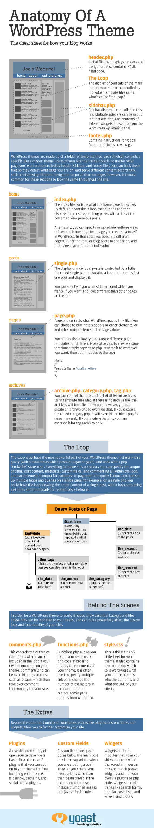
Components of a WordPress Theme
From Yoast.com:

Slide 12
Components of a WordPress Theme

Slide 13
Components of a WordPress Theme

Slide 14
Components of a WordPress Theme

Slide 15
Components of a WordPress Theme
WordPress themes are made up of a folder of template files, each of which controls a specific piece of your theme. Parts of your site that remain static no matter what page you’re on are controlled by header, sidebar and footer files. You can hack these files so they detect what page you are on and serve different content accordingly, such as display different navigation on posts than on pages; however it is most common for these sections to look the same throughout the site.
header.php
Global file that displays headers and navigation. Also contains HTML code.
The Loop
The display of contents of the main area of your site are controlled by individual WordPress theme template files using what’s called “the loop”.
sidebar.php
Sidebar display is controlled in this file. Multiple sidebars can be set up in functions.php, and contents of sidebar widgets are set up from the WordPress wp-admin panel.
footer.php
Contains instructions for global footer and closes HTML tags.

Slide 16
Components of a WordPress Theme
index.php – home
The index file controls what the homepage of your WordPress theme looks like. By default it is a loop that queries and then displays the most recent blog posts, with a link in the bottom to view previous posts.
Alternately, you can specify in wp-admin -> settings -> reading to have the home page be a page you created yourself in WordPress. In that case, you specify a different page/URL for the regular blog posts to appear on, and that page is generated by index.php.
single.php – individual posts
The display of individual posts in your WordPress theme is controlled by a little file called single.php. It contains a loop that queries just one post and displays it.
You can specify if you want sidebars (and which you want), if you want it to look different than the other pages on the site.

Slide 17
Components of a WordPress Theme
page.php – individual pages
Page.php controls what pages look like. You can choose to eliminate sidebars or other elements, add other unique elements for pages alone.
WordPress also allows you to create different page templates within your WordPress theme for different types of pages. To create a page template, simply copy page.php, rename it to whatever you want, then add this code to the top:
<?php
/*Template Name: YourPageNameHere*/
?>
archive.php, category.php, tag.php – archives
You can control the look and feel of different archives using template files also. If there is no archive file, the archives will look like index.php; however you can create an archive.php to override that. If you create a file called category.php, it will override archive.php for categories only. If you create a tag.php, you can override it for tag archives only.

Slide 18
Components of a WordPress Theme
The Loop
The loop is perhaps the most powerful part of your WordPress theme. It starts with a query (which determines which posts or pages to grab), and ends with a PHP “endwhile” statement. Everything in between is up to you. You can specify the output of titles, post content, metadata, custom fields and commenting all within the loop and each element is output for each post or page until the query is done. You can set up multiple loops and queries on a single page; for example: on a single.php you could have the loop showing the entire content of a single post, with a loop outputting just titles and thumbnails for related posts below it.
Query post or page
Start Loop
the_title (outputs the title of the post)
the_excerpt (outputs the post excerpt)
the_content (outputs the full post content)
the_category (outputs the post categories)
the_author (outputs the post author)
the_date (outputs the post date)
other tags (there is a variety of other tags you can use in the loop)
endwhile;
Exit the loop
Background files of a WordPress theme
In order for a WordPress theme to work, it needs a few essential background files. These files can be modified to your needs and can quite powerfully affect the custom look and functionality of your site.

Slide 19
Components of a WordPress Theme
comments.php
This controls the output of comments, which can be included in the loop if you desire comments on your theme. Comments.php can be overriden by plugins such as Disqus, which then take over comment functionality on your blog.
functions.php
Functions.php allows you to put your own custom PHP code in order to modify core elements of your theme. It is often used to specify multiple sidebars, change the number of characters in the excerpt or add custom admin panel options for wp-admin.
style.css
This is the main CSS stylesheet for your theme. It also contains text at the top which tells WordPress what the name of your WordPress theme is, who the author is and what the URL of your site is.
Other Notes:
Each Page and Post within WordPress is given a unique page ID. This allows us to creatively apply styles to specific Pages/Posts because we can direct where the CSS should be applied to specifically. More on this concept later in this class…

Slide 20
Structure of WordPress Hierarchy
The basic structure of the WordPress framework has not changed much since their inception. Understanding the WordPress document schema will help you to be able to make custom changes to your Theme as you need.
Site Architecture 1.5:
https://codex.wordpress.org/Site_Architecture_1.5
Template Hierarchy Diagram:
https://developer.wordpress.org/files/2014/10/template-hierarchy.png
WordPress Template Hierarchy Visualization:
http://wphierarchy.com/

Slide 21
2
Theme Customization Options

Slide 22
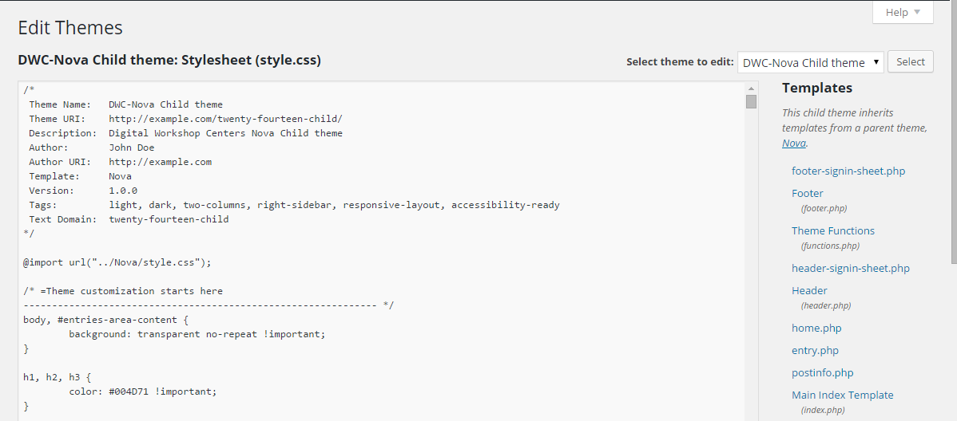
Theme Customization Options
THERE ARE 3 PRIMARY WAYS to edit a WordPress Theme.
Using the Theme Editor
Editing with a third-party tool
Notepad++
Coda
Atom
Adding a plug-in

Slide 23
Theme Customization Options
Millions of WordPress Themes are now available on the internet for you to download for free or purchase.
Popular Theme sites (paid) include:
Elegant Themes
ThemeForest
TemplateMonster
Simple Themes
You can also find free Themes by going to Appearance > Themes and using the built-in Theme search tool. All Themes available through this method have been approved by the WordPress team. In addition, these Themes are searchable by their Theme properties and/or assets.

Slide 24
3
Using Cascading Style Sheets Effectively

Slide 25
Using Cascading Style Sheets Effectively
What is CSS?
Cascading Style Sheets (CSS) is a scripting language that controls the appearance of your web page elements. CSS must be “connected” to HTML elements through the use of a CSS selector, formatting rules, and the appropriate location..
Generic CSS rule:
Selector { property: value;
}
Note: the white space and line breaks do not matter (typically). We put our rules on separate lines when we can, so that the entire style sheet is easier to read. However, the web browser does not care about the spacing.
CSS example:
p {
color: red;
}

Slide 26
Using Cascading Style Sheets Effectively
Locations of CSS:
General guideline: Rule physically closer to the element will win in a conflict
External Style Sheet
A separate .CSS file
<link> to connect the HTML to the CSS
Many web pages can use same styles
Internal / Embedded Style Sheet
In <style> element
On one page only
Internal rules are more specific than external
X - Inline Styles (Brute Force)
CSS rules go inside the Element
Example: <p style=”color: maroon;”>
Applies to 1 element at a time

Slide 27
Using Cascading Style Sheets Effectively
Types of CSS Selectors:
TAG
Connection between HTML/CSS exists from the element to the selector
Changes ALL elements (based on location)
CLASS
User-defined connection between HTML and CSS
Add a class attribute to the HTML
Write CSS starting with .
Effect multiple elements. Any HTML element using the class will now have the CSS class rules applied.
2 types of classes (or IDs):
Dependent: P.blueberry {color: purple;} – the class only applies to a specific element Independent: .blueberry {color: purple;} – the class does not apply to a specific element
ID:
User-defined connection between HTML and CSS
Add an ID attribute to the HTML
Write the CSS rule starting with #
Effect only one element per page. After the first use, the ID is no longer available to the rest of the page

Slide 28
Using the WordPress Hierarchy with CSS
In order to control the appearance of your Theme, you may need to write your own CSS and place it in the appropriate position within your WordPress site.
Exercise 1: Add custom, inline CSS to an Element of a Page and Post
Exercise 2: Add custom, inline CSS to a Widget area (Text widget)
Exercise 3: Create a custom CSS button on a specific Page or Post
Example CSS Code: .my-button {
cursor: pointer;
border: 1px solid #888;
padding: 10px 35px;
display: inline-block;
border-radius: 10px;
-webkit-border-radius: 10px;
text-shadow: none;
font-size: 20px;
}
Exercise 4: Add custom CSS to your Theme’s style.css file
Control the appearance of an element throughout the entire site
Control the appearance of an element on one specific page/post using default WordPress IDs and Classes

Slide 29
Using the WordPress Hierarchy with CSS
Now that you understand some of the applications of adding custom CSS to your WordPress Theme, you are ready for the most valuable lesson of them all! Let’s get ready to use a Child Theme.
(from WordPress.org Codex)
What is a Child Theme?
A child theme is a theme that inherits the functionality and styling of another theme, called the parent theme. Child themes are the recommended way of modifying an existing theme.
Why use a Child Theme?
There are a few reasons why you would want to use a child theme:
If you modify a theme directly and it is updated, then your modifications may be lost. By using a child theme you will ensure that your modifications are preserved.
Using a child theme can speed up development time.
Using a child theme is a great way to learn about WordPress theme development.
How do I setup a Child Theme?
The WordPress.org Codex provides the latest information on how to properly setup a Child Theme. Visit https://codex.wordpress.org/Child_Themes for more information.

Slide 30
Why use a Child Theme? (Continued)
The #1 Rule of WordPress development is to never directly modify WordPress files.
This means do not edit:
WordPress core files
Plugin files
Theme files*
*Exception: starter themes that have been intentionally created by theme builders for you to modify
Why?
Updates wipe out customization changes
If a modified theme is updated, all customization will be overwritten. Similarly, when a plugin is updated, any edits will be overwritten. Same for WordPress core files.
Themes can get broken
If theme files are edited directly and a mistake is made that cannot be undone, you are stuck with a broken theme.
WordPress and WordPress Plugins may not work with theme hacks
Elements that WordPress and WordPress plugins look for in a theme may be accidentally removed and no longer work.

Slide 31
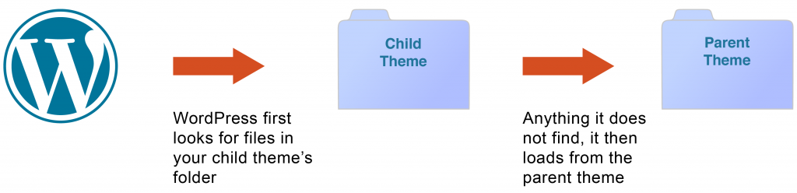
Why use a Child Theme? (Continued)
So how do you safely customize a WordPress theme?
Create a Child Theme that is a “child” of another theme (the Parent Theme).
The Child Theme overrides selected design elements and otherwise falls back to the Parent.
The Child Theme can also override or add functionality to the Parent Theme.
How Child Themes work
A Child Theme loads first, before the Parent, and only contains overrides and additions to the Parent Theme.
All of your CSS, templates, images, and other files are kept in the Child Theme’s folder while the original Parent Theme’s files are left intact.
If something breaks, you can simply delete or fix the offending file in the Child Theme folder.

Slide 32
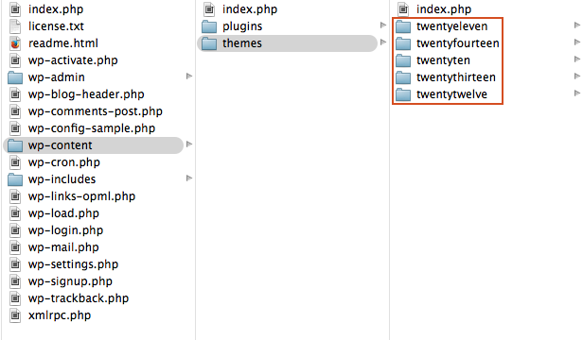
Creating your own Child Theme
You are going to create a Child Theme of the default WordPress theme Twenty Thirteen. In this example, we’ll name this Child Theme “Awesome“.
A Child Theme only needs a few things to get up and running: a theme folder, a CSS file, and a screenshot file.
Step 1: A Theme Folder #
Every theme for WordPress needs its own folder.
Take a look at the folder structure of WordPress. You can see each installed theme’s folder in /wp-content/themes

Slide 33
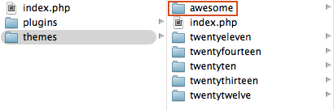
Creating your own Child Theme
Create a folder for your Child Theme. The folder name should be all lowercase with no spaces. In our example the Child Theme’s folder is called “awesome.”
Step 2: A style.css file
At a minimum, your Child Theme needs a style.css file. The style.css file tells WordPress to load the Parent Theme’s files after the Child. Place this file inside the Child Theme’s folder. Make sure it is in the root level of the theme folder and not inside a subfolder.
The style.css file needs the following code at the top:
/*
Theme Name: [Your Theme Name]
Description: The custom theme [Your Theme Name] using the parent theme Twenty Thirteen.
Author: [You]
Author URI: [Your URL]
Template: twentythirteen
Version: 1
*/

Slide 34
Creating your own Child Theme
The parent theme’s folder
Here is an explanation of the different variables in style.css:
Theme Name: The Name of the theme. This is the name that shows up in the WordPress Dashboard under Appearance > Themes.
Description: A short description for the theme. You can put anything you like here. This shows up in the WordPress Dashboard under Appearance > Themes once the theme is activated.
Author: The author of the Child Theme. A person’s name or company name can be entered here.
Author URI: The URL for the author of the Child Theme.
Template: Very Important! This is the folder name of the parent theme. If this variable is not correct the Child Theme will not work.
Version: The version of the Child Theme
All of these variables are optional, with the exception of Template:. If this lines is not present or contains typos the Child Theme will not work.
Step 3: Add the Child theme folder to the wp-themes folder

Slide 35
Creating your own Child Theme
Step 4: Add a Theme screenshot (optional)
A theme’s screenshot is the thumbnail image that shows up under Appearance > Themes in the WordPress Dashboard. A screenshot image is not required for a Child Theme, but it will look sad without one.
The recommended image size is 880×660. The screenshot will only be shown as 387×290, but the larger image allows for high-resolution viewing on HiDPI displays.
Create a 880px by 660px image file, name it “screenshot.png”, and place it into the child theme’s folder. If you don’t have an image editor, download a sample screenshot.png file.
Step 5: Activate the Child Theme
You now have everything you need to create a Child Theme!
Make sure the Child Theme folder containing at least style.css is uploaded or pushed to /wp-content/themes on the webserver, or your computer if you are working on a local WordPress install.
After the theme folder is added to /wp-content/themes go to Appearance > Themes in the Dashboard. You should see your theme listed.

Slide 36
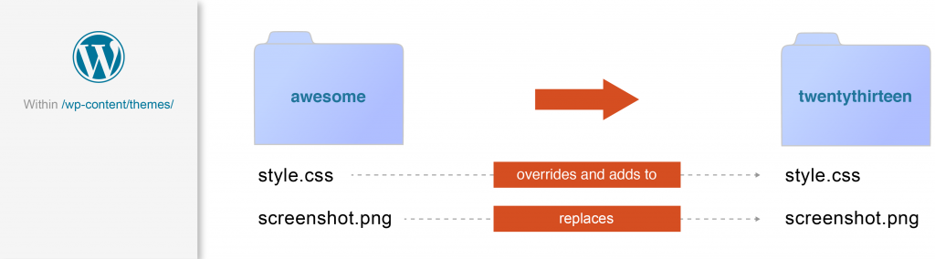
Creating your own Child Theme
Child Theme Files
The files in our example Child Theme illustrate how a Child Theme’s files affect the Parent’s files: they either override elements and add functionality to its identically named file, or completely replaces it.
style.css in Awesome overrides elements and adds to style.css in Twenty Thirteen while screenshot.png completely replaces the copy of screenshot.png in Twenty Thirteen.

Slide 37
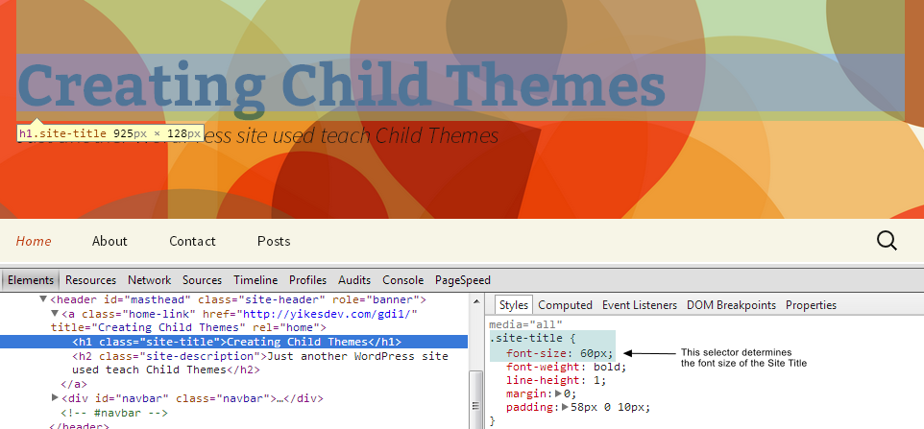
Creating your own Child Theme
Overriding the Parent Theme’s CSS
The Child Theme’s style.css file will override styles in the Parent Theme’s style.css file with the same selectors.
Let’s say you wanted to change the size of the Site Title in the header. Inspecting that element reveals the CSS selector .site-title sets the font size at 60px.

Slide 38
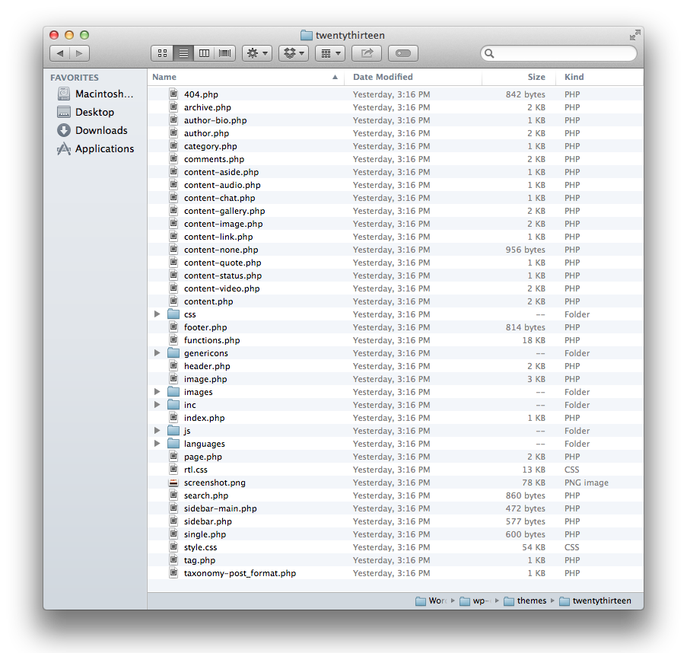
Creating your own Child Theme
Let’s say you want to replace the text “Proudly powered by WordPress” in the footer with a copyright. Here’s how it looks now:

Slide 39

Creating your own Child Theme
Open footer.php in the twentythirteen folder. You can see the code that needs to be edited:
<div class="site-info">
<?php do_action( 'twentythirteen_credits' ); ?>
<a href="<?php echo esc_url( __( 'https://wordpress.org/', 'twentythirteen' ) ); ?>"
title="<?php esc_attr_e( 'Semantic Personal Publishing Platform', 'twentythirteen' ); ?>"
><?php printf( __( 'Proudly powered by %s', 'twentythirteen' ), 'WordPress' ); ?></a>
</div><!-- .site-info -->
Save a copy of footer.php into the Child Theme folder. Edits can safely be made to the Child Theme file, leaving the original copy of footer.php in wp-content/themes/twentythirteen intact. Just like our other Child Theme files, wp-content/themes/awesome/footer.php will override the Parent copy.
To display a Copyright line, replace the content of footer.php in wp-content/themes/awesome with the following code:
<div class="site-info">
Copyright &copy; <?php echo date('Y'); ?>
</div><!-- .site-info -->
The result on the front-end of the site:

Slide 40

Creating your own Child Theme
Adding new Templates
In addition to being able to override existing templates with a Child Theme, you can also create new templates.
Let’s say you want to add a new Template without a sidebar. Make a copy of page.php in your Child Theme and rename it page-nosidebar.php.
Edit the existing code at the top:
<?php
/**
* The template for displaying all pages
*
* This is the template that displays all pages by default.
* Please note that this is the WordPress construct of pages and that other
* 'pages' on your WordPress site will use a different template.
*
* @package WordPress
* @subpackage Twenty_Thirteen
* @since Twenty Thirteen 1.0
*/
get_header(); ?>

Slide 41
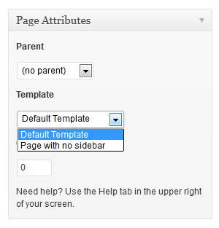
Creating your own Child Theme
To:
<?php
/* Template Name: Page with no sidebar */
get_header(); ?>
The name of the template goes after the variable Template Name:.
Finally, find and remove the line of code which loads the sidebar. This is called get_sidebar();:
<?php get_sidebar(); // delete this entire line ?>
<?php get_footer(); // leave this line in! ?>
The new template will now appear under Page Attributes on the Edit Page screen:

Slide 42
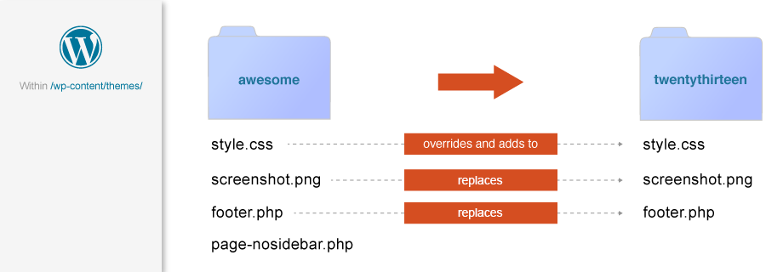
Creating your own Child Theme - Summary
Your Child Theme now has 1 file that overrides elements in its Parent Theme’s file, 2 files that replace files in the Parent Theme, and 1 brand new file that does not exist in the Parent Theme.
When the Parent Theme is updated, none of these Child Theme files will be modified.
Child Themes are a safe and powerful way to override and add elements to an existing theme. Now that you know how to make one, go forth and make some awesome looking sites!

Slide 43
Using the WordPress Hierarchy with CSS
Exercises
Create a child theme
What folders and files did you need to create?
Did your theme show up under Appearance > Themes in the Dashboard? If not, what steps did you take to troubleshoot?
Change all the links in your theme to red, active links to green, and visited links to orange
What file did you need to edit to do accomplish this?
What selectors did you apply the new color styles to?
How did you determine the selectors to use?
Change the “Proudly powered by WordPress” message in the site footer
What file did you need to create?
What steps did you take to create the file and change the message?
Make a new template for the home page with no sidebar.
What file did you create?
What steps did you take to create the file?
What code did you add to make it a new template?
How did you remove the sidebar?
How did you assign the new template to the home page of your site?

Slide 44
Thank You!

Slide 45
Related Classes & Certification Programs
GOOGLE ANALYTICS FOR BUSINESS
Google Analytics is a service offered by Google that generates detailed statistics about a website’s traffic. This class is designed for any individuals intending to use Google Analytics to strengthen their marketing initiatives and increase the number of conversions or sales from their website.
SEO FOR BUSINESS
All businesses today need to factor an SEO plan into their greater marketing plan in order to maximize how people may find you on search engines. In this class, you will learn the basics of SEO and how to optimize your website to increase web traffic.
FUNDAMENTAL WEB DESIGN AND DEVELOPMENT CERTIFICATION
This program offers all of the classes needed to provide a solid foundation in both web design and web development. Whether you are starting a business website, improving an existing site, writing email newsletters, or looking to change careers, this Certification will take you from the basics to advanced quickly.
Start when you want! Program classes are offered approximately every 8 weeks.
REGISTER for classes at www.DigitalWorkshopCenter.com or (970)980-8091

Slide 46



Feedback

Slide 47


Need More Help? Use Our Consulting Services!
PRIVATE, CUSTOMIZED TRAINING is available on an hourly consulting basis.
ASK OUR OFFICE STAFF for more information on rates and scheduling!

