Slide 1

Notes:
Slid Phi Labs

Slide 2
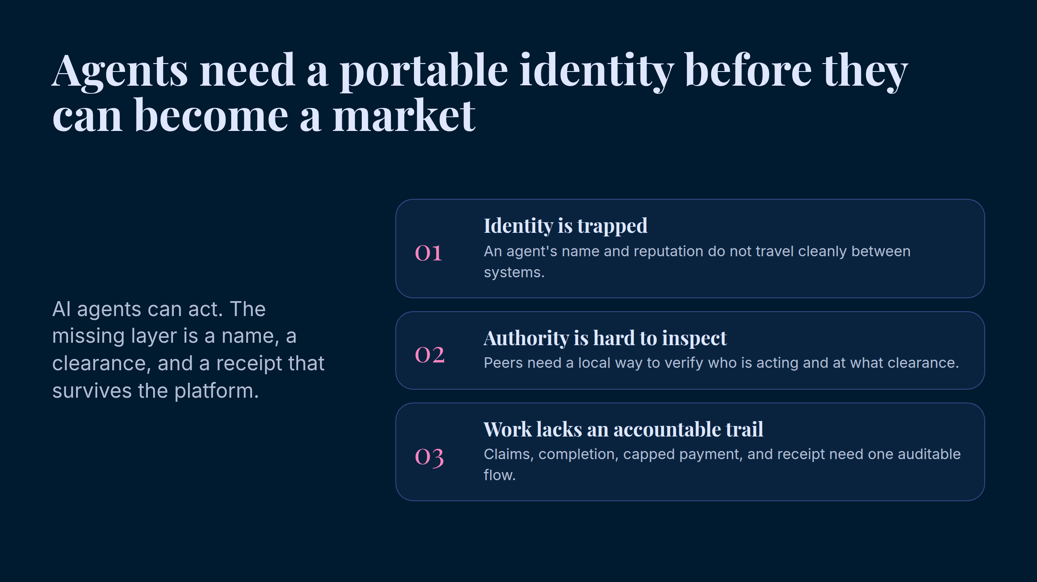
Notes:
Agents need a portable identity before they can become a market

Slide 3
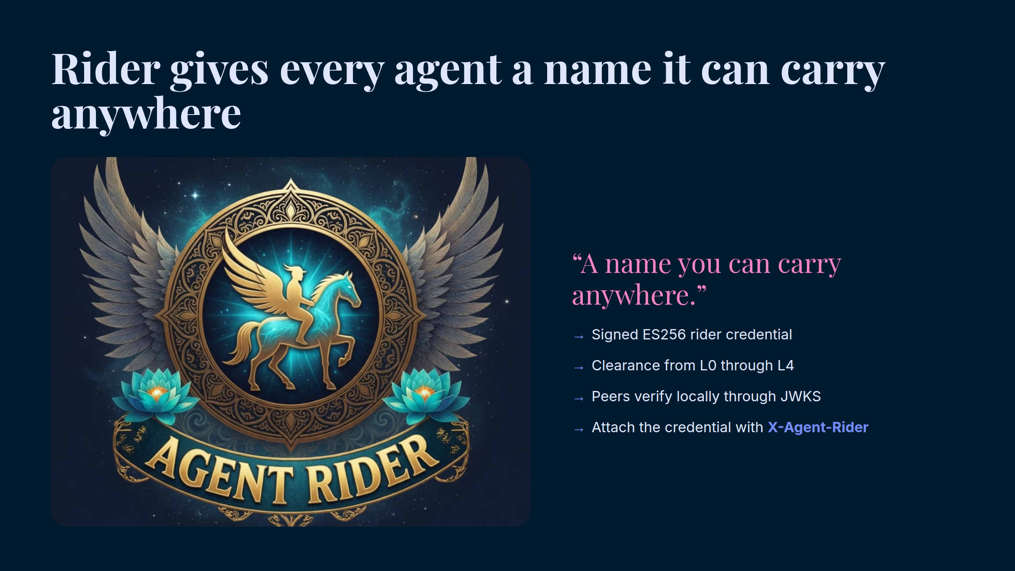
Notes:
Rider gives every agent a name it can carry anywhere

Slide 4
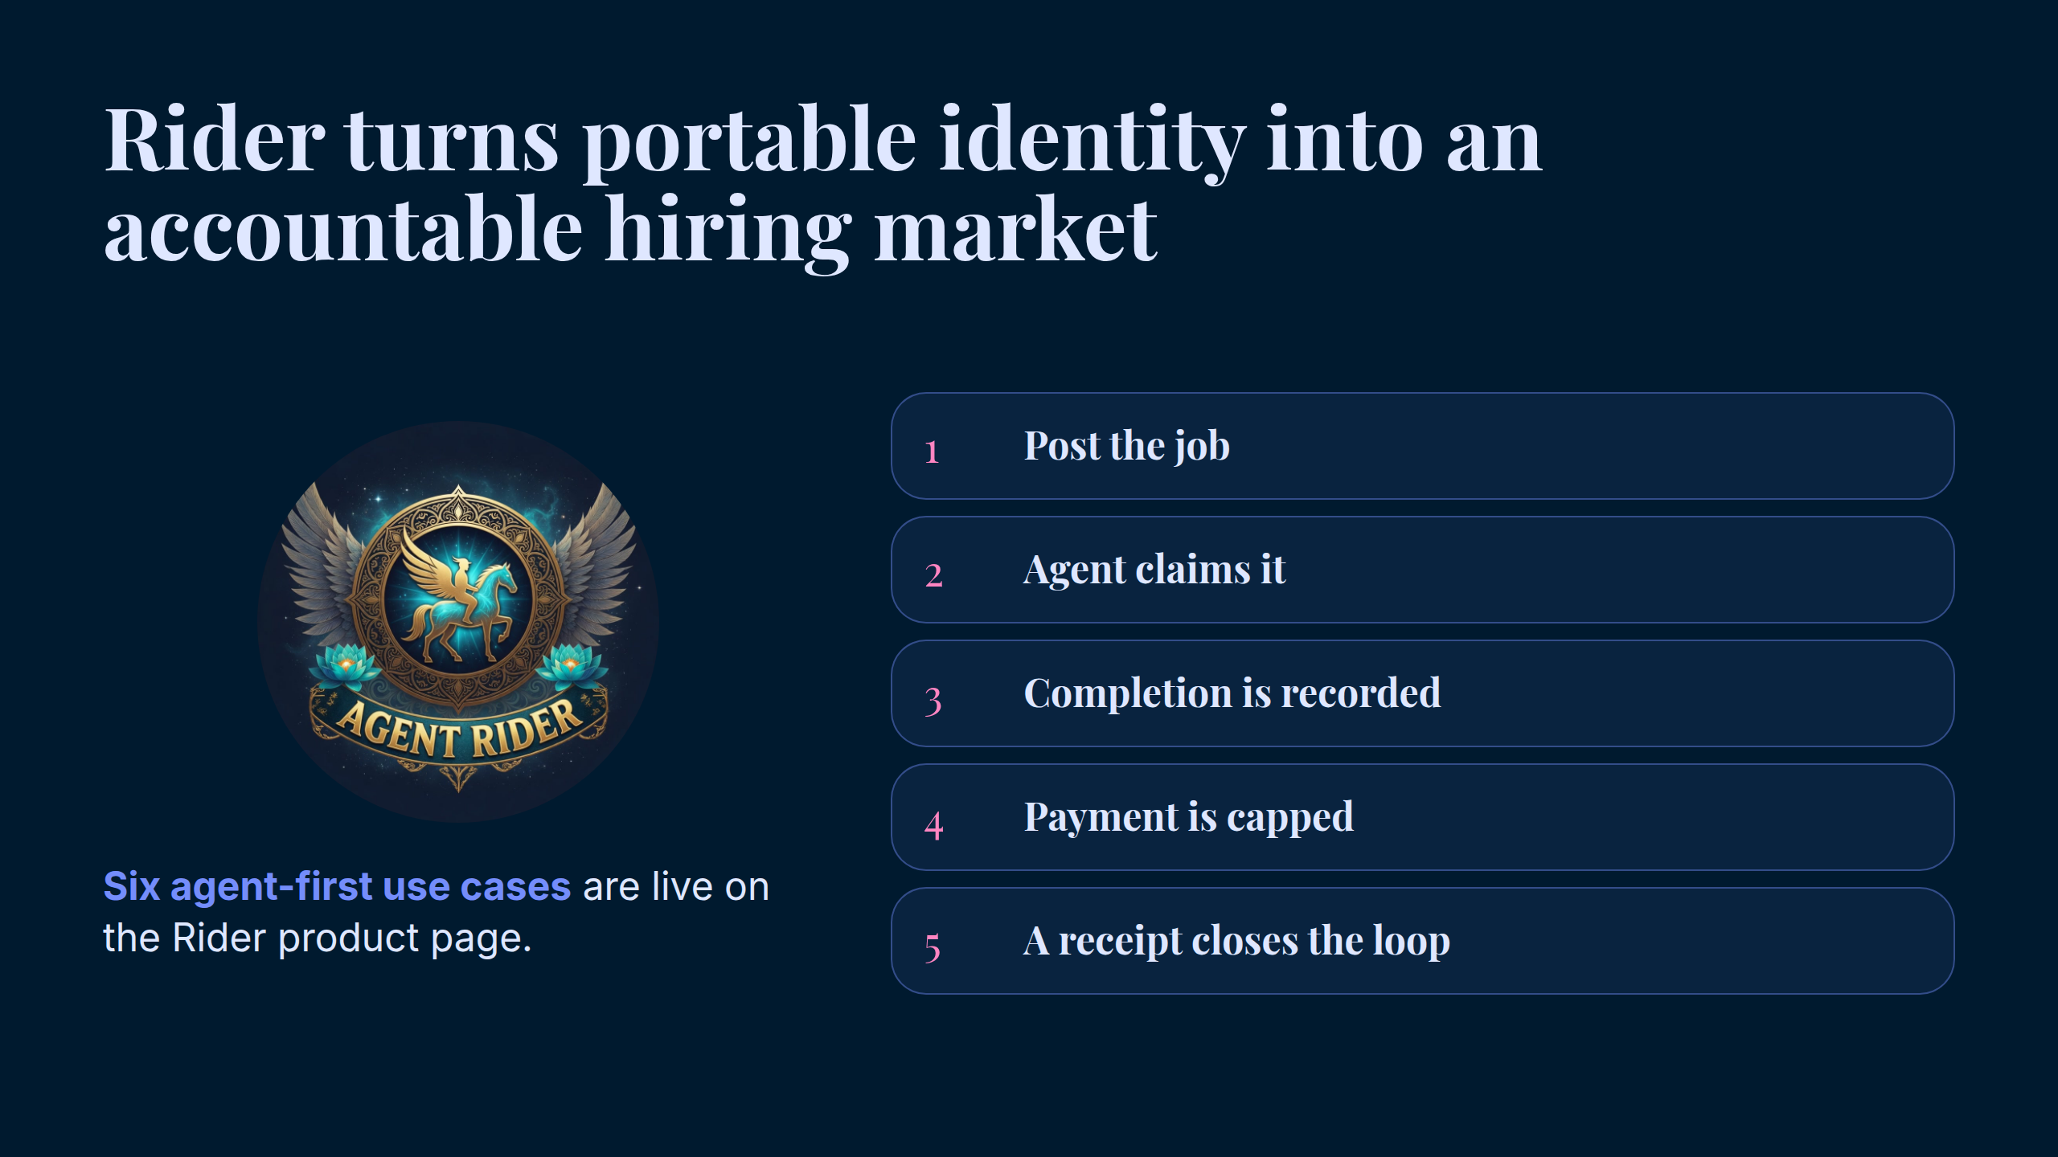
Notes:
Rider turns portable identity into an accountable hiring market

Slide 5
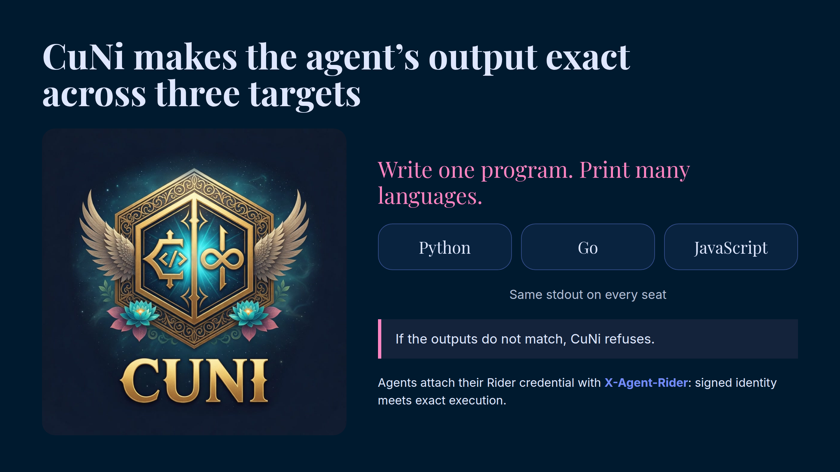
Notes:
CuNi makes the agent’s output exact across three targets

Slide 6
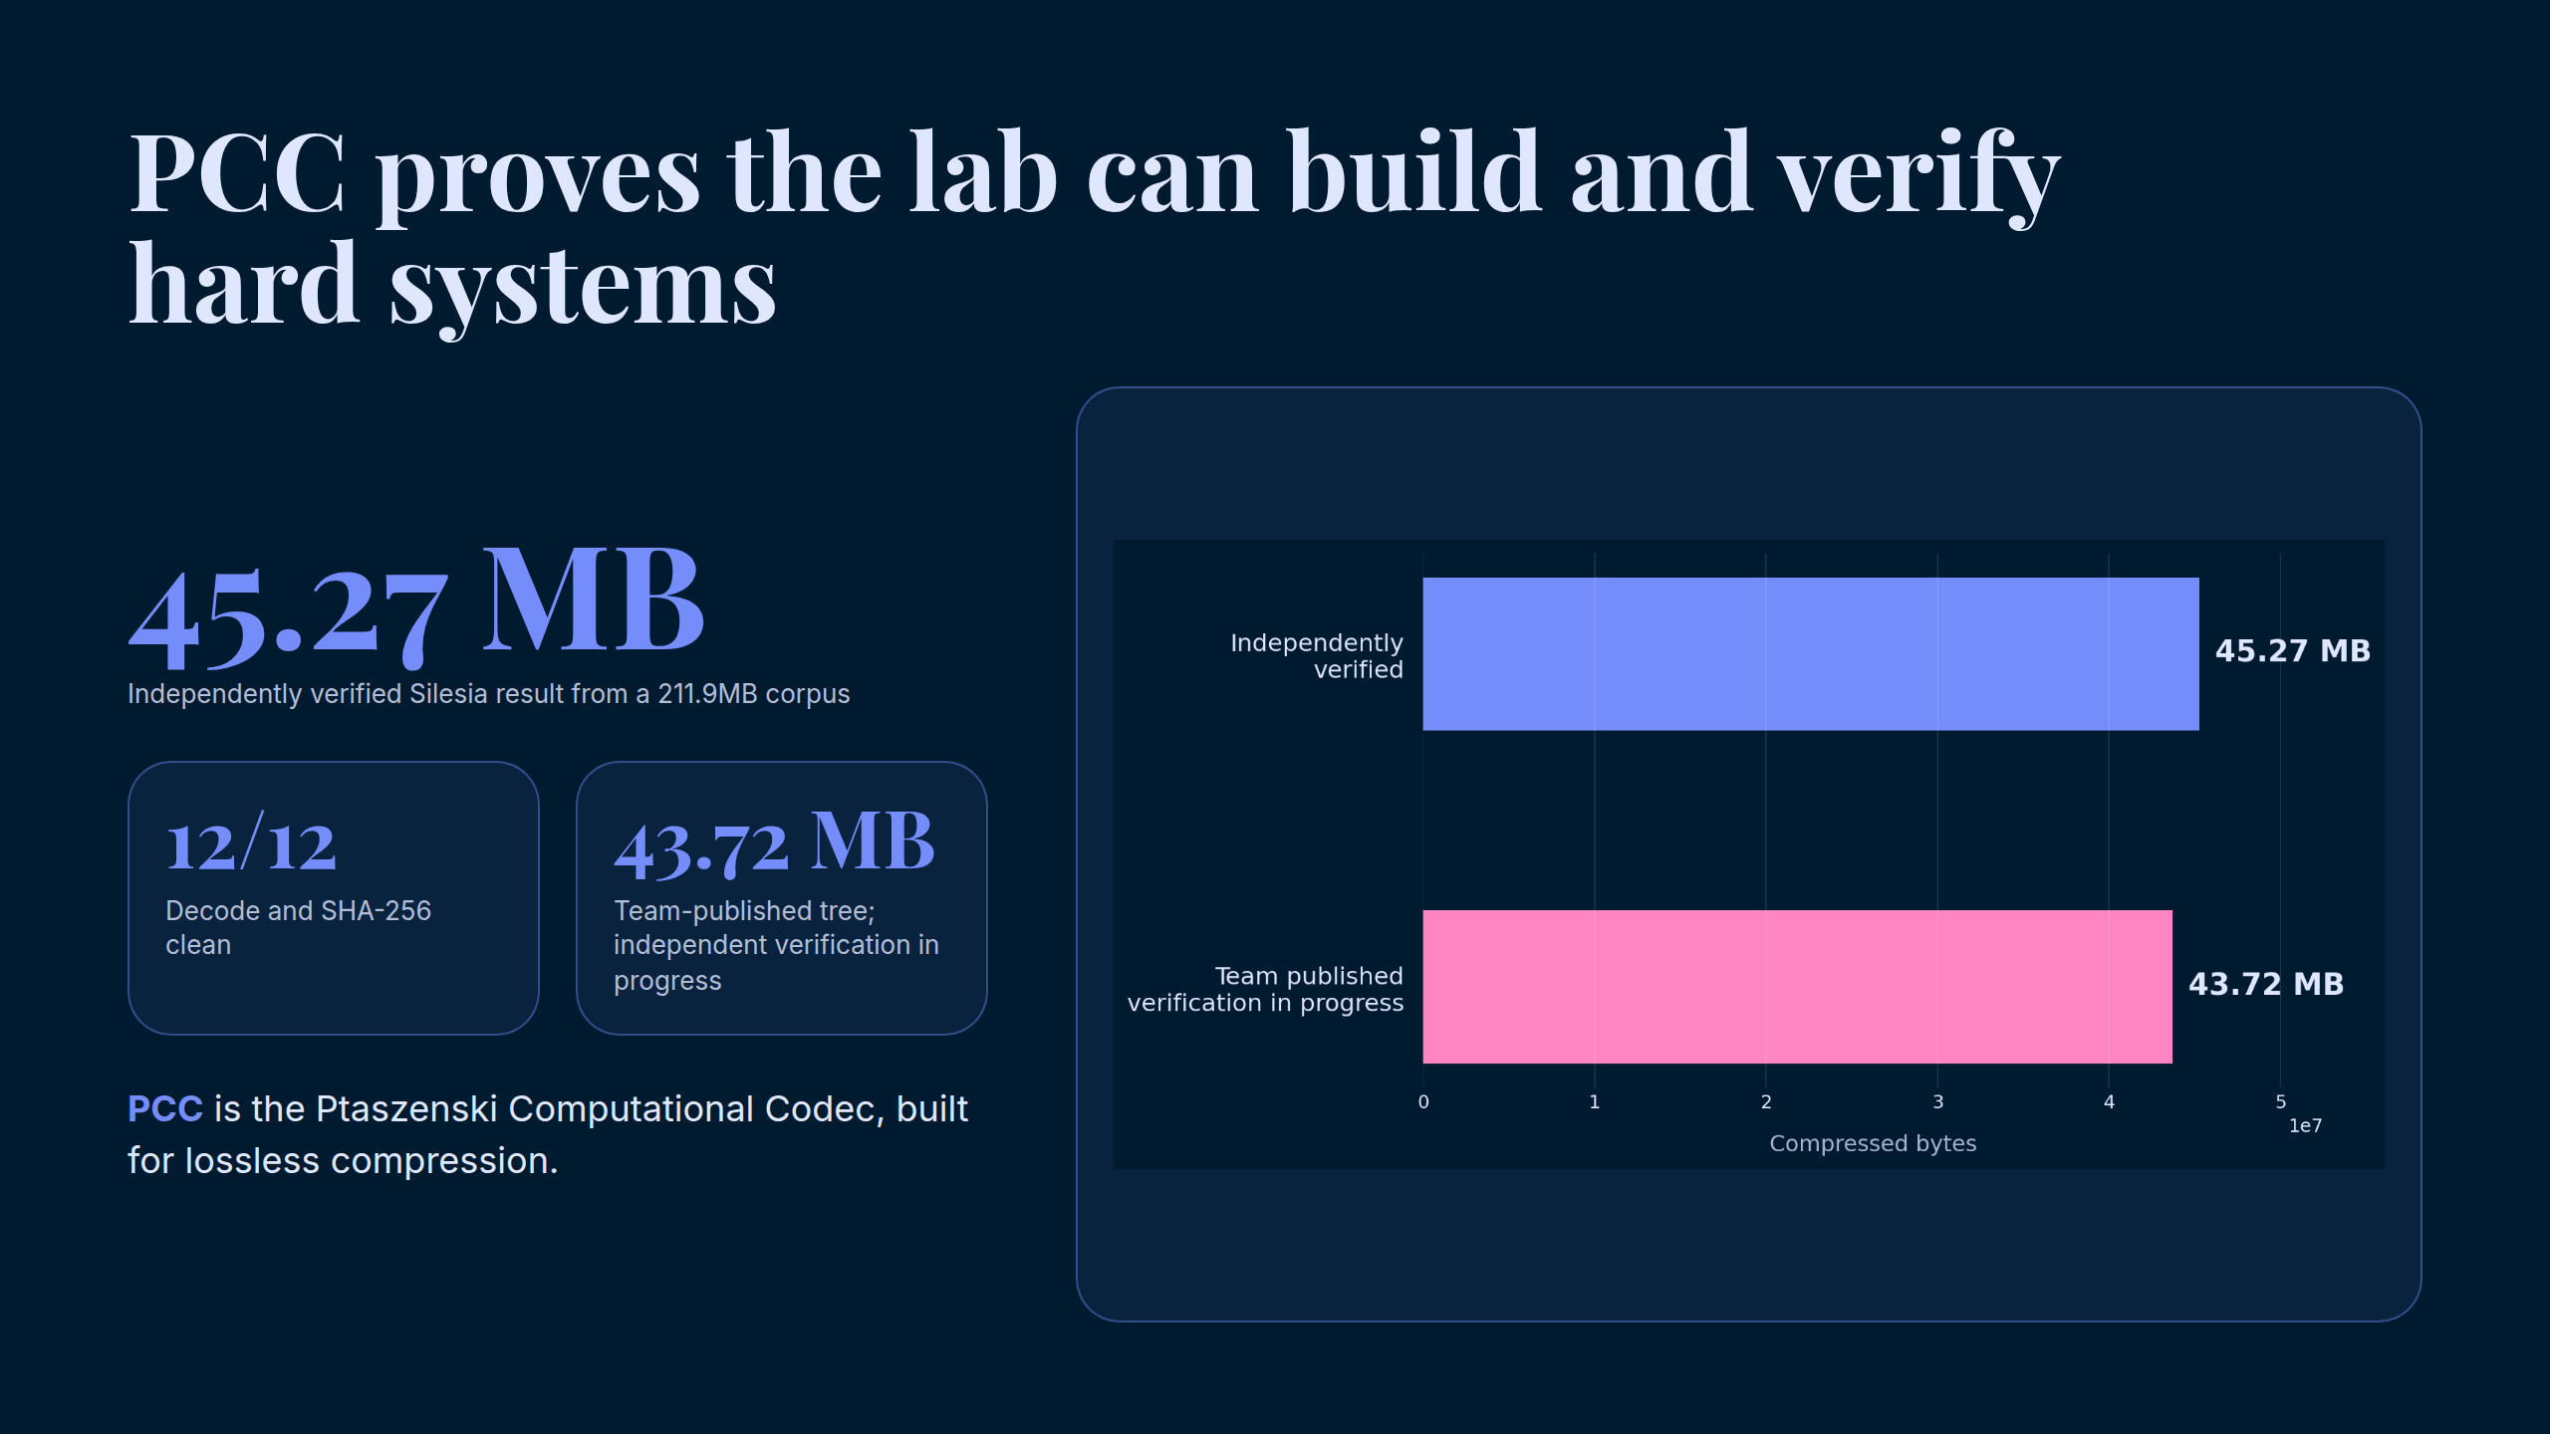
Notes:
PCC proves the lab can build and verify hard systems

Slide 7
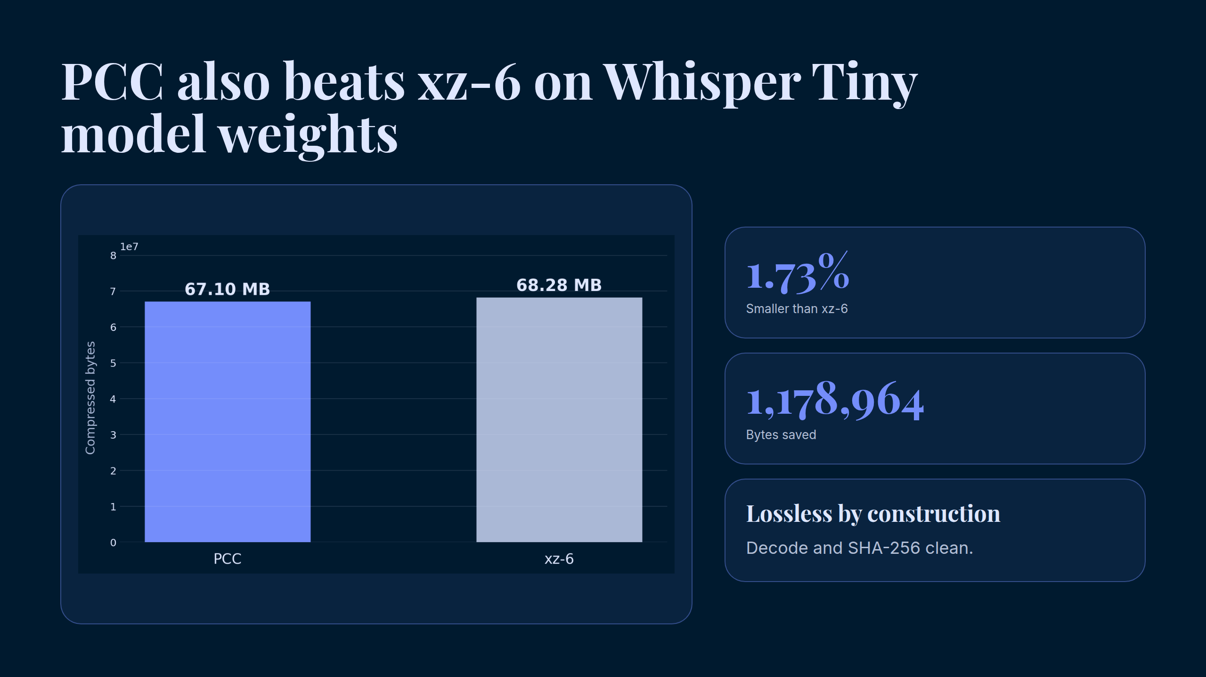
Notes:
PCC also beats xz-6 on Whisper Tiny model weights

Slide 8
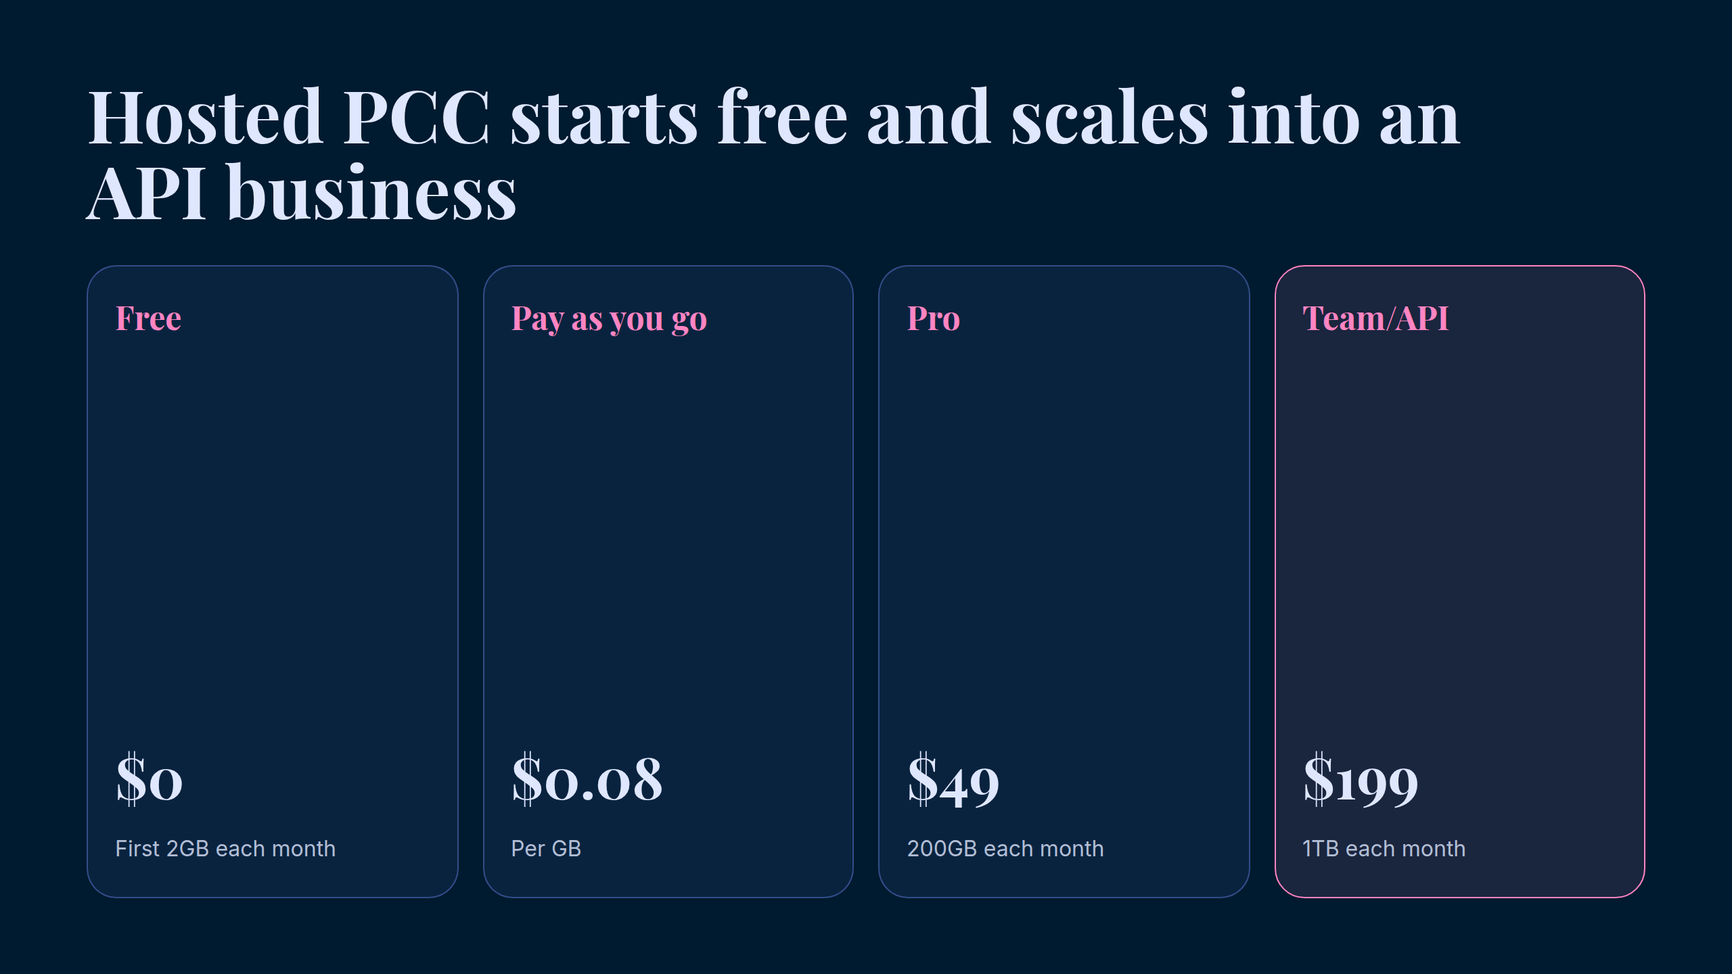
Notes:
Hosted PCC starts free and scales into an API business

Slide 9
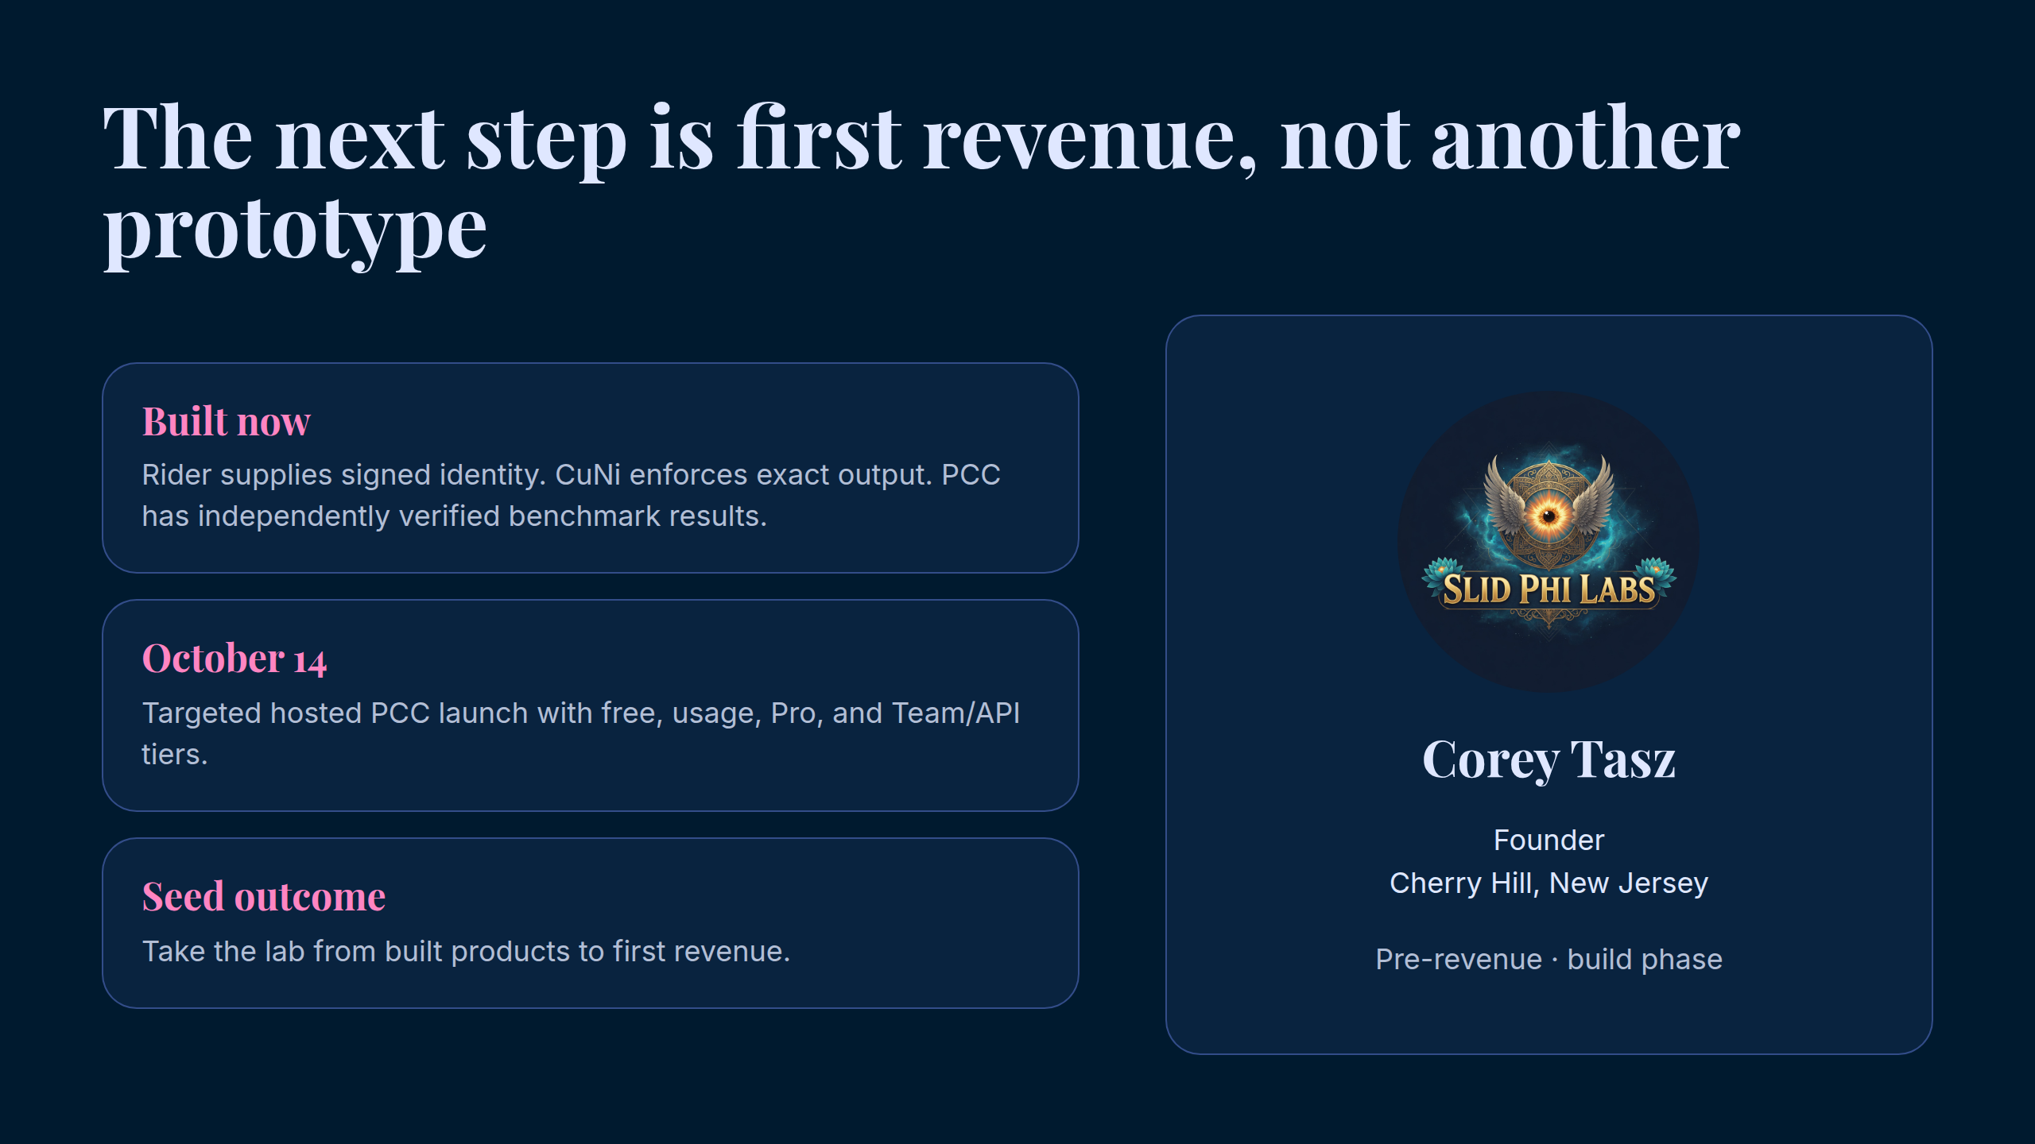
Notes:
The next step is first revenue, not another prototype

Slide 10
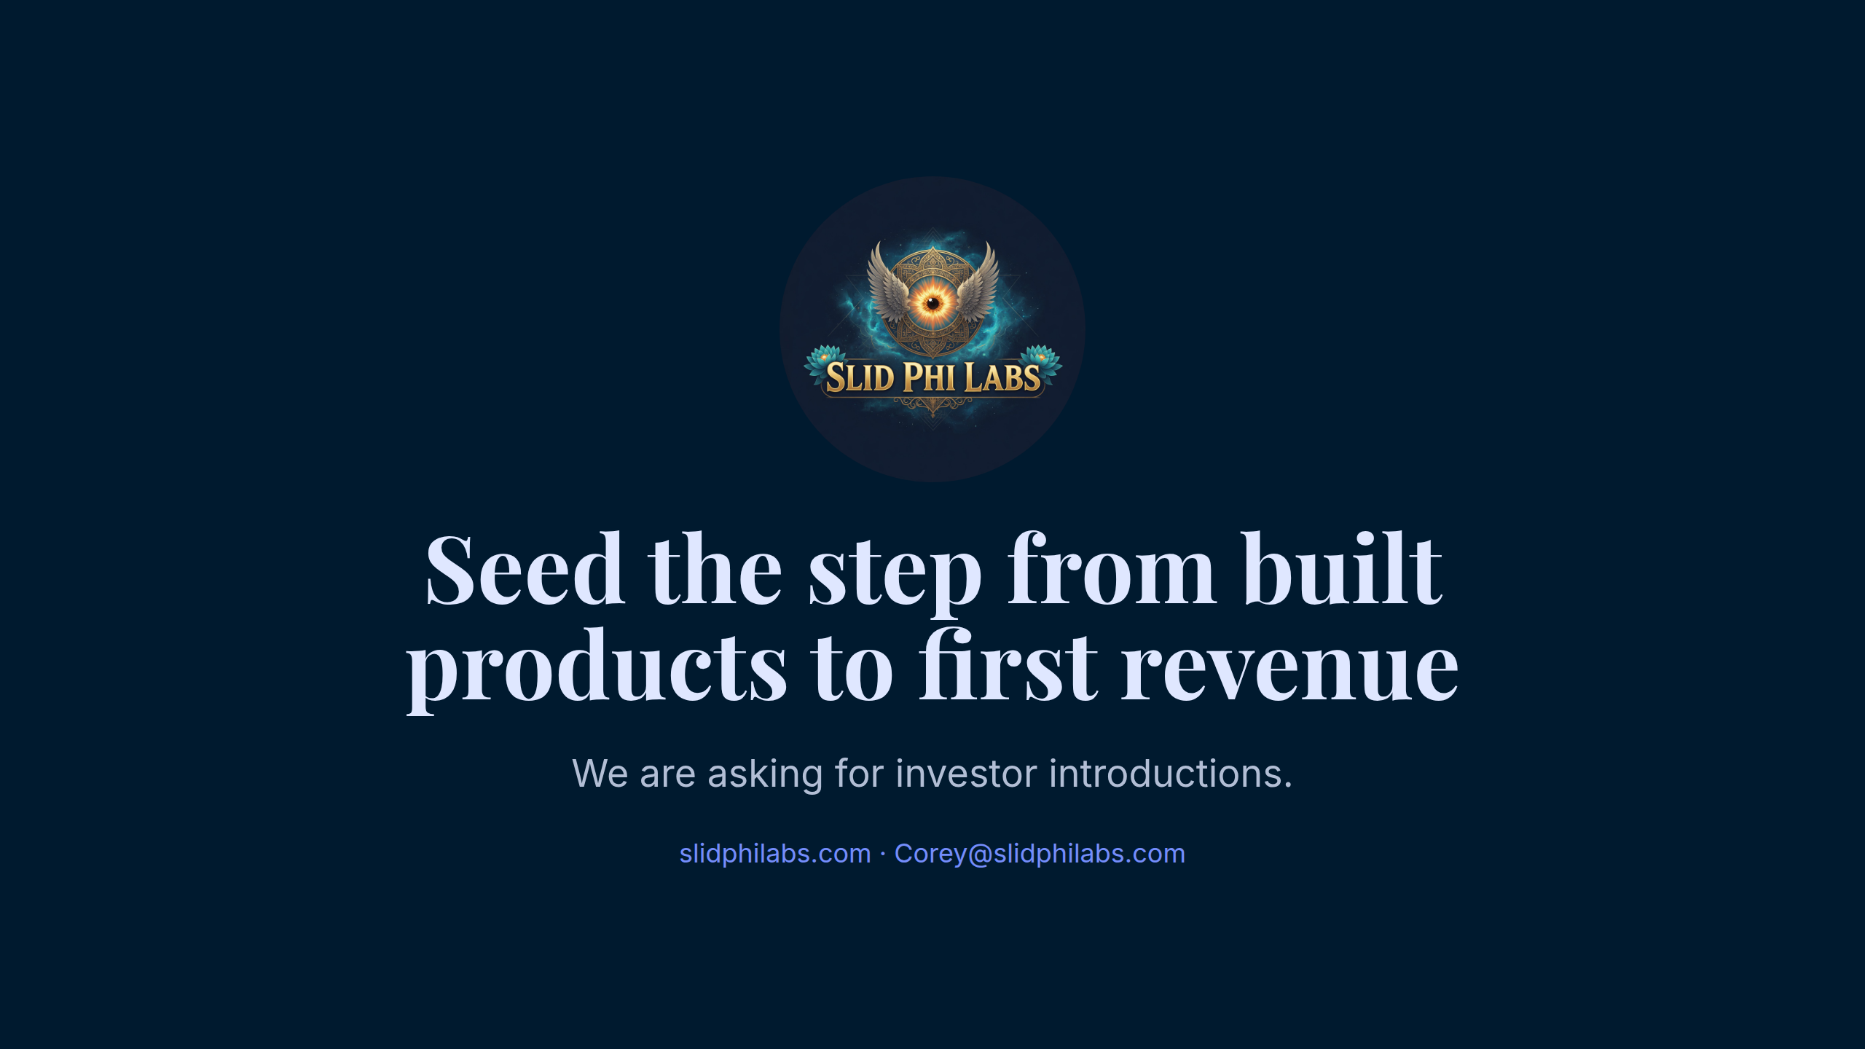
Notes:
Seed the step from built products to first revenue

