Slide 1


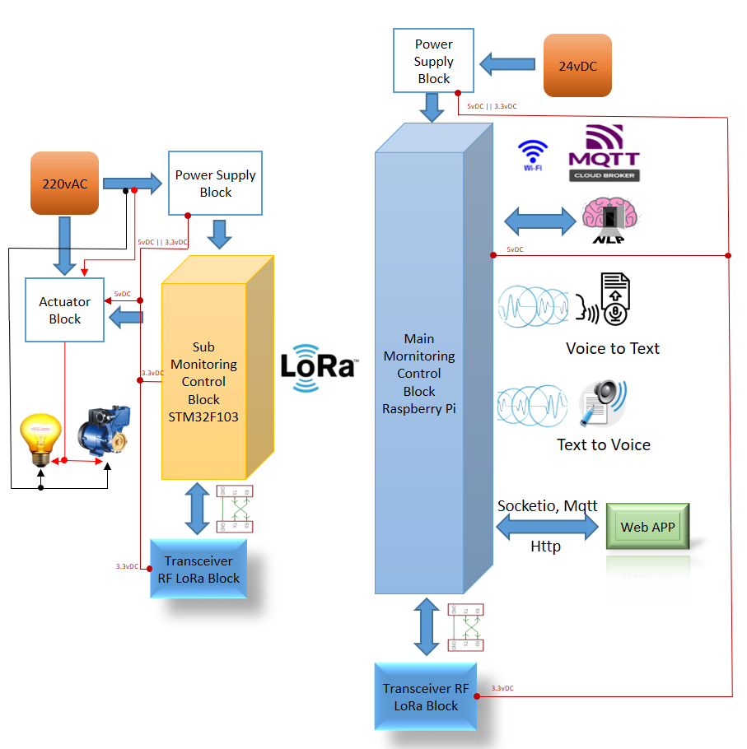
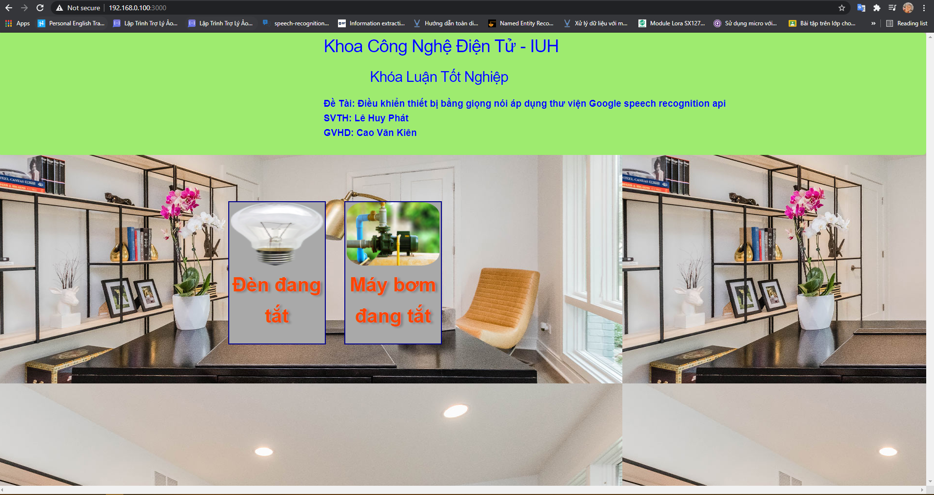
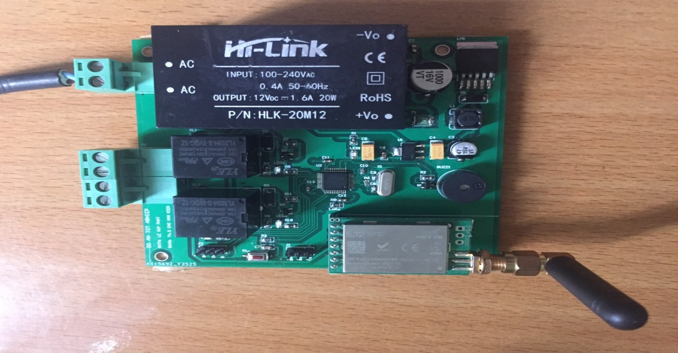
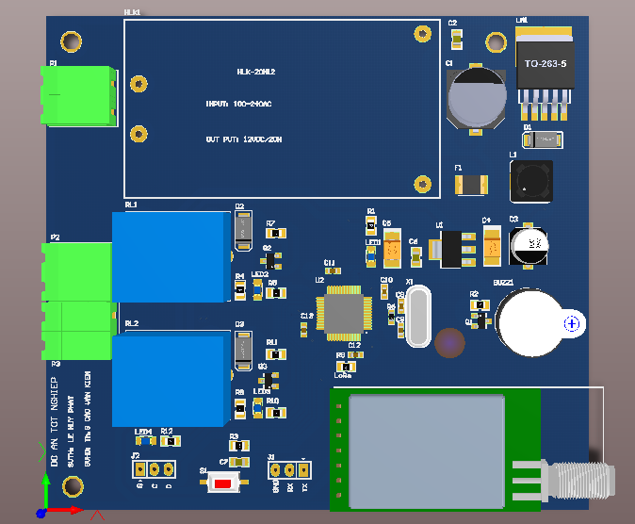
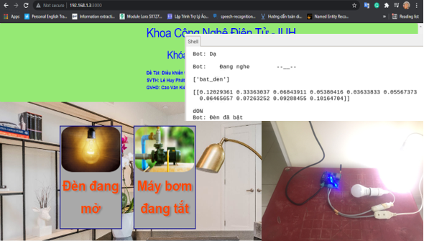
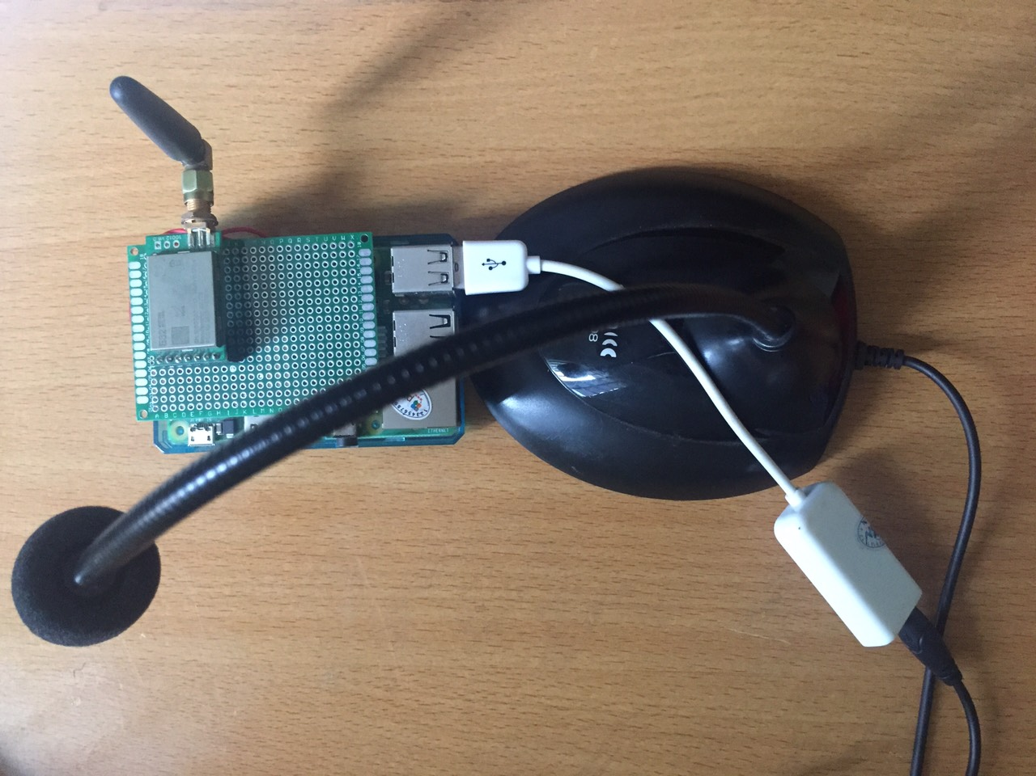
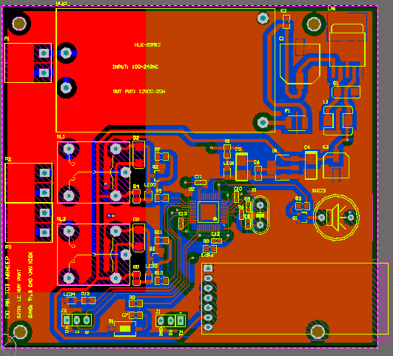
VOICE DEVICE CONTROL APPLY RECOGNITION API LIBRARY
Le Huy Phat – Student Implementation
Industrial University of Ho Chi Minh City, Faculty of Electronics Technology
Abstract
System Structure
Function/Advantages
Making the place where you are or where you work smart and optimizing daily work to improve lives and increase work productivity is something we are all concerned about.
That's why I came up with the idea of applying AIOT to build a system capable of recognizing your voice and classifying what you intend to do to take action immediately. Immediately no matter where you are, just within the range of the device's voice recognition, everything around you is just waiting for your voice command to speak.
Control devices (lights, pumps, ..) by voice and monitor the status of devices on the website.
Simple and easy to use
Monitor all the time
Doesn't take up much spaceSimple chat
Control smart devices
Results and Discussion
Product
System Design
Figure 5: Website interface on raspberry
Figure 1: Node device
Figure 3: Design 3D for End Node
Figure 6: Results of controlling lights by voice through predictive machine learning model on 10 output layers
Figure 2: Control device
Figure 4: Design 2D for End Node
Conclusions
Latency of Node device and Control device depends on internet speed and processor speed of microcontroller.
Lora transmission distance is just over 100m in obstructed environment and 500m in unobstructed environment.
The accuracy of the predictive model depends on the number of documents that are included in training the model.
How To Operate
Warning !!!
Step 1: Turn on the power and wait for the system to boot
Step 2: Connect to the internet for Control device
Step 3: Control the device by voice through the microphone.
No throw the device
No water in the circuit board
Acknowledgment
Sincere thanks to MSc Cao Van Kien for supporting and helping us complete the product and presentation.
Contact
References
Le Huy Phat
Industrial University of Ho Chi Minh City
Email: phatlhcs2005002@fpt.edu.vn
Phone: 0349055566
1. Kamal Nigam, Andrew McCallum, “A Comparison of Event Models for Naive Bayes Text Classification”, School of Computer Science Carnegie Mellon University Pittsburgh, PA 15213.
2. Hiroshi Shimodaira, “Text Classification using Naive Bayes”, January-March 2020
3. Mai Thanh Tuấn, “THIẾT KẾ ĐIỀU KHIỂN THIẾT BỊ BẰNG GIỌNG NÓI VỚI GOOGLE ASSISTANT (GOOGLE HOME)”, Trường Đại Học Bà Rịa-Vũng Tàu, Bà Rịa-Vũng Tàu,Tháng 06 Năm 2019.
4. https://vietbaixuyenviet.com/ifttt-la-gi/
5. https://viblo.asia/p/mo-hinh-phan-lop-naive-bayes-vyDZO0A7lwj
6. https://machinelearningcoban.com/2017/08/08/nbc/
7. https://codetudau.com/posts/machine-learning-nlp-scikit-learn/
8. https://dientuviet.com/huong-dan-lam-mach-nguon-on-ap-su-dung-ic-lm2596/

