Slide 1
Proctor
Facial Recognition for Online Classes

Slide 2
Progress
Sampling
Face Recognition
Demo

Slide 3
Sampling
Initially, the plan was to train the faces of individuals before running the program. But I have observed that sometimes in online lectures, some face features may change (hair, glasses, video quality, etc.) in each session.
Thus, I made a sampling phase at the beginning of the recording, this can take up to 5-7 minutes.

Slide 4
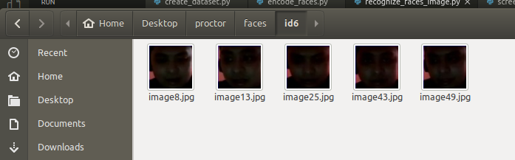
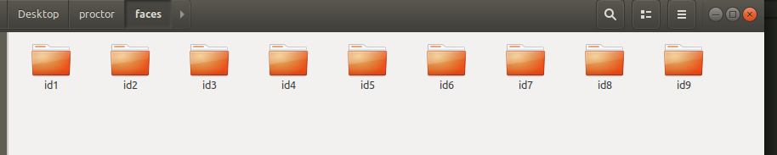
Sampling
First step was to capture the images every 10 seconds, and use the first 2 minutes for sampling. The faces were cropped and saved in a directory.
Second step was to compile them for the face recognition training

Slide 5
Face Recognition
Using the compiled cropped faces, a model was created by training them with “kNN” - k-nearest-neighbors algorithm for face recognition
For a set of 7 different faces, the training only took 30-40 seconds

Slide 6
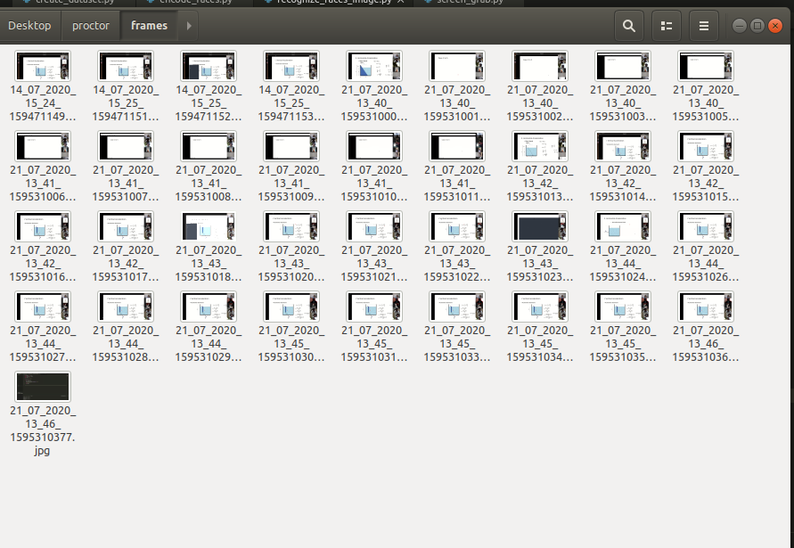
Demo
For demo, I used the video file that sir Chris sent. I screen captured the lecture every 10 seconds to see the accuracy of the model

Slide 7
Demo
Video

Slide 8
Challenges
For the demo video, some students are not detected because I did not have a dataset for them as they were not present in sampling frames.
Some videos of students were too dark or blurred for the face detection algorithm to detect
Not all students can be seen in the lecture but for examinations, if all students can be seen, the detection can have a better performance.

Slide 9
Summary
Proctor Process:
Sampling -> Model Training -> Detection -> Log
2-3 mins <2mins <1 min
Currently, all processes are in different scripts. Compilation is needed to run all of them with one script. As for the sampling, in compiling the student’s faces, I’ve done it manually. I need to find a way to do it automatically so that I can include it to the program

Slide 10
Nex Steps
Log files
  Log file to detect if student is present
Compile all scripts into 1 program

Slide 11
Thank you!
Looking forward to your opinions and suggestions!
Stay safe :-)

