Slide 1

emotion
moment
mint of your day

Slide 2
Motive for Development
Emotions represent us, they dictate our action and impact our future.
Inspiration from powerful social media tools like Instagram, Snapchat & Facebook.
Your selfies are not just picture… but an identifier to your emotions.
Are you tired of searching to find good movies to watch or good music to listen to?

Slide 3
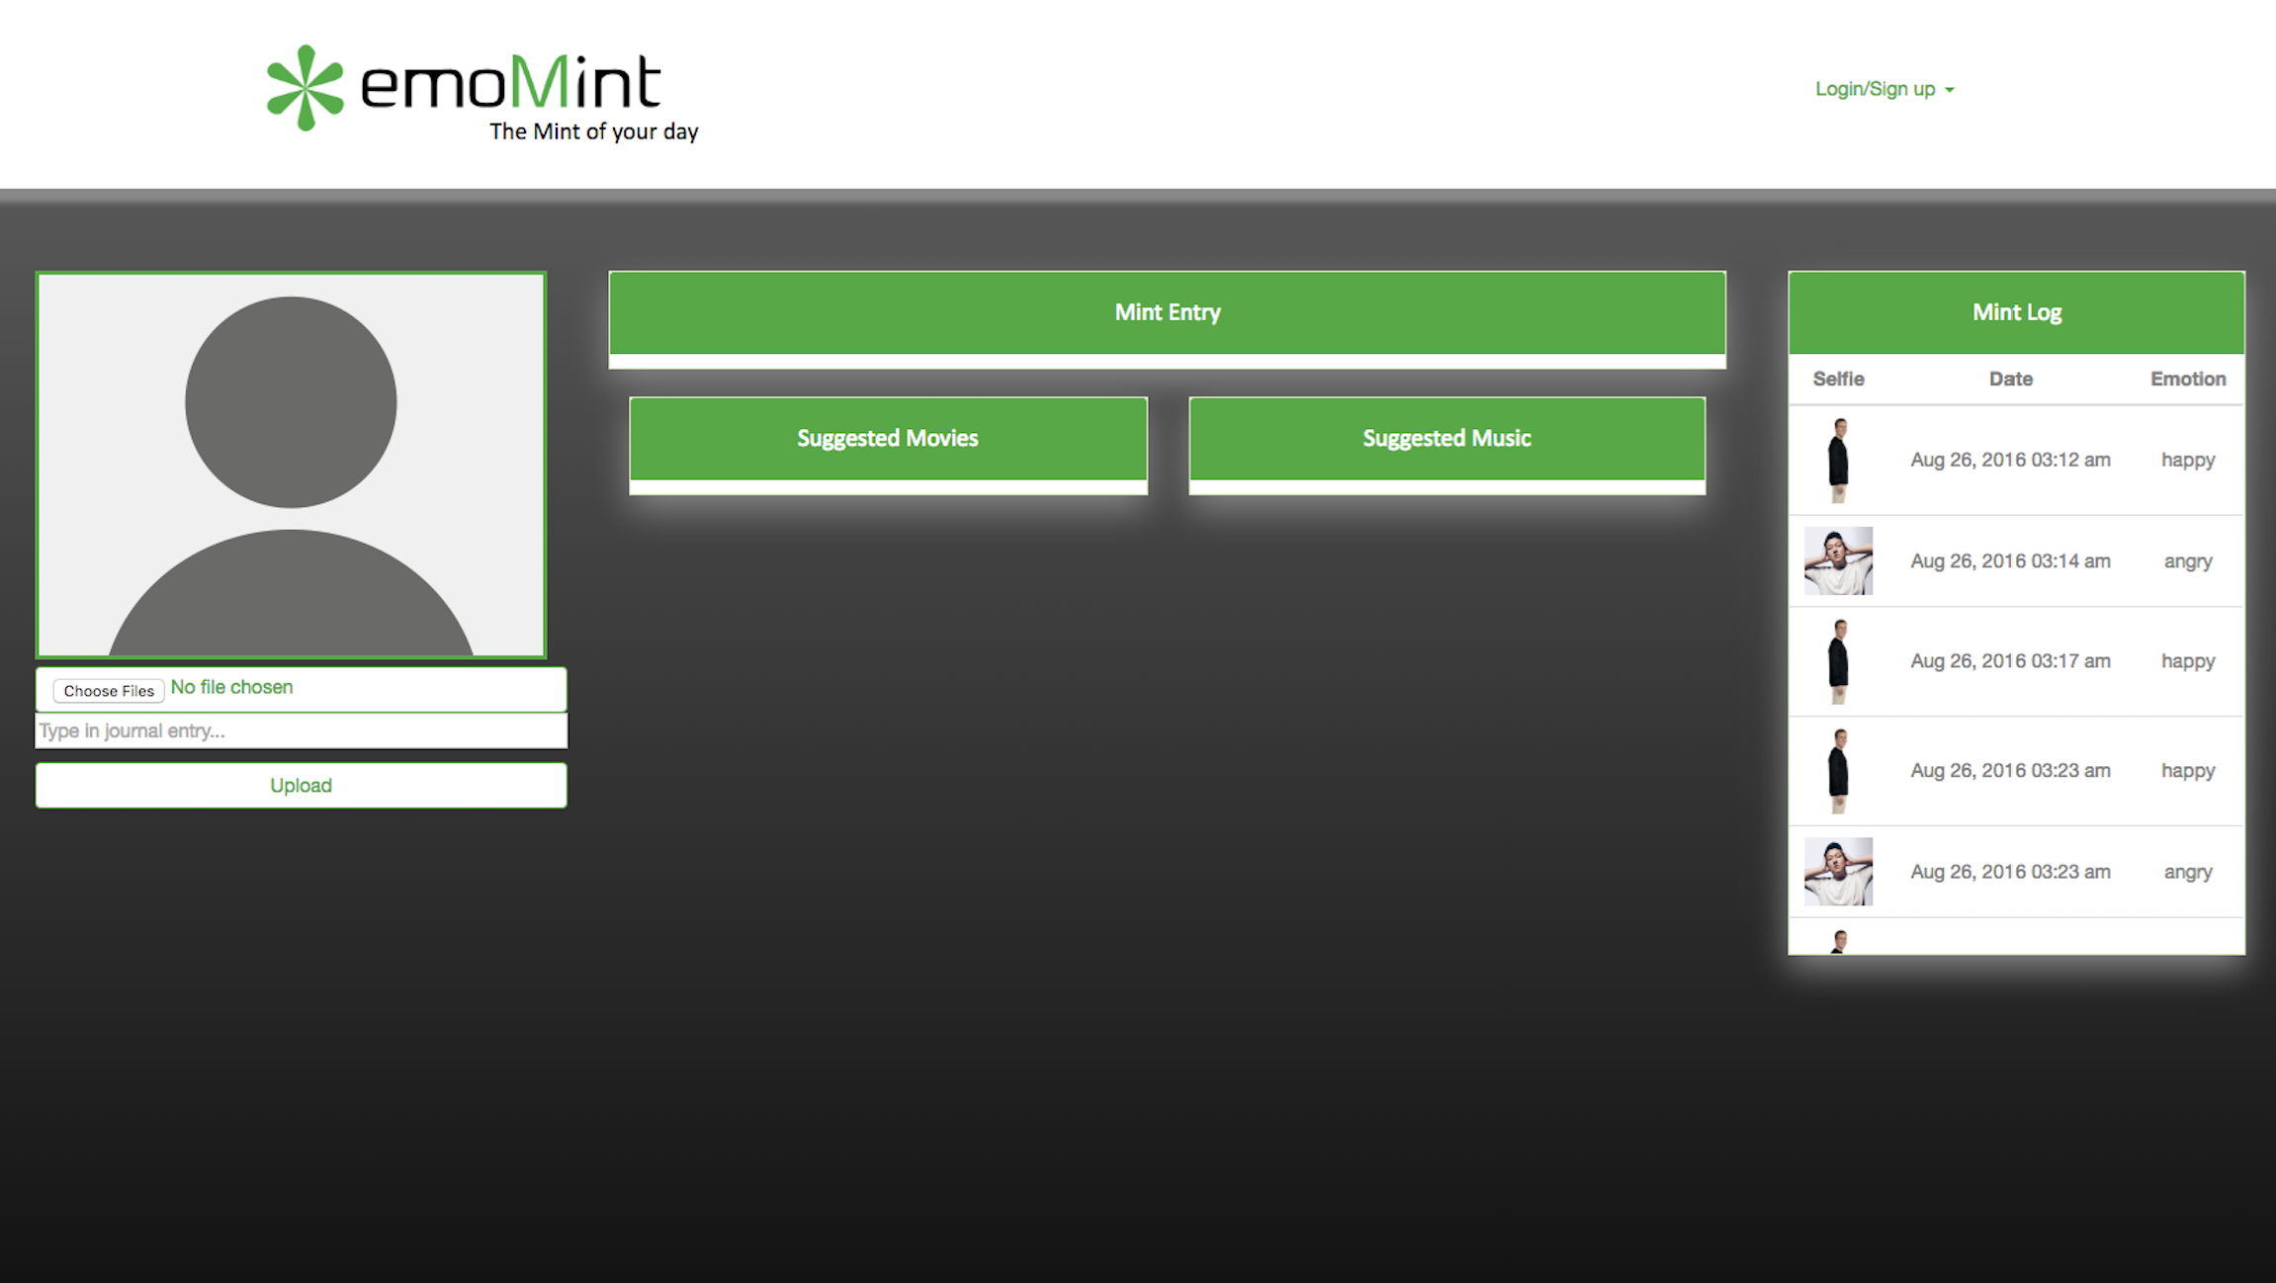
Design

Slide 4





Under the Hood
Cutting Edge Technology
Face Plus Plus API
Spotify API
TMDB (The Movie DB)
Firebase
Heroku

Slide 5
Functionality
Ospry API
Face Plus Plus API
Firebase
Spotify API & TMDB API
Heroku
Demo
Website hyperlink

Slide 6
Future Plans
Facial Recognition Software instead API
Active Camera (uploading directly from mobile)
Moment tracker
Suggestion for entertainment and activities for lifestyle enhancement
Deployment to health services industry

Slide 7
Welcome
To the Future

