Slide 1

emotion
moment
mint of your day

Slide 2
Motive for Development
Are you tire of searching to find good movies to watch or good music to listen to?

Slide 3
Concept
ABCD

Slide 4
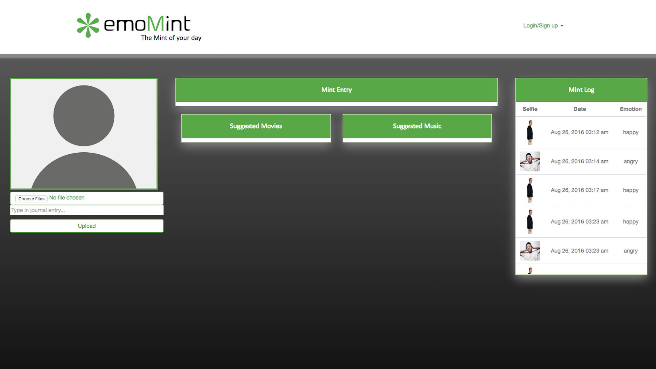
Design
Clean
Simple

Slide 5
Functionality
abc
Demo
Website hyperlink

Slide 6



Under the Hood
Cutting Edge Technology
Face Plus Plus API
Spotify API
TMDB (The Movie DB)

Slide 7
Future Plans
abc

Slide 8
Welcome
To the Future

