Slide 1
A practitioner’s exploration of factors affecting Nifty price movement
Chandan Kumar

Slide 2
About
Chandan Kumar (https://www.linkedin.com/in/chandankr/)
Graduated in Electronics from IIT Kharagpur in 2003, worked in tech sector till 2005
Professional trader since 2006 – traded Crude Oil futures on US exchanges(Nymex and ICE) for 5 years then added US Equity Indices, Treasuries etc
Gradually moved to algo trading from screen trading
Developing algos for Nifty and Banknifty since 2015

Slide 3
Outline
What makes indices different?
Possible factors which influence Nifty price movement?
Data collection
Analysis of factors one by one
Which is the most important
Try to stitch it together using machine learning

Slide 4
What makes Indices different?
Unlike commodities, bonds and stocks, Indices are a different animal
Indices are a basket of other pure underlyings like stocks which may or may not move in sync
Example – When INR weakens, IT and Banking get pulled in opposite directions.
Price does not give full picture about INTERNALS OF THE INDEX
This webinar is an exploration of factors other than historical price(basis of technical analysis) which can explain future price movement

Slide 5
Possible factors which influence future price movement of Nifty
Past price patterns(technical analysis)
Past Nifty Futures volume patterns(technical analysis)
Open Interest patterns
Advance-Decline
Change in Basis(Futures premium over spot Nifty)
Vix change(options data)
Sectoral Indices(BANKNIFTY has highest correlation)

Slide 6
Data collection
Date chosen Dec 30 2013 to Dec 28 2018(5 years)
Bhav copy and other sources
80% of time spent in analysis is data collection and collation
Data needed
Nifty spot prices
Stocks and historical index data for advance-decline
Vix data
Futures data for basis change
Banknifty futures data
Nifty and Banknifty futures OI change

Slide 7
Structuring the study
Variable | Column
Date | Date
Nifty % Change | prevChangeNF
Banknifty % Change | prevChangeBNF
Nifty Futures OI % Change | NFOIChange
BNF Futures OI % Change | BNFOIChange
Advances - Declines | netChange
VIX % Change | vixChange
Futures Premium Change | basisChange
Study the importance of different variables – Price changes, Advance decline, Vix change, OI change, basis change in predicting next day close
Combine different data sources into single csv file with columns defined

Slide 8
Structuring the study(contd..)
Variable | Column
Next Day Open to current day Close % Change | opengap1
Next Day Close to current day Close % Change | closegap1
Next Day High to current day Close % Change | highgap1
Next Day Low to current day Close % Change | lowgap1
Output variables
Next day Open % Change
Next day High % Change
Next day Low % Change
Next day Close % Change

Slide 9
Sample Data
Date | vixChange | netChange | prevChangeNF | prevChangeBNF | NFOIChange | BNFOIChange | basisChange | opengap1 | closegap1 | highgap1 | lowgap1
30/12/13 | 2.86 | 8 | 0.4 | 0.4 | 4.15 | 6.95 | -12 | 0.2 | -0.6 | 0.3 | -0.8
01/01/14 | 3.04 | 10 | 0.3 | 0.1 | -2.51 | -0.58 | -23 | 0.5 | 0.4 | 0.6 | 0.2
02/01/14 | 6.23 | 6 | 0.1 | 0.2 | 0.34 | 4.58 | -11 | -0.1 | -1.6 | 0.8 | -1.8
03/01/14 | -4.11 | -32 | -1.6 | -2.2 | -2.5 | -1.2 | -31 | -0.5 | -0.1 | 0.1 | -0.9
06/01/14 | 3.97 | -5 | -0.1 | 0.2 | -8.82 | 4.86 | 6 | -0.2 | -0.4 | 0 | -0.8
07/01/14 | -1.09 | -9 | -0.4 | -1.4 | 0.88 | 7.78 | -4 | 0.3 | -0.5 | 0.5 | -0.9
08/01/14 | 0 | -18 | -0.5 | -0.2 | -0.27 | -0.95 | -6 | 0.2 | 0 | 0.4 | -0.2
09/01/14 | -0.86 | -8 | 0 | 0 | -2.53 | 0.26 | -18 | 0 | -0.2 | 0.1 | -0.6
10/01/14 | -3.71 | -10 | -0.2 | -0.8 | -1.12 | -0.71 | -11 | 0 | -0.1 | 1.4 | -0.5
13/01/14 | 2.37 | -13 | -0.1 | -1.6 | -0.16 | 5.97 | -15 | 0.4 | 1.7 | 2 | 0.4
14/01/14 | -1.32 | 28 | 1.7 | 2 | 3.1 | -2.29 | 9 | 0 | -0.5 | 0.1 | -0.7
15/01/14 | -2.03 | -20 | -0.5 | -0.8 | 0.97 | 1.12 | 3 | 0.2 | 1.2 | 1.3 | 0.2
16/01/14 | 0.78 | 31 | 1.2 | 1.7 | 2.59 | -0.21 | -7 | 0 | 0 | 0.3 | -0.4
17/01/14 | -0.84 | 12 | 0 | -0.3 | 4.51 | -2.03 | 1 | -0.4 | -1.1 | 0.1 | -1.3
20/01/14 | -0.39 | -20 | -1.1 | -1.7 | -5.47 | 6.46 | -17 | 0.1 | 0.9 | 1.1 | -0.2
21/01/14 | 1.3 | 14 | 0.9 | 1 | -4.99 | -6.96 | 26 | 0.1 | 0.1 | 0.3 | -0.2
22/01/14 | 1.93 | -4 | 0.1 | 1.4 | 3.33 | -5.48 | -6 | 0 | 0.4 | 0.6 | -0.6
23/01/14 | -1.7 | 21 | 0.4 | 0.3 | -0.82 | -0.97 | 2 | -0.3 | 0.1 | 0.3 | -0.5
24/01/14 | 1.6 | -11 | 0.1 | -0.2 | -1.94 | 1.4 | -3 | -0.6 | -1.3 | -0.3 | -1.4
27/01/14 | 17.94 | -39 | -1.3 | -1.9 | -7.58 | 0.36 | -4 | -1.3 | -2 | -1.1 | -2.1
28/01/14 | -5.09 | -35 | -2 | -4 | -20.28 | 11.4 | 5 | 0 | -0.1 | 0.4 | -1
29/01/14 | 1.81 | 2 | -0.1 | -0.3 | -14.62 | -10.42 | 1 | 0.4 | -0.3 | 0.6 | -0.5
30/01/14 | -4.38 | 3 | -0.3 | -0.8 | -19.53 | -23.14 | -20 | -0.4 | -0.3 | -0.1 | -1
31/01/14 | -2.49 | -8 | -0.3 | -2 | 12.32 | 61.37 | 49 | 0.2 | 0.1 | 0.5 | -0.2
03/02/14 | 8.62 | 14 | 0.1 | 0.5 | 1.71 | -0.9 | -13 | -0.4 | -1.2 | -0.2 | -1.3
04/02/14 | 2.3 | -28 | -1.2 | -1.2 | -1.06 | 5.88 | 26 | -0.7 | 0 | 0.2 | -1.4
05/02/14 | 1.28 | 12 | 0 | 1 | 1.22 | 0.81 | -1 | -0.2 | 0.2 | 0.3 | -0.9
06/02/14 | 0.05 | 1 | 0.2 | 0.1 | 0.84 | 0.68 | -18 | 0.1 | 0 | 0.3 | -1.2

Slide 10
The actual analysis
For data analysis, we use python inside jupyter notebook
Results and charts at link below(feel free to run the code yourself)
https://mybinder.org/v2/gh/ceekaybtc/niftywebinar/d1d4fb246a5243bf25470cd21ebff19a2658aa86

Slide 11

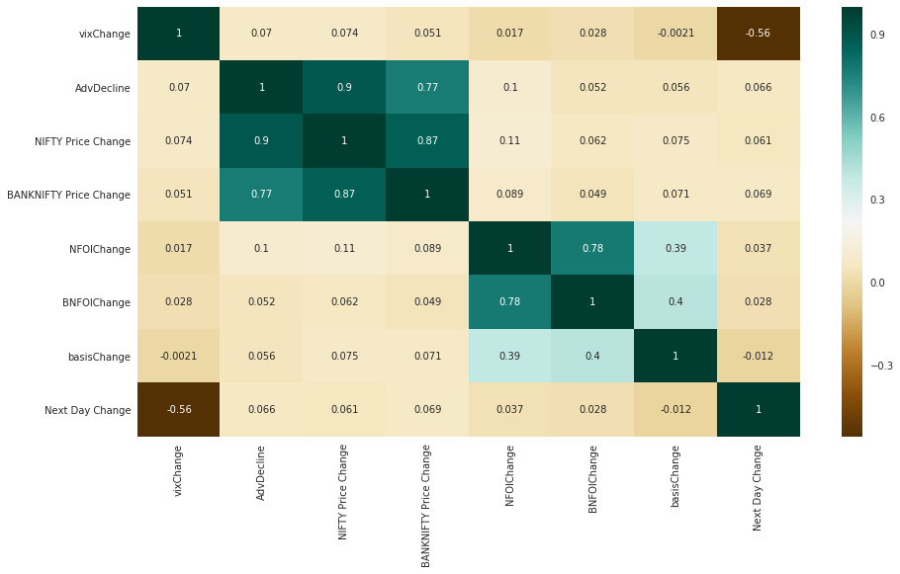



Analysis of factors

Slide 12
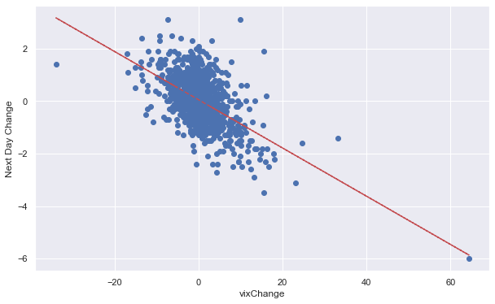
Scatter Plots (Vix Change)

Slide 13
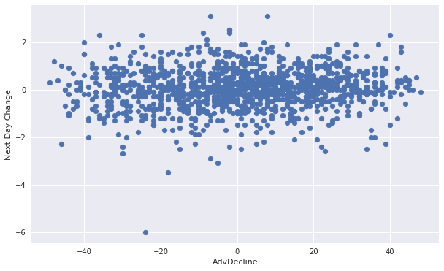
Advance Decline vs Next Day price change

Slide 14
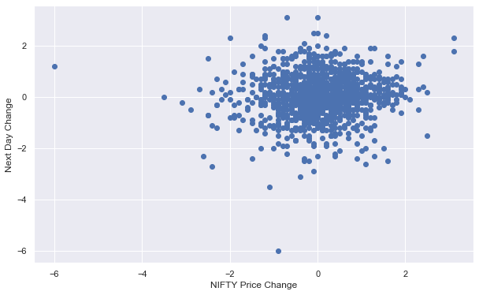
Nifty price change vs next day change

Slide 15
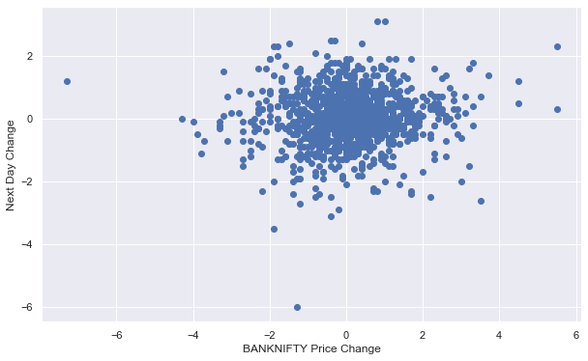
Banknifty price change vs next day change

Slide 16
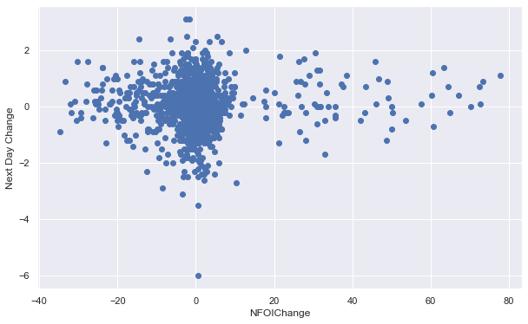
Nifty OI Change vs Next Day price change

Slide 17
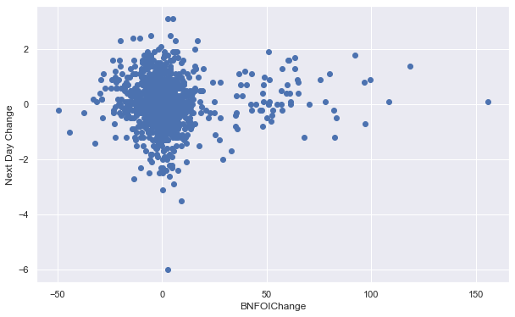
BNF OI vs Next Day price change

Slide 18
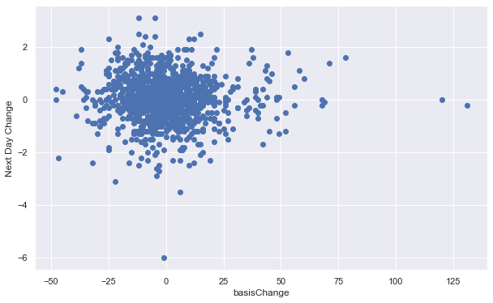
Basis change vs Nifty next day change

Slide 19
Now what?
Many more possibilities
Can combining OI change and price direction give better correlation(new custom column)
Is Vix effect more dominant in one direction compared to the other(bullish/bearish)
How do we go about studying outlier days(which have disproportionate impact on Profit/Loss)
This becomes too subjective(relies on us to find possible patterns and complex variables)
Is there a better way?

Slide 20
Enter Machine learning
Theory out of scope for the webinar
Better way of doing multi variable regression with many loose correlations(here only VIX has strong correlation numbers)
We need to pre-process data(each row is independent of other rows), specify input and output columns(exclude date column) and let ML models do the rest
Training + Validation data – from Dec 2013 to Dec 2018
Model generated based on this dataset
Apply model on 2019 data(including 2019 can lead to curve fitting)

Slide 21
Machine learning contd..
Platform used h20.ai
http://docs.h2o.ai/h2o/latest-stable/h2o-docs/starting-h2o.html
Gradient Boosting Algo used(XGBoost)

Slide 22

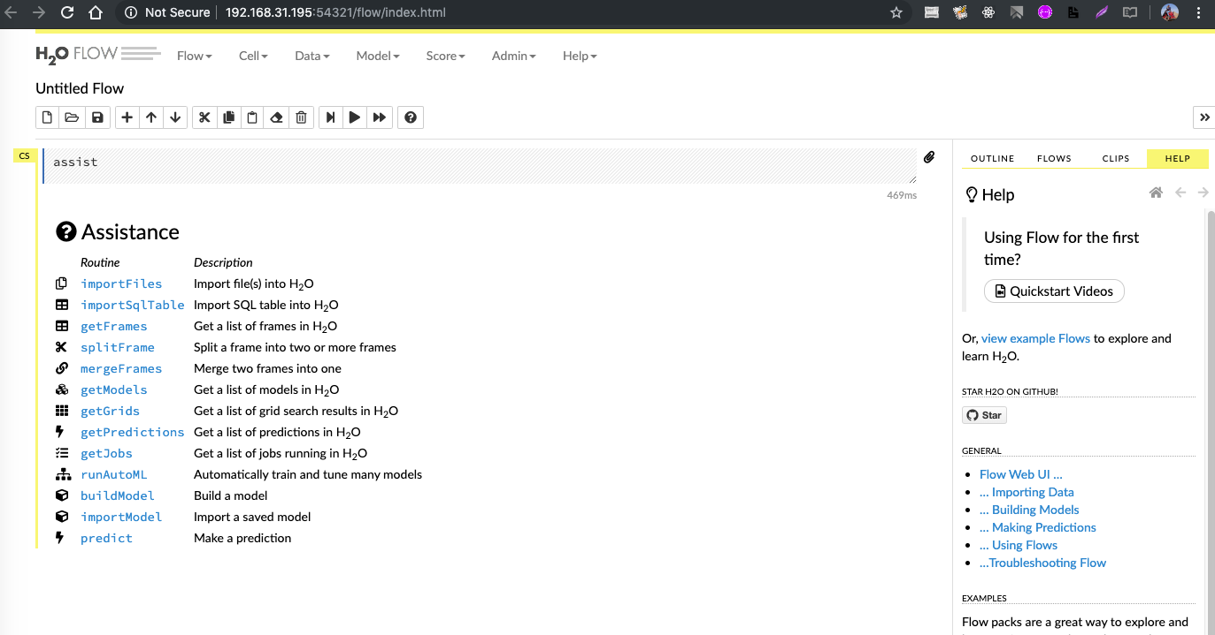

Slide 23
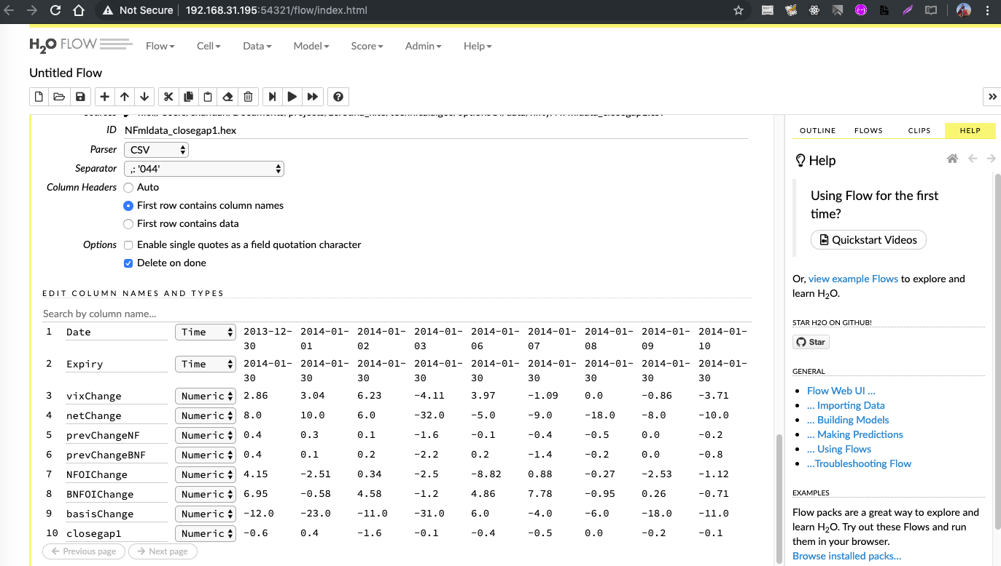

Slide 24
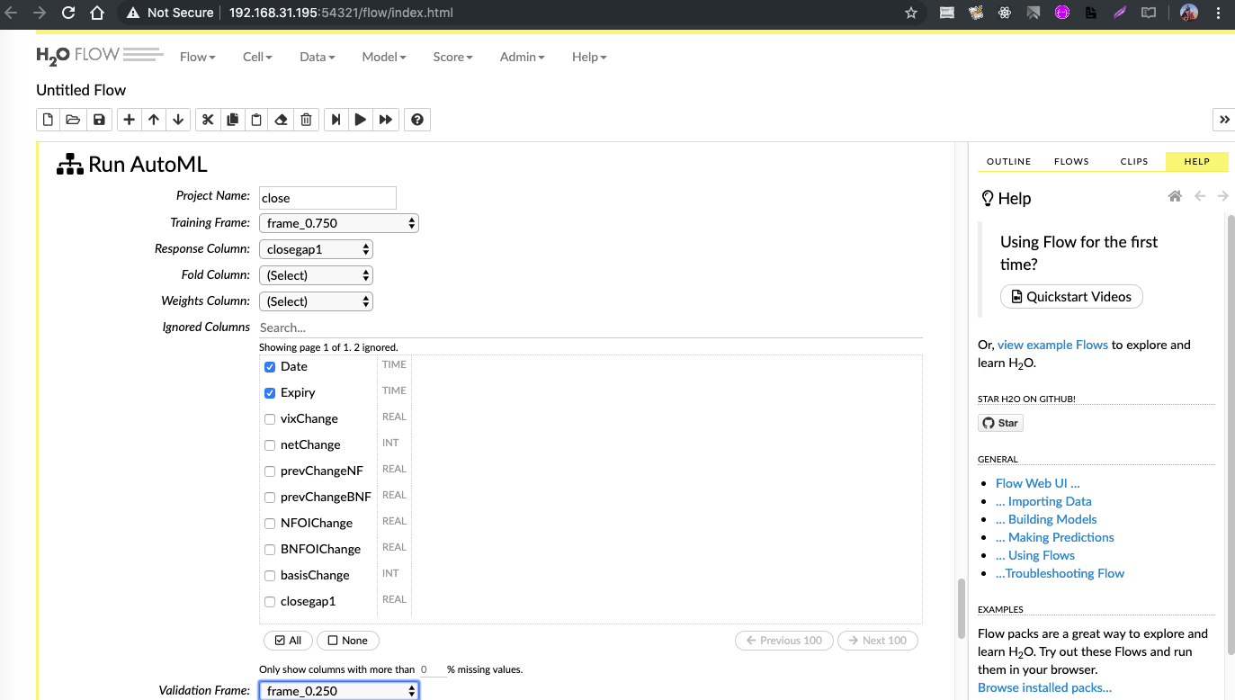

Slide 25
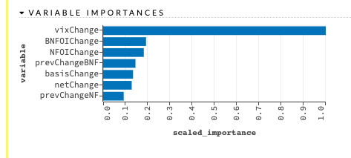
What does ML Model say?

Slide 26
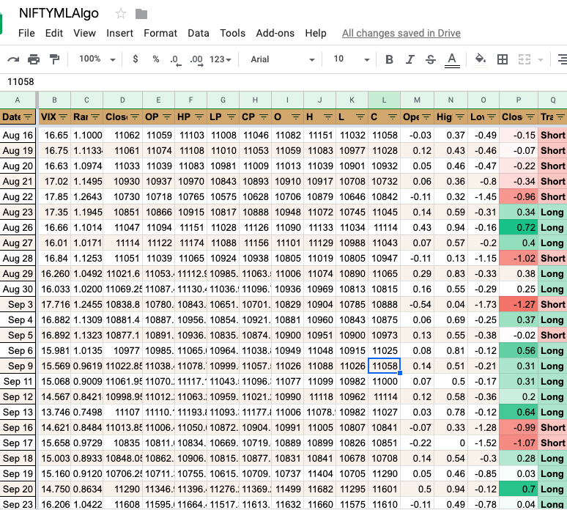
Simple Trading Strategy on live data

Slide 27
Contd..
Long if close prediction >0, Short if close prediction <0
Hold today close to next day close
Model went live on Aug 16th 2019
Total PL | 1374.25
Positive Days | 36
Negative Days | 23

Slide 28
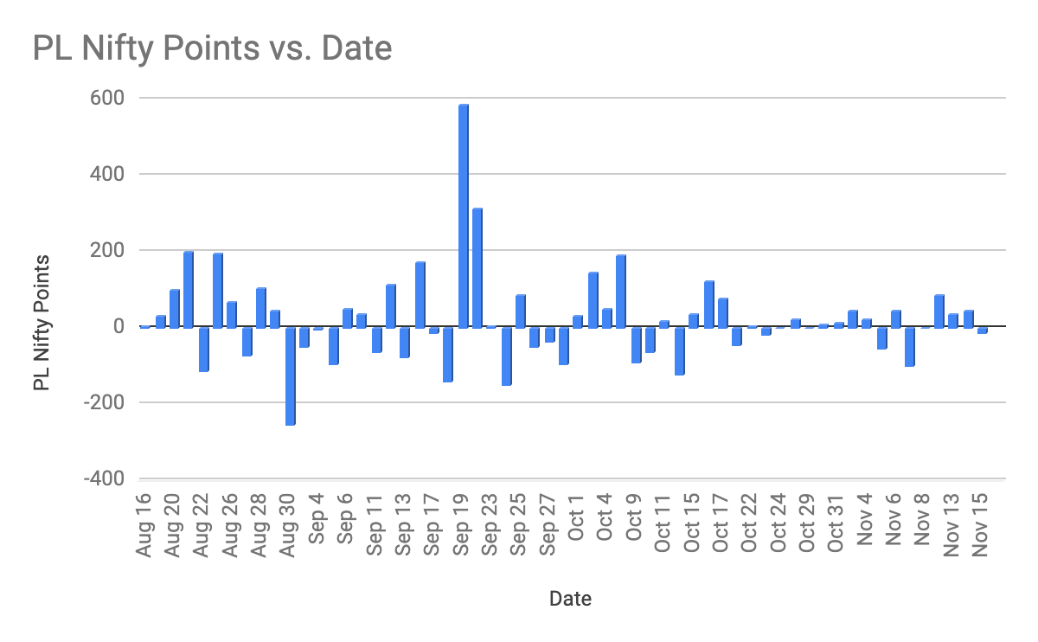
Day wise PL

Slide 29
Summary
Machine learning models gives a framework for predictions based on multiple loosely correlated variables
Number of models and trading strategies can be developed – BTST, close to close, hold for N days, intraday movement based on previous day data and today gap
Knowledge of programming a must for data processing and developing models

Slide 30
Thank you

