Slide 1

Gombe state university
STUDENTS INDUSTRIAL WORK EXPERIENCE SCHEME (SIWES)

Slide 2
Title: Snapzy – A Social Media Photo Sharing Platform
Subtitled: industrial training (IT) Project Presentation
Presented by: Fatimah Dukku
Ug19/sccs/0000
HELD AT NGIT SOFTWARE SOLUTIONS

Slide 3
INTRODUCTION
What is Snapzy ?
* A platform for users to like, share and view photos
* Users can register, login, post images, like and share content
* Built with PHP, MySQL, HTML, and CSS

Slide 4
Objectives
* Build a working social media photo app
* Practice full-stack web development
* Implement user interaction features
* Secure user data with sessions

Slide 5
Technologies Used
* Frontend: HTML5, CSS3
* Backend: PHP
* Database: MySQL
* Other Tools: Font Awesome, VS Code and Xampp Server.

Slide 6
Key Features
* User Registration and Login
* Upload Photo with Caption
* Like and Share Posts
* Personal Dashboard

Slide 7
Database Structure
* Users Table: id, username, email, password
* Posts Table: id, user_id, image_path, caption
* Likes Table: id, user_id, post_id

Slide 8
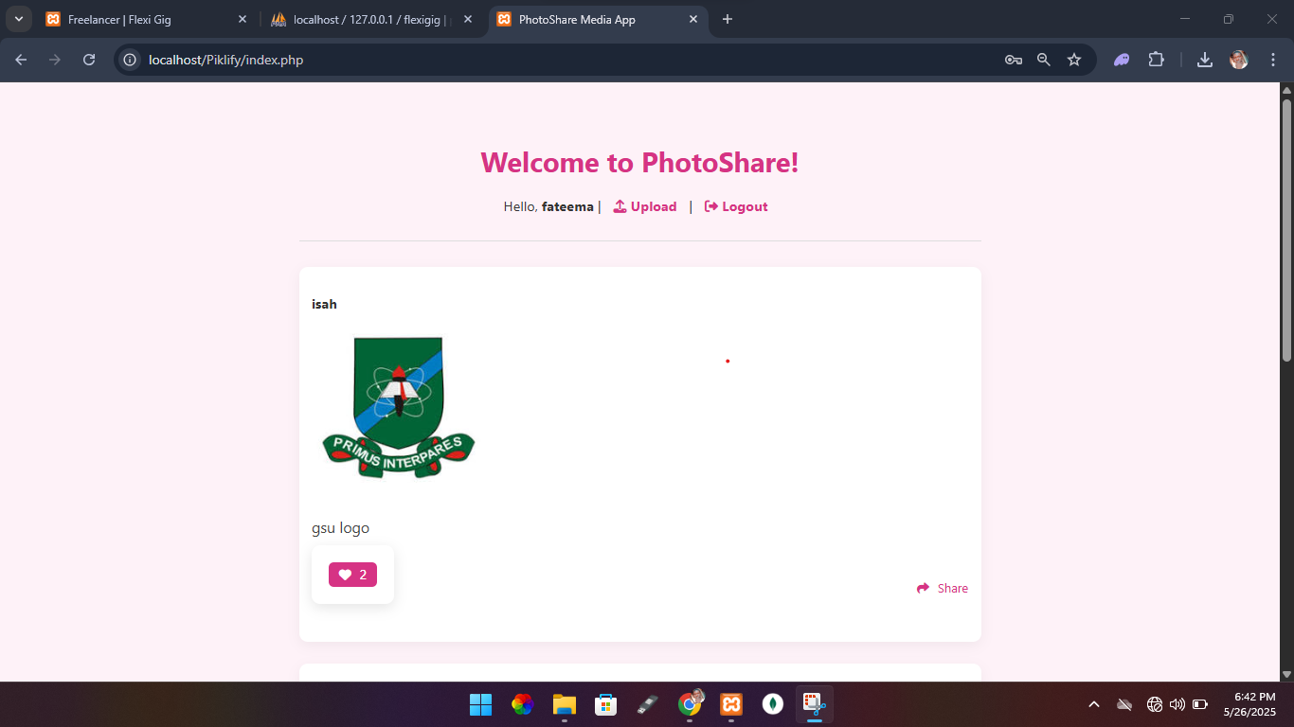
Application Screenshots
* Screenshot 1: Home Page
* Screenshot 2: Upload Page
* Screenshot 3: Register/Login
* Screenshot 4: Share Page
* Home Page

Slide 9
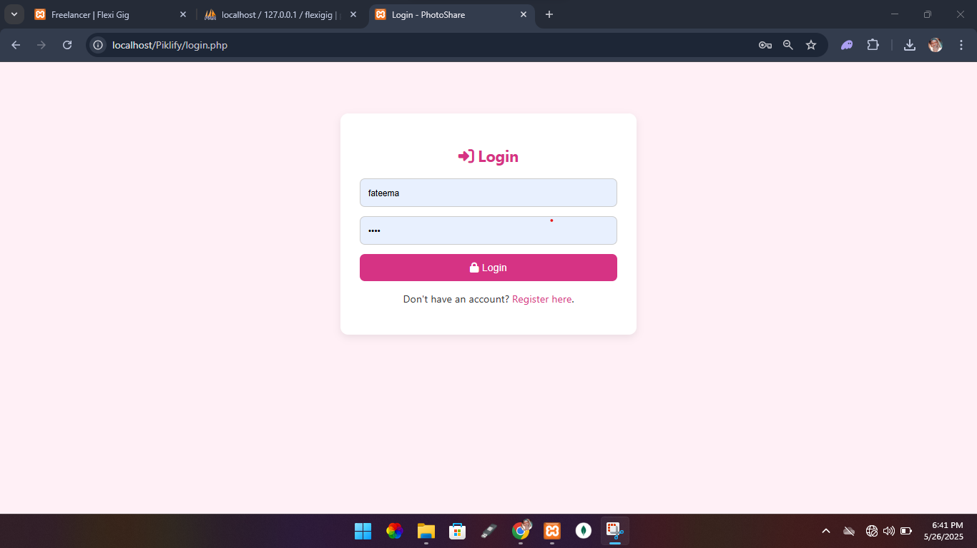
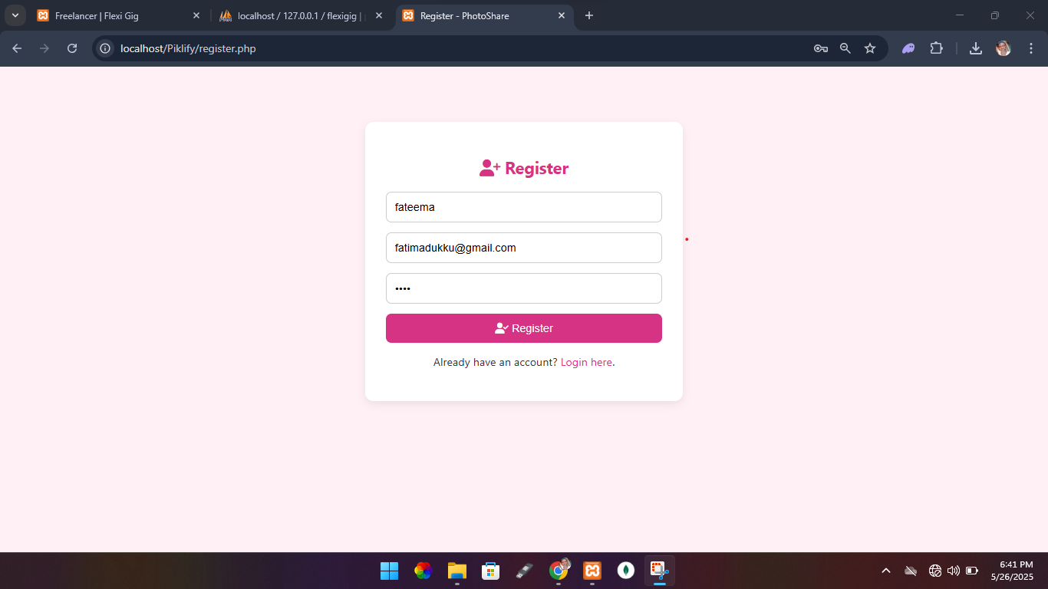
Authentication page
* Login Page
* Register Page

Slide 10
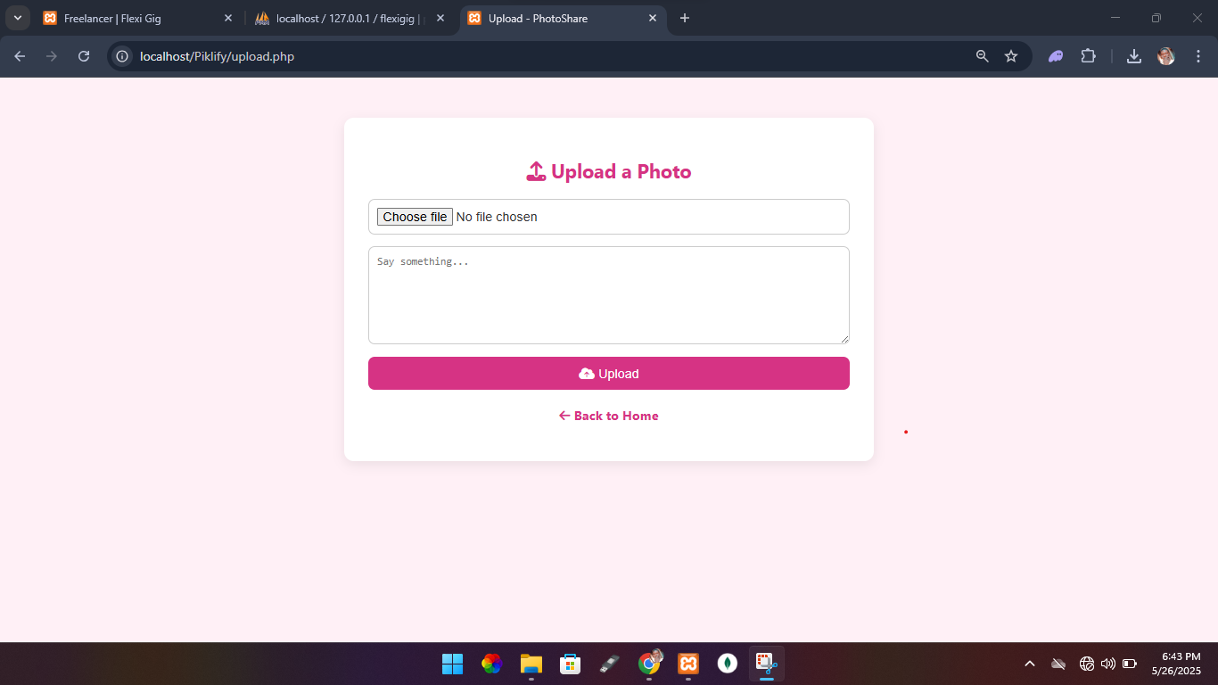
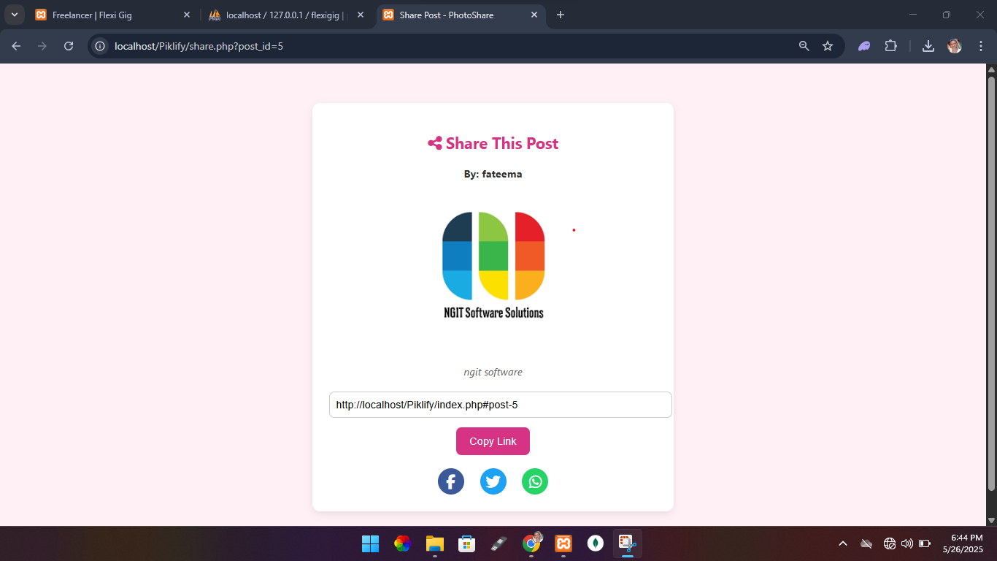
Post page
* Upload Post Page
* Share Post Page

Slide 11
Development Challenges
* Maintaining user sessions
* Validating input and managing errors
* Designing UI without frameworks

Slide 12
Why Snapzy Matters
* Encourages photo sharing among peers
* Simple and intuitive UI for all users
* Demonstrates full-stack development
* Scalable for real-world use

Slide 13
Future Plans
* Add comments to posts
* Notification system
* Integrate cloud storage
* Add hashtags and image filters

Slide 14
Thank you!
Any questions?

