Slide 1
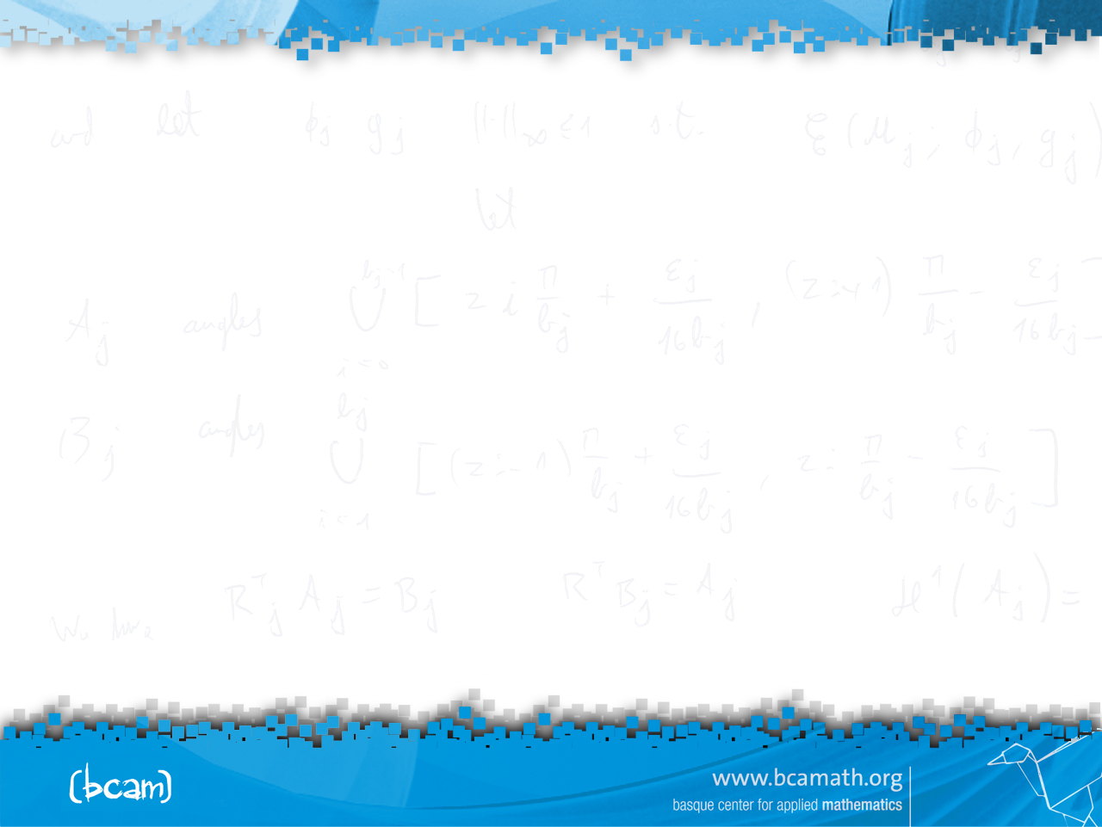


Introduction to
Machine Learning
César Hernández,
Ekhiñe Irurozki,
Aritz Pérez

Slide 2
Data pre-processing and
more...
César Hernández

Slide 3
Outline
Introduction
Technologies, software and “to know how the companies do it”
Important information links.
Data pre-processing
  Data checking.
      Outliers detection.
      Missing values.
  Numeric data standardization & normalization.
  Numeric data discretization.
  Feature selection.
  Feature extraction.
  Handling unbalanced data.

Slide 4
Introduction

Slide 5
Introduction
Which is my purpose when using ML with my data?
Did I collect my data?
  If so, did I do it right?
  If not, can I be (almost) sure that my data was rightly collected?
  What does “right” mean?
  Right in terms of data representation and structure, volume, … (problem dependent)
Is my data useful? (Reliable, representative, noisy, …)
Once my goal and my options in term of ML algorithms (computation or memory limitations, etc.) are clear, how will I evaluate the goodness of my results and infer valid conclusions?

Slide 6
Introduction
Summarizing:
Know where you want to go.
Know how to go there.
Know (if you can) that you will eventually reach there.
The first step in your journey is preprocessing your data.
It has been usually neglected.
In real-world problems, data preprocessing takes around 80% of your working time.
It is crucial for the subsequent steps. The bigger your data, the more important their preprocessing process.

Slide 7
Introduction
Our goal!!!
Data
acquisition
Data
pre-processing
Feature
Selection
ML
Algorithm
Obtaining
The model
Evaluation of
The results

Slide 8
Technologies, software and
“to know how the companies do it”

Slide 9
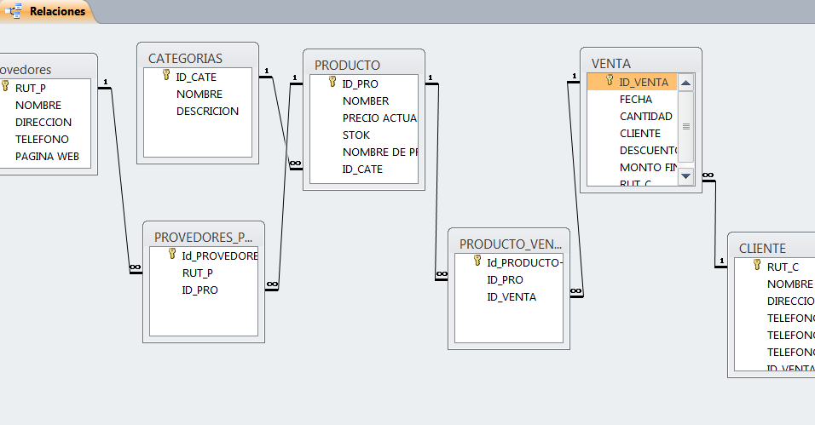






Technologies, software and “to know how the companies do it”
Queries using SQL
(Structured Query
Language)
CSV
xls
txt

Slide 10




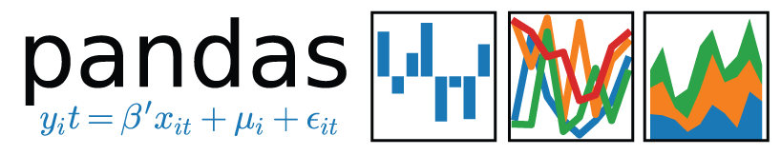


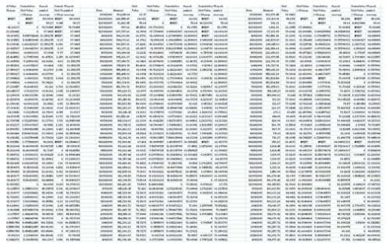
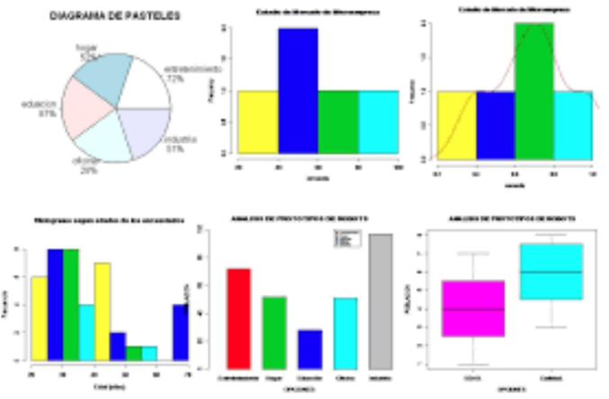
Technologies, software and “to know how the companies do it”
V1
--
--
--
. . .
V3
--
--
--
. . .
V_m
--
--
--
. . .
Database
V2
--
--
--
. . .
…
m columns
n rows

Slide 11
Important information links

Slide 12
Important information links
Github repository
https://github.com/ceelch/Introduction_ML_2019_BCAM_preprocessing
Anaconda, R, Rstudio, Weka, Spark
https://www.anaconda.com/
https://www.r-project.org/
https://www.rstudio.com/products/rstudio/download/
https://www.cs.waikato.ac.nz/ml/weka/downloading.html
https://spark.apache.org/
SQL practice
https://www.w3schools.com/sql/trysql.asp?filename=trysql_select_columns

Slide 13
1) Data checking

Slide 14
1) Data checking
Expert knowledge is always relevant, not only in preprocessing.
Due to expert knowledge you can:
  Know which features are the most relevant (from experience).
  Know the valid ranges of numerical variables (domain knowledge).
  Identify redundancies in the features.
  Set bounds to the modeling choices.

Slide 15
1) Data checking
Data cleaning can be done by applying expert knowledge or in a data-driven fashion.
Get familiar with your data:
  Look for useless attributes (noticeable even without expert knowledge).
  Look for corrupted data (empty or constant variables).
Just have a look and see what comes out, if the volume of your data allows it.

Slide 16
1) Data checking:
Outliers detection

Slide 17
Outliers detection
Their detection can be by expert knowledge (e.g. known attribute’s range) or data-driven. Let’s focus on the latter.
Outliers detection can be done in two ways:
  Individual: Performed variable by variable. The simplest approaches consist on considering as outliers the values outside the intervals:
Collective: Using all variables. The most representative one takes into account the distribution of the data, and is based on calculating an ellipsoid around the data points, using Mahalanobis distance. Te points outside it are considered as outliers.
When detected the record is ignored or imputed (risky).

Slide 18
1) Data checking:
Missing values

Slide 19
Missing values
Missing values are unexpected “holes” in the data.
There are three strategies for dealing with missing values:
  Ignore records (rows, samples, …) where missing values are detected.
  Treat missing values in an attribute as legitimate values of the attribute.
  Impute a value to “fill the holes”:
    Direct imputation, in a supervised or unsupervised way, of a significant value, such as the mean or median (numerical attributes), the mode categorical attributes), or a suggestion by an expert.
    More advanced techniques requiring some data analysis, such as k-nearest neighbours or expectation & maximization algorithm.

Slide 20
2) Numeric data standardization &
normalization

Slide 21
2) Numeric data standardization & normalization
When computing distances between pairs of samples, the scales of the different features is very relevant.
Moreover, we cannot obviate the curse of dimensionality effect, i.e. in high-dimensional spaces all data is sparse. In simple words, all distances become huge.
Therefore, if the algorithm we plan to apply after preprocessing implies distances and/or we are in a high-dimensional problem, we should transform all the features to a similar scale.

Slide 22
2) Numeric data standardization & normalization
Some of the approaches are:
  Mean centering: scaling to zero mean by subtracting the mean. Necessary, for instance, in approaches related to Mahalanobis distance, like PCA.
  Standardization: scaling to zero mean and unit variance by subtracting the mean and dividing by the standard deviation.
  Normalization: scaling to [0, 1] by subtracting the minimum and dividing by the range.
In general, do not standardize or normalize your data unless you have a good reason for doing so.
Other transformations from Statistics (logit, square root, power, Box-Cox, angular, etc.) are not considered because they are part of the posterior processing phase.

Slide 23
3) Numeric data discretization

Slide 24
3) Numeric data discretization
The goal of discretization is reducing the number of values of a continuous attribute by grouping them into intervals (bins). The new values are the bins.
Some methods require discrete attributes (some naïve Bayes and Bayesian networks methods, etc.).
Sometimes, the results are better after discretization. Some methods do it implicitly (e.g. decision trees).
In general, the computational cost of algorithms with discrete attributes is lower than their continuous versions.

Slide 25
3) Numeric data discretization
Types of discretization: Unsupervised vs supervised.
Unsupervised. Without using the attribute of interest.
Some require to fix the number of bins, k, in advance:
  If too large the bins could have not enough data to be significant.
  If too little, we might loose the informative power of the attribute.
  It is tricky to find out the right value.
Examples:
  Equal-width. Divide the range into k equal-width ranges. It could cause unbalance (e.g. the salary in a company).
  Equal-frequency. Divide the range into k ranges with the same frequency. Better than equal-width in terms of clumping, but could produce odd artifacts with frequent or special values.

Slide 26
3) Numeric data discretization
Supervised. Using the attribute of interest.
In general, they have the advantage of not having to fix k in advance.

Slide 27
4) Feature selection

Slide 28
4) Feature selection
With variables, there are possible feature subsets. Exploring all options is not frequently feasible.
Feature selection consists on choosing a subset of the original features according to certain criteria to be optimized (optimization problem).
Depending on the criteria and the way to optimize it we can get two types of outputs:
  Just the subset of selected features.
  A measurement of the importance of the features. This allows us to rank the features. Then we could get a subset by fixing a threshold for a cut-point of the importance.

Slide 29
4) Feature selection
There are three types:
  Filter methods: based on intrinsic properties of the data. The most widely used are statistical properties, such as correlation or mutual information. Not algorithm dependent (universal).
  Wrapper methods: using some learning task in the selection. Unless the computational cost is too high, we would use the same learning task chosen for the subsequent processing. Usually much more computationally expensive than filters.
  Embedded methods: included inside the algorithm (outside preprocessing).
Examples of filters: Correlation-based feature selection (different definitions of correlation), InfoGain (mutual information), ReliefF (distance to the nearest sample from the same class and from a different class), simmetrical uncertainty (entropy of the sample and the class).

Slide 30
5) Feature extraction

Slide 31
5) Feature extraction
Feature extraction is the action of defining new features from all or part of the original ones.
Despite expert knowledge could be also used, we focus on data-driven approaches.
When applying feature extraction, there is usually a price to pay in terms of loss of interpretability because of the lack of meaning of the artificial features.
There are both supervised and unsupervised methods.
We will have a deeper look to the most famous unsupervised (and linear) method: principal component analysis (PCA).

Slide 32
5) Feature extraction
Principal Components Analysis
PCA is mathematically defined as an orthogonal linear transformation that transforms the data to a new coordinate system such that the greatest variance by some projection of the data comes to lie on the first coordinate (called the first principal component), the second greatest variance on the second coordinate, and so on.
Principal
Components
PC1
PC2

Slide 33
5) Feature extraction
Principal Components Analysis
Algorithm.
Obtain the eigenvectors and eigenvalues of the covariance matrix.
Order the eigenvalues from highest to lowest and choose the "k" eigenvectors that correspond to the larger "k" eigenvectors (where "k" is the number of dimensions of the new characteristics subspace).
Build the projection matrix W with the "k" selected autovectors.
We transform the original “X standardized” dataset via W to obtain the new k-dimensional characteristics.
Principal
Components
PC1
PC2

Slide 34
6) Handling unbalanced data

Slide 35
6) Handling unbalanced data
Unbalanced data in classification happens when the class of interest has very low frequency.
Example: Predicting if certain part of a machine is faulty or not, based on sensor data (fault detection problem).
Cost-sensitive methods: penalize the errors in the minority class in order to guide the training towards a better representation of that class.

Slide 36
6) Handling unbalanced data
Sampling-based methods:
  Oversampling: add artificially samples of the minority class by copying (randomly or not) or creating instances.
  Undersampling: Remove samples (randomly or not) of the majority class.
  Combined: Both oversampling and undersampling.
Pros & Cons:
  Classes get equilibrated, promoting a better classification trade-off.
  Undersampling removes samples that could contain relevant discriminant information.
  Oversampling incorporates artificial/redundant information that could drive models (depending on their characteristics) towards non-realistic conclusions.

Slide 37
6) Handling unbalanced data
Oversampling methods
Selection methods:
  Random oversampling. With or without replacement, pure or guided,…
  Generation methods:
      Synthetic Minority Oversampling TEchnique (SMOTE).
      ADAptive SYNthetic sampling method (ADASYN).
Undersampling methods
Selection methods:
  Random undersampling. With or without replacement, pure or guided,…

Slide 38
Introduction to
Machine Learning
César Hernández,
Ekhiñe Irurozki,
Aritz Pérez

Slide 39

César Ernesto Hernández Hernández.
Postdoc Fellow.
Machine Learning.
chernandez@bcamath.org
http://www.bcamath.org/es/people/chernandez

