Slide 1
ECE 18731 Network Security Course Overview
Vyas Sekar

Slide 2
Introduction
Me = Vyas Sekar
Best way to reach me – vsekar@andrew
For course material -- Piazza
Office Hours: Thu 3:30 – 5 or by appointment
(Email to setup time)
TAs: Tianlong Yu and Tushar Goyal
TA Office Hours: TBD

Slide 3

B.Tech, IIT Madras CSE,2003 PhD, CMU CSD, 2010 Pittsburgh → Berkeley → Long Island → Pittsburgh! Research: Networking, Security, Systems Where: CIC 2122 Web: http://users.ece.cmu.edu/~vsekar/ Keywords: SDN/NFV, IoT, DDoS, Cloud

Slide 4
Example of Current Research
Elastic Defense
Defending against changing attack patterns
Security for Internet of Things
Handle trillion unfixable flaws on billion devices?
Abstractions for network testing/verifiability
Is network implementing my policy correctly?
Support for reconfigurable network security
What if we can change the network on demand?
How can the cloud help improve security?

Slide 5
TAs
TianlongYu, PhD student
Tushar Goyal, MS student
Get to know them!

Slide 6
Today’s Class
Course personnel introductions
Course expectations
Grading and course policies
Paper review
Projects (never too early to start)

Slide 7
Goals of this class
Basic principles of network security
Architecture, protocols, systems
Attacks
Defenses
Get familiar with current network security research
Critically read research papers
Where is it headed?
Understand solutions in context
Goals (e.g., performance, security, scalability)
Assumptions (e.g., technology, economics)

Slide 8
What is Network Security

Slide 9




What is Network Security?
Public Channel
Alice
Bob
The Network,
typically runs IP “protocol”
Providing a “reliable” channel
→ If the network protocols have flaws, crypto may not save you

Slide 10
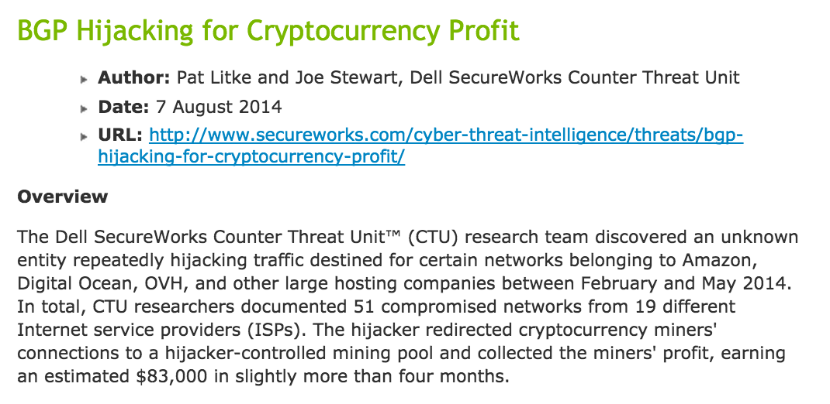
http://www.secureworks.com/cyber-threat-intelligence/threats/bgp-hijacking-for-cryptocurrency-profit/

Slide 11
What is Network Security?
Public Channel
Alice
Bob
The Network,
typically runs IP “protocol”
2. Providing an “available” channel
→ Can Alice talk to Bob? Can Eve deny service to Alice/Bob?

Slide 12
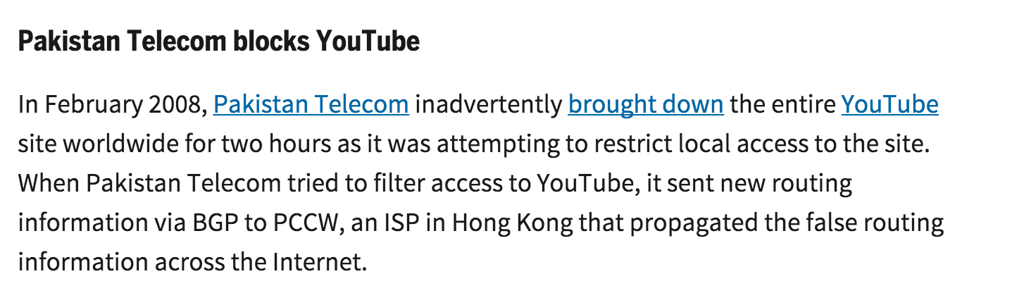
http://www.networkworld.com/article/2272520/lan-wan/six-worst-internet-routing-attacks.html

Slide 13

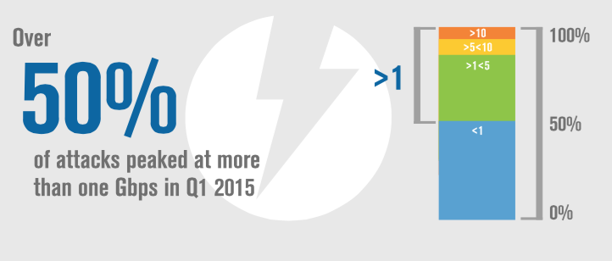
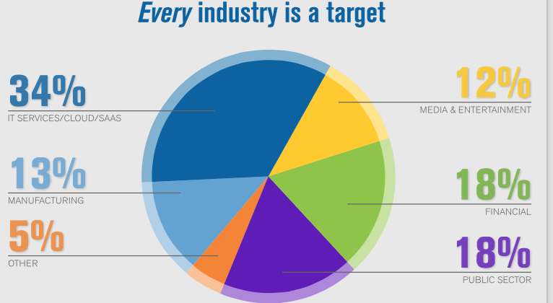
DDoS growing in number, scale, and diversity
Source: Verisign

Slide 14
What is Network Security?
Public Channel
Alice
Bob
The Network,
typically runs IP “protocol”
3. Providing an “enforcement” for observing/mediating access
Stop Eve’s malware from reaching Bob in the first place
Observe aggregated view of malicious intents

Slide 15
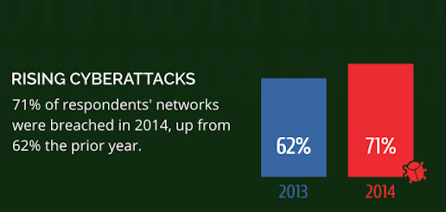
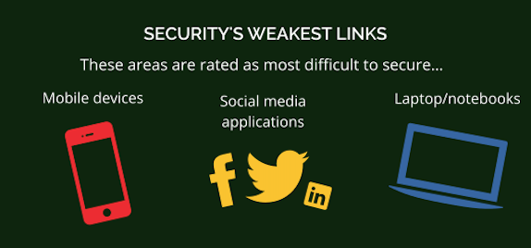
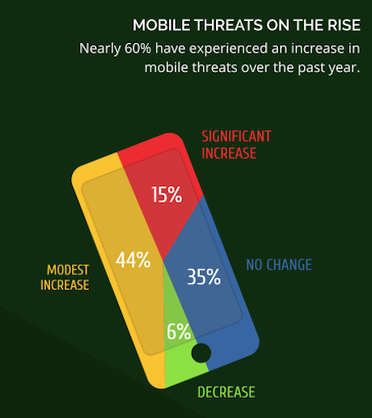
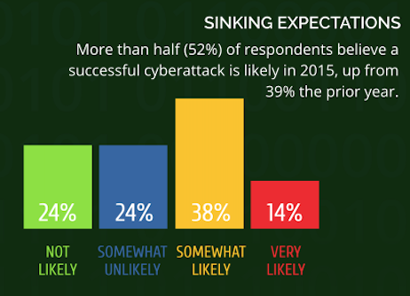
Source: Webroot

Slide 16
Source: HP

Slide 17
What is Network Security?
Public Channel
Alice
Bob
The Network,
typically runs IP “protocol”
4. Enabling and preventing eavesdropping/modifications
→ Not all network protocols use crypto!

Slide 18
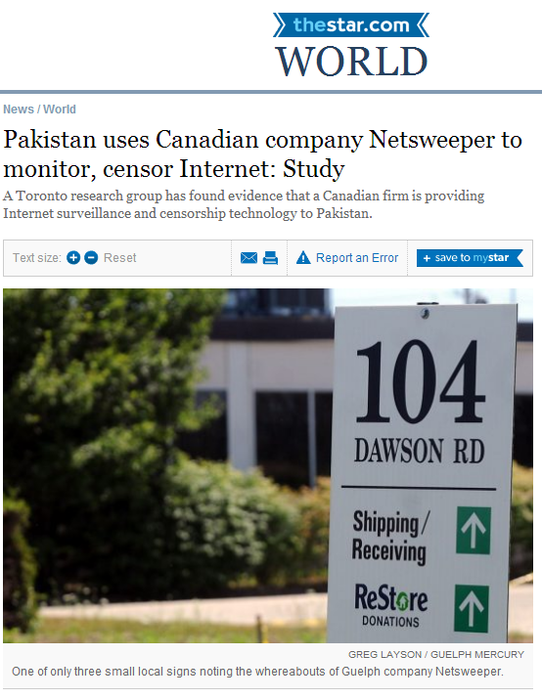
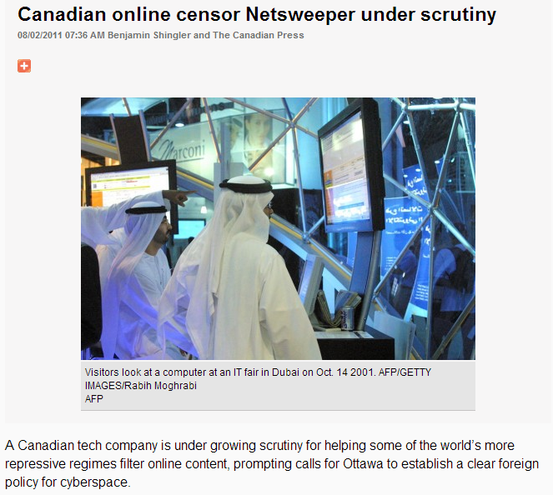

Slide 19
Specifics of network security
Large scale (people and hardware)
Heterogeneity (hardware, protocols, implementations, apps)
No centrally trusted authority
Distributed management
Geographically diverse (long latencies)
Potentially mobile (wireless communications)
Participants from different administrative entities

Slide 20
Class Expectations
Mix of theory/concept + Practice
Not pure theory or pure tools
Expect to write code (C/scripting etc)
All homeworks will involve writing code
All homeworks involve use real n/w security tools
Projects will involve implementation
We assume you have UG networks/systems background

Slide 21
Prerequisites
Passing grade (C or above) in
An intro networking class: 18-345, 14-740, 15-441
An intro security class: 14-741/18-631, 18-730, 18-487
(or equivalent coursework)
Very limited (if any) review of crypto, security properties, basic networking materials
You may want to review the materials covered in these classes
C and UNIX programming skills will be helpful for homeworks and semester project
Talk to me ASAP if you are unsure of pre-reqs or readiness for class.

Slide 22
Class format
Concepts explained in lectures
Tools and techniques introduced through homework assignments
Gain additional knowledge (practical and/or theoretical) in your favorite topic through semester project

Slide 23
Class format details
For each lecture
Approx. 12-page reading assignment (on average), hand in summary before lecture
Active participation is expected
Please do ask questions and make constructive comments during lectures…
You participation grade depends on it
Be on time! (important announcements are made at beginning of lecture)
4 homework assignments/mini-projects
2 in-class written exams: midterm and final (not cumulative)
1 semester project

Slide 24
Class Topics
Infrastructure
E.g., TCP/IP, DNS, SDN
Network-wide attacks
E.g., Worm, DDoS
Analysis and Inference
E.g., side channels, economics, forensics
User-related topics
E.g., Anonymity, censorship,
5. New technologies
E.g., Future Internet, IoT

Slide 25
How is this different from course X ?
18487: (UG) Intro to security
Some topics were covered briefly (e.g., BGP, DDoS, NIDS)
90% different topics
18631/18730: Intro to information security
80% different topics
Some topics revisited (e.g., NIDS, DDoS, Anonymity, TCP/IP, Econ)
We will go in greater depth + more “research” mentality
Homework assignments are hands-on + different topics
Research project gives you a unique opportunity!

Slide 26
Assignments
Build a very basic network security appliance
Attacks against the SDN controller
Low-rate TCP DoS or ``shrew'' attack
DNS hijack attacks and defenses

Slide 27
Today’s Class
Course personnel introductions
Course expectations
Grading and course policies
Paper review
Projects (never too early to start)

Slide 28
Grading
http://users.ece.cmu.edu/~vsekar/Teaching/Spring18/18731/policy
30% Homeworks: Four homeworks
To be done individually
30% Class research project
Groups of 3-4
15% Midterm (in class)
15% Final (in class)
10% Paper reviews and Discussion/participation

Slide 29
Course policies: Plagiarism
Homework assignments (including reading critiques)
Your fellow students are your best resource for advice, discussions...
But all solutions presented must be your own work
Don’t copy from any source (web, other students, …)
Short citations are ok, if properly quoted and referenced
In-class exams
No collaboration of any kind is allowed
Laptops and cell phones can’t be used
Open notes/papers
Cheating will be dealt with in the severest manner
Don’t do it: you will get caught and it is not worth it
Contact me if you are unsure if some form of collaboration is OK

Slide 30
Course policies: Late submissions
Reviews are due before class, otherwise don’t count for credit
Homework must be turned in by class time on the due date
Two grace credits for the entire semester
You can use each grace credit at your convenience to extend a deadline by 24 hours
When you run out of grace credits, you incur a penalty of 25% per day your homework is late
We will not accept homework late by more than three days
Project deliverables cannot be submitted late

Slide 31
Course policies: Other
Please turn off/mute your cell phones
(or put them on vibrate – and don’t pick up!)
Penalty on participation grade for offenders
Laptops OK, but
Please refrain from reading the news, being on Facebook, or checking email in class
Even though it may not necessarily disrupt the lecture, it is rude!
You probably do not need to have your laptop with you in class
Please avoid using backchannels (Twitter, IRC, instant messaging) with other students
Instead, share your comments with the rest of the class
Please do not upload or redistribute class materials without instructor’s permission

Slide 32
Staying out of trouble
Attacks discussed in class are illegal to execute
Warning: don’t try this at home
Well, actually, you might, if you have your own private network
Goal of this course is not to teach you how to attack systems … But, to teach you how to defend systems by knowing what the attackers do
Never use any of the attacks on a network connected to the Internet!
Approach for projects/assignments:
code is executed on isolated network (e.g., virtual machine)
Sandbox, sandbox, sandbox

Slide 33
Important URLs
Course webpage
http://users.ece.cmu.edu/~vsekar/Teaching/Spring19/18731
Check announcements for course updates!
Discussion of papers etc on Piazza
https://piazza.com/class/jbs4907vxy166
→ We enrolled from s3, if you are not yet in, write down your names in the handout
Canvas: For grades etc
Paper review submission site: https://docs.google.com/forms/d/e/1FAIpQLSfm1UrLZIHfgTOuD0gFoMGu-dGGmPFfLd1mSad-EV1aBtu0KA/viewform

Slide 34
Today’s Class
Course personnel introductions
Course expectations
Grading and course policies
Paper review
Projects (never too early to start)

Slide 35
Three-pass approach
Pass1: The skim
Read abstract, intro, conclusions, section titles
Pass2: Grasp technical content
Main thrust + supporting evidence
Pass3: Virtually re-implement the paper
Challenge/Question every assumption

Slide 36
Five Cs to summarize the paper
Category: What type of paper is this? A measurement paper? An analysis of an existing system? A description of a research prototype?
Context: Which other papers is it related to? Which theoretical bases were used to analyze the problem?
Correctness: Do the assumptions appear to be valid?
Contributions: What are the paper’s main contributions?
Clarity: Is the paper well written?

Slide 37
Writing your review
DO NOT PARAPHRASE THE PAPER, have a critical, independent view
Did you like this paper?
Why? 1-2 sentences.
What problem is this paper solving?
2-3 sentences.
What are the strengths of this paper?
3-4 sentences.
What are the main weaknesses in the paper?
3-4 sentences.
What would you do differently? Are there assumptions you disagree with? Do you see ideas for future work or improving the solution?
Do you see new attack vectors/vulnerabilities?
5-6 sentences

Slide 38
Today’s Class
Course personnel introductions
Course expectations
Grading and course policies
Paper review
Projects (never too early to start)

Slide 39
Research-oriented Class Project
Project groups of 3-4 students
Any group of different size has to get OK-ed
Start forming groups early
Project grading criteria
Research component
Implementation component
Project presentation/poster
Project report

Slide 40
Formulating a research project
Problem statement
What problem, does it matter
Who will benefit
Proposed approach
What method or idea
Hypothesis
Do you have specific expectations? What is known?
Evaluation plan
What tools? What resources?
Results
What are the metrics of success? What is the deliverable?
Milestones

Slide 41
Project Logistics
Project proposal
Project description
Related work
Outline of research contribution
Timeline of implementation milestones
Evaluation metrics (how do you know that you were successful)

Slide 42
Project milestones
3-4 milestones
A (written) proposal phase (until Feb XXX)
Form groups, submit pre-proposal to make sure your project is feasible
Describe the proposed work
Motivation behind it
Schedule to completion
One mid-semester emails (tentatively March 15 and week of April 7)
One page report where you will describe the status of your project – instructors may follow up with an interview with the team if needed.
Final presentation (in class) and report (early May/finals week)
Highly encouraged to communicate with the instructors outside of the mandatory milestones
Communicate!
We will not run after you to get information, you are in complete control

Slide 43
Some example topics ..
Will be posted soon
http://users.ece.cmu.edu/~vsekar/Teaching/Spring18/18731/projects
More in a couple of weeks

Slide 44
Choosing your own project
Anything related to this course and appropriately challenging should be doable
Most important factor: your own motivation
Talk to us!

Slide 45
Todo (0)
Read the “how to read”
Read the “project how to”
Internalize these!

Slide 46
Todo (1) for you this week
Look at the draft syllabus

Slide 47
Todo (2) for you this week
Get to know your classmates, and form project groups

Slide 48
Todo (3) for you this week
Start thinking of project ideas

Slide 49
If you are ..
Waitlisted?
Unsure of prereqs?
Want to audit?
Anything else?
Talk to me ASAP

Slide 50
Take away slide
Ensuring security in networked systems presents unique challenges
We’ll explore network security through attacks and defenses at various networking layers
Concept + practice oriented course
Exposure to tools through assignments and projects
Todos for you:
Form groups
Look at syllabus
Start thinking about your semester project!
Talk to us ASAP if you have questions/concerns.
This will be quite a bit of work, but loads of fun!

Slide 51
Next class
Quick refresher of networking and security basics
No reading critique necessary

