Slide 1
Final Project Presentation: Sign Language Recognition
Carol Fan
June 26, 2017

Slide 2
Can A Computer Understand Sign Language?
Background: Sign language is a visual language that uses hand motions to represent a word or concept
Objective: Can we use motion sensor data to translate signs in Australian sign language into written English?
Hypothesis: A computer can distinguish whether or not a motion represents a given sign or not with 90% accuracy

Slide 3
Sign Language Data
https://archive.ics.uci.edu/ml/machine-learning-databases/auslan2-mld/auslan.data.html
Dataset description:
2565 signs: 27 samples of 95 signs made by 5 different signers
Motion captured using Flock system
X, Y, Z position
Roll, Pitch, and Yaw
Finger bend for each of 5 fingers
Avg Frames per instance: 41-102 (avg: 57)
Notes:
https://pdfs.semanticscholar.org/80d6/54eb9a924eb22d8cd6d72c45f2672cab7c75.pdf

Slide 4
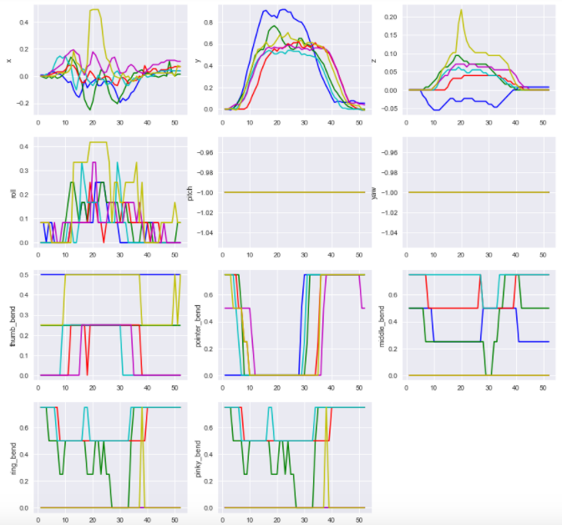
What
Not helpful
Ring and pinky bend are exact copies

Slide 5
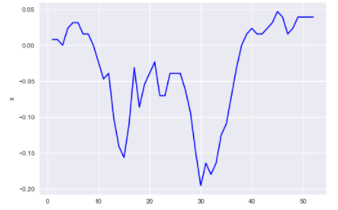
Individual Sign-level Features Selected/Created
Number of frames captured
Proxy for how long it takes to make a sign
Distance hand traveled in (x,y,z)-space
For each of the 8 relevant graphs, described features of each colored line
Differences between
first, middle, and last values
75th percentile value
– 25th percentile value
Last Value
1st Value
Middle Value
75th %ile
25th %ile

Slide 6
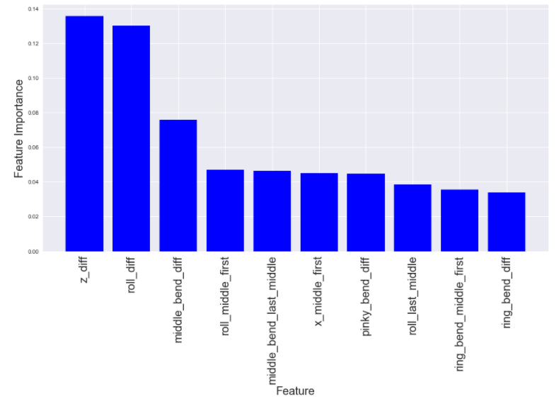
Logistic Regression Results: What vs When
Logistic Regression Grid Search CV Score: 94.6%
Random Forest Grid Search OOB Score: 93.2% (CV 88.0%)
75th %ile – 25th %ile Z
75th %ile – 25th %ile Roll
75th %ile – 25th %ile
Middle Bend

Slide 7
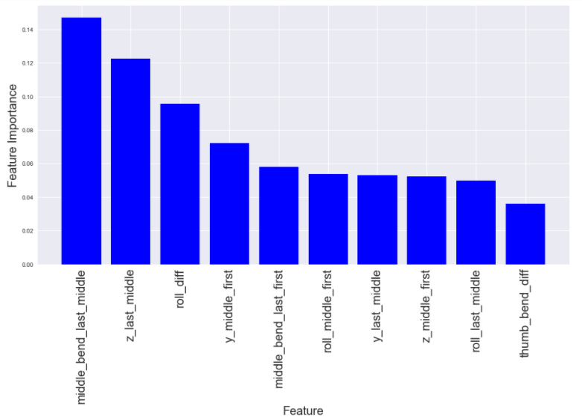
Logistic Regression Results: What vs Where
Logistic Regression Grid Search CV Score: 98.6%
Random Forest Grid Search OOB Score: 95.6% (CV 95.6%)
75th %ile – 25th %ile
Middle Bend
Last – Middle Z
75th %ile – 25th %ile
Roll

Slide 8
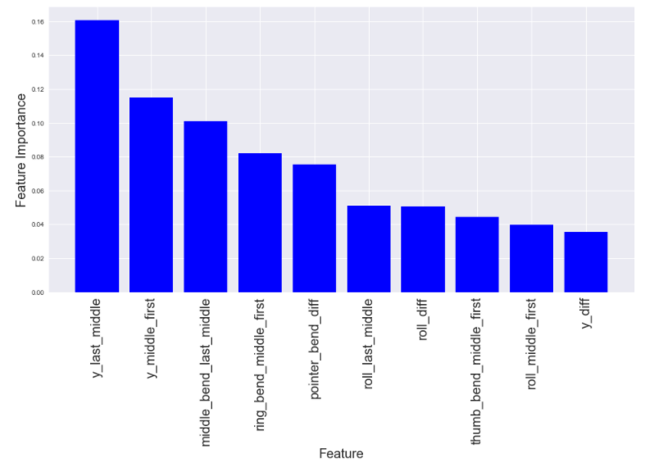
Logistic Regression Results: What vs Which
Logistic Regression Grid Search CV Score: 98.6%
Random Forest Grid Search OOB Score: 97.1% (CV 97.1%)
Last – Middle Y
Middle – First Y
Last – Middle Middle
Bend
Three pairs of words have different sets of important features

Slide 9
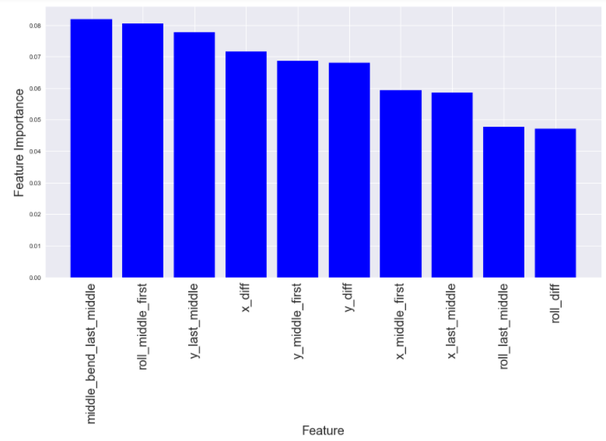
(Harder) Logistic Regression: What vs NOT What (Up Sampling)
Up Sampling:
“Not What” is 173 of 208 records
Sample “What” population to be 173 records
Logistic Regression Grid Search CV Score: 90.2%
Random Forest Grid Search OOB Score: 98.8% (CV 74.3%)
Last – Middle Middle Bend
Middle – First Roll
Last – Middle Y

Slide 10
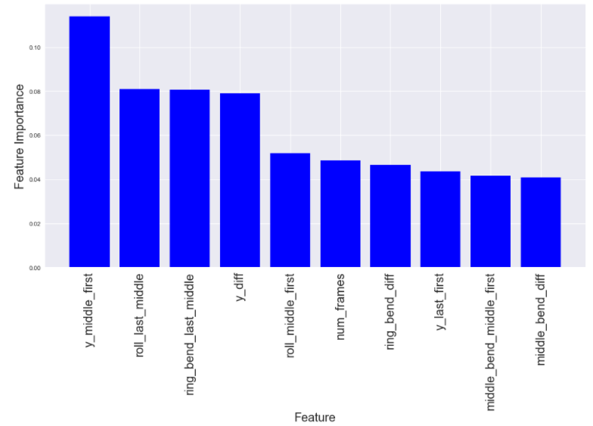
(Harder) Logistic Regression: What vs NOT What (Down Sampling)
Down Sampling:
“What” is 35 of 208 records
Sample to get NOT What to be 35 records
Logistic Regression Grid Search CV Score: 94.3%
Random Forest Grid Search OOB Score: 87.1% (CV 82.9%)
Middle – First Y
Last – Middle Roll
Middle – Last Ring Bend
Down Sampling performs better, but may not be as robust

Slide 11
Findings & Next Steps
Relatively easy (> 95% accuracy) to distinguish between two words
But models are specifically fit to those two words
Not terrible (> 90% accuracy) to distinguish between What and 5 other words
No agreement on important features (due to sample selected?)
Limited feature set did not improve performance
Would like to generalize to ability to recognize any word
Neural networks can handle increased complexity

