Slide 1
Final Project Presentation: Sign Language Recognition
Carol Fan
June 26, 2017

Slide 2
Can A Computer Understand Sign Language?
Background: Sign language is a visual language that uses hand motions to represent a word or concept
Objective: Can we use motion sensor data to translate signs in Australian sign language into written English?
Hypothesis: A computer can distinguish whether or not a motion represents a given sign or not with 90% accuracy

Slide 3
Sign Language Data
https://archive.ics.uci.edu/ml/machine-learning-databases/auslan2-mld/auslan.data.html
Dataset description:
2565 signs: 27 samples of 95 signs made by 5 different signers
Motion captured using Flock system
X, Y, Z position
Roll, Pitch, and Yaw
Finger bend for each of 5 fingers
Avg Frames per instance: 41-102 (avg: 57)
Notes:
https://pdfs.semanticscholar.org/80d6/54eb9a924eb22d8cd6d72c45f2672cab7c75.pdf

Slide 4
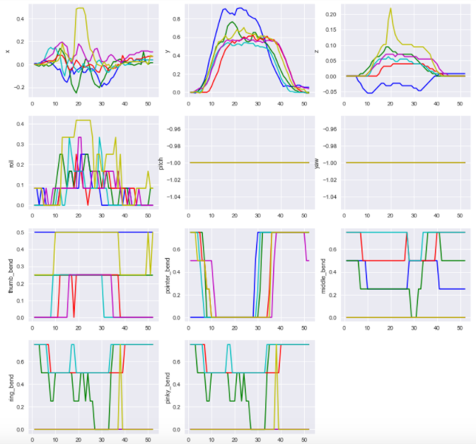
What
Not helpful
Ring and pinky bend are exact copies

Slide 5
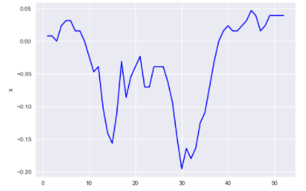
Individual Sign-level Features Selected/Created
Number of frames captured
Proxy for how long it takes to make a sign
Distance hand traveled in (x,y,z)-space
For each of the 8 relevant graphs, described features of each colored line
Differences between
first, middle, and last values
75th percentile value
– 25th percentile value
Last Value
1st Value
Middle Value
75th %ile
25th %ile

Slide 6
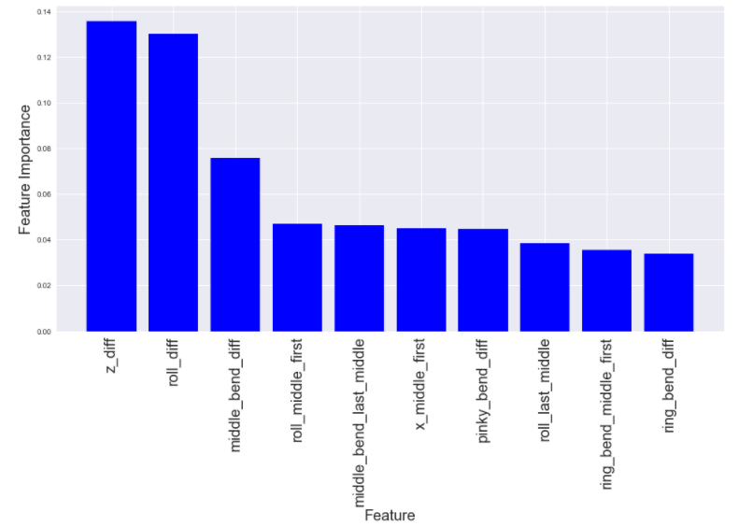
Logistic Regression Results: What vs When
Logistic Regression Grid Search CV Score: 94.6%
Random Forest Grid Search OOB Score: 93.2% (CV 88.0%)
75th %ile – 25th %ile Z
75th %ile – 25th %ile Roll
75th %ile – 25th %ile
Middle Bend

Slide 7
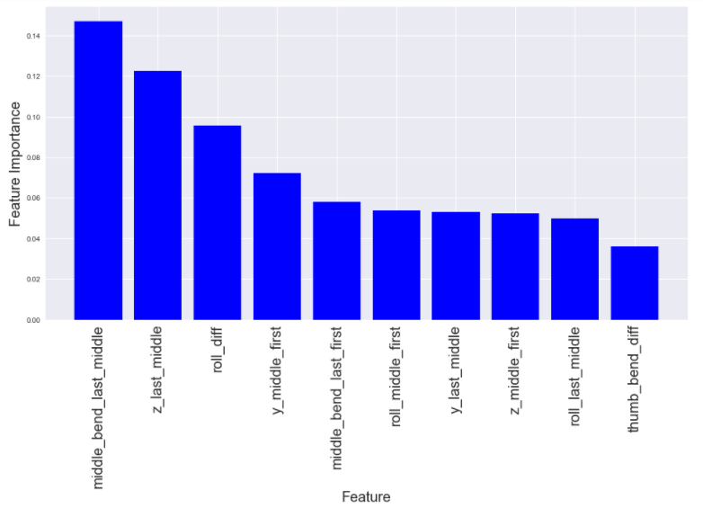
Logistic Regression Results: What vs Where
Logistic Regression Grid Search CV Score: 98.6%
Random Forest Grid Search OOB Score: 95.6% (CV 95.6%)
75th %ile – 25th %ile
Middle Bend
Last – Middle Z
75th %ile – 25th %ile
Roll

Slide 8
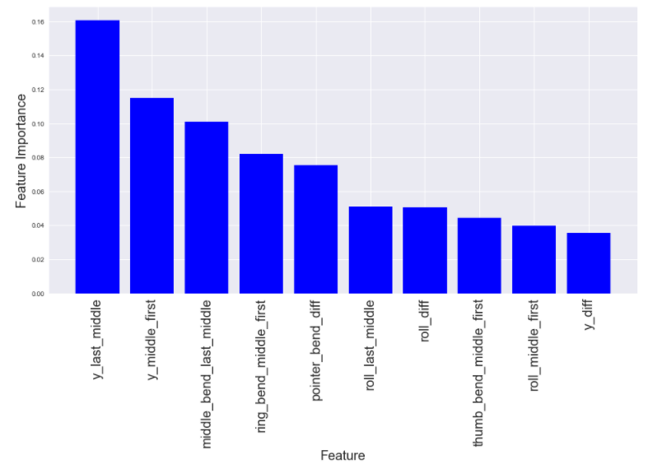
Logistic Regression Results: What vs Which
Logistic Regression Grid Search CV Score: 98.6%
Random Forest Grid Search OOB Score: 97.1% (CV 97.1%)
Last – Middle Y
Middle – First Y
Last – Middle Middle
Bend
Three pairs of words have different sets of important features

Slide 9
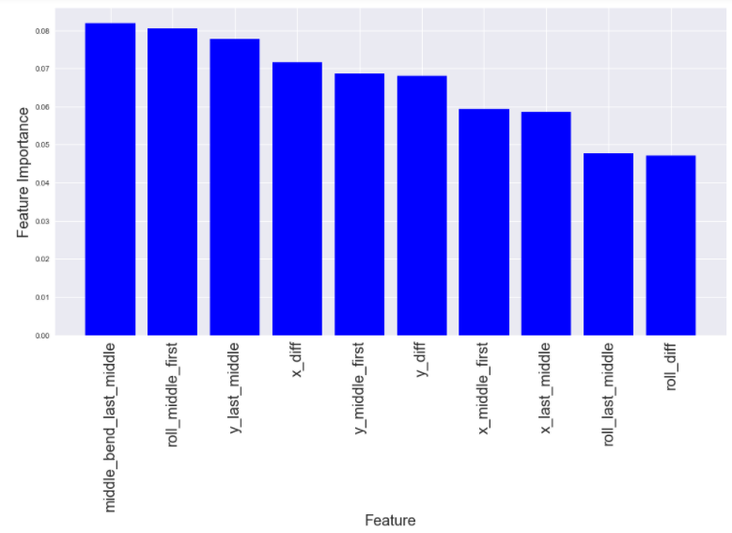
(Harder) Logistic Regression: What vs NOT What (Up Sampling)
Up Sampling:
“Not What” is 173 of 208 records
Sample “What” population to be 173 records
Logistic Regression Grid Search CV Score: 90.2%
Random Forest Grid Search OOB Score: 98.8% (CV 74.3%)
Last – Middle Middle Bend
Middle – First Roll
Last – Middle Y

Slide 10
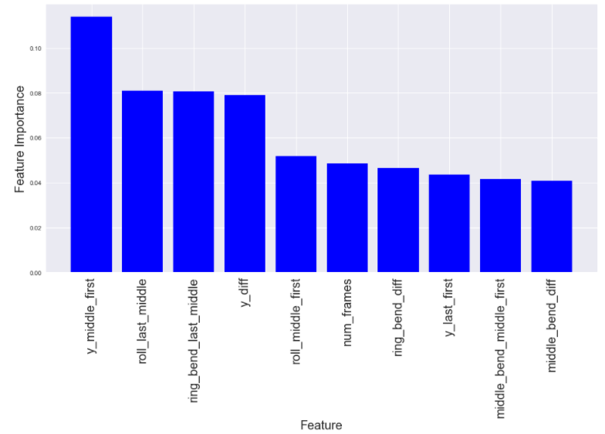
(Harder) Logistic Regression: What vs NOT What (Down Sampling)
Down Sampling:
“What” is 35 of 208 records
Sample to get NOT What to be 35 records
Logistic Regression Grid Search CV Score: 94.3%
Random Forest Grid Search OOB Score: 87.1% (CV 82.9%)
Middle – First Y
Last – Middle Roll
Middle – Last Ring Bend
Down Sampling performs better, but may not be as robust

Slide 11
Findings & Next Steps
Relatively easy (> 95% accuracy) to distinguish between two words
But models are specifically fit to those two words
Not terrible (> 90% accuracy) to distinguish between What and 5 other words
No agreement on important features (due to sample selected?)
Would like to generalize to ability to recognize any word
Neural networks can handle increased complexity

