Slide 1



A novel metric for soft evaluation of event detection performance
Rebecca Salles rebeccapsalles@acm.org
Doctorate in Production Engineering and Systems
CEFET/RJ
Advisor: Eduardo Ogasawara
Co-advisor: Fabio Porto (LNCC)
Research status 2021/03

Slide 2
Event detection metrics
Proposed solution
Short-term publication plan

Slide 3
I. Event detection metrics

Slide 4
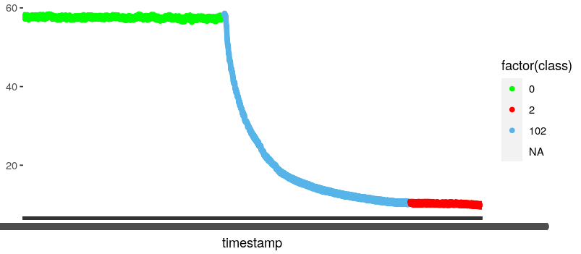
I. Motivation
Traditional classification scoring methods, such as precision and recall, don’t suffice for evaluating online event detection performance.
They do not incorporate time and do not reward early detection.
True positives are rewarded. All other results are “harshly” and equally punished.
penalized
rewarded
Event
Event detection
Early detection
Slightly delayed detection
penalized
penalized
[1] Lavin, A., & Ahmad, S. (2015, December). Evaluating Real-Time Anomaly Detection Algorithms--The Numenta Anomaly Benchmark. In 2015 IEEE 14th International Conference on Machine Learning and Applications (ICMLA) (pp. 38-44). IEEE.
Notes:
We begin by saying that works that involve event detection in time series often need to evaluate the quality of this detections and the performance of the detection method that they have adopted.
It follows that this detection performance evaluation is generally done by traditional classification scoring methods, such as precision and recall.
However, we find that these traditional scoring methods used in classification don’t suffice for evaluating online event detection performance.
In particular, they do not incorporate the concept of time, which is paramount in time series applications, and also, they do not reward early detection.
In practice, these traditional scoring methods only reward true positives, that is, exact matches in event detection. All other results are “harshly” and equally punished.

Slide 5
I. Motivation
Standard classification metrics – true positive (TP), false positive (FP), true negative (TN), and false negative (FN) are not applicable for evaluating detection.
TP are related to an exact match in event detection, which in some cases could be too late.
Not all FP should be equally punished (may be early/delayed detections).
An FN could be produced by an early/delayed detection rather than a fault in detection.
TN should not count for scoring methods.
 |  | Detected events
 |  | TRUE | FALSE
Actual events | TRUE | TP | FN
 | FALSE | FP | TN
[1] Lavin, A., & Ahmad, S. (2015, December). Evaluating Real-Time Anomaly Detection Algorithms--The Numenta Anomaly Benchmark. In 2015 IEEE 14th International Conference on Machine Learning and Applications (ICMLA) (pp. 38-44). IEEE.
Notes:
So, we observe that standard classification metrics generally are not applicable for evaluating detection.

Slide 6
I. State-of-the-art
NAB score [1]
Anomaly window
Application profiles
reward low FPs, and reward low FNs (standard)
greater penalties for FPs
greater penalties for FNs
Scoring function
Critics [2]
Determining anomaly window’s size
Arbitrary (application specific) weights make comparison unfeasible
Gaps in scoring function
Bad-definition
Arbitrary constants
Event position
Detection position
[1] Lavin, A., & Ahmad, S. (2015, December). Evaluating Real-Time Anomaly Detection Algorithms--The Numenta Anomaly Benchmark. In 2015 IEEE 14th International Conference on Machine Learning and Applications (ICMLA) (pp. 38-44). IEEE.
[2] Singh, N., & Olinsky, C. (2017, May). Demystifying Numenta anomaly benchmark. In 2017 International Joint Conference on Neural Networks (IJCNN) (pp. 1570-1577). IEEE.
Notes:
There have been efforts towards addressing this problem and nowadays the state-of-the-art is the NAB score.
It is based on anomaly windows and it was developed for scoring the performance of online event detection methods.
But still, it presents serious problems with arbitrary and altogether bad definitions.

Slide 7
I. Problem definition
In literature, the performance of event detection methods is evaluated mainly by standard classification metrics (hard metrics), which may not be adequate.
The state-of-the-art on scoring real-time anomaly detectors is arbitrary, poorly-defined and, in some cases, not applicable.
How can we obtain theoretically sound metrics that incorporate time tolerance for scoring the performance of online event detection methods?
Notes:
So we still have the problem that…
In literature, the performance of event detection methods is evaluated mainly by standard classification metrics (here we will call them hard metrics), which may not be adequate.
Plus, the state-of-the-art on scoring real-time anomaly detectors is arbitrary, poorly-defined and, in some cases, not applicable.
So we are left with the question…
How can we obtain theoretically sound metrics that incorporate time tolerance for scoring the performance of online event detection methods?

Slide 8
II. Proposed solution
Notes:
Our proposed solution aims at addressing precisely this demand.

Slide 9
II. Proposed solution
New distance-based classification metrics and scoring methods inspired by soft (approximate) computing
Soft computing [1]:
“collection of methodologies, which aim to exploit tolerance for imprecision, uncertainty and partial truth to achieve tractability, robustness and low solution cost. “
Soft computing
Approximate reasoning
Probabilistic models
Multivalued & Fuzzy logics
Hard computing
Symbolic logic reasoning
Numerical modeling
Binary & Crisp logic
[1] Applied Soft Computing - Journal - Elsevier
Notes:
So, as a follow-up of our discussion in the last meeting. We studied our problem and we found that the use of fuzzy logics made sense to some extent, but ultimately it was, in fact, unnecessary.
So we abandoned the idea of the fuzzy logic in favor of a distance-based approach, as it was suggested by Florent in the last meeting.
However, we found that our inspiration for the proposed solution was actually related to soft (or, approximate) computing.
Soft computing can be described as a collection of methodologies, which aim to exploit tolerance for imprecision, uncertainty and partial truth to achieve tractability, robustness and low solution cost.
So our main idea here is to “soften” the standard classification metrics, which may be considered “hard metrics” in order to incorporate time tolerance or imprecision in event detection.

Slide 10
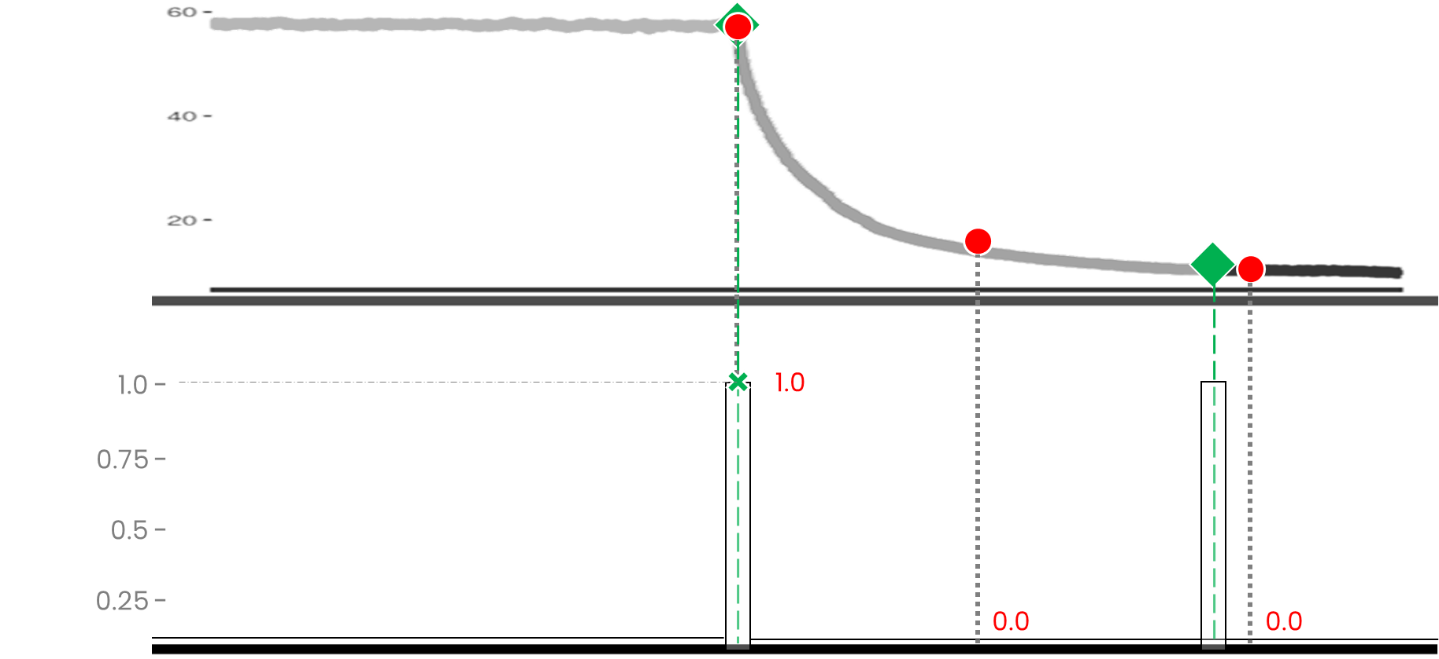
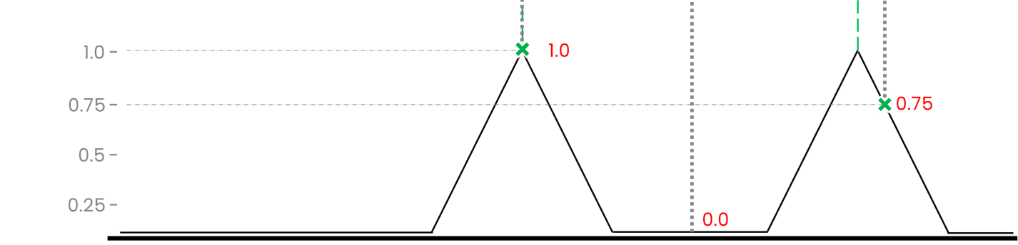
II. Adopting soft (approximate) computing
Time series
Proposed solution:
“Soften” standard classification metrics (“hard” metrics) for event detection
Incorporate distance-based time tolerance
Define membership of an event detection to an event
Hard evaluation
Soft evaluation
Notes:
So in order to “soften” the standard “hard metrics”, incorporate a distance-based time tolerance for event detection.
And this can be done by defining the membership of a particular event detection to an event
The figure gives a general idea of the approach, comparing what would be the standard “hard” evaluation and a “soft” evaluation of the event detections.
In that case, the “hard” evaluation marks if a detection is a match to an event or not. It’s binary.
Whereas the “soft” evaluation marks the degree to which a detection is a member of a particular event.
Now let’s formalize the event membership function.

Slide 11
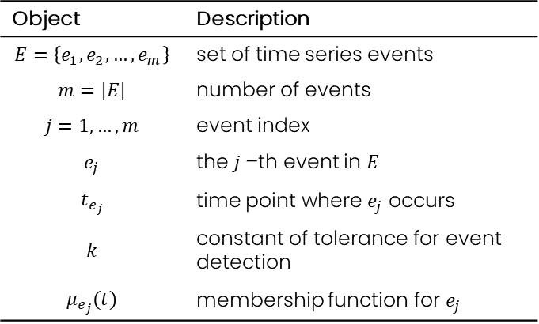





II. Event membership
Membership function for event $e_{j}$
Object | Description
$$E=\left\{e_{1},e_{2},…,e_{m}\right\}$$ | set of time series events
$$m=|E|$$ | number of events
$$j=1,…,m$$ | event index
$$e_{j}$$ | the $j$–th event in $E$
$$t_{e_{j}}$$ | time point where $e_{j}$ occurs
$$k$$ | constant of tolerance for event detection
$$μ_{e_{j}}(t)$$ | membership function for $e_{j}$
1
$$μ_{e_{j}}$$
0
$$time$$
$$t_{e_{j}}−k$$
$$t_{e_{j}}$$
$$t_{e_{j}}+k$$
Notes:
We begin by defining E, m, j, and ej.
The plot gives the membership function for event ej which is defined in time and is given by mu_ej.
mu_ej lies within [0,1].
And the Higher score is given by tej which is the time point where event ej occurs.

Slide 12



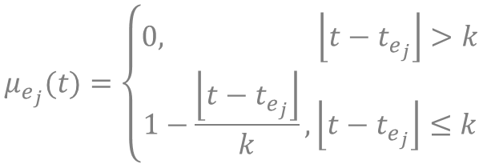

II. Event membership
Membership function for event $e_{j}$
Object | Description
$$E=\left\{e_{1},e_{2},…,e_{m}\right\}$$ | set of time series events
$$m=|E|$$ | number of events
$$j=1,…,m$$ | event index
$$e_{j}$$ | the $j$–th event in $E$
$$t_{e_{j}}$$ | time point where $e_{j}$ occurs
$$k$$ | constant of tolerance for event detection
$$μ_{e_{j}}(t)$$ | membership function for $e_{j}$
1
$$μ_{e_{j}}$$
0
$$time$$
$$t_{e_{j}}−k$$
$$t_{e_{j}}$$
$$t_{e_{j}}+k$$
Euclidean distance-based function
$$μ_{e_{j}}(t)=\left\{\begin{aligned}0, \left\lfloor t−t_{e_{j}}\right\rfloor >k \\ &1−\frac{\left\lfloor t−t_{e_{j}}\right\rfloor }{k}, \left\lfloor t−t_{e_{j}}\right\rfloor ≤k\end{aligned}\right.$$
Notes:
mu_ej is an euclidean distance-based function, which is given by the formula below and translates to a triangular curve as the one you see here.

Slide 13

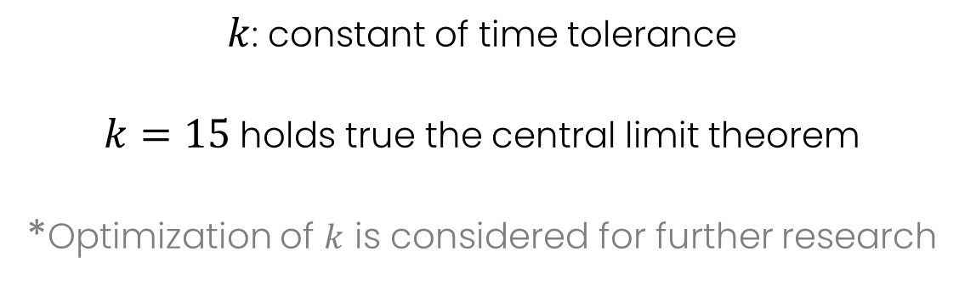
II. Event membership
Membership function for event $e_{j}$
Object | Description
$$E=\left\{e_{1},e_{2},…,e_{m}\right\}$$ | set of time series events
$$m=|E|$$ | number of events
$$j=1,…,m$$ | event index
$$e_{j}$$ | the $j$–th event in $E$
$$t_{e_{j}}$$ | time point where $e_{j}$ occurs
$$k$$ | constant of tolerance for event detection
$$μ_{e_{j}}(t)$$ | membership function for $e_{j}$
1
$$μ_{e_{j}}$$
0
$$time$$
$$t_{e_{j}}−k$$
$$t_{e_{j}}$$
$$t_{e_{j}}+k$$
$k$: constant of time tolerance
$k=15$ holds true the central limit theorem
*Optimization of $k$ is considered for further research
Notes:
The base of the triangle is given by k, a constant of time tolerance for event detection.
Here, we define k as 15 time observations, as it is the minimum value that assures the data sample within the triangle (30) holds true the central limit theorem.
This definition is based on statistical background, however, the optimization of $k$ is considered for further research.
The central limit theorem tells us that no matter what the distribution of the population is, the shape of the sampling distribution will approach normality as the sample size (N) increases.
Sample size equal to or greater than 30 are required for the central limit theorem to hold true.

Slide 14
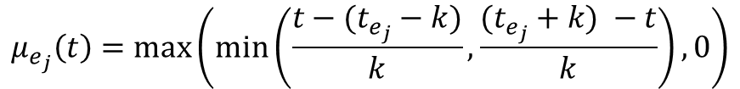
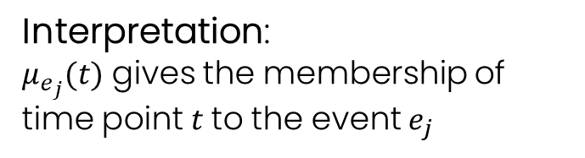
II. Event membership
Object | Description
$$E=\left\{e_{1},e_{2},…,e_{m}\right\}$$ | set of time series events
$$m=|E|$$ | number of events
$$j=1,…,m$$ | event index
$$e_{j}$$ | the $j$–th event in $E$
$$t_{e_{j}}$$ | time point where $e_{j}$ occurs
$$k$$ | constant of tolerance for event detection
$$μ_{e_{j}}(t)$$ | membership function for $e_{j}$
1
$$μ_{e_{j}}$$
0
$$time$$
$$t_{e_{j}}−k$$
$$t_{e_{j}}$$
$$t_{e_{j}}+k$$
Interpretation:
$μ_{e_{j}}(t)$ gives the membership of time point $t$to the event $e_{j}$
$$μ_{e_{j}}\left(t\right)=max⁡\left(min\left(\frac{t−(t_{e_{j}}−k)}{k},\frac{(t_{e_{j}}+k) −t}{k}\right),0\right)$$
Notes:
The rewritten equation for uej is given here.
The interpretation is that uej of t gives the membership of time point $t$to the event $e_{j}$
Now let's talk about the detections.

Slide 15




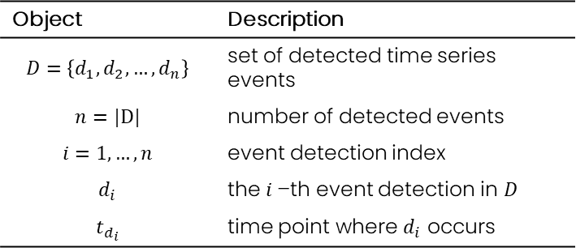



II. Event detections and event membership
1
Object | Description
$$D=\left\{d_{1},d_{2},…,d_{n}\right\}$$ | set of detected time series events
$$n=|D|$$ | number of detected events
$$i=1,…,n$$ | event detection index
$$d_{i}$$ | the $i$–th event detection in $D$
$$t_{d_{i}}$$ | time point where $d_{i}$ occurs
$$μ_{e_{j}}$$
0
$$time$$
$$t_{e_{j}}−k$$
$$t_{e_{j}}$$
$$t_{d_{1}}$$
$$t_{e_{j}}+k$$
$$t_{d_{2}}$$
Notes:
Here we define D, n, i, and di.
Now, in the plot we can see two detections d1 and d2 occurred in the time points td1 and td2 respectively.

Slide 16
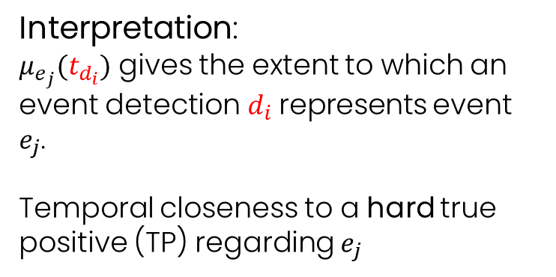
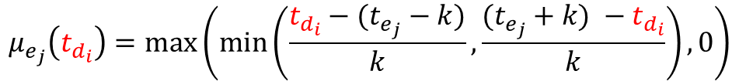



II. Event detections and event membership
$$μ_{e_{j}}\left(t_{d_{1}}\right)=0.7$$
$$μ_{e_{j}}\left(t_{d_{2}}\right)=0$$
1
Object | Description
$$D=\left\{d_{1},d_{2},…,d_{n}\right\}$$ | set of detected time series events
$$n=|D|$$ | number of detected events
$$i=1,…,n$$ | event detection index
$$d_{i}$$ | the $i$–th event detection in $D$
$$t_{d_{i}}$$ | time point where $d_{i}$ occurs
$$μ_{e_{j}}$$
0
$$time$$
$$t_{e_{j}}−k$$
$$t_{e_{j}}$$
$$t_{d_{1}}$$
$$t_{e_{j}}+k$$
$$t_{d_{2}}$$
Interpretation:
$μ_{e_{j}}(t_{d_{i}})$ gives the extent to which an event detection $d_{i}$represents event $e_{j}$.
Temporal closeness to a hard true positive (TP) regarding $e_{j}$
$$μ_{e_{j}}\left(t_{d_{i}}\right)=max⁡\left(min\left(\frac{t_{d_{i}}−(t_{e_{j}}−k)}{k},\frac{(t_{e_{j}}+k) −t_{d_{i}}}{k}\right),0\right)$$
Notes:
We have that uej evaluated in td1 and td2, based on its equation below, gives 0.7 and 0, respectively.
The interpretation here is that $μ_{e_{j}}(t_{d_{i}})$ gives the extent to which an event detection $d_{i}$represents event $e_{j}$.
Or you can interpret it as the temporal closeness to a hard true positive (TP) regarding $e_{j}$
In that case, detection d1 is closer to a true positive and d2 would be as far as possible and could be considered a false positive, for example.
Now, for this approach to make sense in practical applications we need to define some constraints.

Slide 17
II. Hard integrity constraints
Hold valid concepts applicable to traditional (hard) metrics.
Assure quality metrics hold the same semantics as their hard correspondents.
Maintain reference to the perfect performance and indicate how close a detection method came to it.
Notes:
These constraints are necessary for maintaining integrity with regard to the standard hard metrics.
In particular, in our approach we want to hold valid the concepts applicable to traditional (hard) metrics.
We want to assure quality metrics hold the same semantics as their hard correspondents.
And we want mainly to maintain the reference to the perfect performance (as we have with hard metrics) and indicate how close a detection method came to it.

Slide 18
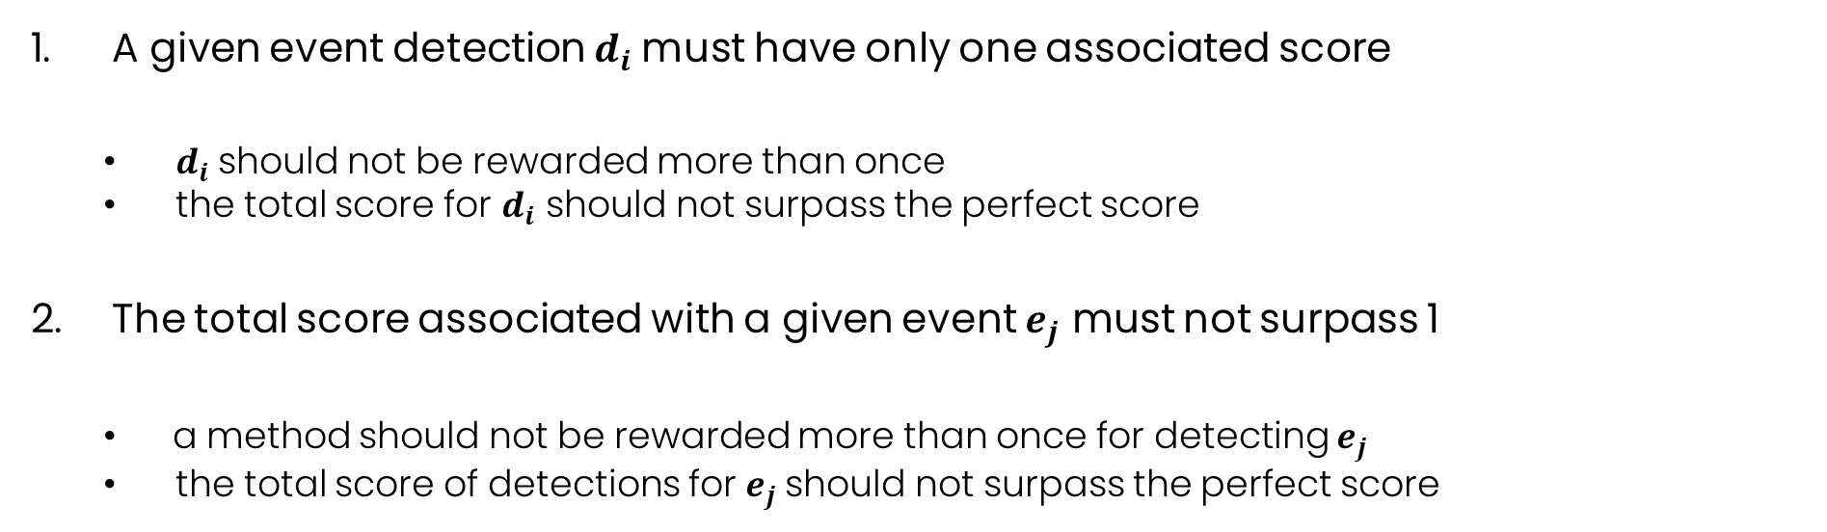
II. Hard integrity constraints
A given event detection $d_{i}$must have only one associated score
$d_{i}$should not be rewarded more than once
the total score for $d_{i}$ should not surpass the perfect score
The total score associated with a given event $e_{j}$ must not surpass 1
a method should not be rewarded more than once for detecting $e_{j}$
the total score of detections for $e_{j}$should not surpass the perfect score

Slide 19




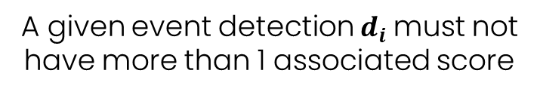




II. Hard integrity constraints
$$μ_{e_{1}}$$
$$μ_{e_{2}}$$
$$μ_{e_{3}}$$
1
0
$$time$$
$$t_{e_{1}}$$
$$t_{d_{1}}$$
$$t_{e_{2}}$$
$$t_{e_{3}}$$
Scenario: one detection, many events
A given event detection $d_{i}$must not have more than 1 associated score
Notes:
For example, take this first scenario in which we have one detection and many events.
Explain plot.
Td1 would have three fuzzy membership scores regarding ue1, ue2 and ue3 of events e1, e2, and e3, respectively.
But in order to maintain integrity with crisp metrics, a given event detection $d_{i}$must not have more than 1 associated score.
Otherwise, the detection d1 would be rewarded three times.
The total score for d1 could even surpass the score of a perfect match which would be 1.
In order to address this issue we could adopt the following approach.

Slide 20





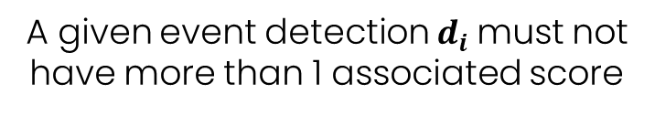








II. Hard integrity constraints
$$μ_{e_{1}}$$
$$μ_{e_{2}}$$
$$μ_{e_{3}}$$
1
Solution:
$$μ_{e_{1}}\left(t_{d_{1}}\right)=0.8$$
$$μ_{e_{2}}\left(t_{d_{1}}\right)=0.7$$
$$max$$
0
$$μ_{e_{3}}\left(t_{d_{1}}\right)=0.1$$
$$time$$
$$t_{e_{1}}$$
$$t_{d_{1}}$$
$$t_{e_{2}}$$
$$t_{e_{3}}$$
Scenario: one detection, many events
$d_{1}$is most associated with $e_{1}$
A given event detection $d_{i}$must not have more than 1 associated score
Notes:
We could select the maximum score of d1 among all events.
Ue1(td1) gives the max score of 0.8, which is given by the fuzzy membership of the class of event e1.
$d_{1}$is most associated with fuzzy class $e_{1}$ with membership score of $0.8$
This approach for addressing this first constraint gives us the first phase of our proposed solution.

Slide 21
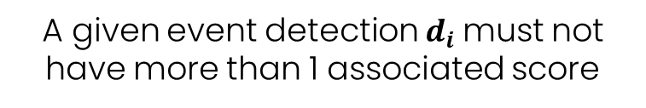
II. Hard integrity constraints
$$μ_{e_{1}}$$
$$μ_{e_{2}}$$
$$μ_{e_{3}}$$
1
Solution:
$$μ_{e_{1}}\left(t_{d_{1}}\right)=0.8$$
$$μ_{e_{2}}\left(t_{d_{1}}\right)=0.7$$
$$max$$
0
$$μ_{e_{3}}\left(t_{d_{1}}\right)=0.1$$
$$time$$
$$t_{e_{1}}$$
$$t_{d_{1}}$$
$$t_{e_{2}}$$
$$t_{e_{3}}$$
Scenario: one detection, many events
$d_{1}$is most associated with $e_{1}$
A given event detection $d_{i}$must not have more than 1 associated score
Distance-based attribution
Avoid optimization problem for each detection
Notes:
We could select the maximum score of d1 among all events.
Ue1(td1) gives the max score of 0.8, which is given by the fuzzy membership of the class of event e1.
$d_{1}$is most associated with fuzzy class $e_{1}$ with membership score of $0.8$
This approach for addressing this first constraint gives us the first phase of our proposed solution.

Slide 22

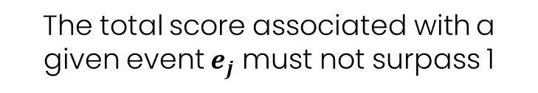






II. Hard integrity constraints
1
$$μ_{e_{1}}$$
0
$$time$$
$$t_{e_{1}}$$
$$t_{d_{1}}$$
$$t_{d_{2}}$$
$$t_{d_{3}}$$
$$t_{d_{4}}$$
Scenario: one event, many detections
The total score associated with a given event $e_{j}$ must not surpass 1
Notes:
But in order to maintain integrity with crisp metrics, the total score associated with a given event $e_{j}$ must not surpass 1.
Otherwise, an event detection method would be rewarded three times for detecting the same event.
The total score for detections associated with e1 could even surpass the score of a perfect match which would be 1.
In order to address this issue we could adopt the following approach.

Slide 23
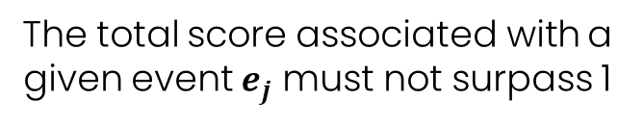

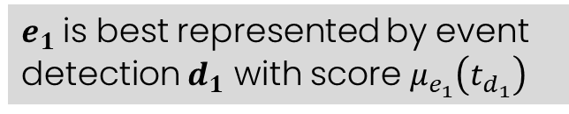











II. Hard integrity constraints
Solution:
1
$$μ_{e_{1}}\left(t_{d_{1}}\right)=0.7$$
$$μ_{e_{1}}\left(t_{d_{2}}\right)=0.5$$
$$max$$
$$μ_{e_{1}}$$
$$μ_{e_{1}}\left(t_{d_{3}}\right)=0.3$$
0
$$μ_{e_{1}}\left(t_{d_{4}}\right)=0.0$$
$$time$$
$$t_{e_{1}}$$
$$t_{d_{1}}$$
$$t_{d_{2}}$$
$$t_{d_{3}}$$
$$t_{d_{4}}$$
$e_{1}$is best represented by event detection $d_{1}$ with score $μ_{e_{1}}\left(t_{d_{1}}\right)$
Scenario: one event, many detections
The total score associated with a given event $e_{j}$ must not surpass 1
Notes:
We could select the maximum score of ue1 among all detections associated with e1.
Ue1(td1) gives the max score of 0.7, which is given by the fuzzy membership of the detection d1.
$e_{1}$is best represented by event detection $d_{1}$ with membership score of $0.7$
This approach for addressing this second constraint gives us the second phase of our proposed solution.

Slide 24
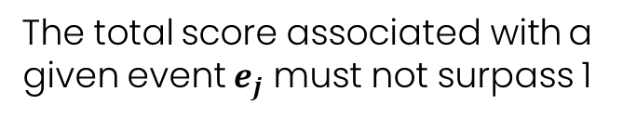

II. Hard integrity constraints
Solution:
1
$$μ_{e_{1}}\left(t_{d_{1}}\right)=0.7$$
$$μ_{e_{1}}\left(t_{d_{2}}\right)=0.5$$
$$max$$
$$μ_{e_{1}}$$
$$μ_{e_{1}}\left(t_{d_{3}}\right)=0.3$$
0
$$μ_{e_{1}}\left(t_{d_{4}}\right)=0.0$$
$$time$$
$$t_{e_{1}}$$
$$t_{d_{1}}$$
$$t_{d_{2}}$$
$$t_{d_{3}}$$
$$t_{d_{4}}$$
$e_{1}$is best represented by event detection $d_{1}$ with score $μ_{e_{1}}\left(t_{d_{1}}\right)$
Scenario: one event, many detections
The total score associated with a given event $e_{j}$ must not surpass 1
Distance-based attribution
Avoid optimization problem for each event
Notes:
We could select the maximum score of ue1 among all detections associated with e1.
Ue1(td1) gives the max score of 0.7, which is given by the fuzzy membership of the detection d1.
$e_{1}$is best represented by event detection $d_{1}$ with membership score of $0.7$
This approach for addressing this second constraint gives us the second phase of our proposed solution.

Slide 25
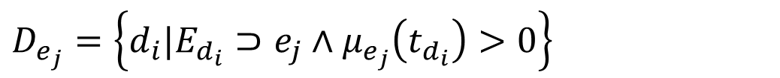
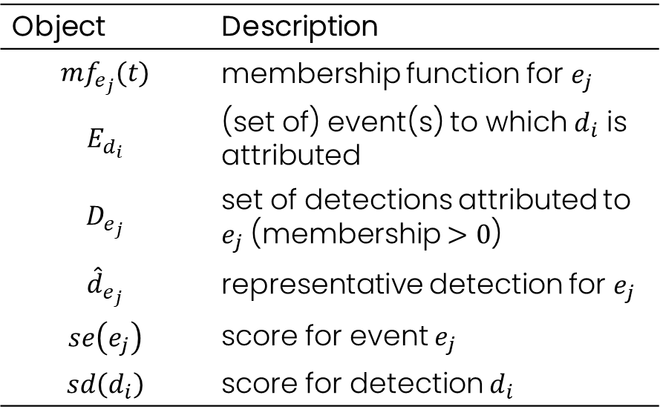
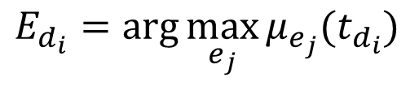
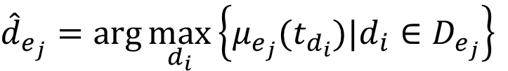
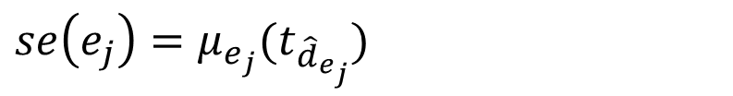
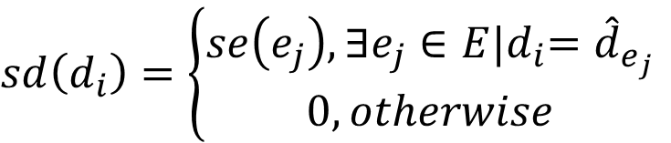
II. Proposed solution
$$E_{d_{i}}=arg\max_{e_{j}}{μ_{e_{j}}(t_{d_{i}})}$$
$$D_{e_{j}}=\left\{d_{i}|E_{d_{i}}⊃e_{j}∧μ_{e_{j}}\left(t_{d_{i}}\right)>0\right\}$$
Object | Description
$${mf}_{e_{j}}(t)$$ | membership function for $e_{j}$
$$E_{d_{i}}$$ | (set of) event(s) to which $d_{i}$ is attributed
$$D_{e_{j}}$$ | set of detections attributed to $e_{j}$ (membership $>0$)
$${\hat{d}}_{e_{j}}$$ | representative detection for $e_{j}$
$$se\left(e_{j}\right)$$ | score for event $e_{j}$
$$sd\left(d_{i}\right)$$ | score for detection $d_{i}$
$${\hat{d}}_{e_{j}}=arg\max_{d_{i}}\left\{μ_{e_{j}}(t_{d_{i}})|d_{i}∈D_{e_{j}}\right\}$$
$$se\left(e_{j}\right)=μ_{e_{j}}(t_{{\hat{d}}_{e_{j}}})$$
$$sd\left(d_{i}\right)=\left\{\begin{aligned}se\left(e_{j}\right),{∃e_{j}∈E|d}_{i}={\hat{d}}_{e_{j}} \\ &0,otherwise\end{aligned}\right.$$

Slide 26
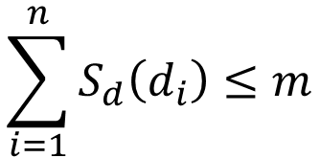

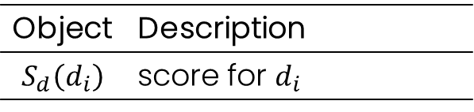


II. Proposed solution
1
$$S_{d}\left(d_{i}\right)$$
$$\sum_{i=1}^{n}{S_{d}\left(d_{i}\right)≤m}$$
0
1
n
$$i$$
$$S_{d}\left(d_{i}\right)=max\left\{S_{e}\left(e_{j}\right)|{\hat{d}}_{e_{j}}=d_{i}, 0\right\}$$
Object | Description
$$S_{d}\left(d_{i}\right)$$ | score for $d_{i}$

Slide 27
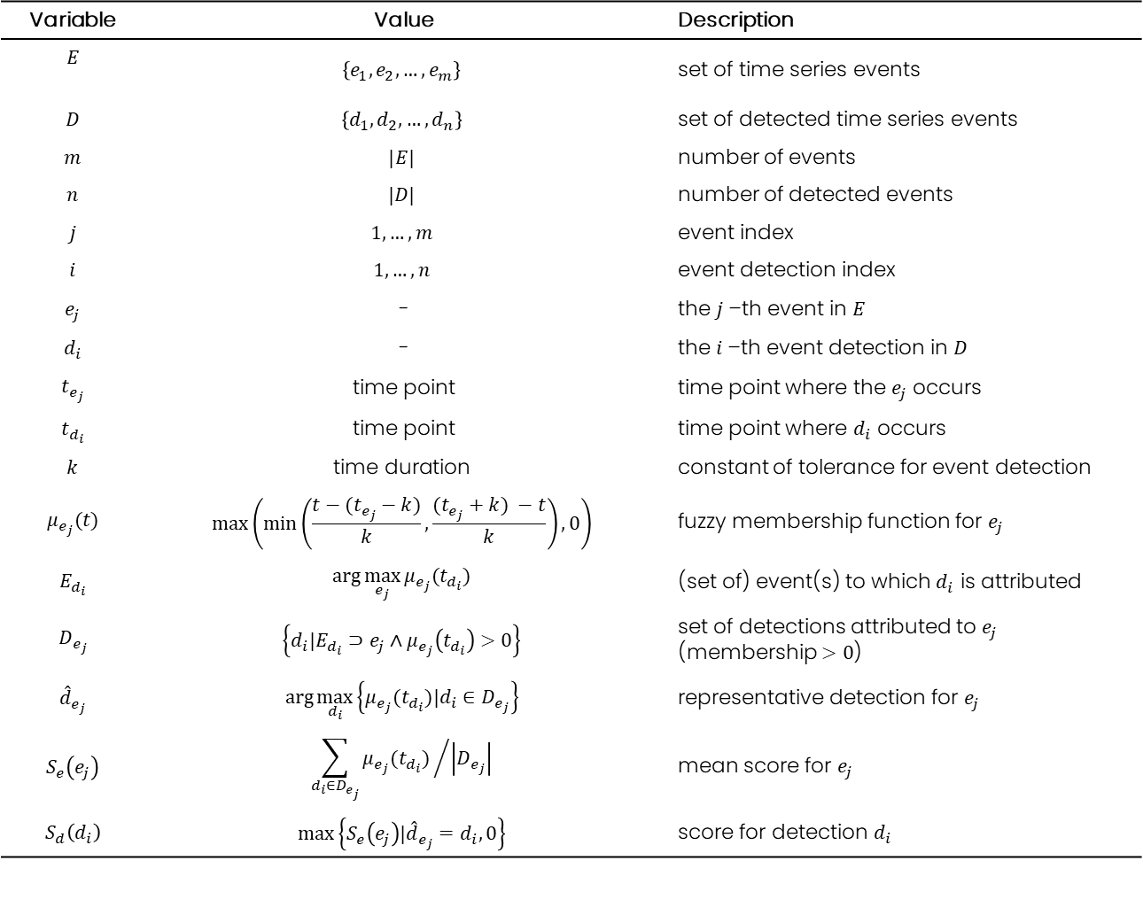
II. Summary of formalization
Variable | Value | Description
$$E$$ | $$\left\{e_{1},e_{2},…,e_{m}\right\}$$ | set of time series events
$$D$$ | $$\left\{d_{1},d_{2},…,d_{n}\right\}$$ | set of detected time series events
$$m$$ | $$|E|$$ | number of events
$$n$$ | $$|D|$$ | number of detected events
$$j$$ | $$1,…,m$$ | event index
$$i$$ | $$1,…,n$$ | event detection index
$$e_{j}$$ | - | the $j$–th event in $E$
$$d_{i}$$ | - | the $i$–th event detection in $D$
$$t_{e_{j}}$$ | time point | time point where the $e_{j}$ occurs
$$t_{d_{i}}$$ | time point | time point where $d_{i}$ occurs
$$k$$ | $$\text{time} \text{duration}$$ | constant of tolerance for event detection
$$μ_{e_{j}}(t)$$ | $$max\left(min\left(\frac{t−(t_{e_{j}}−k)}{k},\frac{(t_{e_{j}}+k) −t}{k}\right),0\right)$$ | fuzzy membership function for $e_{j}$
$$E_{d_{i}}$$ | $$arg\max_{e_{j}}{μ_{e_{j}}(t_{d_{i}})}$$ | (set of) event(s) to which $d_{i}$ is attributed
$$D_{e_{j}}$$ | $$\left\{d_{i}|E_{d_{i}}⊃e_{j}∧μ_{e_{j}}\left(t_{d_{i}}\right)>0\right\}$$ | set of detections attributed to $e_{j}$ (membership $>0$)
$${\hat{d}}_{e_{j}}$$ | $$arg\max_{d_{i}}\left\{μ_{e_{j}}(t_{d_{i}})|d_{i}∈D_{e_{j}}\right\}$$ | representative detection for $e_{j}$
$$S_{e}\left(e_{j}\right)$$ | $${\sum_{d_{i}∈D_{e_{j}}}{μ_{e_{j}}(t_{d_{i}}) }}/{\left|D_{e_{j}}\right|}$$ | mean score for $e_{j}$
$$S_{d}\left(d_{i}\right)$$ | $$max\left\{S_{e}\left(e_{j}\right)|{\hat{d}}_{e_{j}}=d_{i}, 0\right\}$$ | score for detection $d_{i}$

Slide 28
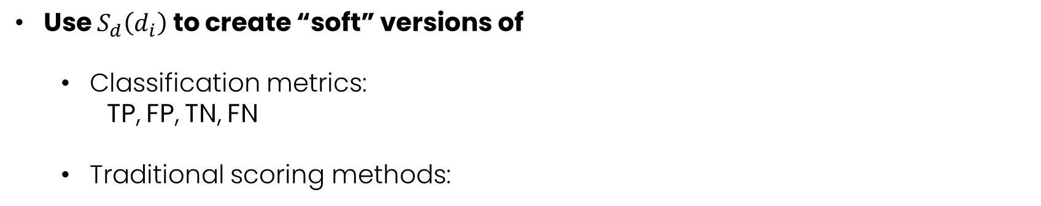
II. Next
Use $S_{d}\left(d_{i}\right)$ to create “soft” versions of
Classification metrics:
TP, FP, TN, FN
Traditional scoring methods:
sensitivity,
specificity,
positive predictive value,
negative predictive value,
precision,
recall,
F1,
prevalence,
detection rate,
detection prevalence and balanced accuracy

Slide 29
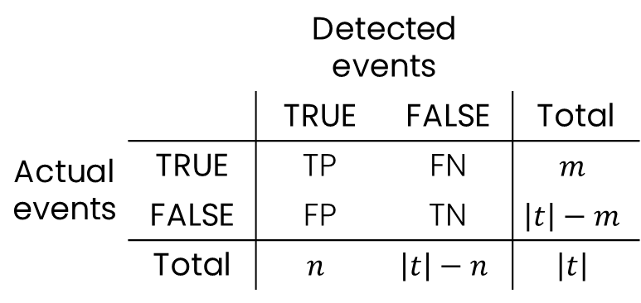
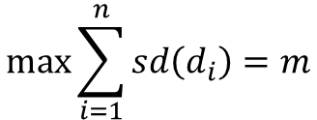
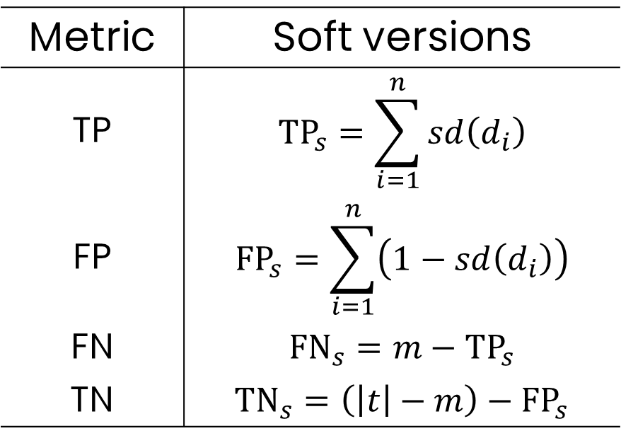


II. Classification metrics
 |  | Detected events
 |  | TRUE | FALSE | Total
Actual events | TRUE | TP | FN | $$m$$
 | FALSE | FP | TN | $$\left|t\right|−m$$
 | Total | $$n$$ | $$\left|t\right|−n$$ | $$\left|t\right|$$
Metric | Soft versions
TP | $${TP}_{s}=\sum_{i=1}^{n}{sd\left(d_{i}\right)}$$
FP | $${FP}_{s}=\sum_{i=1}^{n}{\left(1−sd\left(d_{i}\right)\right)}$$
FN | $${FN}_{s}=m−{TP}_{s}$$
TN | $${TN}_{s}=\left(\left|t\right|−m\right)−{FP}_{s}$$
1
$$S_{d}\left(d_{i}\right)$$
0
1
n
$$i$$
$$max\sum_{i=1}^{n}{sd\left(d_{i}\right)=m}$$

Slide 30
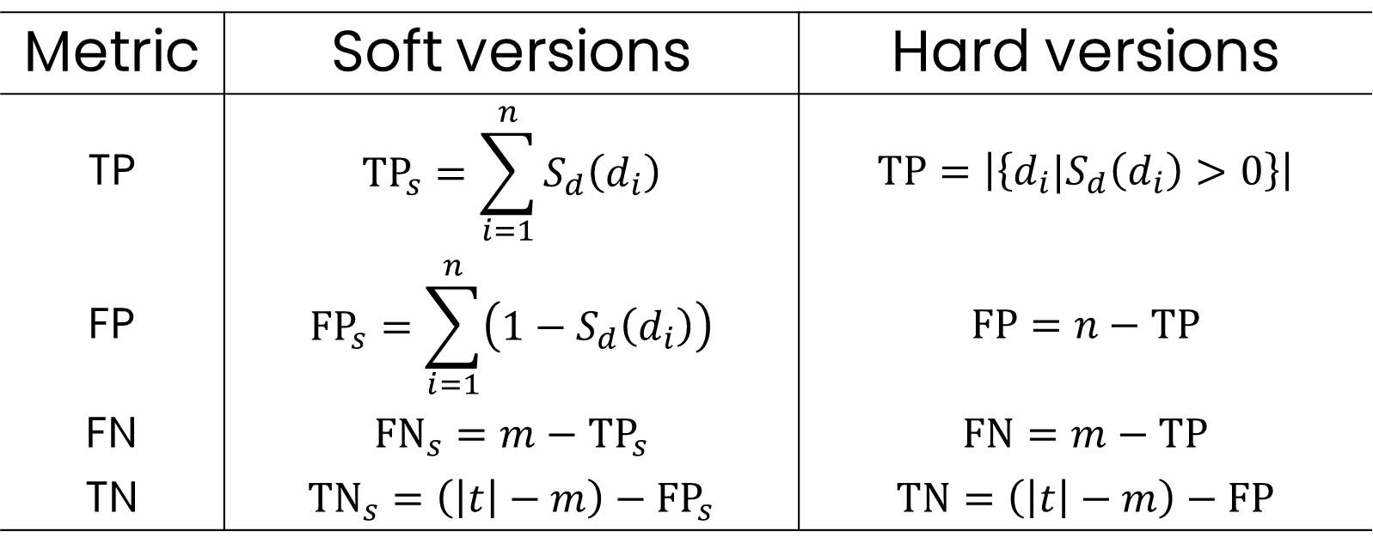
II. Classification metrics
Metric | Soft versions | Hard versions
TP | $${TP}_{s}=\sum_{i=1}^{n}{S_{d}\left(d_{i}\right)}$$ | $$TP=\left|\left\{d_{i}|S_{d}\left(d_{i}\right)>0\right\}\right|$$
FP | $${FP}_{s}=\sum_{i=1}^{n}{\left(1−S_{d}\left(d_{i}\right)\right)}$$ | $$FP=n−TP$$
FN | $${FN}_{s}=m−{TP}_{s}$$ | $$FN=m−TP$$
TN | $${TN}_{s}=\left(\left|t\right|−m\right)−{FP}_{s}$$ | $$TN=\left(\left|t\right|−m\right)−FP$$

Slide 31
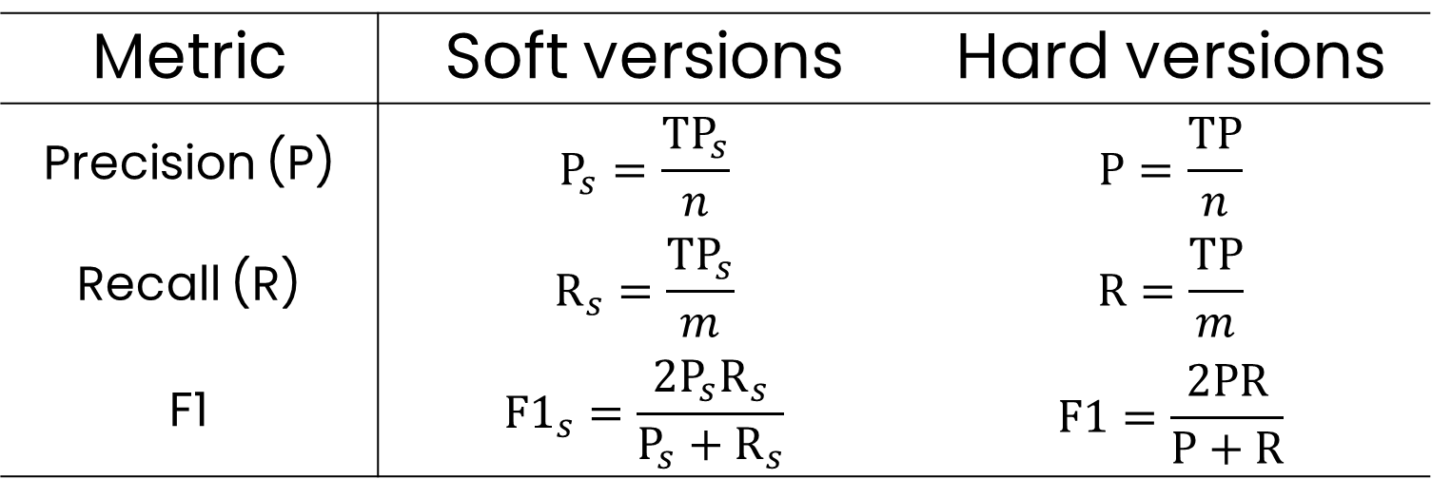
II. Scoring methods
Metric | Soft versions | Hard versions
Precision (P) | $$P_{s}=\frac{{TP}_{s}}{n}$$ | $$P=\frac{TP}{n}$$
Recall (R) | $$R_{s}=\frac{{TP}_{s}}{m}$$ | $$R=\frac{TP}{m}$$
F1 | $${F1}_{s}=\frac{2P_{s}R_{s}}{P_{s}+R_{s}}$$ | $$F1=\frac{2PR}{P+R}$$

Slide 32
III. Research and Publication Plan

Slide 33
III. Short-term Plan
Ongoing research paper:
A novel metric for soft evaluation of event detection performance
Journal: Applied Soft Computing
Submission goal: 2021/04
Scope & Main Contributions
Motivation: Online detection
Methodology: Soft evaluation metric
Experiment scope:
Application to the WaterQuality, NAB, YahooLabs
Compare to NAB score and hard metrics
Notes:
Plano B: Applied Soft Computing (Applied Soft Computing - Journal – Elsevier)
Applied Soft Computing
Knowledge Based Systems
Future Generation Computer Systems

Slide 34
References
E. Calikus, S. Nowaczyk, A. Sant’Anna, and O. Dikmen. No free lunch but a cheaper supper: A general framework for streaming anomaly detection. Expert Systems with Applications, 155:113453, October 2020. ISSN 0957-4174.
R. Carmona. Statistical Analysis of Financial Data in R. Springer-Verlag New York, 2014.
H. Chen and N. Zhang. Graph-based change-point detection. The Annals of Statistics, 43(1):139–176, February 2015. ISSN 0090-5364.
D. De Paepe, S. V. Hautte, B. Steenwinckel, F. De Turck, F. Ongenae, O. Janssens, and S. V. Hoecke. A generalized matrix profile framework with support for contextual series analysis. Engineering Applications of Artificial Intelligence, 90, 2020. ISSN 0952-1976.
B. Eriksson, P. Barford, R. Bowden, N. Duffield, J. Sommers, and M. Roughan. Basisdetect: A model-based network event detection framework. In Proceedings of the 10th ACM SIGCOMM, page 451–464, New York, NY, USA, 2010. Association for Computing Machinery.
M. Gupta, J. Gao, C. Aggarwal, and J. Han. Outlier Detection for Temporal Data: A Survey. IEEE Transactions on Knowledge and Data Engineering, 2014. ISSN 1041-4347.
V. Guralnik and J. Srivastava. Event Detection from Time Series Data. In Proceedings of the Fifth ACM SIGKDD, KDD ’99, pages 33–42, New York, NY, USA, 1999. ACM. ISBN 978-1-58113-143-7.
G. Lu, Y. Zhou, C. Lu, and X. Li. A novel framework of change-point detection for machine monitoring. Mechanical Systems and Signal Processing, 83, 07 2016.
H. Raza, G. Prasad, and Y. Li. EWMA Model Based Shift-Detection Methods for Detecting Covariate Shifts in Non-Stationary Environments. Pattern Recogn., 48(3):659–669, March 2015. ISSN 0031-3203.
F. Rehbach, S. Moritz, S. Chandrasekaran, M. Rebolledo, M. Friese, and T. Bartz-Beielstein. GECCO 2018 Industrial Challenge: Monitoring of drinking-water quality. pages 1–7, 2018.
R. Salles, K. Belloze, F. Porto, P.H. Gonzalez, and E. Ogasawara. Nonstationary time series transformation methods: An experimental review. Knowledge-Based Systems, 164:274–291, 2019.
D. Silva, A. Simões, C. Cardoso, D. E. M. Oliveira, Y. Souto, L. E. G. Vignoli, R. Salles, H. S. C. Jr, A. Ziviani, E. Ogasawara, F. C. Delicato, P. F. Pires, H. L. C. P. Pinto, L. Maia, and F. Porto. A conceptual vision toward the management of machine learning models. In Proceedings of the ER Forum 2019, Salvador, Bahia, Brazil, volume 2469, pages 15–27, 2019.
J.-I. Takeuchi and K. Yamanishi. A unifying framework for detecting outliers and change points from time series. IEEE Transactions on Knowledge and Data Engineering, 18(4):482–492, 2006.
P. D. Talagala, R. J. Hyndman, K. Smith-Miles, S. Kandanaarachchi, and M. Muñoz. Anomaly Detection in Streaming Nonstationary Temporal Data. Journal of Computational and Graphical Statistics, 29(1):13–27, 2020.
Yahoo! Webscope. Labeled anomaly detection dataset. March 2015.
L. Xiong, C. Jiang, C. Xu, K. Yu, and S. Guo. A framework of change-point detection for multivariate hydrological series. Water Resources Research, 51, 09 2015.
Lavin, A., & Ahmad, S. (2015, December). Evaluating Real-Time Anomaly Detection Algorithms--The Numenta Anomaly Benchmark. In 2015 IEEE 14th International Conference on Machine Learning and Applications (ICMLA) (pp. 38-44). IEEE.

Slide 35
A novel metric for soft evaluation of event detection performance
Rebecca Salles rebeccapsalles@acm.org
Doctorate in Production Engineering and Systems
CEFET/RJ
Advisor: Eduardo Ogasawara
Co-advisor: Fabio Porto (LNCC)
Research status 2021/03

Slide 36




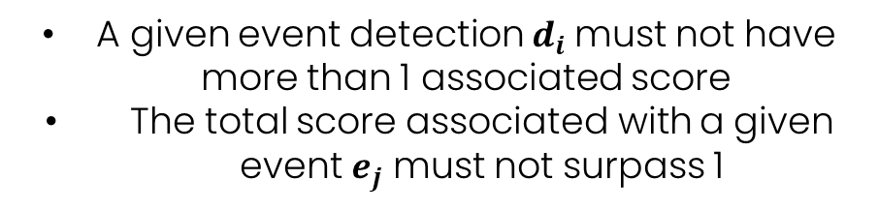









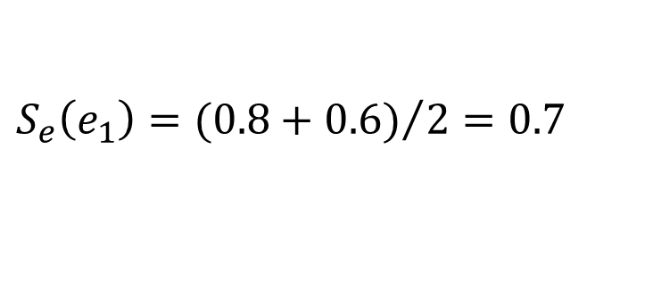









II. Hard integrity constraints - Discussion
$$μ_{e_{1}}\left(t_{d_{1}}\right)=0.8$$
$$μ_{e_{1}}\left(t_{d_{2}}\right)=0.6$$
$$μ_{e_{1}}$$
$$μ_{e_{2}}$$
$$μ_{e_{2}}\left(t_{d_{1}}\right)=0.2$$
$$μ_{e_{2}}\left(t_{d_{2}}\right)=0.4$$
1
Proposed Solution:
$$E_{d_{1}}=e_{1}$$
$$E_{d_{2}}=e_{1}$$
$$μ_{e_{1}}$$
$$μ_{e_{2}}$$
0
$$D_{e_{1}}=\{d_{1},d_{2}\}$$
$$D_{e_{2}}=\{\}$$
$$time$$
$${\hat{d}}_{e_{1}}=d_{1}$$
$${\hat{d}}_{e_{2}}=\{\}$$
$$t_{e_{1}}$$
$$t_{d_{1}}$$
$$t_{d_{2}}$$
$$S_{e}\left(e_{1}\right)={(0.8+0.6)}/{2=0.7}$$
Scenario: tied scores
$$S_{e}\left(e_{2}\right)=N/A$$
A given event detection $d_{i}$must not have more than 1 associated score
The total score associated with a given event $e_{j}$ must not surpass 1
$$S_{d}\left(d_{1}\right)=S_{e}\left(e_{1}\right)=0.7$$
$$S_{d}\left(d_{2}\right)=0$$
$${TP}_{s}=0.7$$
Notes:
We could select the maximum score of ue1 among all detections associated with e1.
Ue1(td1) gives the max score of 0.7, which is given by the fuzzy membership of the detection d1.
$e_{1}$is best represented by event detection $d_{1}$ with membership score of $0.7$
This approach for addressing this second constraint gives us the second phase of our proposed solution.

Slide 37


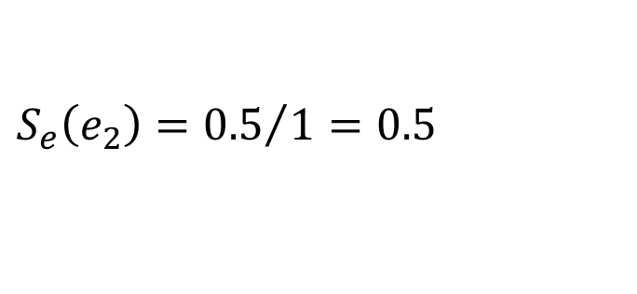


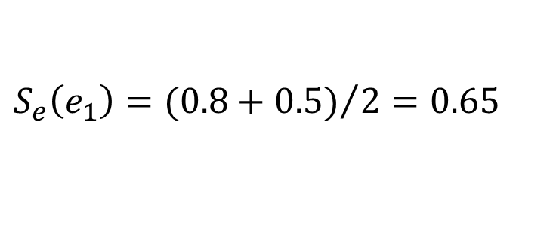








II. Hard integrity constraints - Discussion
$$μ_{e_{1}}\left(t_{d_{1}}\right)=0.8$$
$$μ_{e_{1}}\left(t_{d_{2}}\right)=0.5$$
$$μ_{e_{1}}$$
$$μ_{e_{2}}$$
$$μ_{e_{2}}\left(t_{d_{1}}\right)=0.2$$
$$μ_{e_{2}}\left(t_{d_{2}}\right)=0.5$$
1
We have a tie!
Proposed Solution:
Proposed Solution:
$$E_{d_{1}}=e_{1}$$
$$E_{d_{2}}=\{e_{1},e_{2}\}$$
$$μ_{e_{1}}$$
$$μ_{e_{2}}$$
0
$$D_{e_{1}}=\{d_{1},d_{2}\}$$
$$D_{e_{2}}=\{d_{2}\}$$
$$time$$
$${\hat{d}}_{e_{1}}=d_{1}$$
$${\hat{d}}_{e_{2}}=d_{2}$$
$$t_{e_{1}}$$
$$t_{d_{1}}$$
$$t_{d_{2}}$$
$$S_{e}\left(e_{1}\right)={(0.8+0.5)}/{2=0.65}$$
Scenario: tied scores
$$S_{e}\left(e_{2}\right)={0.5}/{1=0.5}$$
A given event detection $d_{i}$must not have more than 1 associated score
The total score associated with a given event $e_{j}$ must not surpass 1
$$S_{d}\left(d_{1}\right)=S_{e}\left(e_{1}\right)=0.65$$
$$S_{d}\left(d_{2}\right)=S_{e}\left(e_{2}\right)=0.5$$
$${TP}_{s}=1.15$$
Notes:
We could select the maximum score of ue1 among all detections associated with e1.
Ue1(td1) gives the max score of 0.7, which is given by the fuzzy membership of the detection d1.
$e_{1}$is best represented by event detection $d_{1}$ with membership score of $0.7$
This approach for addressing this second constraint gives us the second phase of our proposed solution.

Slide 38


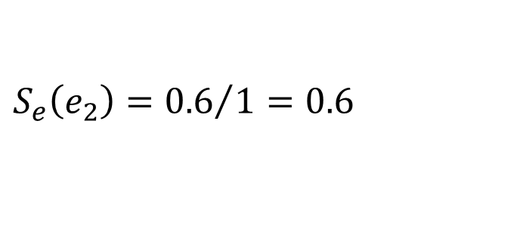


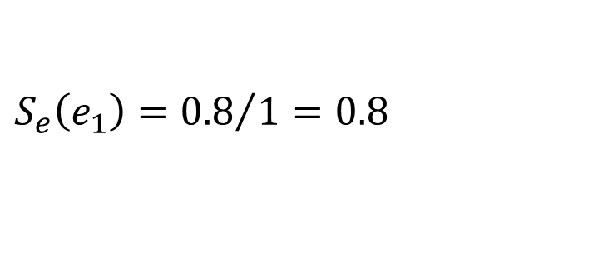








II. Hard integrity constraints - Discussion
$$μ_{e_{1}}\left(t_{d_{1}}\right)=0.8$$
$$μ_{e_{1}}\left(t_{d_{2}}\right)=0.4$$
$$μ_{e_{1}}$$
$$μ_{e_{2}}$$
$$μ_{e_{2}}\left(t_{d_{1}}\right)=0.2$$
$$μ_{e_{2}}\left(t_{d_{2}}\right)=0.6$$
1
Proposed Solution:
$$E_{d_{1}}=e_{1}$$
$$E_{d_{2}}=e_{2}$$
$$μ_{e_{1}}$$
$$μ_{e_{2}}$$
0
$$D_{e_{1}}=\{d_{1}\}$$
$$D_{e_{2}}=\{d_{2}\}$$
$$time$$
$${\hat{d}}_{e_{1}}=d_{1}$$
$${\hat{d}}_{e_{2}}=d_{2}$$
$$t_{e_{1}}$$
$$t_{d_{1}}$$
$$t_{d_{2}}$$
$$S_{e}\left(e_{1}\right)={0.8}/{1=0.8}$$
Scenario: tied scores
$$S_{e}\left(e_{2}\right)={0.6}/{1=0.6}$$
A given event detection $d_{i}$must not have more than 1 associated score
The total score associated with a given event $e_{j}$ must not surpass 1
$$S_{d}\left(d_{1}\right)=S_{e}\left(e_{1}\right)=0.8$$
$$S_{d}\left(d_{2}\right)=S_{e}\left(e_{2}\right)=0.6$$
$${TP}_{s}=1.4$$
Notes:
We could select the maximum score of ue1 among all detections associated with e1.
Ue1(td1) gives the max score of 0.7, which is given by the fuzzy membership of the detection d1.
$e_{1}$is best represented by event detection $d_{1}$ with membership score of $0.7$
This approach for addressing this second constraint gives us the second phase of our proposed solution.

Slide 39


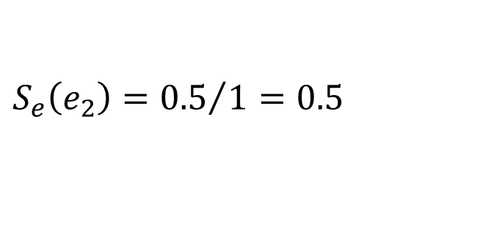



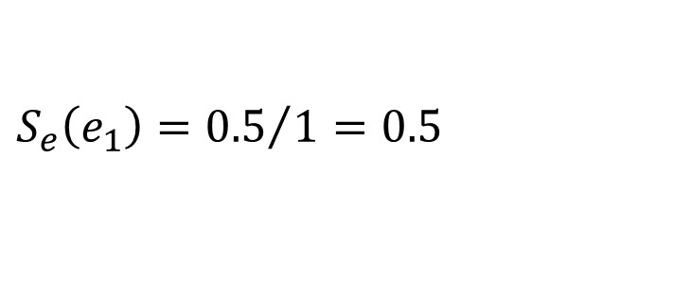




II. Hard integrity constraints - Discussion
$$μ_{e_{1}}\left(t_{d_{1}}\right)=0.5$$
$$μ_{e_{2}}\left(t_{d_{1}}\right)=0.5$$
$$μ_{e_{1}}$$
$$μ_{e_{2}}$$
We have a tie!
1
Proposed Solution:
Proposed Solution:
$$E_{d_{1}}=\{e_{1},e_{2}\}$$
$$μ_{e_{1}}$$
$$μ_{e_{2}}$$
0
$$D_{e_{1}}=\{d_{1}\}$$
$$D_{e_{2}}=\{d_{1}\}$$
$$time$$
$${\hat{d}}_{e_{1}}=1$$
$${\hat{d}}_{e_{2}}=1$$
$$t_{e_{1}}$$
$$t_{d_{1}}$$
$$S_{e}\left(e_{1}\right)={0.5}/{1=0.5}$$
Scenario: tied scores
$$S_{e}\left(e_{2}\right)={0.5}/{1=0.5}$$
A given event detection $d_{i}$must not have more than 1 associated score
The total score associated with a given event $e_{j}$ must not surpass 1
$$S_{d}\left(d_{1}\right)=max⁡(S_{e}\left(e_{1}\right),S_{e}\left(e_{2}\right))=0.5$$
$${TP}_{s}=0. 5$$
Notes:
We could select the maximum score of ue1 among all detections associated with e1.
Ue1(td1) gives the max score of 0.7, which is given by the fuzzy membership of the detection d1.
$e_{1}$is best represented by event detection $d_{1}$ with membership score of $0.7$
This approach for addressing this second constraint gives us the second phase of our proposed solution.

