Slide 1
(t)
(t+j), j > k
(t+k)

Slide 2
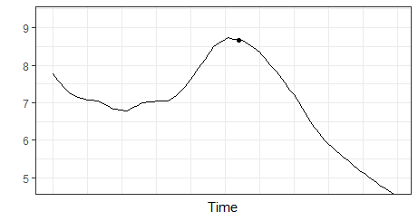






Event
Detection Method A
$$time$$
$$time$$
$$t$$
$$t$$
$$t+k_{1}$$
Detection Method C
Detection Method B
$$time$$
$$time$$
$$t−k_{3}$$
$$\text{(}k_{3}>k_{2})$$
$$t$$
$$t+k_{2}$$ ($k_{2}>k_{1})$
$$t$$
$$t+k_{3}$$ ($k_{3}>k_{2}$)

Slide 3

Detection Method A
Detection Method B
$$time$$
$$t−k_{2}$$
$$\text{(}k_{2}>k_{1})$$
$$t$$
$$t+k_{1}$$

