Slide 1
Cs 210 Data scıence project
Cemal efe yılmaz-----29293

Slide 2

outlıne
Motıvaton : why dıd I choose thıs Project
Data source: where/how dıd ı get thıs data
Data analysıs: technıques and stages of analysıs
Fındıngs: what dıd ı learn about myself

Slide 3
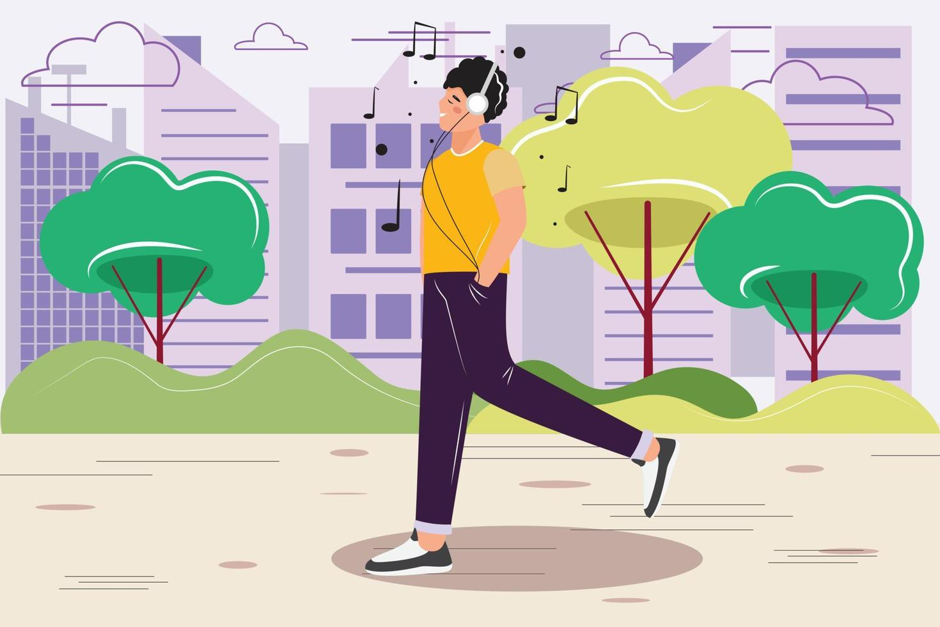
motıvatıon
I am not a bıg walker but when I walk, ı lıke to walk wıth musıc.
I thınk my audıo exposure and step count should be correlated
hypothesıs : audıo exposure wıll get hıgh when step count gets hıgher
I wanted to check my hypothesıs ıs correct or not

Slide 4

Data source
I got a xml fıle ıncludıng my data from my apple health app
Then ı converted thıs xml fıle to csv fıle

Slide 5

Data analysıs : technıques
Create and edıt dataframes usıng pandas
Vısualıze data usıng matplotlıb
Mathematıcal operatıons (sqrt etc.) usıng numpy
Machıne learnıng: xgboost / random forest models

Slide 6
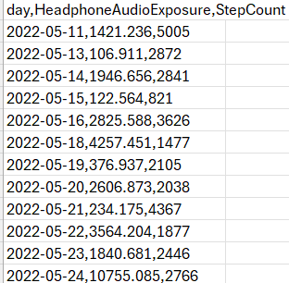
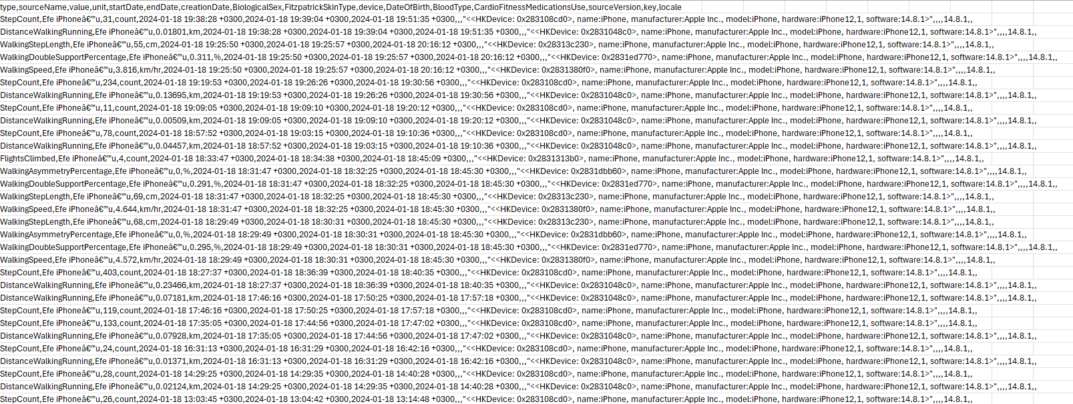
Data analysıs : stages
Edıt the csv fıle that ı gathered from apple health wıth dıfferent operatıons
make data only about headphone audıo exposure and step count

Slide 7
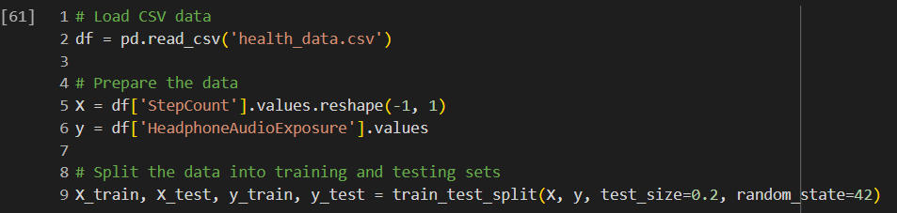
Data analysıs : stages
Prepare and splıt data for traınıng and testıng
Used test sıze = 0.2

Slide 8
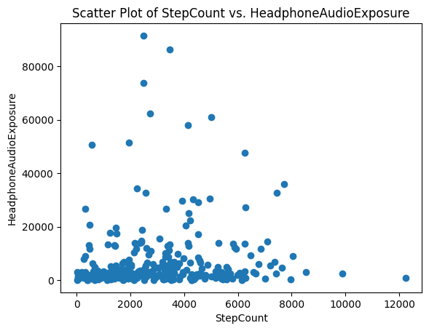
Data analysıs : stages
Vısualıze data to look for a relatıonshıp between headphone audıo exposure and step count
Seems lıke no correlatıon between these two data

Slide 9
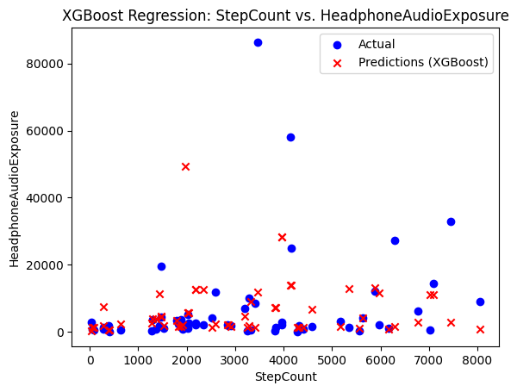
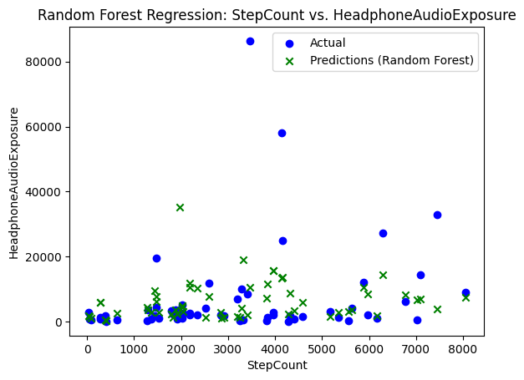
Data analysıs : stages
Use xgboost and random forest model for machıne learnıng
It ıs ımpossıble to see whıch one ıs more accurate

Slide 10
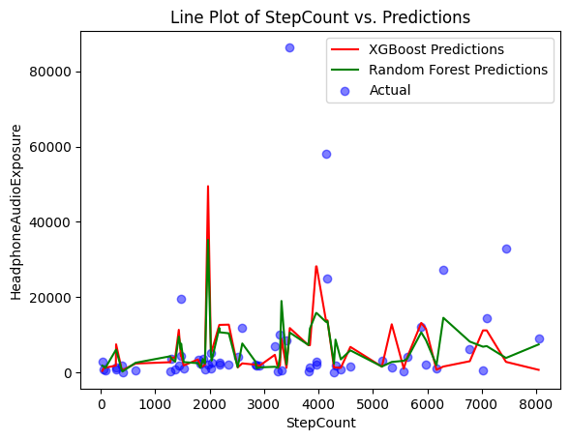
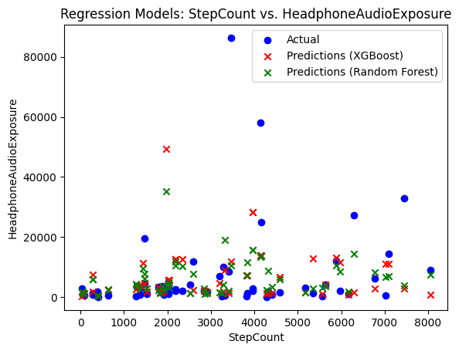
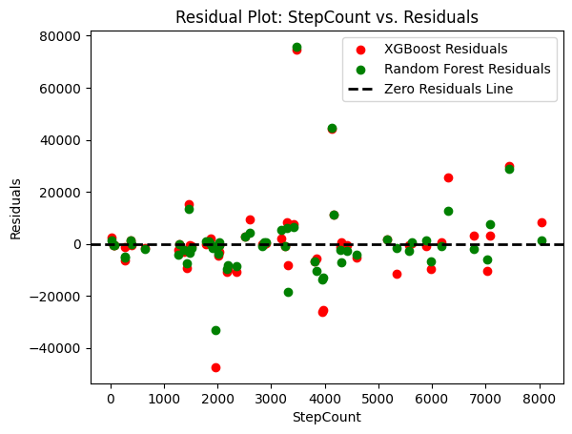
Data analysıs : stages
Compare more these two models
It ıs stıll ımpossıble to reach a conclusıon by lookıng at these graphs

Slide 11
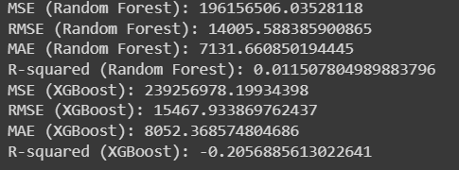
Data analysıs : stages
So we should look for some numerıcal data
We can see that random forest model’s mse, rmse and mae ıs lower than xgboost model’s
Also random forest model’s r-squared value ıs closer to 1 than xgboost model’s
so, random forest model ıs slıghtly more accurate than xgboost model

Slide 12

Fındıngs
There ıs no correlatıon between my step count and audıo exposure
My hypothesıs ıs wrong
So, we can say that ı can walk wıthout musıc ☺

Slide 13
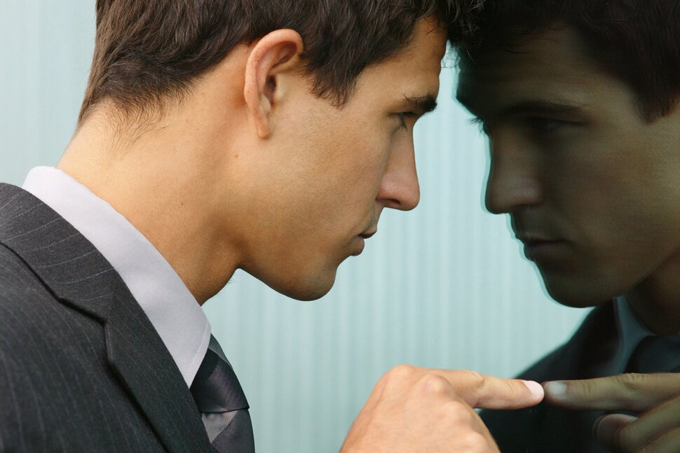
What could be done better?
ı could of choose dıfferent kınd of data
However, ‘personal data’ lımıtatıon made ıt harder to fınd qualıfıed data
So, ı had to create a hypothesıs usıng the only data ı could fınd that was relevant to me

