Slide 1
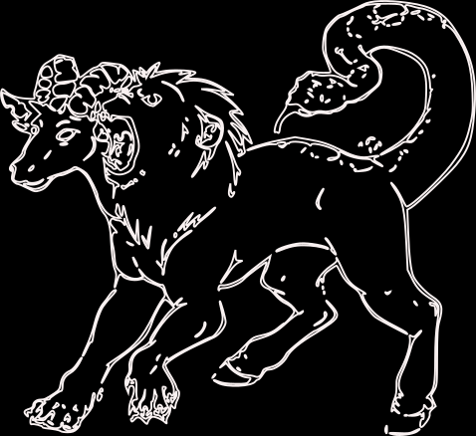
Chimera
Composable Semantic
Data Transformations
Alessio Carenini

Slide 2
Chimera objectives
Enable data conversion by exploiting
Ontologies
SHACL Rules
Create custom conversion pipelines without writing Java code
Provide a general framework to integrate new lifting/lowering and transformation technologies
Easy reuse:
as a library
as a service

Slide 3
Semantic conversion pipeline
Input -> RDF conversion
Transformation rules
RDF -> output conversion
Data Enrichment
Ontology loading
A generic semantic conversion pipeline is composed by:
Conversion of input data into RDF triples
Data enrichment
Ontology-based inference
Custom transformation rules
Conversion of resulting RDF triples into output data

Slide 4
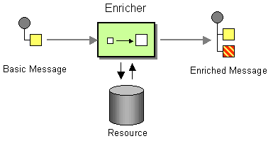
Data conversion and EIP
The core of a conversion process can be seen as a chain of Content Enricher EIPs
Once the input Message has been converted into triples, the Resource is the local in-memory RDF repository which is then enriched and transformed

Slide 5
Components: Lifter
Lifter
Apply transformation rules
Lowerer
Enricher
Ontology loader
From Java objects to RDF
Pinto framework can convert any Java object into a set of RDF triples
Output: Apache Jena Model
< https://github.com/carenini/pinto >

Slide 6
Other candidates to provide alternative Lifters
ST4RT lifter
Based on annotations
Prototype implementation (by Trenitalia) ready to be integrated
RML lifter
Based on RML
Prototype implementation ready to be integrated (uses RDF4j, see link 1)
SPARQL-Generate
Extension of the SPARQL language
Prototype implementation ready to be integrated (uses Jena, see link 2)
< 1 https://github.com/RMLio/rmlmapper-java >
< 2 https://ci.mines-stetienne.fr/sparql-generate/index.html >

Slide 7
Components: Enricher
Lifter
Apply transformation rules
Lowerer
Enricher
Ontology loader
Loads additional RDF data.
Can be used to inject master/lookup data inside the conversion context.
Output: enriched Apache Jena Model

Slide 8
Components: Ontology loader
Lifter
Apply transformation rules
Lowerer
Enricher
Ontology loader
Loads an RDFS / OWL ontology and enables inference.
Output: enriched Apache Jena Model with enabled inference

Slide 9
Components: Apply transformation rules
Lifter
Apply transformation rules
Lowerer
Enricher
Ontology loader
Custom transformation rules are the real core of the conversion process
Rules are expressed using SHACL Advanced Features
< https://www.w3.org/TR/shacl-af/ >

Slide 10
SHACL Rule Example 1
co:SegmentRulesShape
a sh:NodeShape ;
sh:targetClass fsm:Segment;
sh:rule [
a sh:SPARQLRule ;
sh:prefixes co: ;
sh:construct """
PREFIX rdf: <http://www.w3.org/1999/02/22-rdf-syntax-ns#>
PREFIX co: <http://st4rt.eu/ontologies#>
PREFIX s:<http://st4rt.eu/ontologies/fsm#>
construct {
?x co:hasRouteLink [
a co:RouteLink;
co:isStartingAt ?source;
co:isEndingAt ?dest ]
}
where {
{
?x a s:Segment;
s:origin ?source;
s:stopPlace ?list_head.
?list_head rdf:first ?dest.
}
union {
?x a s:Segment;
s:stopPlace/rdf:rest*/rdf:first ?source.
?node_el rdf:first ?source;
rdf:rest ?next_el.
?next_el rdf:first ?dest.
}
union {
?x a s:Segment;
s:stopPlace/rdf:rest*/rdf:first ?source;
s:destination ?dest.
?last rdf:first ?source;
rdf:rest rdf:nil.
}
}
""" ;
] .
Mapping IT2Rail ontology to FSM
From a FSM Segment (each one having origin, destination and a list of StopPlaces)
To an unordered set of IT2Rail RouteLinks (each one having a starting point and an ending point)
IT2Rail
FSM

Slide 11
SHACL Rule Example 2
Mapping NeTEx to GTFS
From a NeTEx Operator having contact details to a GTFS Agency
sh:rule [
a sh:SPARQLRule;
sh:construct """
prefix rdf: <http://www.w3.org/1999/02/22-rdf-syntax-ns#>
prefix netex: <http://www.cefriel.it/chimaera/netex#>
prefix gtfs: <http://st4rt.eu/ontologies/gtfs#>
construct {
$this a gtfs:Agency;
gtfs:agency_id ?id;
gtfs:agency_name ?name;
gtfs:agency_url ?url;
gtfs:agency_timezone ?tz;
gtfs:agency_phone ?phone.
}
where {
$this a netex:Operator;
netex:id ?id;
#netex:shortName ;
netex:name/netex:value ?name ;
netex:contactDetails/netex:url ?url;
netex:contactDetails/netex:phone ?phone;
netex:locale/netex:timeZone ?tz.
}
""";
GTFS
NeTEx

Slide 12
Components: Lowerer
Lifter
Apply transformation rules
Lowerer
Enricher
Ontology loader
From RDF to Java object
Pinto framework is used to extract proper information from the RDF graph and build an instance of a desired Java class
Output: Java object

Slide 13
Other candidates to provide alternative Lowerer
ST4RT lowerer
Based on annotations
Prototype implementation (by Trenitalia) ready to be integrated
STTL
SPARQL-based language (see link 1)
Prototype implementation in Javascript (see link 2)
< 1 http://ns.inria.fr/sparql-template/ >
< 2 https://github.com/vcharpenay/STTL.js >

Slide 14
Apache Camel integration
The conversion pipeline components are Apache Camel Processors, and they can be integrated with any Camel data format.
Chimaera uses Spring XML to define the Camel processing pipeline.
The overall pipeline will be something like:
(Camel) Obtain the raw input data
(Camel) Unmarshal data into Java object
Lift
Enrich
Load ontologies
Transform
Lower
(Camel) Serialize Java object

Slide 15
Current Limitations
Pinto and TopBraid SHACL implementations use incompatible RDF libraries. Converting to and from such libraries is time (and memory) consuming.
SHACL Advanced Features are not yet stable.
Semantics of Dependencies between rules not yet clear
SHACL processor just executes the rules once. If the output of rule R1 is enough to trigger R2, you must re-execute the processor to obtain R2 output.

Slide 16
Possible use cases
Transforming GTFS data (plus external sources) into NeTEx
Transforming UIC 918 XML into FSM (and back)
Aggregating multiple transportation sources into a coherent graph

