Slide 1

JAVA
Enterprise Software Development| Security Security Extra Topics
www.switchfully.com
Notes:
Switchfully

Slide 3
OAuth2
Chapter 1

Slide 4
Overview
OAuth2
Classic authentication vs OAuth2
Flows
JWT

Slide 5
Classic authentication vs OAuth2
OAuth2

Slide 6




Classic authentication
- Provide credentials + Log in
- Perform requests as logged in user
Classic authentication vs OAuth2

Slide 7




Classic authentication in Oauth terms
Actual person, Knows his own credentials and has created (‘owns’) some resources on site
Resource
Owner
Classic authentication vs OAuth2
Notes:
Resources examples: uploaded photos, filled in address forms, has a history of video views (eg on Youtube)

Slide 8



Classic authentication in Oauth terms
Software used to access resource (eg: website, desktop app, mobile app)
Client
Classic authentication vs OAuth2
Notes:
In the past, only websites were used to access data. Options have increased a lot with the introduction of smartphones and mobile data

Slide 9




Classic authentication in Oauth terms
Backend server that handles the requests
Resource server
Classic authentication vs OAuth2
Notes:
In the past, only websites were used to access data. Options have increased a lot with the introduction of smartphones and mobile data

Slide 10
Classic authentication in Oauth terms
Backend server that handles the requests…
AND authentication
Resource server
Classic authentication vs OAuth2
Notes:
In the past, only websites were used to access data. Options have increased a lot with the introduction of smartphones and mobile data

Slide 11
Classic authentication: some problems/concerns
Resource server has multiple responsibilities
Handling regular requests
Handling authentication
Should a user blindly trust any site to handle their credentials safely?
One backend can have multiple UIs, eg: because the backend supplied a public REST api to the world
Do all of these UIs have the best intentions?
Only two states: logged in or not logged in
User cannot determine granularity of the features the client can access
Classic authentication vs OAuth2

Slide 12



OAuth authentication
Client
Authorization server
Uses
Owns a resource
Resource
Owner
Resource
Server
Classic authentication vs OAuth2
Notes:
Responsibility split: Authorization server – Resource server
It’s possible to host your own authorization server or use a third-party server. Third-party are usually ‘globally trusted’ parties like google, facebook or github
Starting situation before a user is logged in

Slide 13
OAuth authentication
Client
Authorization server
Uses
Trusts
Owns a resource
Resource
Owner
Resource
Server
Classic authentication vs OAuth2
Notes:
Responsibility split: Authorization server – Resource server
It’s possible to host your own authorization server or use a third-party server. Third-party are usually ‘globally trusted’ parties like google, facebook or github
Starting situation before a user is logged in

Slide 14
OAuth authentication
Registers with
Authorizes
Client
Authorization server
Uses
Trusts
Owns a resource
Resource
Owner
Resource
Server
Classic authentication vs OAuth2

Slide 15
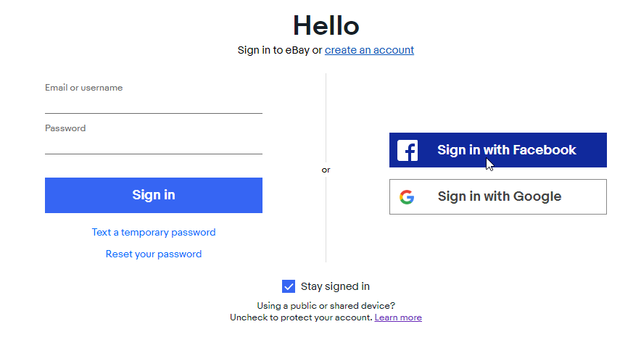
OAuth on eBay example
Classic authentication vs OAuth2
Notes:
Oauth on Ebay

Slide 16
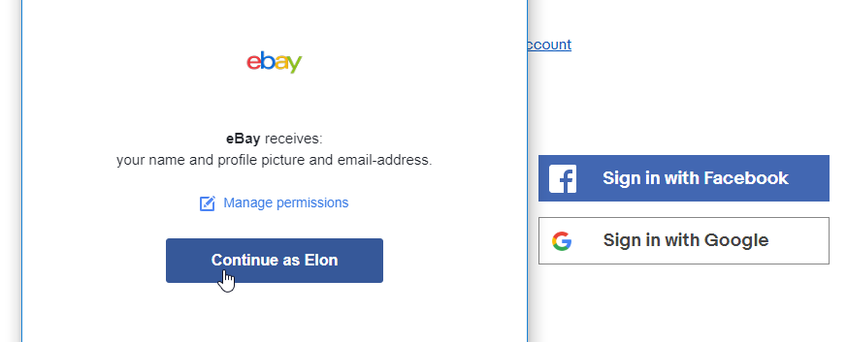
OAuth on eBay example
Authentication happens on Facebook’s website. Ebay has no clue what is happening over there
Classic authentication vs OAuth2
Notes:
‘The pop-up’ (if I wasn’t already logged into a Facebook account, I would have had to log in right then and there)

Slide 17
OAuth on eBay example
Resource owner can determine which resources the client (=eBay) can access
Classic authentication vs OAuth2
Notes:
Also happens on smartphones. Install app -> Open it -> It asks if it can use your gps, contact list, make phone calls, etc
User has option to deny some requested permissions and allow others. Some apps won’t allow you to log in if you don’t allow certain permissions or disable some features. If user does not agree with obligatory requested permissions, he can still cancel the log in procedure and leave the client website

Slide 18
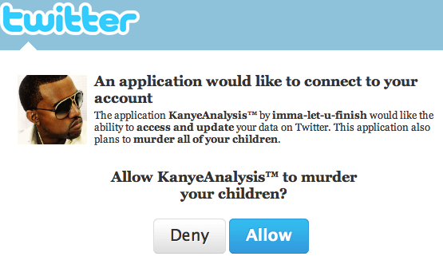
OAuth on eBay example
Most users will blindly allow any app to do anything, but keep in mind that not all users will and that users can change their mind at any time
Classic authentication vs OAuth2
Notes:
As a developer, we need to be aware that a user can change which parts he permits and which he doesn’t at any time our code needs to be able to respond to this accordingly.

Slide 19
Client – Authorisation server flow
User arrives on client on clicks ‘log in’
User chooses OAuth login option like logging in via Facebook or Google
User is redirected to page of Authorisation server
Client sends a payload during redirect to AS which contains a list of Resources he needs the user to confirm access to (= ‘Scope’)
User logs in with account known to Authorisation server
When using eg Facebook or Google as an AS, a lot of users will already be logged in, so this step is skipped
User is presented with list of resources the client will get access to and enables/disables them
Classic authentication vs OAuth2

Slide 20
Client – Authorisation server flow
User confirms or cancel log in procedure and is redirected back to client’s page
While redirecting from AS to Client page, the AS sends a payload that proves the user is authenticated and contains info concerning the requested Resources (eg: an url to the user’s profile picture or his full name). This payload is usually a Json Web Token (JWT)
Classic authentication vs OAuth2
Notes:
More on JWT later

Slide 21
OAuth authentication
Registers with
Authorizes
Client
Authorization server
Uses
Trusts
Owns a resource
Resource
Owner
Resource
Server
Classic authentication vs OAuth2
Notes:
Now we are authorised
The Authorisation server is called this way, because even though it performs the authentication as well, for the client using it, it just returns the authorisation parameters the user configured while logging in
For the client the AS is used as a way to find out what the user can do in its app, not if he is who he claims to be.

Slide 22
OAuth authentication
Registers with
Authorizes
Client
Authorization server
Accesses
Uses
Trusts
Owns a resource
Resource
Owner
Resource
Server
Classic authentication vs OAuth2
Notes:
So we can access the resource server

Slide 23
OAuth2 summary
OAuth features
Separate authentication/authorization and accessing resources over two separate servers
Give client the possibility to request subset of available resources
Gives resource owner the possibility to allow/deny client to access some of his resources
Classic authentication vs OAuth2

Slide 24
Flows
OAuth2

Slide 25
Types overview
Different ways authentication can happen using OAuth
Authorization code flow
Implicit flow
Resource Owner Credentials Flow
Aka password Grant Flow
Client flow
Flows

Slide 26
Authorization flow & Implicit flow
Authorization code flow & Implicit flow
Flows discussed in previous part
Most common flows when dealing with human resource owners
Flows

Slide 27
Authorization flow & Implicit flow
Authorization code flow & Implicit flow: differences
Authorization flow returns an access code while implicit flow returns an access token
Code must be converted by server to token. Server stores the secret. For implicit flow, the browser stores it
Authorization flow has renewable access tokens, Implicit flow has not
Authorization code is used for server-side apps, implicit flow for client-side
Flows
Notes:
Implicit flow is less secure, since the access token has to be stored client-side, which makes it easier to steal (and then spoof the user’s identity) than the auth flow, which stores the token server side
Auth0 has ‘Authorization code flow with proof key for code exchange’ for client-side apps

Slide 28
Resource Owner Credentials Flow
Resource Owner Credentials Flow
Resource enters credentials in client (so no redirect to AS)
Used when client is trusted
EG: Official Twitter mobile app talking to Twitter backend
Resource owner’s credentials are exposed to the client
Resource owner needs absolute trust in the client
Access token is stored client-side
Flows

Slide 29
Client flow
Client flow
Used for app-to-app communication
Client authenticates itself against an Authentication Server
Access token has no data concerning a human user
Flows

Slide 30
JWT
OAuth2

Slide 31
JSON Web Tokens
JWT = Json Web Token
Standard format for access tokens in OAuth2
Sent with every request so server can validate authorization rules
Just like basic authentication, content is encoded
EG
Can be signed to verify integrity of the token
Detects Man-in-the-middle tampering
Can be encrypted to hide content
Encryption has performance impact
Serving all requests over HTTPS achieves broadly the same result as encryption
Is pronounced ‘jot’ and not ‘jewed’
JWT

Slide 32
JSON Web Tokens
Anatomy of a Json Web Token
xxxxx.yyyyy.zzzzz
Payload
Header
Signature
JWT
Notes:
Parts separated by dots
(after decoding it)

Slide 33
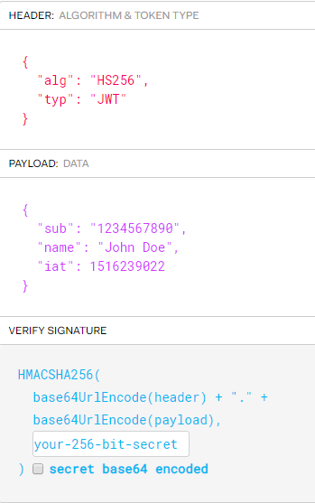
JSON Web Tokens
Anatomy of a Json Web Token: example
JWT
Notes:
Parts separated by dots
(after decoding it)

Slide 34
JSON Web Tokens
Header
typ
JWT
alg
Hashing algorithm used (eg: HS256)
JWT
Notes:
TYP= type of token

Slide 35
JSON Web Tokens
Payload
Info about token & data we want to transmit
Reserved, but optional fields:
Iss: (issuer): who created the token. EG: ‘Facebook’
Exp: (Expiration date): after this time, the resource server will no longer accept this as a valid token
Nbf: (not before): Token is only valid starting from this date
JTI , Sub, aud
Contains all info granted by resource owner
Eg: first and last name, address, url to profile picture, list of authorization names, …
JWT
Notes:
Bulk of data of the jwt is found here

Slide 36
JSON Web Tokens
Signature
A hash of header+payload+’secret’
Secret is stored on the server. This allows the server to verify if the token is valid
If a hacker alters the header or payload, the hash of the header+payload+secret will no longer match the hash in the signature and the server can deny requests performed by that token
JWT

Slide 37
JWT security risks
Security risks
JWTs cannot be revoked once issued
They will stay valid until the expiration date is reached. Don’t issue JWTs that are valid for more than a couple of hours
Can be stolen by hackers if there’s a weak link in the chain
JWTs are often used in single-sign-on environment where multiple apps reuse the token to authorize a user. All these apps need to store this token somewhere.
Never store this token in plain text when persisting it to the db
JWT

Slide 38
References
Hackers

Slide 39
References: OAuth
https://zachholman.com/2011/01/oauth_will_murder_your_children/
The problem addressed here has been solved since the post was created
https://itnext.io/an-oauth-2-0-introduction-for-beginners-6e386b19f7a9
https://medium.com/google-cloud/understanding-oauth2-and-building-a-basic-authorization-server-of-your-own-a-beginners-guide-cf7451a16f66#targetText=Essentially%2C%20OAuth%202.0%20allows%20arbitrary,%2C%20reliable%2C%20and%20efficient%20manner.
https://stackoverflow.com/questions/13387698/why-is-there-an-authorization-code-flow-in-oauth2-when-implicit-flow-works-s
https://auth0.com/docs/api-auth/which-oauth-flow-to-use
Flows

Slide 40
References: JWT
https://jwt.io/
https://scotch.io/tutorials/the-anatomy-of-a-json-web-token
https://tools.ietf.org/html/rfc7519#section-1
Explains how ‘jwt’ should be pronounced.
https://medium.com/@cjainn/anatomy-of-a-jwt-token-part-2-c12888abc1a2
Flows

Slide 41

You make me feel even more secure now!
JAVA
Enterprise Software Development| Security Security Extra Topics
www.switchfully.com
Notes:
Switchfully

