Slide 1
Spring
and Axon
Notes:
:D :D :D D: :D

Slide 2
Axon concepts

Slide 3
Aggregates

Slide 4
Aggregates
Originates from Domain-Driven Design (DDD) ~ Aggregate root
Domain objects that are equal if their id’s are the same
Eg: Two person objects with the same first and last name, address, etc are only equal if their ids are equal
Can contain other domain objects (eg: Person has an Address object)
Annotate class with @Aggregate and annotate id field with @AggregateIdentifier

Slide 5
Events and Commands

Slide 6
Commands and events
Command: something that should happen: CreatePersonCommand, ChangePersonNameCommand, RemovePersonCommand
Event: something that has happened: PersonCreatedEvent, PersonNameChangedEvent, PersonRemovedEvent
Both are regular classes with 0-n fields
Commands need the id of the aggregate it is supposed to change, annotated with @TargetAggregateIdentifier. This allows Axon to link a command to an aggregate
Commands usually create events with a similar name: FileComplaintCommand -> ComplaintFiledEvent
Commands are meant to change an aggregate, events are meant to react to a change in an aggregate. EG: perform some logging or contact another system
Notes:
Decreased coupling between components
Multiple listeners for one event possible
Harder to debug/follow code flow

Slide 7
Event sourcing

Slide 8
Event sourcing
Store every change in the state of an application as events instead of only storing the current state. The current state can be constructed by applying all past events
CreditAccountEvent
event# 1
Amnt 100
CreditAccountEvent
event# 101
Amnt 200
CreditAccountEvent
event# 5
Amnt 300
BankAccount
Amnt 400
DebitAccountEvent
event# 21
Amnt 1000
Notes:
Events are saved instead of entity in its entirety. If we replay all events for an aggregate in the correct order, the most recent state for that object is restored
If number of events for a single aggregate become too large, it’s possible to create a snapshot, a combination of all events up to that point

Slide 9
Producing and consuming commands and events

Slide 10
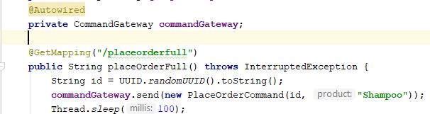

Producing and consuming commands
Notes:
CommandHandler can also be placed on a constructor. Usually done for ‘create’ commands that create aggregates

Slide 11
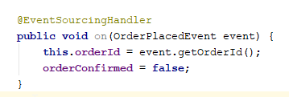
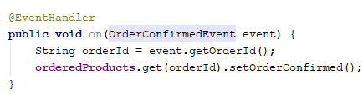
Producing and consuming events
Notes:
Apply is on AggregateLifecycle
EventSourcingHandler is used in aggregate if the event should be replayed every time the aggregate is reconstructed from events

Slide 12
CQRS
Notes:
Command/Query responsibility separation

Slide 13
Commands and queries
Command: creates/updates/deletes entities
Query: reads entities (eg: findById, findWhereUsernameLike)
Read model - Write model
Write model constructed via event sourced events
Read model is a classic entity saved in db
One write model can have multiple read model representations, eg if a certain entity is used (partially) on multiple screens
Notes:
Command/Query separation allows the read side of your application to scale differently from the write side depending on the type of traffic your app uses the most.

Slide 14
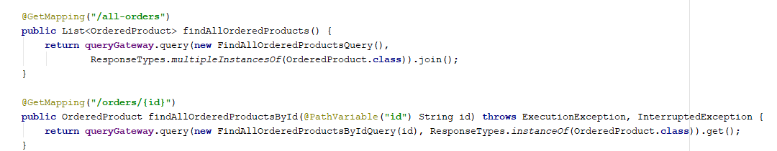
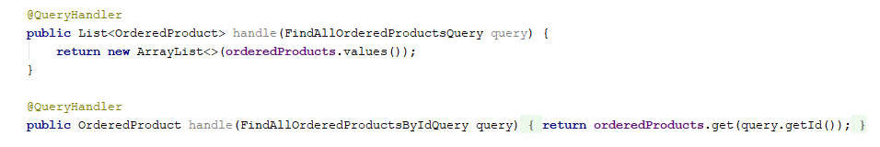
Performing queries
Notes:
Queryhandler would usually connect to some repository
xxxQuery classes are simple POJOs

Slide 15
Axon server
Notes:
Separate jar that serves as event store.
Default runs on localhost:8024 and allows you to inspect all queries/commands, etc that were created/errored in the application
Is an optimized db made to work with an axon application that has a high load of events/high number of events in storage
Works out of the box with spring

Slide 16
References

Slide 17
References
https://axoniq.io/
https://www.novatec-gmbh.de/en/blog/event-sourcing-spring-boot-axon/#targetText=With%20Axon%20you%20manipulate%20domain,necessary%20information%20to%20execute%20it.&targetText=It%20verifies%20the%20command%20and,aggregate%20to%20change%20its%20state.
https://martinfowler.com/bliki/CQRS.html

Slide 18
Exercises

Slide 19
Exercise
Open extra/axon in IDE
Read Exercise.md and implement solution

