Slide 1
Spring
Database
Notes:
Focussing on Relational Databases like Oracle, MySql, Postgres.
Won’t mention MongoDB

Slide 2
Spring Data JPA and ORM

Slide 3
Java Persistence API

Slide 4
JPA
javax.persistence.*
Saving, updating, fetching, deleting database records
Controller
Service
Repository
DB
Notes:
JPA is just an interface. Multiple implementations exist, like EclipseLink or Hibernate (=Spring default).

Slide 5
Object-relational mapping

Slide 6
ORM
Link between DB table and OO-class
Java
DB
Person
-name
-age
-sex
-id
PERSONS
-ID
-nmbryears
-fullname
-sex
Notes:
EG map varchar(1) to boolean
Support for ID, schemas,foreign keys (one to one, one to many, many to one, many to many), …
Generates queries based on mappings provided in Java code
Most well known ORM is hibernate

Slide 7
ORM in Spring
Notes:
This won’t be a complete guide on Hibernate, just the basics parts + some stuff needed for the exercises/showing capabilities of Spring

Slide 8
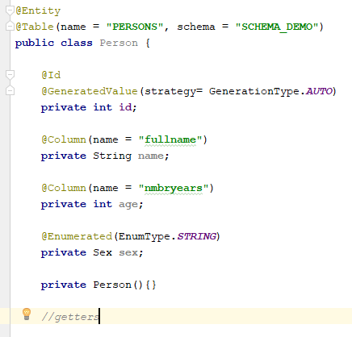
Mappings example
Notes:
Enums are stored in db as integer by default, based on their position in the enum list in Java
Hibernate will fill in fields using reflection. Empty constructor is needed (can be private), setters are not .
@Column is not necessary if field name is same as column name, but best practice is to always add it

Slide 9
Mappings example: 1-n relationship
Person
1-n
Shoes

Slide 10
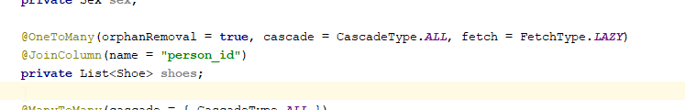
Mappings example: 1-n relationship

Slide 11

Mappings example: n-1 relationship
Notes:
@OneToOne exists too, similar to ManyToOne

Slide 12
Mappings example: n-n relationship
Person
1-n
Person
Clothing Brands
n-1
Clothing Brands
Notes:
N-n has to be denormalized on db level, so extra table is added
Middle table usually has two columns: person_id and clothing_brand_id

Slide 13
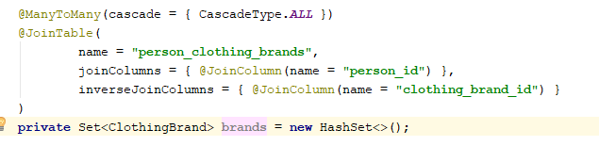
Mappings example: n-n relationship

Slide 14
Eager vs Lazy fetching

Slide 15
Fetch types
Notes:
FetchType: two options: Lazy or Eager
Eager will perform the join query immediately when object is fetched from db, lazy will perform when getter is called.
ManyToX is always eager, even when fetchtype is set to lazy

Slide 16
Fetch types dangers
Multiple eager lists in single class -> huge cartesian product -> slow query
Lazy list -> N + 1 query problem -> Slow query and / or big strain on db
Eg Object with lazy loaded list containing 100 elements will perform 101 queries

Slide 17
Spring Repositories

Slide 18
Spring Repository interfaces
CrudRepository
PagingAndSortingRepository
JpaRepository
Notes:
CrudRepo: basic functionalities like saving, deleting, findAll
P&SRepo: Pagination and Sorting
JpaRepo: BatchDelete, Flushing the persistence context

Slide 19

Using a Spring Repository
Notes:
Exposes all basic methods through inheritance

Slide 20
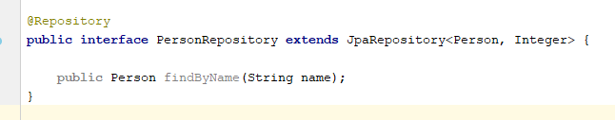
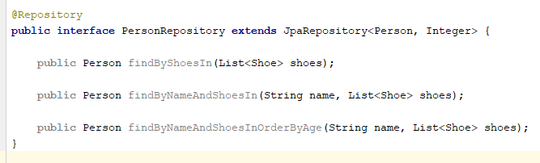
Customizing a Spring Repository
Notes:
Name correspond to field on Person
Also support to return optionals, lists and streams
Params sanitized, so no code injection is possible

Slide 21

Customizing a Spring Repository
Notes:
@Query also corresponds to Java objects, not SQL tables/columns
@Query has nativeQuery option. When set to true, you can use regular SQL

Slide 22
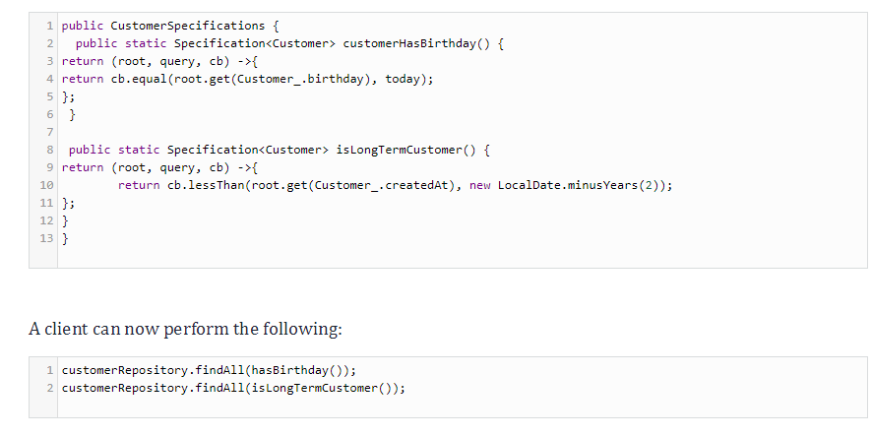
Building complex queries using Java code:
Specifications
Notes:
Cb = ‘CriteriaBuilder’

Slide 23

Chaining specifications
Notes:
‘Or’ is also available

Slide 24
Manual queries

Slide 25
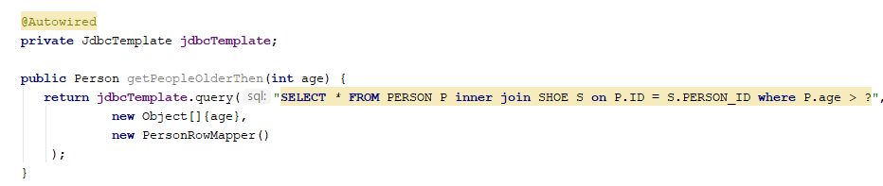
JdbcTemplate
Notes:
Part of Spring Jbdc
Parameters (eg ‘age’) are sanitized, so no code injection is possible

Slide 26
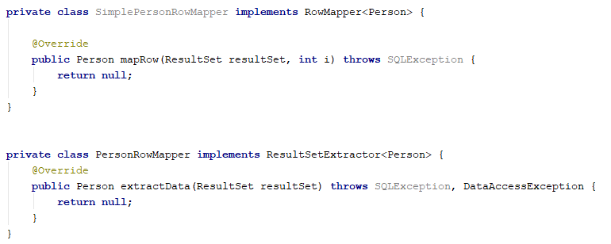
JdbcTemplate: RowMappers
Notes:
RowMapper passes row per row of resultset to function
ResultSetExtractor passes whole result at once.
RowMapper is handy when processing a single table query (or joins with 1-1 relationships)
RSE is handy when having 1-n/n-1/n-n joins. Allows you to collect children of the owner (eg: shoes of a person)

Slide 27
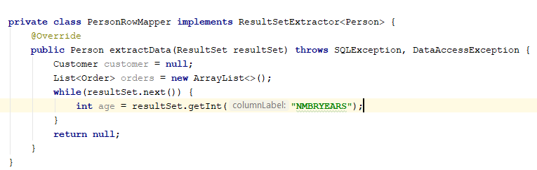
JdbcTemplate: RowMappers
Notes:
Also available: getString, getFloat, get...

Slide 28
Transactions

Slide 29
@Transactional
Enabled by default by Spring Boot when depending on spring-data-* or spring-tx
Otherwise, enable by adding @EnableTransactionManagement on a @Configuration file + Configure a PlatformTransactionManager bean
@Transactional on Method or Class level
Configurable transaction type, when to (not) rollback, isReadOnly, etc
Notes:
@Transactional only works on public methods.
Also creates a proxy on the class level (even when annotating on the method) that only works when called from an external source (so class X method A calling method B will not trigger @Transactional, even if method B has an @Transactional annotation and both are public.

Slide 30
References

Slide 31
References
https://www.baeldung.com/spring-boot-h2-database
https://dzone.com/articles/what-is-the-difference-between-hibernate-and-sprin-1
https://en.wikipedia.org/wiki/Object-relational_mapping
https://docs.spring.io/spring-data/jpa/docs/current/reference/html/
https://dzone.com/articles/using-spring-data-jpa-specification
https://www.baeldung.com/transaction-configuration-with-jpa-and-spring

Slide 32
Exercises

Slide 33
Exercise
Open 02-database in IDE
Read Exercise.md and implement solution
Notes:
We will be using a h2 database for all exercises. This is an in-memory db. This means it will be wiped after every application restart. (there is an option to save its data to a file so it stays persisted between restarts)
The data.sql file is executed automatically on every startup. If you need to add tables/data, add it in the data.sql
/localhost:<your-app-port>/h2-console allows you to login to h2 and inspect its tables / data + perform queries
Dont use h2 in production
Connection properties can be found in properties file

