Slide 1
Spring
REST
Notes:
:D :D :D D: :D

Slide 2
Rest and Spring

Slide 3
REST feature overview

Slide 4

REST input
POST http://localhost:1234/api/v3/person/5/shoe?sneaker=true&brand=Adidas
Notes:
HTTP method: POST, GET, PUT and DELETE are the most popular ones
Path variable, eg: Person with ID 5, interpreted by owner of the REST interface
Query parameter: sneaker and brand with values true and Adidas. These are usually optional
Body (usually JSON, similar makeup as a JS object). Not possible for GET calls
Headers can be sent as well. Key/Value pairs.

Slide 5
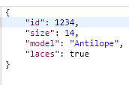
REST output
HTTP 200
Notes:
HTTP code + response body (optional) + headers

Slide 6
REST in Spring

Slide 7
RestController
@RestController on class level
@RequestMapping for shared parts of url
@PostMapping/@GetMapping/@PutMapping on method to bind method to url/HTTP method
Define url with ‘value’ property. (use {xyz} to indicate path parameters)
produces/consumes property defines media type (eg JSON)
Method params can be annotated @RequestBody, @PathVariable(“xyz”) or @PathParam (for query parameters)
@RequestHeader(value = “headerName”) to get headerValue
Return ResponseEntity with optional value used as body
Can also return any object, then HTTP 200 will be returned by default
Notes:
Shared parts of url: eg if all rest calls for controller start with ‘/rest/person’, put that on class level. Method level urls will be appended to it
ResponseEntity can be assigned a HTTPStatus code to return

Slide 8
Turning exceptions into HTTP codes
Notes:
Sometimes things go wrong (some expected, some not). Spring will generate some default HTTP codes for well known exception types, but we can also define these ourselves.

Slide 9
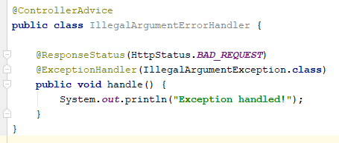
Exception handler
Notes:
Returns a bad request when an IllegalArgument occurs. Then prints something to console.

Slide 10
Performing REST calls from Java code

Slide 11

RestTemplate
Notes:
String.class is the expected return type from the call
Input is the body
Also possible to get the statuscode or headers from the postForEntity

Slide 12
References

Slide 13
References
https://spring.io/blog/2013/11/01/exception-handling-in-spring-mvc

Slide 14
Exercises

Slide 15
Exercise
Open 03-rest in IDE
Read Exercise.md and implement solution
Notes:
Two servers: ‘comfy-hotel’ and ‘sleeping-pattern-service’
Sleeping pattern should only be turned on/off. No code should be touched/added

