Slide 1
Spring
Caching
Notes:
:D :D :D D: :D

Slide 2
Caching and Spring

Slide 3
Caching basics

Slide 4
Caching internals (simplified)
Indicate a method to be Cached + Configure cache
Determine how many elements should be cached
Determine which elements to delete if cache limit reached
Determine how long elements should remain in cache
First time the method is ‘hit’ by a call, it will call through (aka will still be slow)
Cache will store the result of the call
Next time method is hit, cache will check if it has stored a result for the input parameters and return the result without calling through

Slide 5
Caching in Spring
Notes:
Lots of Cache implementations available. We chose ehcache as implementation, but most code should be reusable for whatever caching implementation you pick.

Slide 6
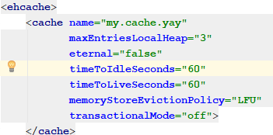
Caching in Spring
Enable caching by using @EnableCaching in any @Configuration class
Create an ehcache.xml to define different caches and their properties
Add @Cacheable to methods that need caching
Refer to cache name defined in ehcache.xml for value

Slide 7
Caching caveats
Cached data is not immutable
Caching only works when called from an external source (aka from another class)

Slide 8
Accessing caches programmatically

Slide 9
CacheManager
Create CacheManager bean (see reference documentation)
Autowire Cachemanager
getCache(name)
cache.put(key, value)
cache.clear

Slide 10
References

Slide 11
References
https://www.ehcache.org/documentation/2.8/configuration/configuration.html
https://www.mkyong.com/spring/spring-caching-and-ehcache-example/
https://www.baeldung.com/spring-boot-ehcache

Slide 12
Exercises

Slide 13
Exercise
Open 04-cache in IDE
Read Exercise.md and implement solution

