Slide 1
Spring
Validation
Notes:
:D :D :D D: :D

Slide 2
Validation on all levels

Slide 3
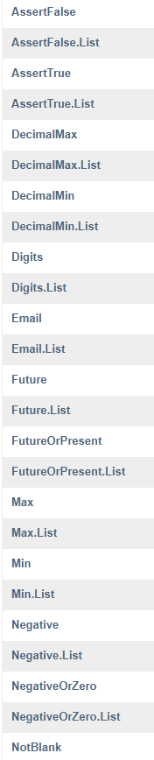
Adding validation rules to fields
Javax.validation annotations
NotNull
Min/Max int
List size
Date in future
Regex
...
Notes:
Also works on PathVariables in Rest calls

Slide 4
Triggering validation
@Valid
Before @RequestBody
@Validated on class level
Eg: service or controller

Slide 5
Custom validators

Slide 6
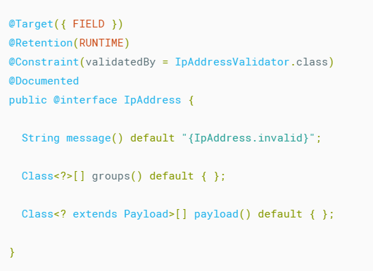
Defining the interface
Notes:
Can be both field and class level
message() -> error returned as response if validator finds error

Slide 7
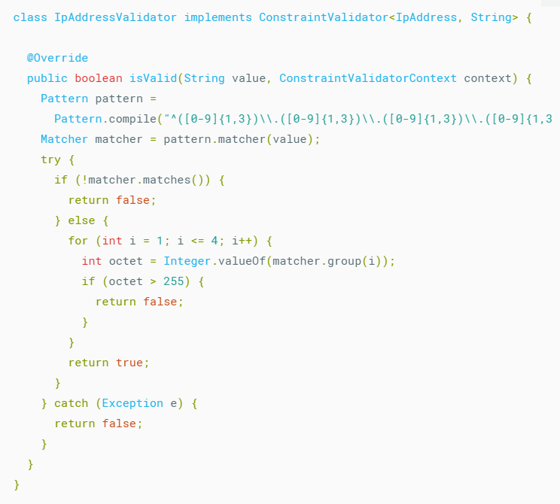
Defining the validator logic
Notes:
Return true if valid, false if not
Implements ConstraintValidator
IpAddress -> annotation coupled to
String -> type of the field to annotate

Slide 8
Validation groups

Slide 9
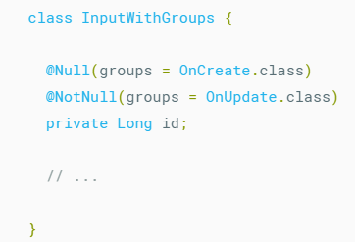
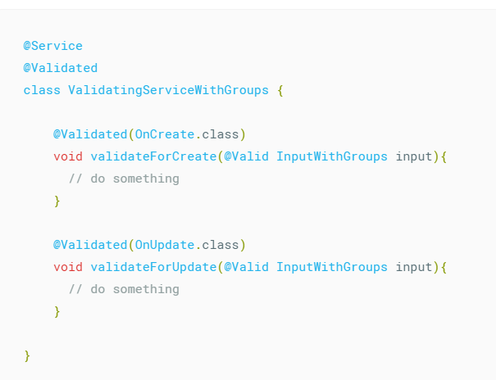
Change validation rules on the fly
Notes:
Id can be null on create, but not on update
OnCreate/OnUpdate are self created empty classes

Slide 10
References

Slide 11
References
https://reflectoring.io/bean-validation-with-spring-boot/
https://docs.jboss.org/hibernate/beanvalidation/spec/2.0/api/javax/validation/constraints/package-summary.html

Slide 12
Exercises

Slide 13
Exercise
Open 06-validation in IDE
Read Exercise.md and implement solution

