Slide 1
Spring
Testing
Notes:
:D :D :D D: :D

Slide 2
Types of tests

Slide 3
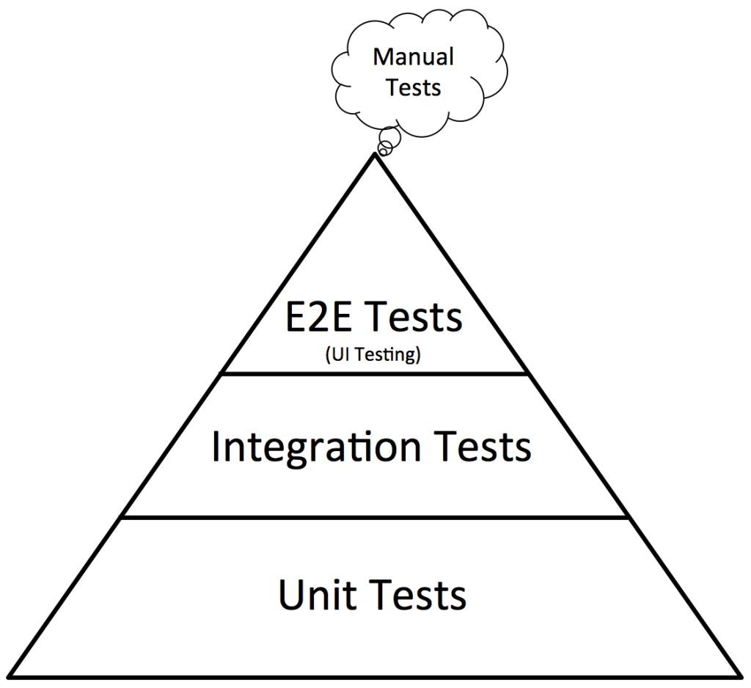
Testing pyramid

Slide 4
Unit Testing

Slide 5
Unit Testing in Spring
@RunWith(SpringRunner.class)
Makes Spring start a Spring context when the test runs
@ContextConfiguration(classes = {a.class, b.class})
Include (class/classes) needed to be loaded in the Spring context to be able to run this test
Annotate fields with @MockBean to create mocks of classes
Mock behaviour can be defined further using regular Mockito methods
Notes:
Why use Spring for unit testing? Recommended to stick with plain Java and Mockito for unit tests

Slide 6
Integration testing

Slide 7
Integration testing a repository and database
@RunWith(SpringRunner.class)
@DataJpaTest
Configures h2 DB
Sets up Hibernate/Spring Data
Entity scans
Turns on SQL logging
Autowire TestEntityManager for data setup

Slide 8
End to end testing

Slide 9
Testing a REST call
@RunWith(SpringRunner.class)
@SpringBootTest
Starts full Tomcat server
webEnvironment determines if it starts at a defined port, random port, …
@Configuration Classes to determine Spring context for backend
@AutoConfigureMockMvc if you want to use MockMvc
@TestPropertySource
If you want to overwrite properties (eg to use a ‘test db’)
Autowire MockMvc field to perform and assert REST calls
Notes:
SpringBootTest.classes will look for Configuration files if it is not defined

Slide 10
References

Slide 11
References
https://www.baeldung.com/spring-boot-testing
https://howtodoinjava.com/spring-boot2/spring-boot-mockmvc-example/

Slide 12
Exercises

Slide 13
Exercise
Open 08-testing in IDE
Read Exercise.md and implement solution
Notes:
Spring provides a built in activemq broker. In real applications you would connect to a separate instance of a messaging queue. This is achieved by setting some properties.
EG for activemq: spring.activemq.user/-.admin/-.broker-url

