Slide 1
Spring
Boot
Notes:
:D :D :D D: :D

Slide 2
Spring Boot features
Notes:
Spring boot was made to get developers to start developing more quickly. Less setup and configuration time, more time to write code
Convention over configuration
All previous exercises were Spring boot apps

Slide 3
Spring initializr
https://start.spring.io/
Search and add groups of dependencies related to a certain functionality (eg JPA or Rest)
Generates .zip with ready to run maven/gradle project
spring-boot-starter-* dependencies
Bundle of dependencies whose versions play well together
Spring-boot-starter-parent is a parent bom that contains all starter dependencies

Slide 4
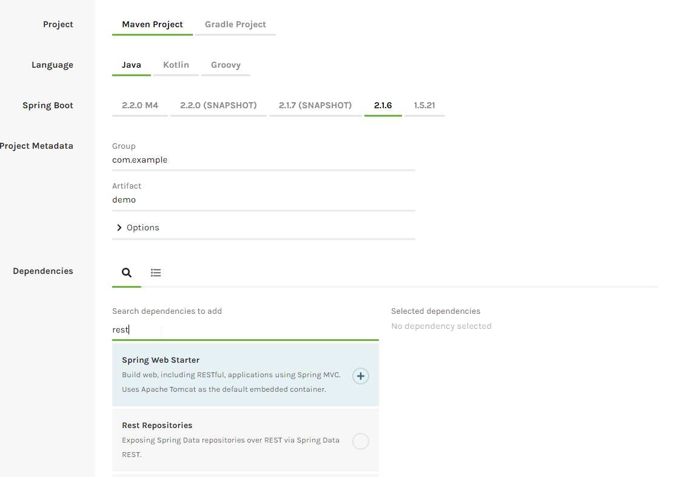
Spring initializr

Slide 5
Autoconfiguration
Built in Tomcat server
Main class automatically scans for annotated classes
Automatically detects if certain dependencies are on classpath and creates a default configuration for them.
EG: if Flyway is on classpath, it will automatically look for flyway sql files at the conventional location and execute them at startup. No config needed if you follow conventions
Some feature need to be enabled explicitly using @EnableXXX annotations.
Eg Security
Often setting some properties is enough to configure things
Eg: db config in the database exercise
Application.properties and bootstrap.properties are automatically read
data.sql under resources is automatically executed every time the application is started

Slide 6
Actuator
Check app health
Some common health checks like db status
Ability to add custom health checks
Metrics
Eg uptime, CPUs available, jvm memory used, etc.
Logging level inspection
Environment variables overview
…
Accessible via /actuator/xyz
Notes:
In Spring boot 2 most actuator URLs are disabled by default. Can be enabled using properties
Make sure to disable/secure these endpoints in production

Slide 7

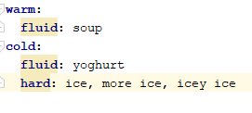
YAML support
Alternative for .properties files
Reuse common root of properties
.properties and .yml can co-exist

Slide 8
Sidesteps: profiles and properties

Slide 9
Profiles
Change behaviour based on profile property
EG: connection string to db on local/tst/prd environment
Annotate class with @Profile(“profilename”) so they are only active if that profile is active
Also possible to use @Profile(“!profilename”) to have it active unless profile is active
Active profile(s) can be set using environment variables, jvm arguments, properties file property, etc…
Properties files will be read based on active profile
Eg: Active profile is “tst” and application-tst.properties exists then application-tst will be read.
Notes:
spring.profiles.active=tst
Mainly used to have a ‘tst’ profile to use eg a h2 db instead of a real one or to disable things like mail sending
Multiple active profiles + same property defined in multiple property files -> last profile wins

Slide 10
Reading properties
Field: @Value(“${property.name.xyz}”)
Autowire Environment
environment.getProperty(“property.name.xyz”)

Slide 11
References

Slide 12
References
https://dzone.com/articles/top-5-spring-boot-features-java-developers-should
http://www.littlebigextra.com/how-to-read-different-properties-file-based-on-spring-profile-in-a-spring-mvc-project/
https://www.javatpoint.com/spring-boot-features
https://www.baeldung.com/spring-boot-actuators
https://www.baeldung.com/spring-profiles
https://stackoverflow.com/questions/51565409/spring-profiles-application-properties-order
https://start.spring.io/

Slide 13
Exercises

Slide 14
Exercise
Open 09-boot in IDE
Read Exercise.md and implement solution

