Slide 1
Evolving Cellular Automata
Chris Egersdoerfer

Slide 2
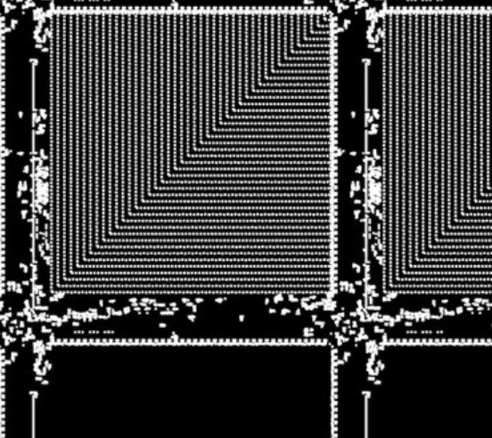
Conway’s Game of Life
Simple Rules:
Cells with 1 or 0 neighbors dies
Cells with 4 or more neighbors dies
Cells with 2 or 3 neighbors lives
Empty cell becomes alive with 3 neighbors
Cell
Neighbors
Dies
Dies
Lives
Is born

Slide 3
Expansion 1
Continuous state:
Cell is bounded by the range [0,1]
Updates scaled by time
Original
…
Updated
Timestep
T₁
T₂
T₃

Slide 4
Expansion 2
Continuous space:
Expand the Neighborhood
1/K
K: size of grid
Rules stay the same:
Sum of neighbors is K/8 or less -> Negative
Sum of neighbors is 2K/8 to 3K/8 -> Positive
Sum of neighbors is K/2 or more -> Negative

Slide 5
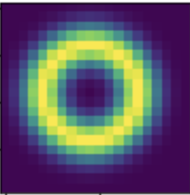
Expansion 3
Weighted Neighborhood
Cell’s fate is decided by some neighbors more than others
Gaussian distribution of distance from cell

Slide 6
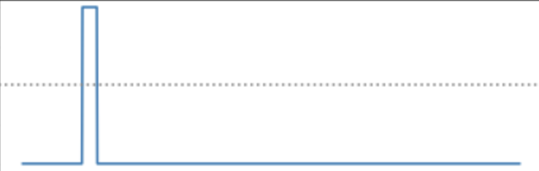
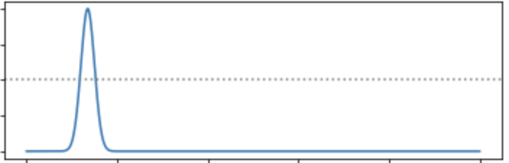
Expansion 4
Continuous growth function:
Rules are no longer discrete
Rules maintain the same principles
Growth Functions
Previous Rule-Set
New Rule-Set
0
2K/8
3K/8
5K/16
Sum of Neighborhood
Sum of Neighborhood

Slide 7
Update Calculation
Current State: S_{t}
Current Field: A_{t}
Kernel Map: K_{t}
Growth Function: G(x)
Potential Field: U_{t} = (K_{t}*A_{t})
Growth Value: G(U_{t})
A_{t}
S_{t}
K_{t}

Slide 8

Result of Expansions
Lenia (Chan 2020)

Slide 9
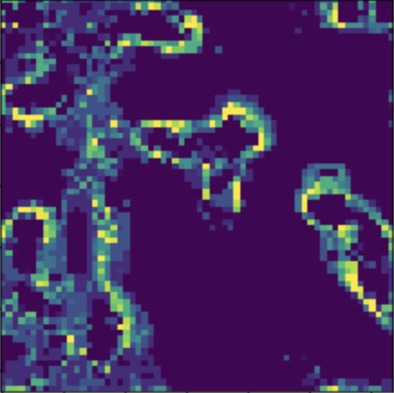
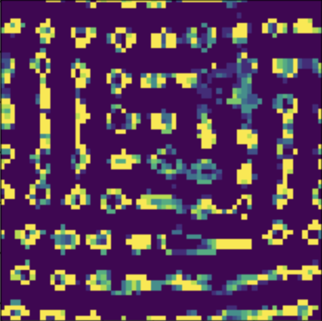
One More Addition
Mass Conservation
Sum of all cells cannot exceed the starting value
Implementation
Replace Growth function with particle system (Mordvintsev, 2022)
G(U_{t}) represents the movement of particles into the current cell
Why is this useful?
Mass tends to uncontrollably increase or decrease in cellular automata systems
S₀
S_{t}

Slide 10
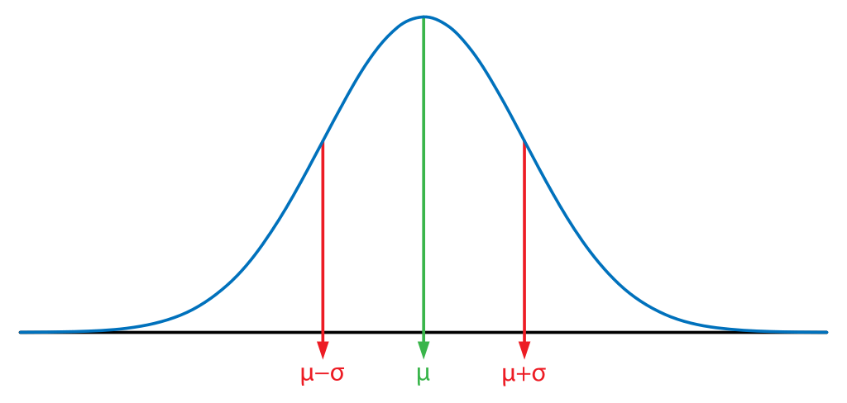
Evolution
Strategy
Learn the a distribution from which sampled parameters yield the highest fitness (reward)
Similar to Reinforcement Learning except learn parameters instead of actions
For this project
The jax-based evosax library was used to implement the evolutionary algorithm
Parameters
Fitness
Simulation
Update

Slide 11
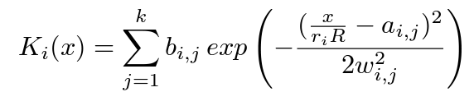
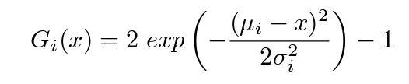
Parameters to learn
Two sets of parameters are learned through evolution
Kernel Map Parameters
Kernel maps are defined as a sum of gaussian bumps:
The variables within the kernel function are learned through evolution
k : number of gaussian bumps
r_{j} : relative radius of the jth gaussian bump
R : maximum radius of all gaussian bumps
w_{j} : width of the jth gaussian bump
b_{j} : height of the jth gaussian bump
a_{j} : horizontal shift of the jth gaussian bump
Growth function parameters
Growth functions are defined by a gaussian distribution:
The variables defining the distribution are learned through evolution
𝛔 : standard deviation
𝜇 : mean
The i in both K_{i}(x) and G_{i}(x) indicate that we can have multiple growth and kernel functions. If there are multiple, the update considers the sum of all

Slide 12

Kernel and Growth Visualized
Kernel Function:
https://www.desmos.com/calculator/xdxhht4zy9
Growth Function:
https://www.desmos.com/calculator/lhhucabryq
Important note: Desmos does not allow for indexed variables (ex. where a has a different value for each index i)

Slide 13
Learning to Move
Goal: Movement
Fitness Function: Distance of center of mass at t=0 and t=n
Create blank 256 x 256 grid
Randomly initialize 40x40 grid (defines total mass of system)
Sample initial parameters
Over 1500 generations:
Sample parameters
Run simulation
Evaluate fitness function
Update distribution

Slide 14
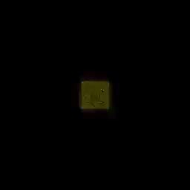
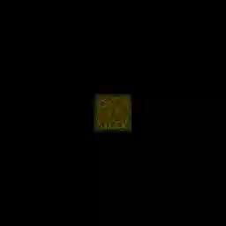
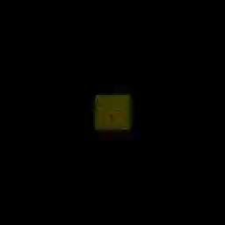
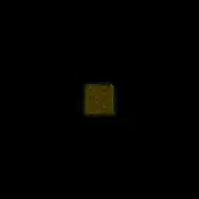
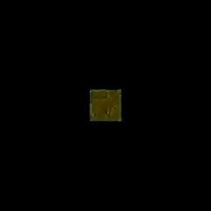
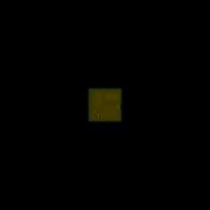
Results
Initial parameters
Generation 250
Generation 750
Generation 1000
Generation 1250
Generation 1500

Slide 15
References
Bert Wang-Chak Chan; July 13–18, 2020. "Lenia and Expanded Universe." Proceedings of the ALIFE 2020: The 2020 Conference on Artificial Life. ALIFE 2020: The 2020 Conference on Artificial Life. Online. (pp. pp. 221-229). ASME.
Mordvintsev, A., Niklasson, E., and Randazzo, E. (2022). Particle Lenia and the energy-based formulation. https://googleresearch.github.io/self-organising-systems/particle-lenia/.
Evosax Library: https://github.com/RobertTLange/evosax
From Conway to Lenia tutorial: https://colab.research.google.com/github/OpenLenia/Lenia-Tutorial/blob/main/Tutorial_From_Conway_to_Lenia.ipynb

