Slide 1
GatorDSR at Trec KBA 2013
Morteza Shahriari Nia, Christan Grant, Yang Peng, Daisy Wang, Milenko Petrovic
Data Science Research Lab, University of Florida

Slide 2
Overview
Introduction
System Overview
Cumulative Citation Recommendation
Stream Slot Filling
Results

Slide 3
Introduction
National Institute of Standards and Technology (NIST)
  Text REtrieval Conference (TREC)
    Knowledge Base Acceleration (KBA)
      Cumulative Citation Recommendation (CCR)
      Streaming Slot Filling (SSF)
13 Teams, 140 run submissions

Slide 4
Corpus
4.5 TB: Compressed and encrypted (sc.xz.gpg)
from 2011-10-05-00 until 2013-02-13-23
  11952 hours
  Oct. 2011 to Feb. 2012 is considered as training data
500+ million StreamItems (document)
  NER tags, Co-reference tags(Lingpipe)
  No POS tag
  Tokenized
Chunk files (.sc)
  (1~1000s) StreamItems
Blogs, linking(bitly), news, social, arxiv, twitter, …

Slide 5
Example Entities (ORG,FAC,PER)
http://en.wikipedia.org/wiki/Stuart_Powell_Field
https://twitter.com/CorbinSpeedway
http://en.wikipedia.org/wiki/John_D._Odegard_School_of_Aerospace_Sciences
http://en.wikipedia.org/wiki/Copper_Basin_Railway
http://en.wikipedia.org/wiki/Hayden_Smelter
http://en.wikipedia.org/wiki/Lewis_and_Clark_Landing
http://en.wikipedia.org/wiki/The_Ritz_Apartment_(Ocala,_Florida)
http://en.wikipedia.org/wiki/Great_American_Brass_Band_Festival
http://en.wikipedia.org/wiki/Innovis_Health
http://en.wikipedia.org/wiki/Hoboken_Reporter
http://en.wikipedia.org/wiki/Boris_Berezovsky_(businessman)
http://en.wikipedia.org/wiki/Boris_Berezovsky_(pianist)
http://en.wikipedia.org/wiki/Basic_Element_(company)
http://en.wikipedia.org/wiki/Basic_Element_(music_group)
https://twitter.com/GandBcoffee
https://twitter.com/WCoffeeResearch
https://twitter.com/evvnt
http://en.wikipedia.org/wiki/Charles_Bronfman
http://en.wikipedia.org/wiki/Clare_Bronfman
http://en.wikipedia.org/wiki/Edgar_Bronfman,_Jr.
http://en.wikipedia.org/wiki/Edgar_Bronfman,_Sr.
https://twitter.com/danvillekyengr
https://twitter.com/tonyg203
https://twitter.com/urbren00
http://en.wikipedia.org/wiki/John_H._Lang
http://en.wikipedia.org/wiki/Ana%C3%AFs_Croze
https://twitter.com/BartowMcDonald
https://twitter.com/KentGuinn4Mayor

Slide 6
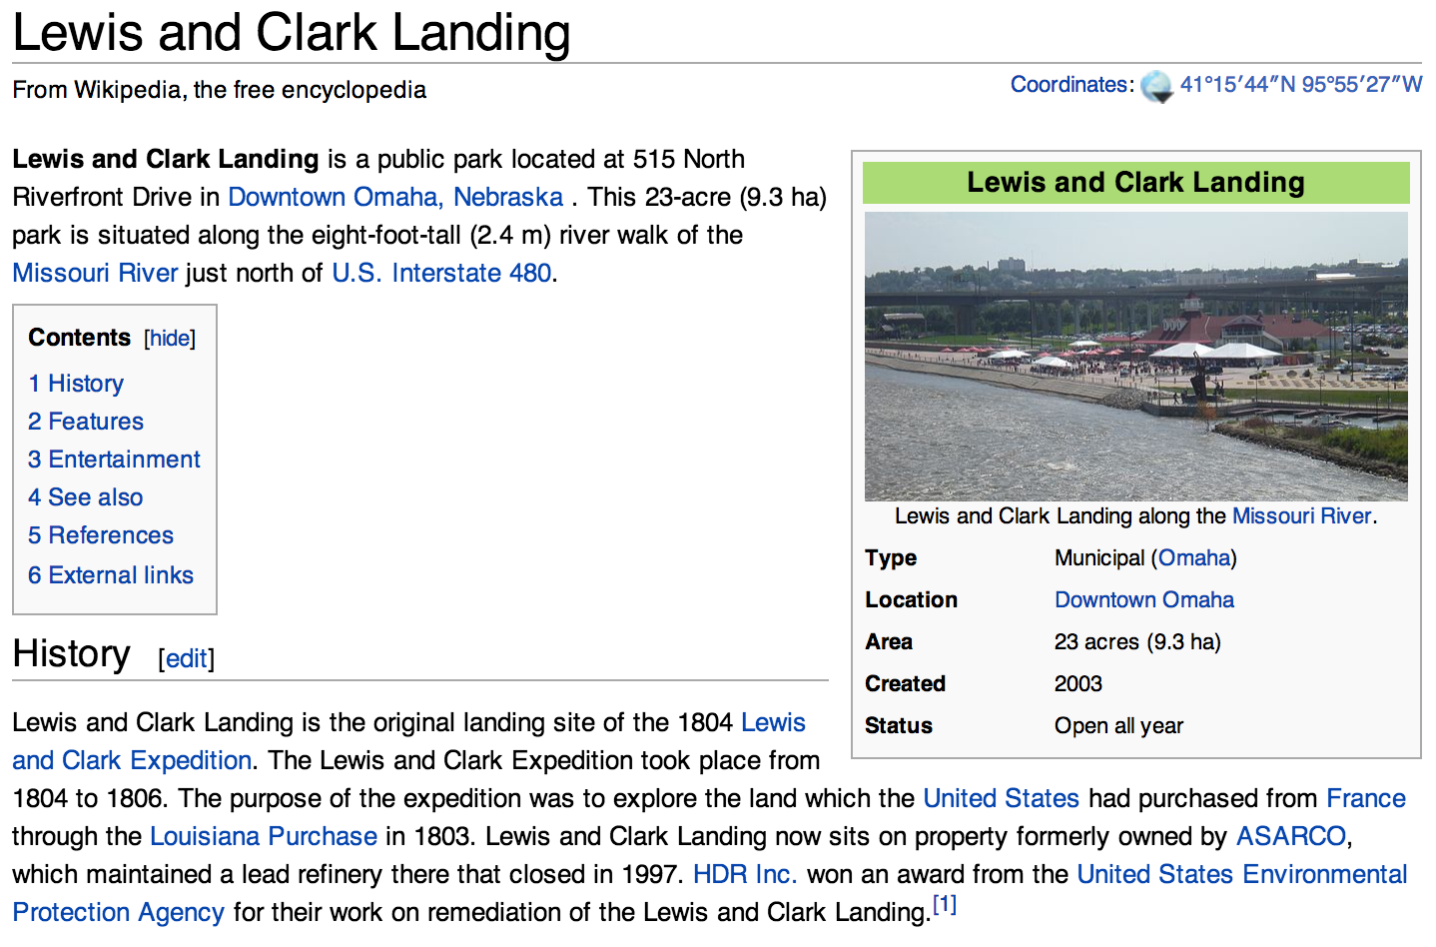

Slide 7
Cumulative Citation Recommendation
Wikipedia: Collaborative, encyclopedia
  Median time to cite: over a year
  Less frequently updated
  # of entities and mentions >> maintainers
Metrics
  Mention
    Explicit Mention
    Zero mention: “this administration” -> Obama
  Relevance
    Garbage: not relevant, spam
    Neutral: not relevant, no information could be learned for entity
    Relevant: mentions and indirectly related
    Central: related directly and worthy to be cited for this entity

Slide 8
Stream Slot Filling
We are interested in
  [Entity, Slot Name, Slot Value]
    [Obama, PresidentOf, USA]
To automatically populate knowledgebases such as Freebase or DBPedia or even fill-in the information boxes at Wikipedia.
Streaming slot filling
  With time slot values might change

Slide 9
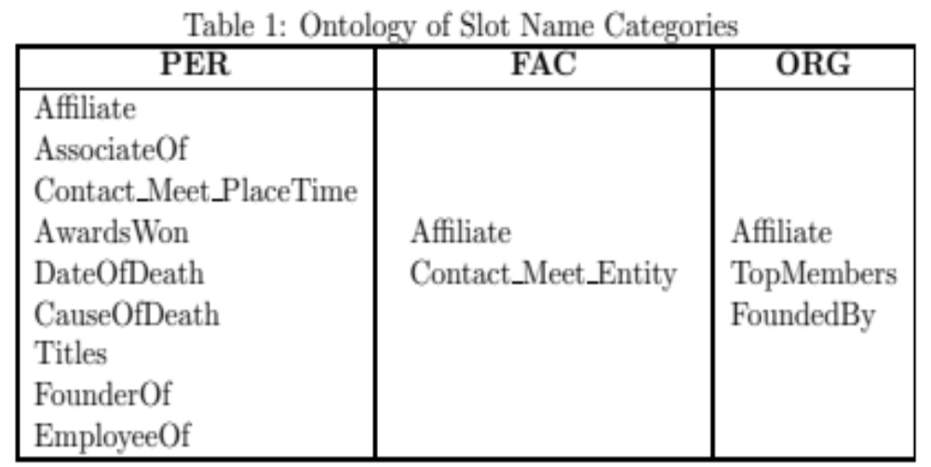

Slide 10
Example
Example: “Veteran songwriters and performers Ben Mason, Jeff Severson and Jeff Smith will perform on Saturday, April 14 at 7:30 pm at Creative Cauldron at ArtSpace, 410 S. Maple Avenue.”
  Entity: http://en.wikipedia.org/wiki/Jeff Severson
  Slot name: Affiliate
  Possible slot values: “Ben Mason”, “Jeff Severson”, “Jeff Smith”
  Incorrect slot values: “Creative Caldron”, “Art Space”
Example 3: “Lt. Gov. Drew Wrigley and Robert Wefald, a retired North Dakota district judge and former state attorney general, unveiled the crest Friday during a ceremony at the North Dakota Capitol.”
  Entity: http://en.wikipedia.org/wiki/Hjemkomst Center
  Slot name: Contact_Meet_PlaceTime
  Slot value: “Friday during a ceremony at the North Dakota Capitol”

Slide 11
System Overview
Preprocessing
Alias Extraction
(Wiki API, Wiki text)
Wikipedia
Manual Aliases Extraction (Twitter)
Name Order Generator
Chunk Files Index Generator
StreamItems Index Generator
Streaming Slot Value Extraction
High Accuracy Filter
Web Corpus
Streaming Slot Values
Cumulative Citation Recommendation
Streaming Slot Filling

Slide 12
Preprocessing
Alias Extraction
  Manual: for Twitter entities
  Automatic: for Wiki entities
    Wikipedia Backlink API
    Bold text/parenthesis in the first paragraph
      HTML DOM / Regex
Normalization
  Parenthesis
  International Characters
  Abbreviation
Name Order Generation
  Bill Gates: Gates, Bill; B. Gates; Gates, B.;…

Slide 13
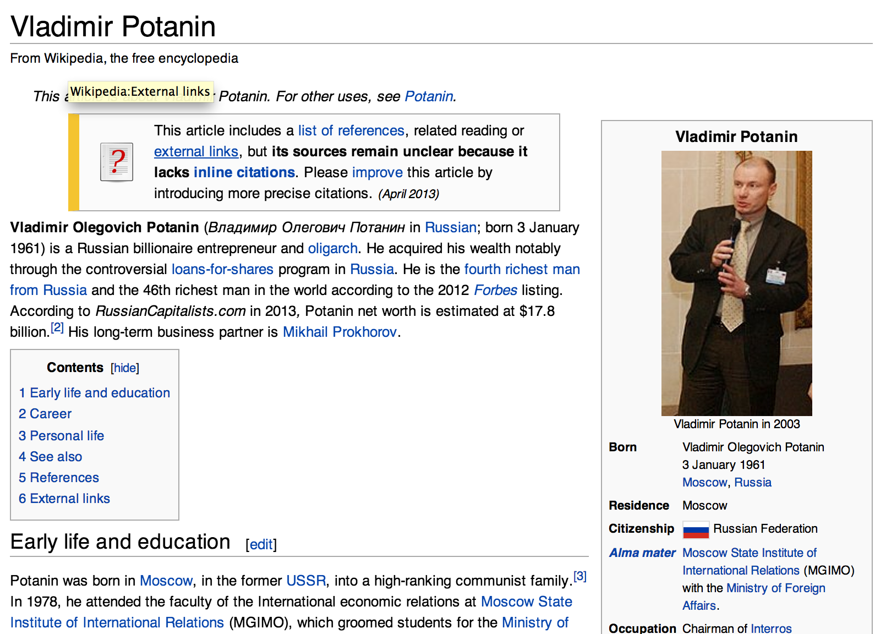

Slide 14
System Overview
Preprocessing
Alias Extraction
(Wiki API, Wiki text)
Wikipedia
Manual Aliases Extraction (Twitter)
Name Order Generator
Chunk Files Index Generator
StreamItems Index Generator
Streaming Slot Value Extraction
High Accuracy Filter
Web Corpus
Streaming Slot Values
Cumulative Citation Recommendation
Streaming Slot Filling

Slide 15
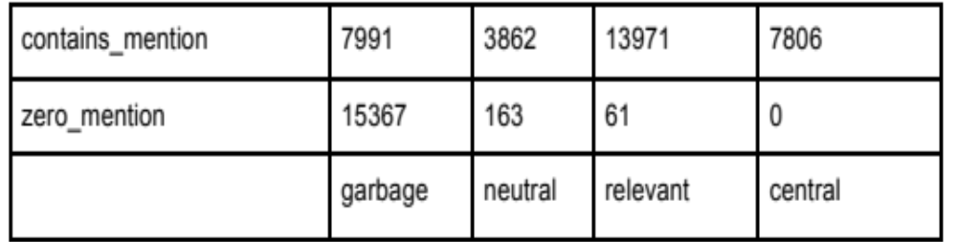
CCR
Two stages: Exact string matching
  Chunk Files Index Generator (+3 days)
    Prefilters Chunk files
    C code, multi-process 32 parallel jobs
  StreamItem Index Generator(+3 days)
    Generates Candidate StreamItems
    Java code, 64 thread pool
D.A. Roberts F. Niu C. Zhang C. R I. Soboroff J.R. Frank, M. KleimanWeiner. Building an entity-centric stream filtering test collection for trec 2012. The Twenty-First Text REtrieval Conference (TREC 2012) Proceedings, (21), 2012.

Slide 16
System Overview
Preprocessing
Alias Extraction
(Wiki API, Wiki text)
Wikipedia
Manual Aliases Extraction (Twitter)
Name Order Generator
Chunk Files Index Generator
StreamItems Index Generator
Streaming Slot Value Extraction
High Accuracy Filter
Web Corpus
Streaming Slot Values
Cumulative Citation Recommendation
Streaming Slot Filling

Slide 17
SSF
Steps: (+12 hrs)
  Input: Candidate StreamItems
  Sentence (Alias/Coreference given via Lingpipe tags)
  Match patterns
  Output: Extract slot value results

Slide 18
Pattern
Pattern: <a,b,c,d,e>
  a: Type of the entity
  b: Slot name
  c: Pattern content
  d: Direction of the slot value to the entity
  e: Type of the slot values

Slide 19
Pattern Types
Slot value type, NER tagged by Lingpipe
<PER, FounderOf, “founder”, right, ORG>
Slot value tagged as noun phrase by OpenNLP
<PER, AwardsWon, “awarded”, right, NP>
Slot value of time phrases, hard coded
<PER, DateOfDeath, “died”, right, “last night”>

Slide 20
System Overview
Preprocessing
Alias Extraction
(Wiki API, Wiki text)
Wikipedia
Manual Aliases Extraction (Twitter)
Name Order Generator
Chunk Files Index Generator
StreamItems Index Generator
Streaming Slot Value Extraction
High Accuracy Filter
Web Corpus
Streaming Slot Values
Cumulative Citation Recommendation
Streaming Slot Filling

Slide 21
High Accuracy Filter
+3 hrs
Window-based deduplication
  Same exact extraction
  Rows have the same slot name and a similar slot value
  Extracted sentence for a particular slot type come from the same sentence
Inference
  “X FounderOf Y” equals “Y FoundedBy X”
  “Contact Meet PlaceTime” as “Contact Meet Entity”
    If sentence contained an additional ORG/FAC tag

Slide 22
System Overview : Languages
C++
Java/Scala
Alias Extraction
(Wiki API, Wiki text)
Scala
Wikipedia
Manual Aliases Extraction (Twitter)
Name Order Generator
Training Data
Chunk Files Index Generator
StreamItems Index Generator
Streaming Slot Value Extraction
High Accuracy Filter
Web Corpus
Streaming Slot Values

Slide 23
Results
158,052 documents with query entities
17,885 unique extracted slot values
  11/12 slots
  139/170 entities

Slide 24
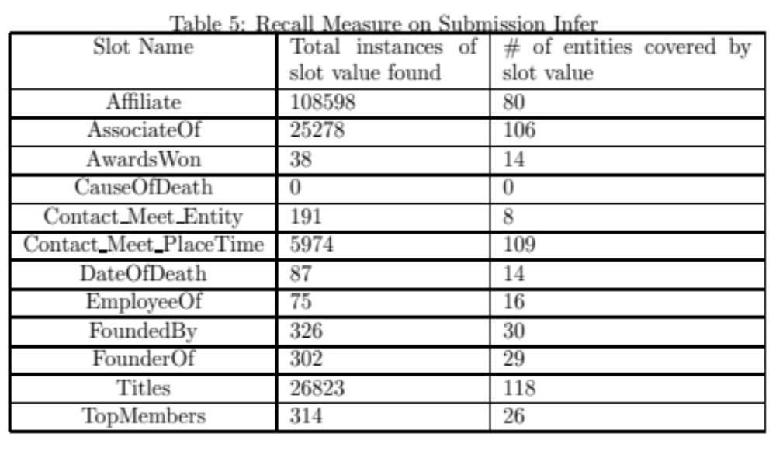
Recall

Slide 25
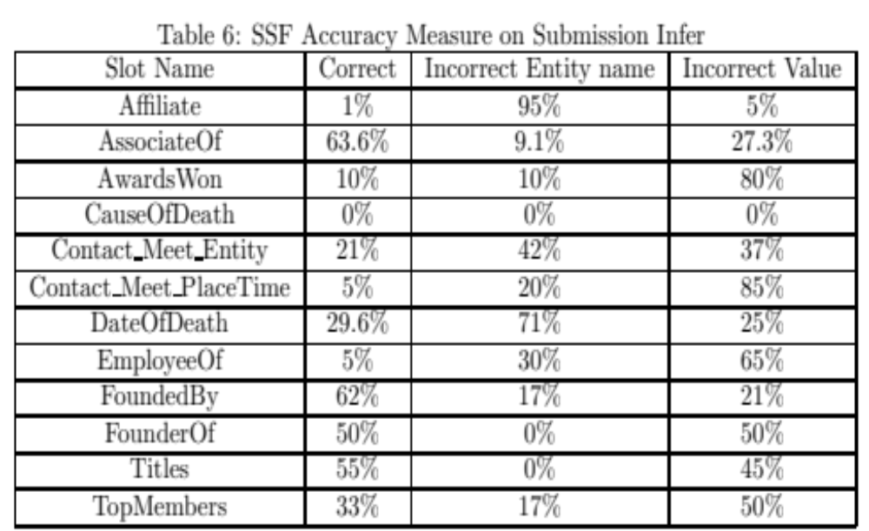
Accuracy

Slide 26
Incomplete Sections
Entity resolution
CCR scoring
Slot value classifier

Slide 27
Thank you

