Slide 1

Global Terrorism’s Influence on Twitter
Team 2
Harsh Shah Bhumit Sheth Tejas Shah
MS in Computer Science
Network Science(ICSI 531)
Prof. Chelmis Charalampos

Slide 2
Introduction
ISIS, the Islamic State, is a Sunni terrorist organization that has seized large portion of the Iraq and Syria.
Estimated 20,000 people from different countries have joined the ISIS.
They are recruiting more and more people and trying to influence people by various social platforms.
According to a study by the Brookings Institution, ISIS supporters used at least 46,000 Twitter accounts between September and December 2014 (Including Machine-Powered!).
ISIS mostly use twitter to share disseminate images of graphic violence, attract new recruiters.

Slide 3
Introduction
In our project, we have used the kaggle data set Exploration of ISIS network.
With the help of the dataset, we have created the network of different twitter account of the ISIS and the way they mention each other in the network.
This mention can be for spreading news among all the followers of the account holders.
Also we have included some graphs representations.

Slide 4
Original Proposal vs. What We Have Done
Originally we have proposed to do analysis of the news spreading of terrorist activity around the world by the counts of the retweet.
But due to privacy policies of twitter, we were not able to find the retweet of the originally retweeted tweet.
Professor suggest us to use different kaggle sets available on the website.

Slide 5
Data Set
Data set that we have used from kaggle.com has 17000 tweets from 100+ ISIS fanboys from all over the world since Paris attack.
Data sets includes following: Name of the account holder, username, tweet, numbers of follower they have and numbers of statuses.
From this data set we are doing social network cluster analysis.

Slide 6
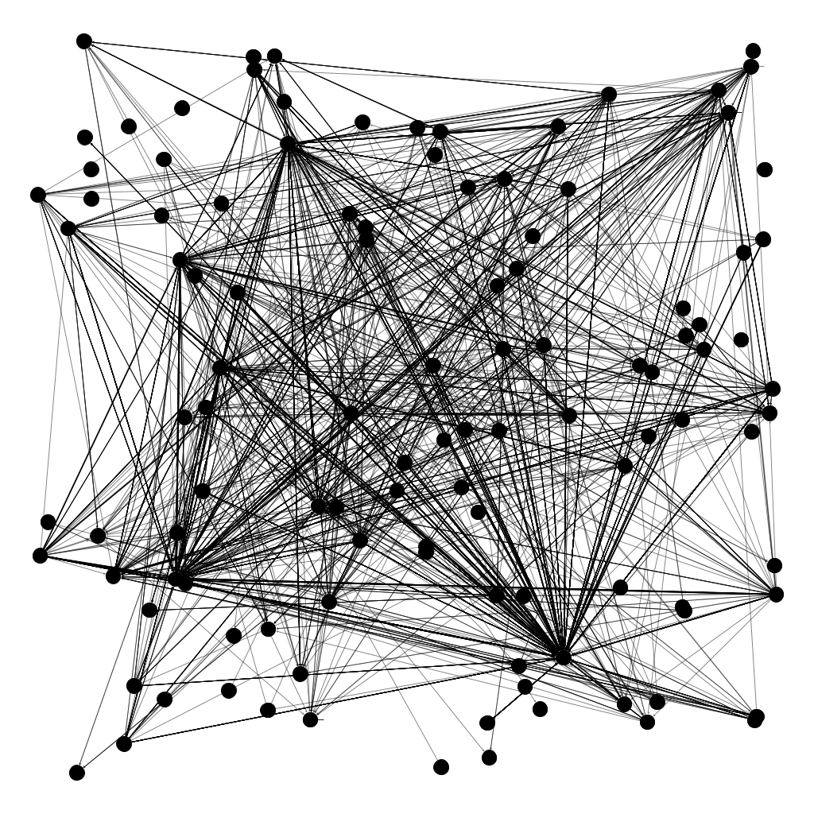
Generated Graph
Numbers of nodes: 113
Numbers of edges: 3928
Edge Type: Directed
Here, node represent different users.
Edges represent the mention of the users by other users in the tweet.

Slide 7
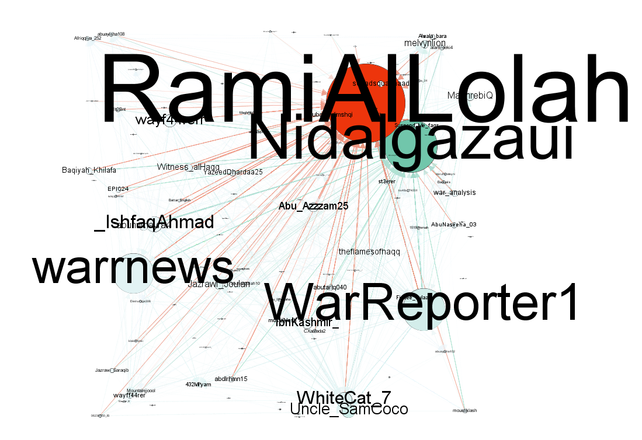

In-Degree Representation of the Graph

Slide 8
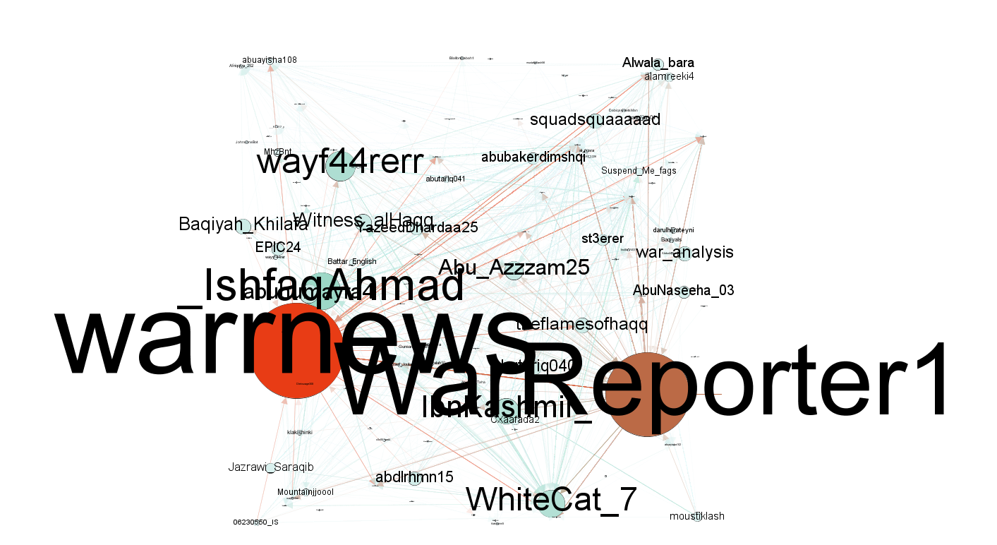
Out-Degree Representation of the Graph

Slide 9
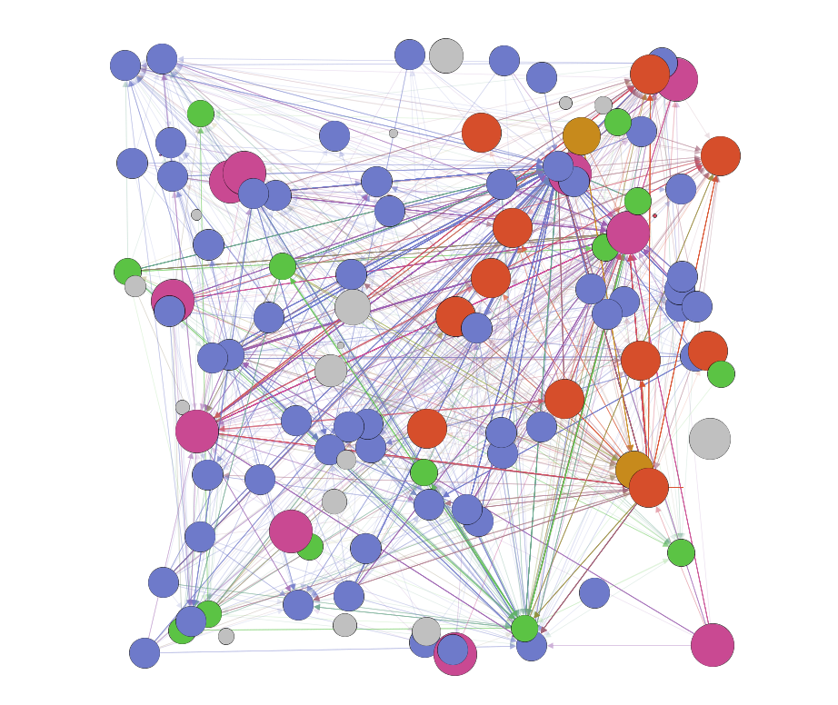
Modularity of the Graph

Slide 10
Analysis of In-Degree(Top-10 Nodes)
 | Node_id | Label | In-Degree | Out-Degree
1 | 97 | RamiAlLolah | 1293 | 0
2 | 13 | Nidalgazaui | 854 | 0
3 | 3 | Uncle_SamCoco | 205 | 0
4 | 103 | WarReporter1 | 181 | 513
5 | 23 | melvynlion | 116 | 0
6 | 9 | MaghrebiQ | 114 | 0
7 | 25 | Jazrawi_Joulan | 99 | 17
8 | 19 | WhiteCat_7 | 79 | 165
9 | 108 | warrnews | 71 | 577
10 | 111 | wayff44rer | 68 | 7

Slide 11
Analysis of Out-Degree(Top-10 Nodes)
 | Node id | Label | In-Degree | Out-Degree
1 | 108 | warrnews | 71 | 577
2 | 103 | WarReporter1 | 181 | 513
3 | 16 | _IshfaqAhmad | 19 | 225
4 | 11 | wayf44rerr | 11 | 180
5 | 19 | WhiteCat_7 | 79 | 165
6 | 74 | IbnKashmir_ | 0 | 153
7 | 75 | Abu_Azzzam25 | 28 | 109
8 | 42 | abuhumayra4 | 10 | 103
9 | 56 | Baqiyah_Khilafa | 3 | 90
10 | 78 | thefIamesofhaqq | 11 | 88

Slide 12
Comparison of In & Out-Degree(Top-10 Nodes)
 | Node id | Label | In-Degree | Out-Degree
1 | 108 | warrnews | 71 | 577
2 | 103 | WarReporter1 | 181 | 513
3 | 16 | _IshfaqAhmad | 19 | 225
4 | 11 | wayf44rerr | 11 | 180
5 | 19 | WhiteCat_7 | 79 | 165
6 | 74 | IbnKashmir_ | 0 | 153
7 | 75 | Abu_Azzzam25 | 28 | 109
8 | 42 | abuhumayra4 | 10 | 103
9 | 56 | Baqiyah_Khilafa | 3 | 90
10 | 78 | thefIamesofhaqq | 11 | 88

Slide 13
Problem Faced
First major problem that we have encountered was the new policy of the twitter.
Due to that we have to deviate from over original proposal.
In the kaggle dataset, there are more than 17000 tweets, but the data is not sorted properly.
There are many missing entries and some of the tweets are in the different language so we were not able to take the whole dataset.
We scale down the dataset to 4000 tweets and have taken all the usernames that are available in the dataset.

Slide 14
Conclusion
From the previously showed graph, we can identify the person who is behind pro-ISIS twitter network.
We have visualized this via a cluster network with the biggest influencers scaled larger than smaller influences.

Slide 15
?

Slide 16
Thank You

