Slide 1










The Cost of (not) Waiting
Christine Harvey
15 December 2015

Slide 2
Outline
Introduction
Background
Model Outline
Design
Components
Description
Verification & Validation
Model Experimentation
Results
Conclusions

Slide 3

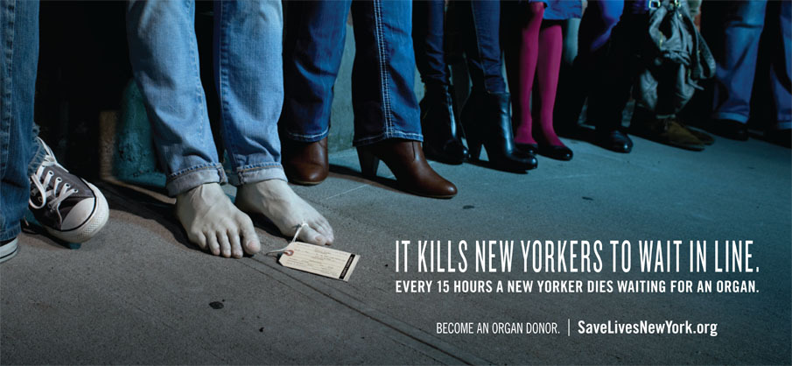
Organ Donation
http://osocio.org/message/an-organ-donor-live-twice/
http://www.liveonny.org/hate-the-wait/

Slide 4
Background
There is a shortage of donor organs in the US [2]
Over 120,000 Americans are on the waiting list for an organ
In 2014, over 11,000 candidates died or became too ill waiting for a transplant

Slide 5

Background
Waiting “lists” are managed by UNOS for:
Heart, Lung, Liver, Kidney, Intestine, Pancreas
Placement on the list is determined by many factors – NOT just waiting time
58 Donor Service Areas determine geographic allocation
Patient receives
alternative treatment
No
Patient Referred for Transplant
Patient Evaluated by for Suitability
Patient is
Suitable?
Yes
Patient is placed on the waiting list
Patients Matched to Available Organs and Ranked
Allocated
Organ?
Yes
Patient receives
transplant
No

Slide 6
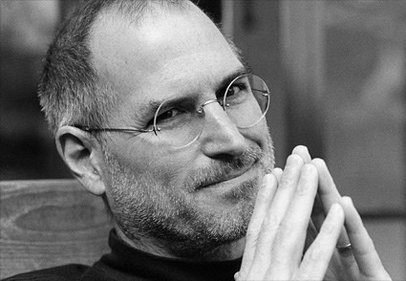
Background
In 2009, Steve Jobs traveled to Tennessee to receive a liver transplant [3]
Steve Jobs lived in California
Multiple registrations are completely legal within the UNOS Guidelines [4]
133,562 Registrations [2]
122,171 Candidates [2]
http://www.blogcdn.com/www.tuaw.com/media/2013/08/steve-jobs-black-white.jpg

Slide 7
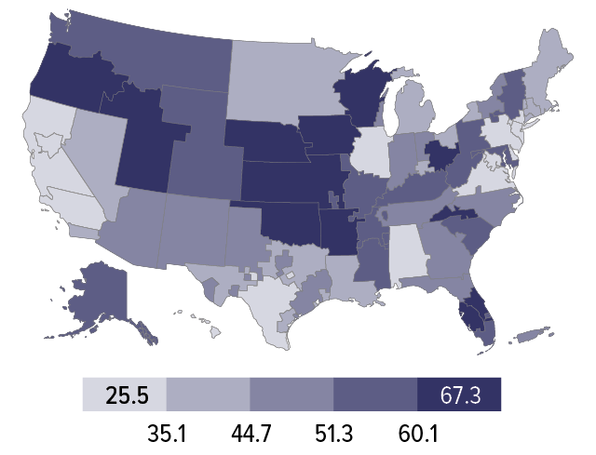
Background
Percent of adult wait-listed patients, 2007, who received a deceased donor kidney transplant within five years, by DSA [1]

Slide 8
Model Outline
Patients (agents) in need of an organ transplant
Patients are added to a waiting list in their primary location
“Advantaged” patients may be added to additional lists
Top patients on each list receive a transplant
Region 1: [ Emily, Louise, Jack, Scott ]
Region 2: [ Howard, Sandra, Brenda, Joan, Clarence ]
Region 3: [ Lori, Clarence, Richard ]
Region 1: [ Emily, Louise, Jack, Scott ]
Region 2: [ Howard, Sandra, Brenda, Joan, Clarence ]
Region 3: [ Lori, Clarence, Richard ]

Slide 9


Model Design
Model developed in Python 2.7 using Mesa [5]
Jupyter used for interactive model design and visualizations [6]
Built in Markup Capabilities
In-Line visualizations
https://www.python.org/community/logos/
https://github.com/jupyter

Slide 10

Model Description
Patients are the entity (agent) in the model
Patients have a state, waiting list registrations, and other descriptive data
Yes
Selected
Transplanted
Waiting
Top of List?
Patient Added
to Model
$T_{wait}>T_{life}$?
Deceased
Yes
No
No

Slide 11
Model Description
The patient has attributes:
Lifespan
T=N(98,24)
Waiting Time
T = ?
Regions
[X, Y, Z…]
State
W
S
T
D
Advantaged?
True
False

Slide 12
Model Description
Model Parameters:
Regions
Initial Patients
Additional Patients
Transplant Rates
Queue Probabilities
Advantage Probability
Average Lifespan

Slide 13
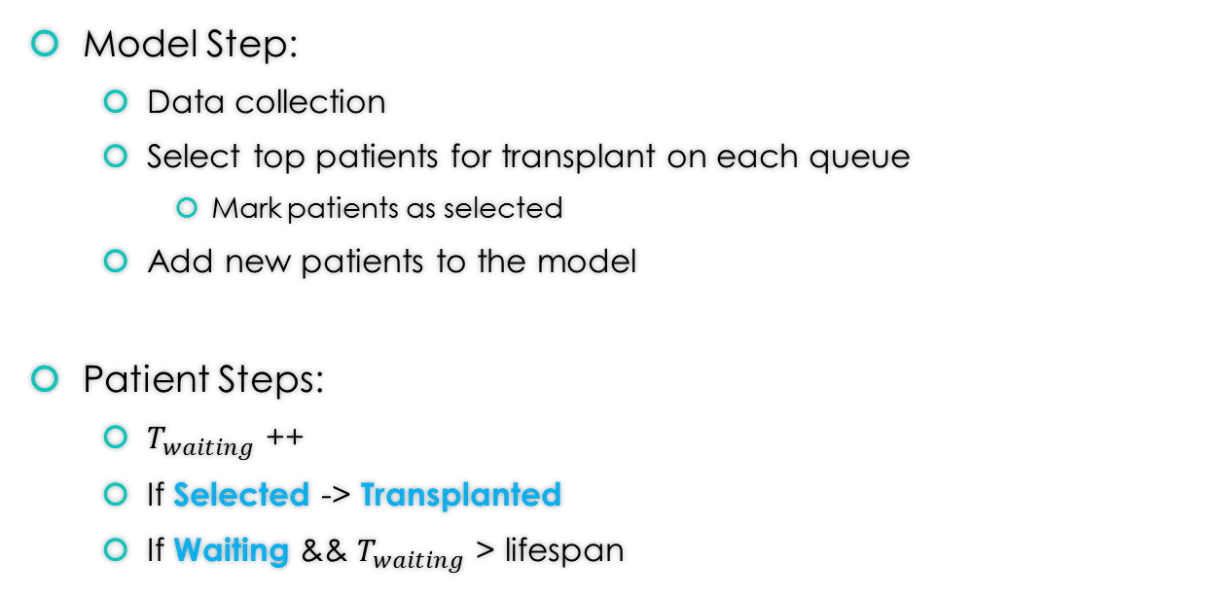
Model Description
Model Step:
Data collection
Select top patients for transplant on each queue
Mark patients as selected
Add new patients to the model
Patient Steps:
$T_{waiting}$ ++
If Selected -> Transplanted
If Waiting && $T_{waiting}$ > lifespan

Slide 14
Model Description (Demo)

Slide 15
Verification and Validation
Checked model outputs in small batches and for trial runs
Compared to actual data and data available from the OPTN website

Slide 16
Results
For test runs, the model was run with data representing four Donor Service Areas [2]:
CAOP-OP1 OneLegacy (California)
ILIP-OP1 Gift of Hope (Illinois)
INOP-OP1 Indiana Donor Network (Indiana)
MNOP-OP1 LifeSource Upper Midwest OPO (Minnesota)

Slide 17
Results
Regions = 4
initial_patients = 16000
additional_patients = 2800
transplant_rates = [610, 370, 188, 255]
queue_probabilities = [0.42, 0.26, 0.11, 0.21]
advantage_prob = 0.05
average_lifespan = 98
Based on a simple linear projection, expected to grow by ~6000 over 10 years

Slide 18
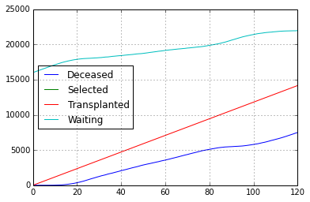
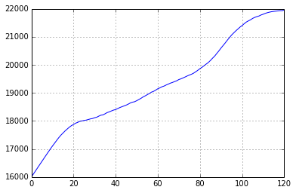
Results
Overall Patient States
Waiting List Size

Slide 19
Batch Runs – Vary Advantage

Slide 20
Conclusions
Model provides an exploratory view of patient advantages in the transplant system
Allowing multiple wait listings does not affect the number of transplants performed

Slide 21
Questions
http://osocio.org/message/an-organ-donor-live-twice/
http://www.liveonny.org/hate-the-wait/

Slide 22
References
[1] 2012 Annual Report of the U.S. Organ Procurement and Transplantation Network and the Scientific Registry of Transplant Recipients. Department of Health and Human Services, Health Resources and Services Administration, Healthcare Systems Bureau, Division of Transplantation, Rockville, MD; United Network for Organ Sharing, Richmond, VA; University Renal Research and Education Association, Ann Arbor, MI. (http://srtr.transplant.hrsa.gov/annual_reports/2012/Default.aspx)
[2] Organ Procurement and Transplantation Network, "Organ Procurement and Transplantation Network," 14 December 2015. [Online]. Available: http://optn.transplant.hrsa.gov/.
[3] Cox, Lauren, "Steve Jobs' Reported Liver Transplant Stirs Debate", 2009. [Online]. Available: http://abcnews.go.com/Health/Economy/story?id=7902416. [Accessed 04-October-2015].
[4] The United Network for Organ Sharing, "Questions \& Answers for Transplant Candidates about Multiple Listing and Waiting Time Transfer", 2015. [Online]. Available: https://www.unos.org/wp-content/uploads/unos/Multiple\_Listing.pdf. [Accessed 04-October-2015].
[5] Project Mesa Team. "Mesa: Agent-based modeling in Python 3+", 2015. [Online]. Available: https://github.com/projectmesa/mesa/. [Accessed 02-December-2015].
[6] Project Jupyter. "Jupyter Notebooks", 2015. [Online]. Available: http://jupyter.org/. [Accessed 04-December-2015].
All Graphics in the slide designs are from the UNOS Website: https://www.unos.org/donation/basic-path-to-donation/

