Slide 1




Short Talk about CISTools at TGIF/DKRZ Meeting 1th March 2018
Based on the Workshop Presentation in 2016 by the CISTools Authors.
Notes:
The aim is: Get to know CIS, what it is, and get hands on-experience of what it is capable of. We’ll only be scratching the surface here - if you want more detail then register on our website and get notified about up-coming user workshops. These are 1-day workshops which go into much more detail.

Slide 2
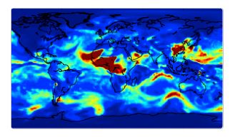
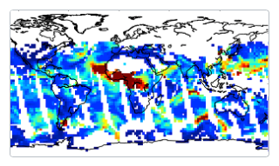
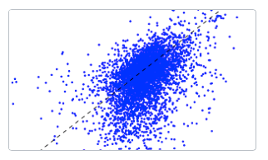
What is CIS?
“CDO for Observational Data”: Satellite, in-situ and model.
Read
Analyse
Visualise
Read your data
Analyse your data
Visualise your data

Slide 3
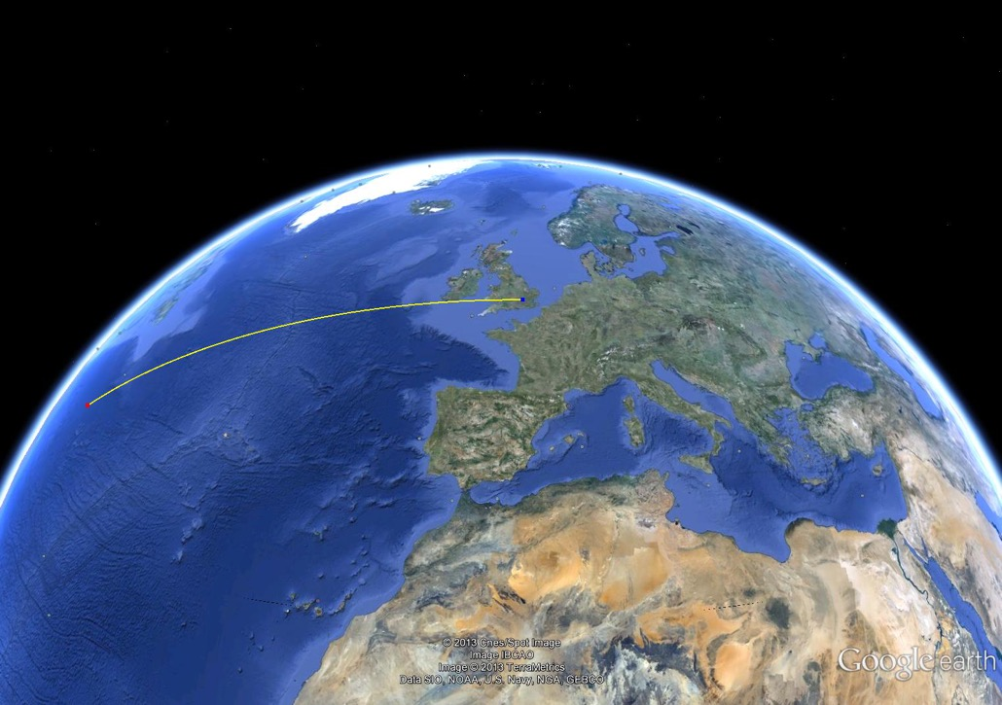


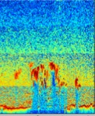


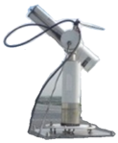
Extensible data reading
Visualise
Analyse
Read
Notes:
ESA Aerosol and Cloud CCI product, MODIS, Cloud CCI, Cloudsat, AERONET
HadGEM, ECHAM, any CF conformant model data
Aircraft data
Plugins allow CIS to interpret user data

Slide 4
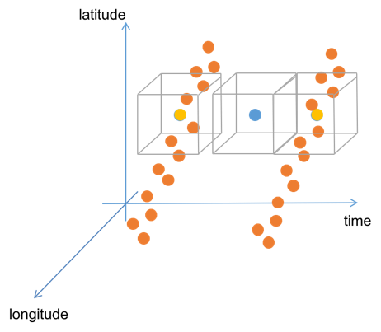
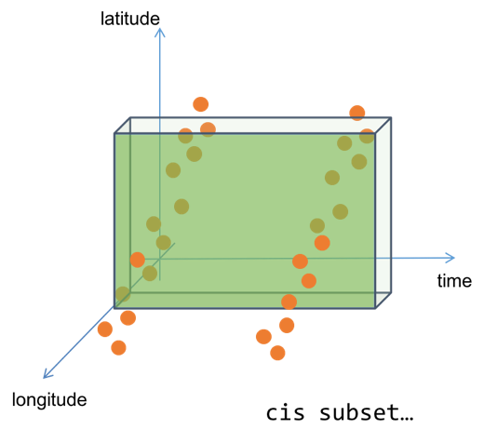
Flexible data analysis
Analyse
Visualise
Read
cis col …
cis aggregate …

Slide 5
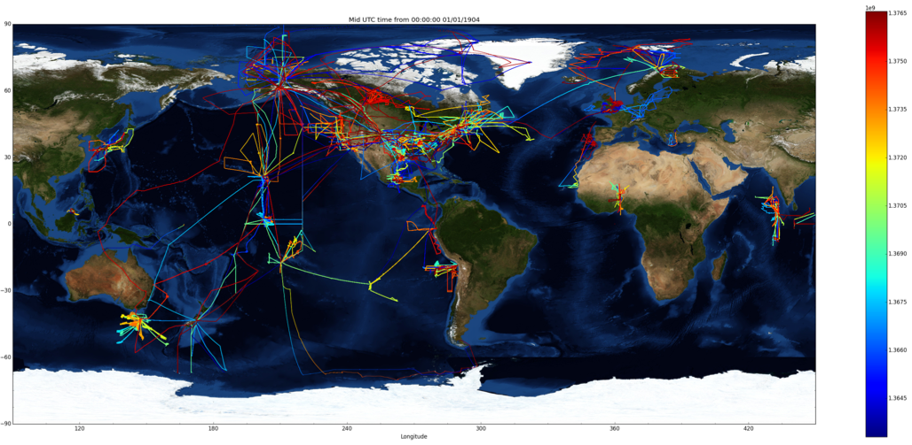
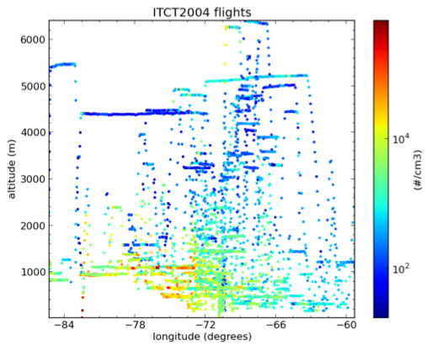
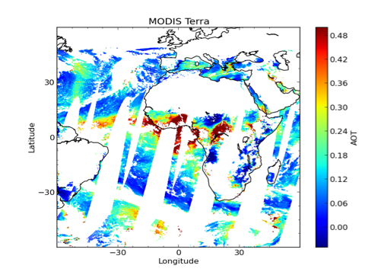
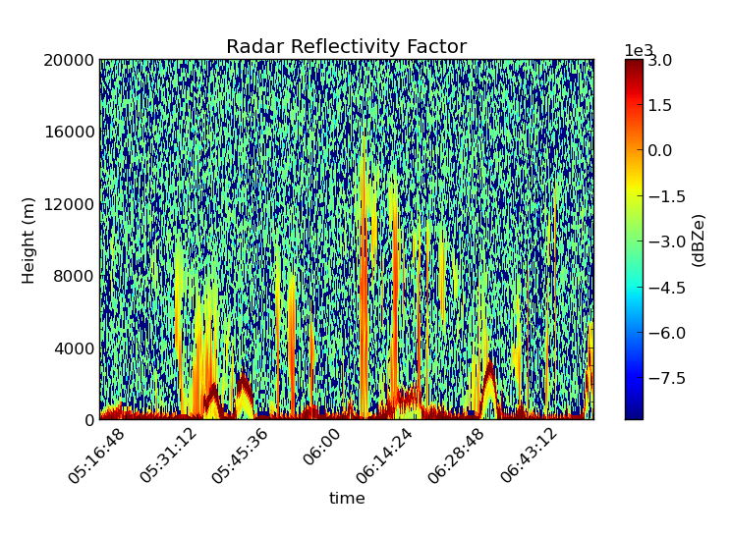
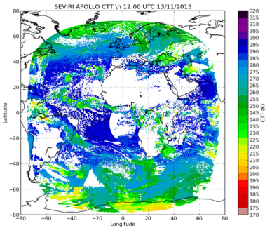
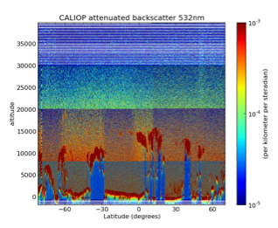
Comprehensive visualisations
Visualise
Read
Analyse
cis plot…
GASSP aircraft
MODIS AOD
SEVIRI
CloudSat
CALIOP

Slide 6
Basic interface introduction
Notes:
30 minutes

Slide 7
Command line interface
Basic structure
CIS <command> <variable>:<file>:<options> <options>
The command to run
(e.g. col, plot)
Global options
(e.g. output filename)
This is a “datagroup”
Options specific to this datagroup

Slide 8
Command line interface
Basic structure
Variable wildcarding
CIS aggregate AOD*:<file>:<options> <options>

Slide 9
Command line interface
Basic structure
Variable wildcarding
Filename wildcarding
CIS aggregate “AOD*”:“my_*_file_?_[0-9]”:<options> <options>
Notes:
This is a much more complex example. Note we put quotes around wildcards to be on the safeside.
You can also specify whole directories – but be careful there are no other files in there
If we need to we can also escape the colons using \

Slide 10
Command line interface
Basic structure
Variable wildcarding
Filename wildcarding
Much more detailed help can be found at: cis.readthedocs.org

Slide 11
Hands-on with CIS
Notes:
Now we’re going to get hands on with CIS so you can try it out yourself.
Don’t forget to do: ‘source activate cis_env’ to activate you environment

Slide 12
Hands-on with CIS
Install cistools with conda:
And download the test data
Then you can use CIS to get a feel for the contents of the files:
conda create -c conda-forge -n cis_env cis
source activate cis_env
cis info ARCPAC_2008

Slide 13
Lat/lon plots
Similarly we can plot the aircraft data:
cis plot NUMBER_CONCENTRATION:ARCPAC_2008
Or, perhaps adding a nice background:
cis plot NUMBER_CONCENTRATION:ARCPAC_2008 --nasabluemarble
We can plot the satellite data too:
cis plot AOD550:AerosolCCI/20080415*.nc --xmin -170 --xmax -100 --ymin 35 --ymax 80

Slide 14
Global model plot
Show the variables in a CMIP5 data file:
cis info cmip5/tas.nc
Taking a time average:
cis aggregate tas:cmip5/tas.nc t -o tas_average.nc
And plot it:
cis plot tas:tas_average.nc
Take a subset and plot it again:
cis subset tas:tas_average.nc x=[-0,50],y=[30,80] --o tas_subset.nc
cis plot tas:tas_subset.nc

Slide 15
Comments from the Author
CDO for observational data
started as a command line tool but is mostly used as a Python library now
builds on Iris (MetOffice)
main selling point is reading weird and wonderful satellite and in-situ (and model!) data into an Iris Cube-like object, and allowing easy spatio-temporal collocation between them

Slide 16
Community and Future Plans?
There are lots of downloads (20k+) and it appears to have a healthy user base
Currently only me developing it in my spare time
Our future plans are mostly around making the most of dask. Moving to Dask/xarray with version 2.0 in 2019.
In touch with the ESMValTool team about using CIS for reading observational data directly into their analysis code

Slide 17

Summary
CIS is an open source python toolbox for reading, analysing and visualising earth sciences data
Lots of support for community developed plugins
There is also a Python API available
Future work:
Support for ‘hybrid’ semi-gridded data types
Vector plots… and more!
Join us at cistools.net
Follow us @cistoolsnet

Slide 18
Resources
Homepage: http://cistools.net/
CIS Workshop in 2016
Jupyter Notebook
Example Data
CIS Paper

Slide 19
Spare slides

Slide 20
Collocation command
CIS col <source> <sample>:<options> -o <output>
Data that will be remapped
New spatio-temporal sampling
CIS col <variable>:<model data> <model data>:collocator=lin
CIS col <variable>:<model data> <obs data>:collocator=lin
CIS col <variable>:<obs data> <model data>:collocator=bin,kernel=mean
CIS col <variable>:<obs data> <other obs data>:collocator=box[<options>]

Slide 21
Collocation options
sample
 | gridded | ungridded
gridded | lin, nn, box | lin, nn
ungridded | box, bin | box
source
lin : linear interpolation in space and time
nn : Nearest Neighbour
bin : operates kernel on all source data in sample bounds
box : operates kernel on all source data in user-defined box on sample

Slide 22
bin/box use in collocation
latitude
time
longitude
source data
sample data
user-defined box
resampled data

Slide 23
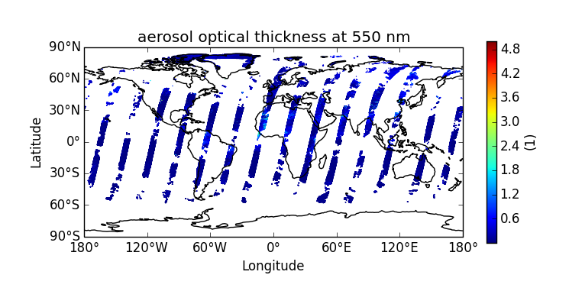
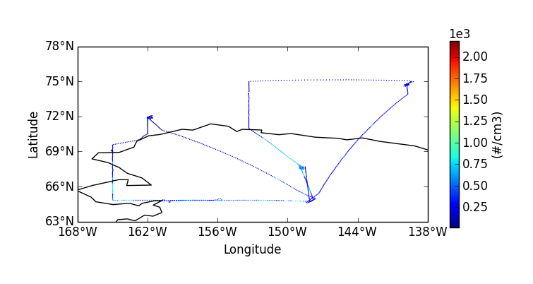
Aircraft onto Satellite
Notes:
As you can see the difficulty here is the sparseness of the aircraft data, and actually of the satellite data in this region.

Slide 24
Aircraft onto Satellite
First subset the satellite data:
CIS subset AOD*:AerosolCCI x=[-170,-100],y=[35,80] --o aerosol_cci_subset_Alaska
We now have a much reduced dataset:
CIS plot AOD550:cis-aerosol_cci_subset_Alaska.nc --itemwidth=4
Now we do the collocation:
CIS col NUMBER_CONCENTRATION,SUPERSATURATION:ARCPAC_2008/*.nc
cis-aerosol_cci_subset_US.nc:variable=AOD550,collocator=box[h_sep=10,t_sep=P1D]
-o collocated_ccn_AOD550

Slide 25
Aircraft onto Satellite
Now we can do a comparison plot:
CIS plot NUMBER_CONCENTRATION:cis-ccn_collocated_to_AOD550.nc
AOD550:cis-aerosol_cci_subset_Alaska.nc
--type comparativescatter --itemwidth=4
Or just plot the collocated data:
CIS plot NUMBER_CONCENTRATION:cis-ccn_collocated_to_AOD550.nc --itemwidth=4
Lets look at the correlation for these few points:
CIS stats NUMBER_CONCENTRATION:cis-collocated_ccn_AOD550.nc
AOD550:cis-aerosol_cci_subset_US.nc
Notes:
As we can see the gradient of the linear fit is pretty much zero

Slide 26
Architecture
HDF
NetCDF4
ASCII
Low-level
data reading
MODIS
CALIOP
Cloud CCI
NCAR-RAF
Model data
Aeronet
Data plugins
CommonData
Interface layer
Subsetting
Aggregation
Collocation
Statistics
Plotting
Analysis routines
and commands
Notes:
CommonData is an abstract base class with two concrete subclasses GriddedData and UngriddedData. Reiterate that these are all CIS software ‘modules’, not data files

Slide 27




GriddedData
Data
$$G_{ijk}$$
Latitude
$$k$$
Longitude
$$i$$
Time
$$j$$
Notes:
GriddedData is just a thin wrapper around the Iris Cube – see http://scitools.org.uk/iris/docs/latest/userguide/iris_cubes.html#cubes-in-practice for more details, and the inspiration for this diagram.

Slide 28


UngriddedData
$$i$$
Data
Time
Latitude
Longitude
$$j$$
Notes:
UngriddedData is a set of numpy arrays for the data and each of the coordinates (and some associated metadata). Each of the arrays need to be the same shape – but not necasarily 1-dimensional.

