Slide 1
CP4CDS: Climate Predictions for the Copernicus Climate Data Store
An extended ESGF sub-system populated and configured to support the Copernicus Climate Data Store

Slide 2
Project structure
WP | Name - Leader | Description
1 | Management and CDS liaison - Bennett (CEDA) | Responsible for overall architecture, reporting, workshops, engagement.
2 | Data Management - Juckes (CEDA) | Responsible for ensuring appropriate data available and fit for purpose.
3 | Data Node Software - Denvil (IPSL) | Responsible for the software deployed in the data node (and elsewhere)
4 | Compute Node Software - Kindermann (DKRZ) | Responsible for compute node software (which may or may not be used elsewhere)
5 | Interface and Tools - Stephens (CEDA) | Responsible for tools and interfaces used by those building code to deploy in compute nodes.
6 | Integration and Operation - Kershaw (CEDA) | Responsible for the integration and deployment of the running system(s)
Notes:
Skip this if you want – just in case you’d like this one

Slide 3
CP4CDS: Aims
Provide:
A quality controlled subset of CMIP5 data to the CDS
Develop ESGF data node software, e.g. Migrate data node software to containers for easier deployment.
Deploy data and compute services across three sites: CEDA, DKRZ and IPSL,
Provide a geographic load balance across these sites
Develop compute node software based on birdhouse
Develop tools for interaction with ESGF:
e.g. esgf-pyclient (Python interface to ESGF), Synda (data replication tool)
SDDS (Software Dependency and Deployment Solution) environment so developers and service providers can share the same compute environment.
Notes:
Quick overview of CP4CDS

Slide 4
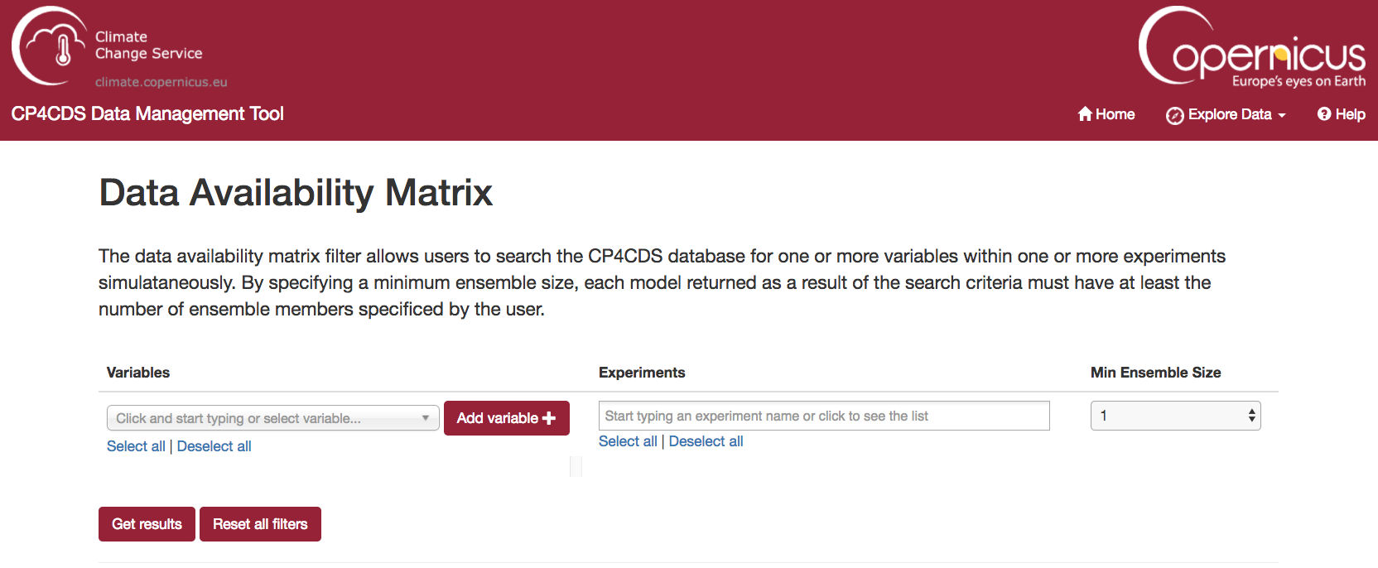
Data Management
Provide a subset of CMIP5 data - cp4cds-index1.ceda.ac.uk
Interrogate CP4CDS data web-app: cp4cds-qcapp.ceda.ac.uk
Data availability matrix:
Notes:
This is WP2: Data management,
Run at CEDA by Martin J. and Ruth P.
Step 1. Provide a web app for data availability interrogation please advertise this is now live at cp4cds-qcapp.ceda.ac.uk
Step 2. Is to provide the QC information – we are working on this and will be available at some point this year, likely end of summer and the web app will be extended.
Screen shot is of the “Data Availability Matrix” part of the app (this was a milestone)

Slide 5
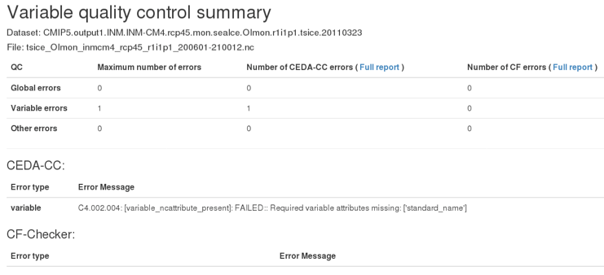
Data Management – QC
Quality control information will become available
Aggregated QC information on models or variables
Detailed file QC information
QC Tools
CEDA-CC
CF-Checker
Time-Checker (new)
(https://github.com/cedadev/time-checks)
Notes:
Again WP2 We will provide QC information aggregated in different ways eg by model or variable and allow user to interrogate further.
The tools used to do the QC are CEDA-CC, that is the CEDA compliance checking tool developed by Martin J. available as python package.
Standard CF checker
Finally a time-checker that has been written specifically for this which does single and multifile time checks.

Slide 6
SUMMARY

