Slide 1
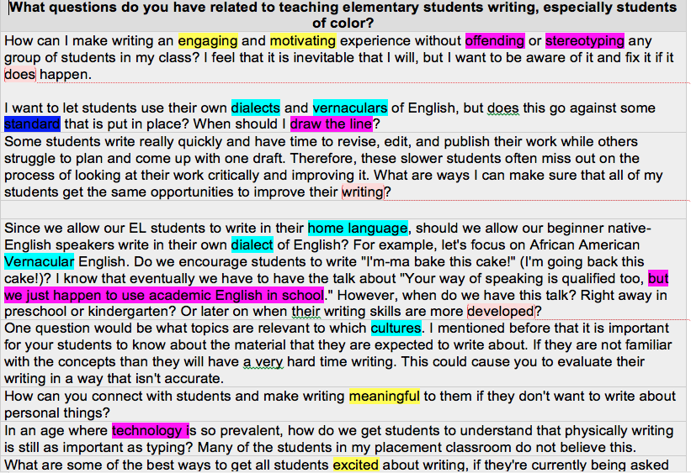
Teaching Writing: Embracing a Culturally Relevant Pedagogy
Keitha-Gail Martin-Kerr
University of Minnesota
Abstract
Culture and learning are inextricably intertwined. This study investigated 22 per-service teachers’ preparedness to teach writing to racially marginalized elementary students utilizing students’ culture as an integral aspect of writing instruction. This study used Culturally Relevant Pedagogy framework to understand pre-service teachers’ beliefs about teaching writing. The study shows pre-service teachers emerging understandings of the relevance of using students’ culture to teach writing and their inner tensions with balancing state standards while incorporating students’ culture in writing instruction. Implications point to the need for pre-service teachers to garner more experiences during their teacher preparation to teach racially marginalized students using students’ culture as the basis for instruction.
Research Questions
How prepared are predominately white pre-service teachers to teach writing to racially marginalized elementary students using students’ culture as the basis of the writing instruction?
What factors contribute to predominately white pre-service teachers preparedness to teach writing to racially marginalized students?
How do predominately white pre-service teachers measure their efficacy to teach writing to racially marginalized students?
Theoretical Framework
Ladson-Billings (1990, 1992, 1995) coined the term culturally relevant pedagogy to describe teaching that ensures students’ academic success, maintain students’ cultural competence, and challenge students to question the status quo. Geneva Gay (2010) and Lisa Delpit (2003) continued to build on this work, affirming the deep connection between culture, teaching and learning. This study seeks to better understand the culturally relevant pedagogue of predominately white pre-service teachers who teach racially marginalized students writing.
Methods
In this qualitative research, an open-ended survey was used as a source of data collection. Qualitative content analysis (Berg & Lune, 2004; Guba & Lincoln, 1994) was used to analyze extended responses to questions posed. The responses were coded for content and also for contextual meaning. The data was systematically coded, through the process of reading and repeated re-readings, for categorizing themes and patterns. While reading and coding, notes were collected on thoughts and impressions of the analysis. Initial categories of themes and patterns were combined into smaller categories based on additional re-reading of the data.
Content Analysis of Data
Data Source
A. Open-ended survey sample questions:
How would you differentiate writing instructions to meet the needs of all learners, specifically racially marginalized students?
Give examples of how your teacher preparation equipped you to work with racially marginalized students in the area of writing
How comfortable do you feel with your ability to teach writing to racially marginalized students?
What questions or concerns do you have related to teaching elementary students writing, especially racially marginalized students?
B. Lesson reflections
C. Video recordings of writing lessons taught
Results
Preliminary results indicated pre-service teachers were concerned about the use of students’ home language in their writing.
Primary concerns were the use of students’ home language and the demand to align teaching with the English Language Arts Common Core State Standards.
Pre-service teachers expressed concerns of how to motivate students to write, especially struggling writers.
The data showed pre-service teachers were troubled that some parents were not writing at home, therefore suggesting, students would not want to write at school.
Predominately white pre-service teachers were concerned about teaching racially marginalized students writing for reasons namely: stereotyping, cultural dissonance, and patronizing overtones
Implications
Racially marginalized students are lagging behind their white peers in the area of writing; preliminary result of this research is very promising in furthering the discussion on how to lessen this gap through teacher preparation that embraces culturally relevant pedagogy and culturally responsive teaching.
It is incumbent on educational stakeholders to ensure that pre-service teachers are prepared to teach writing to racially marginalized students because effective instruction in writing depends on teacher content knowledge, beliefs, and attitudes.
There is a need for the dissemination of pre-service teachers’ voices as it relates to their efficacy in teaching writing to racially marginalized students with culture as the framework of that writing instruction.
Teacher education institutions should offer writing methods courses to pre-service teachers in order to prepare them to teach writing to all students.
Offering a Writing Methods, stand alone, course has the potential to build pre-service teachers’ confidence as writers and empowering them to become teachers of writing.
There is a need for teacher education programs not only to look at grades and teacher licensure examination scores but also at the underlying beliefs, self-efficacy, and even fears of pre-service teachers as it relates to teaching racially marginalized students.
Bibliography
Berg, B. L., & Lune, H. (2004). Qualitative research methods for the social sciences (Vol. 5). Boston: Pearson.
Delpit, L. (2003). Educators as" seed people" growing a new future. Educational Researcher, 7(32), 14-21.
Gay, G. (2010). Culturally responsive teaching: Theory, research, and practice. Teachers College Press.
Guba, E. G., & Lincoln, Y. S. (1994). Competing paradigms in qualitative research. In N. K. Denzin & Y. S. Lincoln (Eds.), Handbook of Qualitative Research (pp. 105-117). Thousand Oaks, CA: Sage.
Ladson‐Billings, G. (1990). Like lightning in a bottle: Attempting to capture the pedagogical excellence of successful teachers of black students 1. International Journal of Qualitative Studies in Education, 3(4), 335-344.
Ladson-Billings, G. (1992). Culturally relevant teaching: The key to making multicultural education work. In C.A. Grant (Ed.), Research and multicultural education: From t he margins to the mainstream, 106-121. London: Falmer Press
Ladson‐Billings, G. (1995). But that's just good teaching! The case for culturally relevant pedagogy. Theory into practice, 34(3), 159-165.

