Slide 1
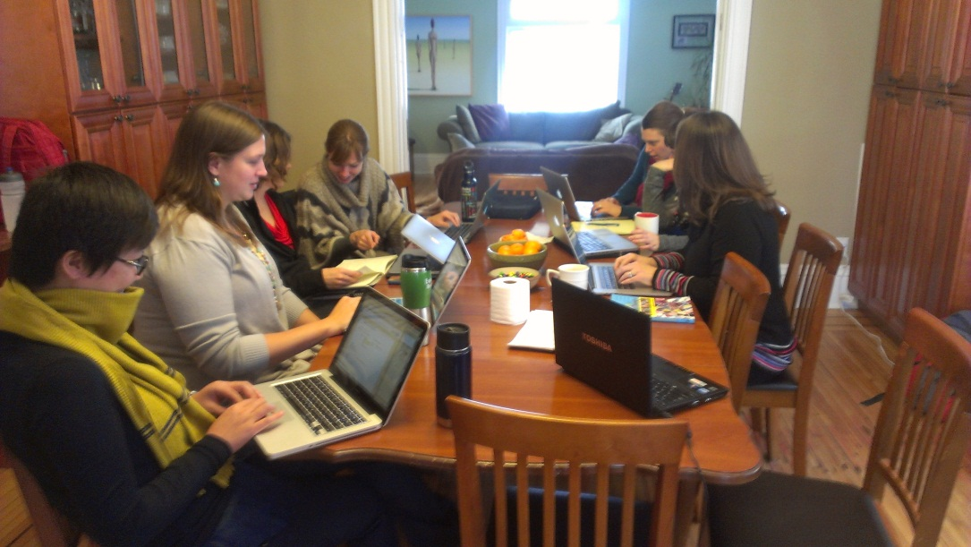
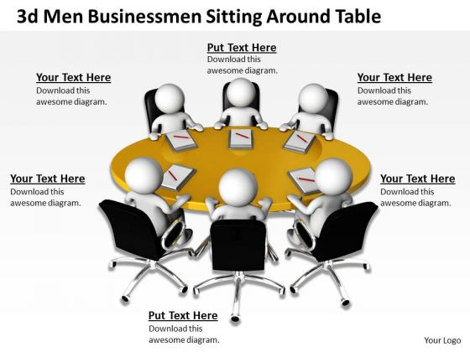
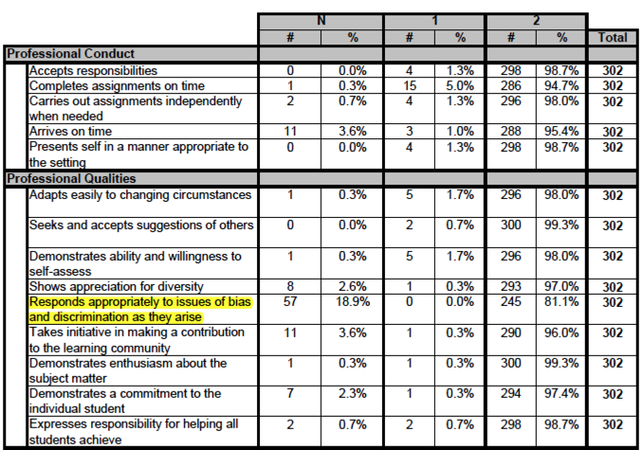
Conceptualizing and Developing a Dispositions Assessment Framework for Beginning Teachers
Conceptualizing
Designing
Validating
Conceptual Framework
Defining Dispositions
Establishing Evidence of Construct Validity
Dispositions are attributed characteristics that manifest in observed behaviors that illustrate the way an individual interprets the world, makes judgments, and takes action in a particular manner under particular circumstances.
Teachers’ dispositions are shaped through and develop within complex and contingent sociocultural contexts and draw upon the knowledge, skills, values, and beliefs of the educator in interactions with students, colleagues, families, and communities.
Research Literature on Dispositions
Professional contract language in local school districts
Formative Assessment
Dispositions can be cultivated, coached, and changed and are not fixed personality traits (Diez & Murrell, 2010; Salazar, Lowenstein, & Brill, 2010; Whitcomb, 2002)
Authored by the TERI Research Group
Dispositions Assessment Framework
Creating Disposition Assessment Strands
Standards of Effective Instruction (SOEI)
in Minneapolis Public School
Interstate Teacher Assessment and Support Consortium (InTASC) Standards
ASSETS: Uses the assets and strengths of students, families, and communities to inform teaching and learning.
ROLE OF SELF: Develops an ongoing critical awareness of one’s own biases, characteristics, experiences, and multiple identities and how these impact teaching and learning.
COLLABORATES AND COMMUNICATES: Collaborates and communicates with families, communities, and colleagues throughout professional practices (including but not limited to curriculum development, instruction, behavior issues).
MAKES INTENTIONAL PROFESSIONAL CHOICES: Makes intentional professional choices for teaching and learning (based on continued inquiry of one’s own practice, knowledge of students, context and content).
CARES FOR STUDENTS: Builds relationships with students in reflexive ways; uses empathy and care to foster resilience in students
NAVIGATES: Navigates complexities in teaching and learning.
RESPONSIVENESS, IMAGINATION, AND INNOVATION: Demonstrates a capacity to respond to situations with creative imagination in practice to affect teaching and learning.
ADVOCACY: Demonstrates a dynamic and responsive approach to advocacy.
Distributed Knowledge
Social Justice Oriented
The knowledge of a candidates’ performance is made visible across a variety of tasks and draws on the multiple minds with differentiated experience in the teacher preparation creating a distributed knowledge system (Hutchins, 1993).
“Dispositions and social justice are inextricably linked” and must go beyond “checklists” that reference “oral and written communication, attire, tardiness [and] initiative” while failing to attend to “culture, diversity, and justice” (Hill-Jackson & Lewis, 2010, p. 65).
Discriminant Validity: In focus groups with Minneapolis Public School Teacher Mentors, the mentors provided clear evidence of the low cross-construct relationship between the instructional skills assessed by the SOEI observation framework and the professional and humanist characteristics described in the Dispositions Assessment Framework.
Content Validity: Content alignment activities included cross-references with the full range of InTASC teaching standards, the research literature on dispositions, and a review of contract language in local school districts.
Design Principles
Content Validity: Focus group of 25 Minnesota National Association of Multicultural Educators’ meeting participants showed high levels of agreement on the relevance of the disposition strands to being a successful teacher of diverse students.
Current Dispositions Assessment | TERI Dispositions Assessment Framework
Single-voiced / Monologic | Multi-voiced / Dialogic
Disjointed | Collaborative
Variability in who assesses dispositions across programs | Flexibility in how multiple stakeholders assess dispositions across programs
False dichotomy; Dispositions are either present or absent | Set on continua: Dispositions can grow and change
No story in the data | Rich story of dispositional assessment and development
Ignores context | Accounts for dispositional development growth that takes place in different contexts
Simplifies dispositions | Unfolds complexities of dispositional assessment and development
Less humanizing | More humanizing
Ambiguous | Transparent to key stakeholders, including the teacher candidate
Punitive | Formative, facilitates coaching and reflection
Disposition Strand | Little Relevance | Somewhat Relevant | Relevant | Very Relevant | Highest Relevance
Assets |  |  | 10 | 14 | 1
Role of Self |  | 1 | 7 | 17 | 5
Collaborates and Communicates |  | 1 | 7 | 16 | 3
Makes Intentional Professional Choices |  | 4 | 1 | 20 | 4
Cares for Students |  |  | 2 | 22 | 10
Navigates |  | 5 | 6 | 13
Responsiveness, Imagination and Innovation |  | 1 | 13 | 11 | 1
Advocacy |  | 3 | 8 | 13 | 1
Locating Disposition Evidence in Common Assessments
 | Assets | Role of Self | Collaborates & Communicates | Makes Intentional Professional Choices | Cares for Students | Navigates | Responsiveness, Imagination, & Innovation | Advocacy
Teacher Identity Self Study 1: Cultural autobiography |  | X |  | X
Teacher Identity Self Study 2: Educational autobiography | X | X |  | X
Teacher Identity Self Study 3: Educational philosophy | X | X | X | X |  |  |  | X
Teacher Identity Self Study 4: Gender identity and sexual orientation | X | X | X | X |  | X
Teacher Identity Self Study 5: Letter to a young teacher |  |  | X | X |  | X | X
Professional Rotation 1: Hidden curriculum | X | X |  | X |  |  | X | X
Professional Rotation 2: Student diversity | X |  | X |  | X |  |  | X
Professional Rotation 3: School / community partnerships | X |  | X |  | X | X | X | X
Professional Rotation 4: Culturally relevant pedagogy | X |  | X | X | X |  | X | X
Professional Rotation 5: Navigating school culture |  |  |  | X |  | X |  | X
English as a Second Language Case Study |  | X | X | X | X | X | X | X
Adolescent Case Study | X | X | X | X | X | X | X | X
Consequential Validity: Focus group with Minneapolis Public Schools Teacher Mentors suggested that the Disposition Assessment Framework had the potential to assess a teachers’ dispositional stance for purposes of coaching and mentoring:
“I could start to see where some of my new teachers who are having difficulties are in their dispositions and how I need to move them along.”
Dialogic Process Among Teacher Candidate and Teacher Educators
COOPERATING TEACHER
TEACHER CANDIDATE
SUPERVISOR
Face Validity: The supervisors and faculty users agreed that data from the existing dispositions assessment showed little to no variation in the performance of the candidate population creating the perception that the existing assessment was not a worthwhile assessment measure.
METHODS INSTRUCTOR
COMMON CONTENT INSTRUCTOR
References
Hill-Jackson, V., & Lewis, C. W. (2010). Dispositions matter: Advancing habits of the mind for social justice. In V. Hill-Jackson, & C. W. Lewis (Eds.), Transforming teacher
education: What went wrong with teacher training and how we can fix it (pp. 61-92). Sterling, VA: Stylus.
Hutchins, E. (1993). Learning to navigate. In S. Chaiklin & J. Lave (Eds.), Understanding practice (pp. 35-63). New York: Cambridge University Press.
Murrell, P. C., Diez, M. E., Feiman-Nemser, S., & Schussler, D. (Eds.). (2010). Teaching as a moral practice: Defining, developing, and assessing professional dispositions in
teacher education. Cambridge, MA: Harvard Education Press.
Salazar, M. d. C., Lowenstein, K.L., and Brill, A. (2010). A journey toward humanization in education. In P. C. Murrell Jr, M. E. Diez, S. Feiman-Nemser, and D. L. Schussler
(Eds.), Teaching as a moral practice (pp. 27-52). Cambridge, MA: Harvard Education Press.
Whitcomb, J. (2002). Composing dilemma cases: An opportunity to understand moral dimensions of teaching. Teaching Education, 13(2), 179-201.
PLC LEADER

