Slide 1



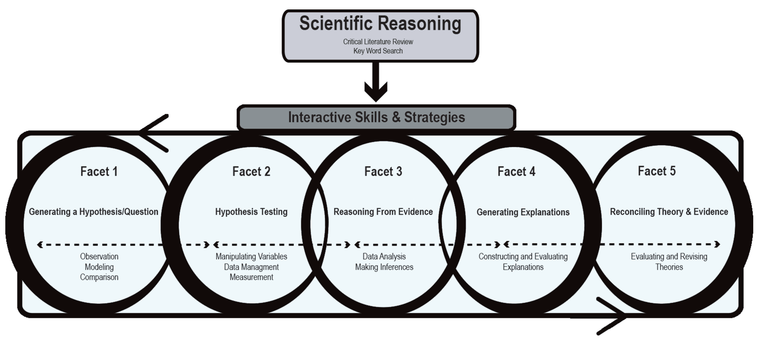
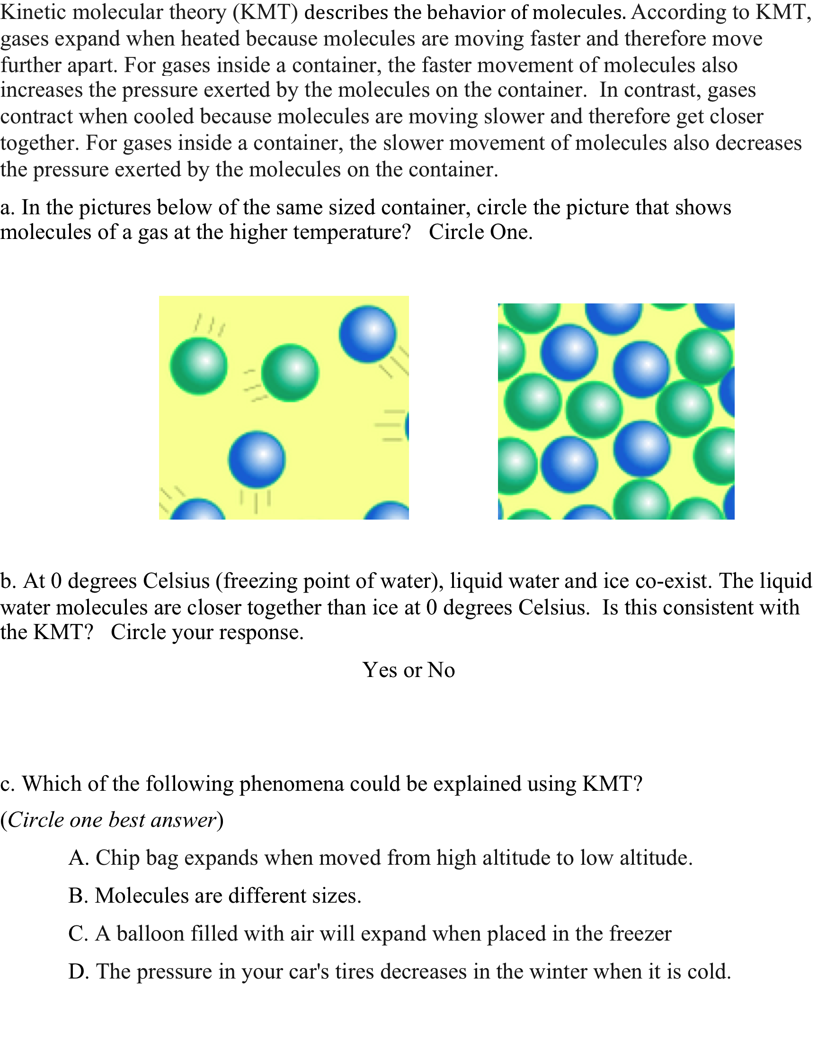
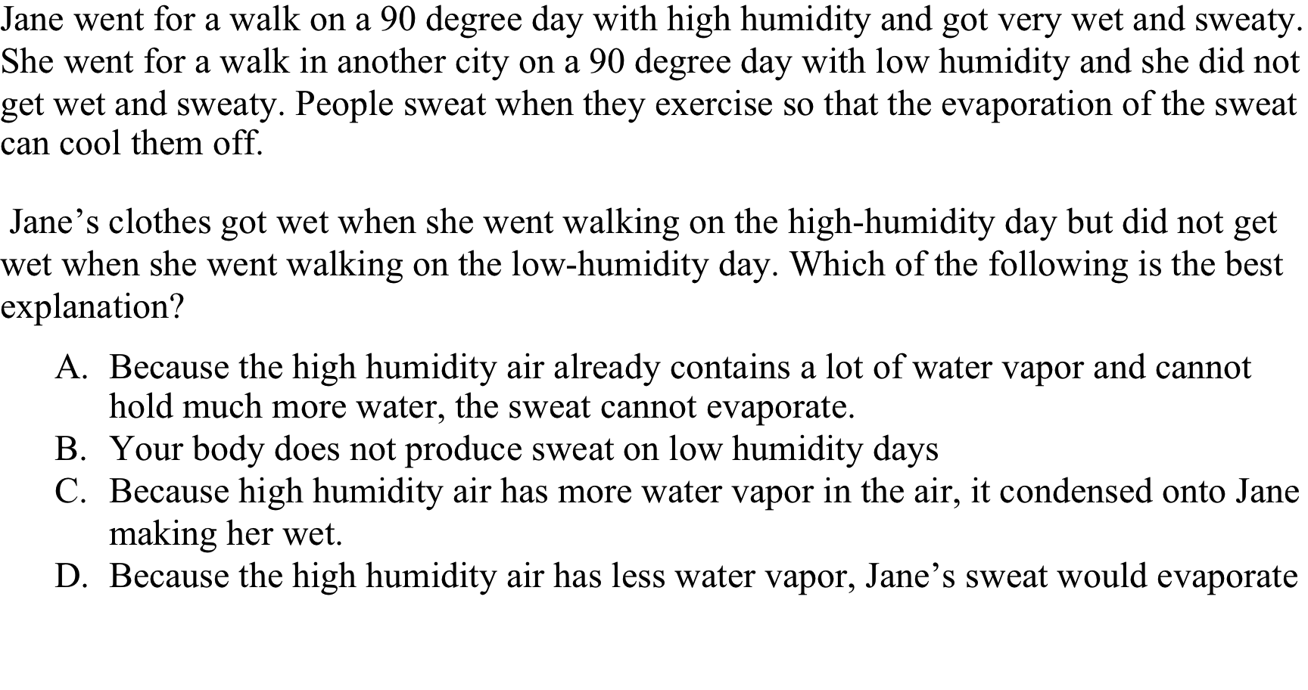
Unpacking the Elements of Scientific Reasoning
Keisha Varma, Patricia Ross, Frances Lawrenz, Gill Roehrig, Douglas Huffman, Leah McGuire, Ying-Chih Chen, Shiyang Su, & Yoo-Jeong Jang
The Cognition, Measurement, & Evaluation (CME) Project
Introduction
Critical Literature Review
Results
Research Focus
Researchers in cognition, education, and the learning sciences have conducted many studies of scientific reasoning. These studies have done much to inform our understanding of the specific skills involved in scientific reasoning. Now there is a need to synthesize the work to better characterize the larger construct of scientific reasoning. The present research project reviews these studies to systematically characterize scientific reasoning. This is an important step for science education reform efforts to improve instruction by further understanding the cognitive processes involved in science learning.
Scientific Reasoning & The National Science Standards
Middle and high school students should have experiences that focus on:
Designing and conducting investigations
Analyzing and interpreting data
Developing descriptions, explanations, predictions, and models
Constructing relationships between evidence and explanations
Two researchers conducted a critical literature focusing on articles investigating at least one aspect of scientific reasoning. Following an initial review of articles from a course on the psychology of scientific reasoning, a secondary review of the references in those articles, and a systematic search of ERIC and Psychological Abstracts, the researchers included ninety-six theoretical, qualitative, and quantitative studies in the final analysis.
The literature review and discussions with experts in cognition, science education, and measurement helped us to generate five facets of scientific reasoning.
Facet 1: Generating Hypotheses
Scientific Reasoning: Five Facets
Observation Skills
Comparing Skills
Modeling Skills
Model Assessment Skills
Question Generating Skills
Identify factors that vary
Relating factors in a qualitative way
Recognize difference between what is known and what more needs to be learned
Relating factors in a more formal way
Recognize that there is something (a) to explain (b) that requires further elaboration or (c) wrong
Formulate questions based upon assessment that can direct empirical investigation to address information needs.
Decomposing an observation into components or factors
Noting features, patterns and contradictions in observations
Making a statement of possible investigation based upon questions, observations and /or previous knowledge
Hypothesis Generating Skills
Construct representation of the observations
Identifying possible rules that relate factors/abstracting from concrete to mathematical/conceptual
Facet I focuses on the ability to observe a situation or event, recognize that there is something to find out, recognize the difference between existing understanding and what more needs to be learned, and to clearly articulate a question that can guide an empirical investigation.
Facet II: Hypothesis Testing
Variable Identification Skills
Variable Manipulation Skills
Data Collection Skills
Data Limitation Recognition Skills
Measurement Skills
determining how much measurement needed for reliability
identifying what data need to be gathered
classifying data into dependent, independent or controls
recognizing possible confounds
naming the categories of data needed
controlling variable to determine effect on dependent variable
combining variables to determine effect of dependent variable
Experimental Data Management Skills
Organizing Data
Reading data tables/graphs
Generating data tables/graphs
assessing the quality and variety of data collected against what was needed
interpreting data
Facet II focuses on the ability to design tests of a hypothesis that correctly identify and manipulate all relevant variables in order that empirical evidence may be produced that will allow one to answer questions. A major aspect of this facet is controlling variables.
Articles included in the literature review structured the scientific reasoning construct by revealing five major facets, and highlighted specific skills related to each one. Even though the literature review indicated there may be separate facets, there is some overlap in their descriptions. This is to be expected because scientific reasoning is not a set of discrete steps but a dynamic set of interactive skills.
Method
Facet III: Reasoning from Evidence
Data Analysis Skills
Inferential Skills
Argument Analysis Skills
summarizing data (graphs, tables or other representation)
recognizing patterns in the data
comparing independent/dependent relationships
judging which data to use to draw a generalization (which data counts as evidence)
inducing a general statement about the relationships among data which summarizes that evidence
evaluate the strength of a conclusion inferred from evidence
Argument Production Skills
construct a scientific argument based upon evidence showing how the evidence supports the conclusion (also referred to as: justifying predictions)
Facet III focuses on students’ ability to interpret the results of an investigation and to draw justified inferences and/or conclusions based upon that data.
Current Work
Measuring Scientific Reasoning
Facet IV: Drawing Conclusions
This facet involves the ability to coordinate theory and evidence in such a way so as to draw inferences that account for either causal relationships or stochastic relationships. These activities employ theory, seek underlying theoretical causes for the evidence and utilize models to describe patterns in the data..
The present work is part of a larger research project that is combining the latest thinking in cognitive science with modern instrument development techniques to develop a validated assessment system for scientific reasoning.
Theory identification Skills
Explanation Construction Skills
Explanation Assessment Skills
recognizing relevant theory
articulating details of theory relevant to experimental situation
coordinating evidence and conclusions drawn from evidence with theory
constructing an argument which uses theory to account for experimental outcomes
assessing the strength of the explanation provided
identifying anomalies and inconsistencies in the explanation
recognize when data are in conflict with expectations (predicted results vs. observed results)
Our ongoing work contributes to multiple recurring issues in science teaching and learning such as how to define and measure the higher order thinking skills involved in inquiry science instruction, and how to provide just in time information to teachers so that they can make evidence based decisions about their classroom instruction.
The Advisory Board
Geneva Haertel | SRI International
David Klahr | Carnegie Mellon University
Anton Lawson | Arizona State University
Iris Weiss | Horizon Research, Inc.
Facet V: Coordinating Theory & Evidence
Theory and Evidence Assessment Skills
Theory Evaluation Skills
Theory Revision Skills
reflecting upon strenghts and weaknesses of the theory and evidence (experimental outcomes)
distinguishes theory and evidence
assessing for causal coherence
recommending changes to theory so as to reconcile theory and evidence
assessing the plausibility of theory changes
predicting possible new hypotheses to test in light of changes and prior evidence
determining the effect of theory change for broader belief systems
assessing the plausibility of the theory in light of, for example, quality or quantity of evidence
Facet V focuses on students’ ability to evaluate theory in light of experimental conclusions, reconcile new evidence with prior beliefs, and (if required) revise one’s theory and generate new predictions

