Slide 1

Closing the Achievement Gap in Minnesota: Making a Difference through Leadership
April 24, 2013

Slide 2
Learning from Leadership:
Research Findings
Karen Seashore Louis
Kyla Wahlstrom
CEHD Policy Breakfast, April 24, 2013

Slide 3

Our Core Questions
Do leaders influence student learning?
What patterns of leadership, from teachers, principals, and district office staff, influence the quality of instruction and student learning?
Notes:
KRS: We are going to present some key findings from a large-scale study that we completed a year ago.

Slide 4
Source of Ideas about Integrative Leadership in Education
State Leadership, Policies and Practices
Student/ Family Background
School Conditions
District Leadership, Policies and Practices
School Leadership
Student Learning
Teachers
Professional Development Experiences
Classroom Conditions
Other Stakeholders
Notes:
K: This was a large, complex study of leadership effects – the largest ever carried out in the U.S.
In this presentation, we will focus primarily on the effects of leaders – in the district and at the school – on teachers and classrooms.
Teacher and principal surveys (>8,500) in 180 schools, across 9 states(NY, NJ, NC, IN, MO, TX, NB, NM, OR)
Coupled with annual state test score data
• 36 case study schools in 18 districts (urban, rural, suburban): interviews (>1,000) and observations gathered in two waves.

Slide 5

We Began with What is Known
Leadership effects on students are indirect.
Leadership matters most when and where it is most needed.
Now, on to our findings…
Notes:
Kyla: In other words, principals and district administrators do not spend much time in classrooms and have limited potential to directly impact a student’s learning. Previous studies that found “leadership effects” have typically not investigated how these occur.
Teacher and principal surveys (>8,500) in 180 schools, across 9 states(NY, NJ, NC, IN, MO, TX, NB, NM, OR)
Coupled with annual state test score data
• 36 case study schools in 18 districts (urban, rural, suburban): interviews (>1,000) and observations gathered in two waves over five years.

Slide 6

A WHOLE SCHOOL FOCUS
Notes:
Kyla
Note on process – this doesn’t mean changing everything at once.

Slide 7
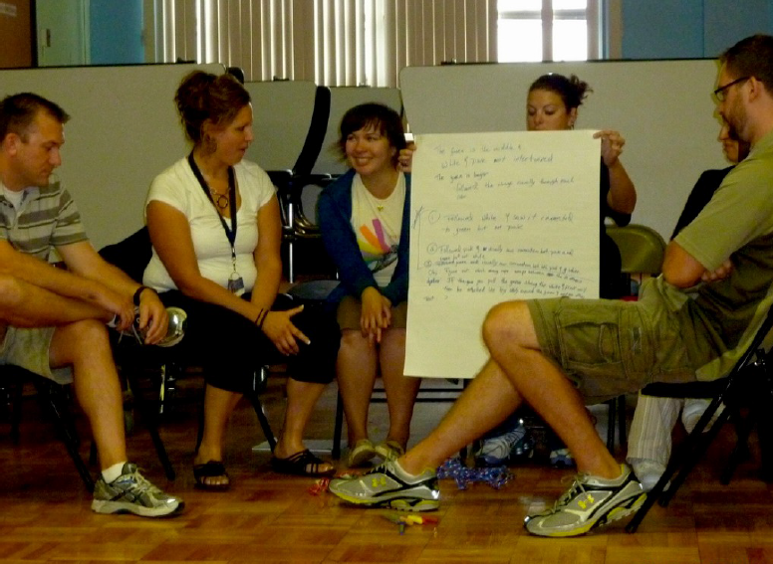
Leadership for Professional Community
Leadership is most effective when it strengthens “professional community”—which is teachers working together to improve their practice and improve student learning.
Notes:
KAREN: The notion of professional community has become very popular over the last 5+ years, and has been incorporated into many school and district conversations about how to strengthen instruction. There have been a number of previous studies that have tied how teachers work together to student learning, but this study added substantially to that because of the large and representative sample. In addition, it was the first to tie principal actions to how teachers work together.

Slide 8
The Power of Professional Community (PC)
Effective Instruction
PC
Student Learning
Improved Climate
Notes:
Karen: First we had to answer the question of why we care about professional community….

Slide 9
PC (Professional Community)
Is Not (Necessarily) PLCs
PLCs = structural vehicle to provide opportunity
PC = actual level of teacher collaboration
Notes:
Karen: It is important to emphasize the point that we make in this slide. Since the emergence of the popular programs to improve teachers’ work by creating more opportunities for collaboration, we have seen the growth of programs that promote Professional Learning Communities. These provide opportunity, but do not guarantee the kind of reflective collaboration that promotes iimproved instruction.

Slide 10

Notes:
Karen: Having established that professional community – how teachers actually collaborate – is important, the question remains: What do principals do to promote or reinforce this?

Slide 11
Leadership for Instructional Improvement
….affects working relationships and, indirectly, student achievement. (Instructional Leadership)
….is shared, fostering stronger teacher working relationships. (Shared Leadership)
Notes:
KAREN: Our study identified two very distinct patterns of activity, both of which were important for promoting PC.

Slide 12
A Revised View of
Professional Community
TEACHER
Professional Community
PRINCIPAL
Leadership
Shared Responsibility for Instruction
Notes:
Karen: This slide represents our conclusion about the importance of revising our view of PC: IT DOES NOT BELONG TO TEACHERS ALONE. RATHER, IT IS A JOINT RESPONSIBILITY OF PRINICiPALS OR OTHER ADMINSITRATORS AND TEACHERS.

Slide 13
Leadership Effects Vary by Building Level
Principal leadership that “matters” occurs more often in elementary schools
Secondary schools have lower professional communities among teachers, and less instructional leadership overall.
Effective secondary school leaders create strong networks of instructional support, with teacher leaders having real responsibility for improvements.
Notes:
KYLA

Slide 14
Leadership and Student Achievement in Elementary Schools
Instructional
Leadership
Professional
Community
Math
Achievement
Shared
Leadership
Notes:
KYLA
Remember to emphasize that the relationships between leadership and PC/Ach are attenuated in secondary schools – Kyla discuss.

Slide 15

Expectations and Accountability
Standards and targets
Appraisals aligned with standards
Meaningful feedback loops
Minimizing one-shot, high stakes procedures
Clear results/fair outcomes
SIMPLE APPROACHES CAN HAVE NEGATIVE EFFECTS
Notes:
Kyla: NOTE: Validates old study of trust and data-based decision making (Louis, Schroeder, ???)

Slide 16
District PD for Principals
Individual
Principal Efficacy
Collective Principal
Efficacy
Achievement
District Use of Targets & Data
Bold lines indicate a statistically significant relationship.
Solid lines indicate a positive relationship.
Dotted lines indicate a negative relationship.
Notes:
Kyla – This does not mean that an emphasis on targets and data are bad – unless they are imposed without adequate professional development and support to build collective efficacy.

Slide 17

Districts Affect Achievement
Using data and setting targets has negative effects on instructional leadership and achievement when principal confidence is low.
Notes:
Kyla: Districts should focus on building confidence of principals to accomplish student learning goals.
Principals’ confidence grows when work collaboratively with district personnel and other principals.
Larger districts generally have less influence on principal confidence and efficacy.
Districts have more influence on the confidence of elementary than secondary school principals.

Slide 18
Professional Development for Leaders is Often Insufficient
Few districts have a coherent professional development system for principals.
Over 50% of the principals reported that they met once a month or less frequently with a regular contact in the district office.
Only 52% of principals agree that the district leaders assist them to be better instructional leaders in their schools.
Notes:
KYLA:
Begin with why its important… Then prove it’s not happening
Many principals reported that they receive pressure, but little support.
Where principals perceived strong support, including PD and coaching, they were more likely to be perceived by their teachers as instructional leaders.

Slide 19
District Networks for Learning
Quality
Teaching
Leader
networks
Student Achievement
Targets & data
Prof.
Community
School poverty
Building level
Notes:
BEFORE FIRST CLICK Karen: What kind of leader development is important?
FIRST CLICK: In our study we concentrated on what districts do to provide a combination of PRESSURE AND SUPPORT for building leaders. We also looked at how this was affected by the characteristics of the community and student body, and the building level.
SECOND CLICK: We found that that the most effective PD is the kind that brings principals together on a regular basis to grapple with the problems of practice that they are experiencing in their buildings. What they talk about is often how best to support their teachers in improving instruction. Research from other studies suggests that this occurs more effectively when there is a coach who is engaged with the principals to help them to reach productive discussion quickly, but even unguided networks are important.
WHEN PRINCIPALS PARTICIPATE IN NETWORKS, THEIR TEACHERS ARE MORE LIKELY TO REPORT THAT THEY WORK IN HIGH PROFESSIONAL COMMUNITY ENVIRONMENTS.

Slide 20
Districts, Leadership PD, and Student Learning
Leaders in higher-performing districts…
Communicated explicit expectations for principal leadership
Provided learning experiences in line with these expectations.
Monitored principal follow-through
Provided further support where needed, including
  discussions about school performance and improvement plans
  informal advising and coaching interventions.
Modeled effective data use
Notes:
Karen– Only when these actions – the pressure and accountability functions – were accompanied by support did we find that principals were more effective leaders.

Slide 21
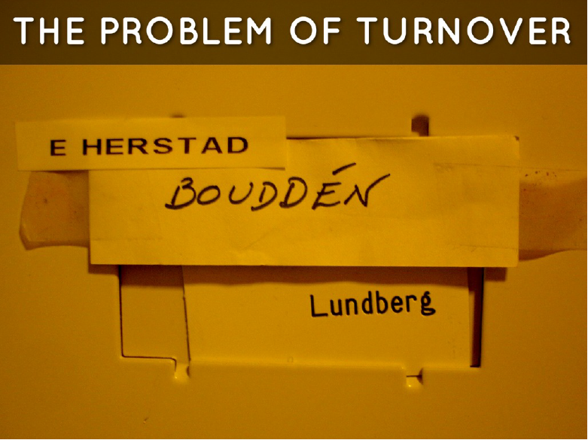
Notes:
Kyla: oo much turnover is a problem in any organization – when extreme, people even forget who is in charge.

Slide 22

The Problem of Turnover….
The typical school has a new principal every 3.2 years
Principal turnover is negatively related to student achievement
Districts approached the issue of principal quality as a “hiring problem”
Districts did not have strategies for managing turnover
Schools with higher teacher PC managed turnover better
Notes:
Kyla -- Only two districts in the study had any planned approach to managing principal turnover.

Slide 23

Parents and Community
Principals
District Office
Teachers
Notes:
Karen: We have quickly covered the role that principals and districts play in creating the climate for effective instruction at the school level. What about community leadership – which is one of the components of the reform process that have been given least attention in recent years.
Turnover is one explanation: engaging parents and community requires sufficient time in the building to build relationships of trust.
CLICK
One of the people involved with this project wanted to investigate schools with exemplary community engagement programs….this goal was abandoned early in the study because although there were many outstanding schools among our 36 case studies, none was particularly outstnading on this dimension.

Slide 24

Community Engagement Starts with the District
  District policies that promoted engagement increased participation from diverse stakeholders.
  Where it is not a superintendent priority, principals generally avoid it.
Notes:
Karen: In only two of the 18 school districts in our study did Superintendents have policies AND PRACTICES in place that suggested that community engagement was a priority.

Slide 25
Does More Broadly Distributed Leadership Affect Students?
Instructional
Leadership
Trust in
Principal
Professional
Community
Quality
Instruction
Achievement
Shared
Leadership
Parent
Involvement
Gordon & Louis, 2009
Notes:
Karen: This slide shows how the relatinship between teachers leadership and parent engagement affect student learning. Obviously we confirmed what everyone knows: where parents are engaged, students learng more. What is also shows, however, is that where teachers saw themselves as sharing leadership with parents, that their working relationships with colleagues were higher, and therefore instruction.
25##

Slide 26

Notes:
Kyla

Slide 27
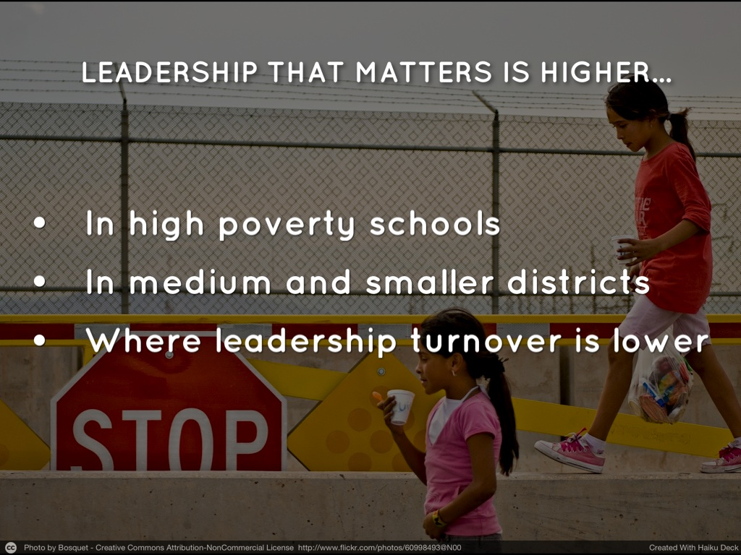
Notes:
Kyla

Slide 28
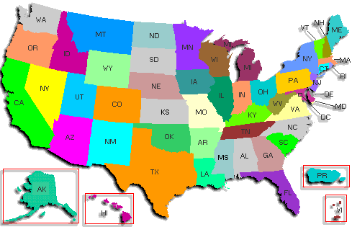
State Leadership
…Varies between states based on deep political culture
District responses are affected by size and state political culture
School responses to states are affected by district responses
NCLB resulted in adjustments rather than major changes to state policy directions
Notes:
Minnesota was NOT in our study – our conclusions are based on the nine states we did study.
There is no one U.S. educational system
States have long traditions of being more or less centralized; more or less focused on efficiency or equity, etc.
Individual schools respond not to the state, but to their district’s interpretations of state policy – we found that this varied within state depending on the characteristics and leadership in the district.

Slide 29
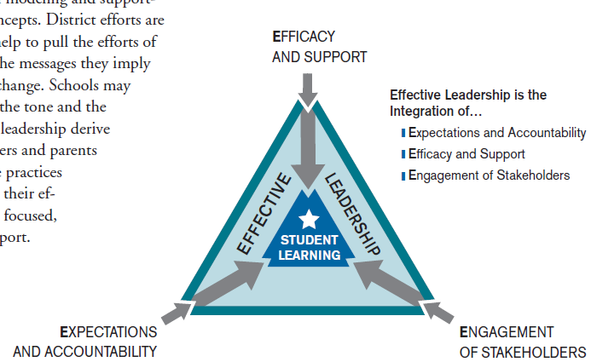

EFFECTIVE LEADERSHIP
EFFICACY
ENGAGEMENT
EXPECTATIONS

Slide 30
Project Publications
Final Report/Executive Summary:
  http://www.cehd.umn.edu/CAREI/
  http://www.wallacefoundation.org/Pages/default.aspx
Additional analysis included in:
  Leithwood, K. & Louis, K.S. (2011) Linking leadership to student learning. San Francisco: Jossey Bass.
  Over 40 published papers (available on request)

Slide 31

klouis@umn.edu
wahls001@umn.edu

Slide 32
Panel Discussion
Bernadeia Johnson, Superintendent, Minneapolis Public Schools
Douglas Revsbeck, Principal, Saint Paul Harding High School
Carol McFarlane, former member of the Minnesota House of Representatives
Laura Bloomberg, Director, Center for Integrative Leadership, Humphrey School of Public Affairs at the University of Minnesota

