Slide 1
Making the Most of
Multisite Evaluations
ADD PLACE
ADD DATE
Notes:
Note to the presenter:
Edit the title screen of this slide to reflect your session location and date
As the session begins:
Introduce the session and the presenter(s).
Lead participants in the Voicing Variables Activity (see Presenter toolkit for complete instructions).

Slide 2

Note
This material is based upon work supported by the National Science Foundation under Grant No. REC 0438545. Any opinions, findings, and conclusions or recommendations expressed in this material are those of the authors and do not necessarily reflect the views of the National Science Foundation.
Notes:
Note to the presenter:
This disclaimer does not need to be read aloud, but it should be somewhere in the presentation. This statement acknowledges the funding by NSF and provides the audience with the grant number. We have placed it as the second slide, but it could easily be the first and be up while people are getting settled. Then, when you are ready to begin just start at the title slide.

Slide 3
Today’s Agenda
Overview and introductions
What? Our research grounding
So what? Implications for practice
Now what? Application discussion
Notes:
Note to the presenter:
Review the agenda with your participants
To the audience:
This research was done to examine some well-known frameworks in evaluation to see how the ideas held up or required changes in a multi-site evaluation context. The findings have implications for practice that may improve the processes or outcomes of evaluation done in multi-site settings. We hope that this session will help you apply what you learn today to your multisite evaluations.

Slide 4
Session Goals
Review the basics of UFE and PE
Distinguish between participation and involvement in multisite settings
Discuss how to increase the impact of multisite evaluations
Apply these ideas to evaluation examples
Brainstorm solutions to multisite evaluation involvement and use challenges
Notes:
Notes to the presenter:
UFE stands for utilization-focused evaluation (work of M. Q. Patton)
PE stands for participatory evaluation
To the audience:
To get started we will first review the principles of utilization-focused evaluation and participatory evaluation, specifically explaining how traditional notions of participation have morphed in the multisite settings into something more like involvement.
Next we will discuss the ways in which the impact of a multisite evaluation may be increased and then apply all of the ideas to some examples we have created. Finally, we will brainstorm solutions to some challenges that we all may have faced in our work with multisite evaluations.

Slide 5
Three-step Interview
Think about your own evaluation experiences. . .
Notes:
Notes to the presenter:
Set the stage for the Three-Step Interview activity (complete instructions and necessary documents for this activity are in the Presenter’s toolkit). You will also see a brief clip on the project website demonstrating how to get started with this activity.
Ask participants to organize into groups of three for the activity and have them introduce themselves to their group mates.
Ask members of each group to count off…”I’m 1” – “I’m 2” – “I’m 3.”
Members do this because this activity will involve 3 rounds of small “interviews” where each group member assumes a different role for each round. The numbers make it easier for group members to get started.
Explain how the activity works. Presenter poses the question about evaluation use for conversation. Check for understanding of what people are to do one last time before beginning. Each group begins with the Interviewee discussing his/her thoughts and experiences on the topic for 2-3 minutes. The Interviewer prompts with additional clarifying questions as needed and the Recorder writes down the main ideas being discussed. Post in the front of the room how group members should switch roles for next round (or hand out sample rotation slips to each group). At the end of the first round, members in each group switch roles and repeat the process. At the end of the second round, group members assume their third and final role and repeat.
Call the group back together and provide final group instructions (found on the bottom of the participant handout). Allow 2-4 minutes for groups to discuss the commonalities and differences in their interview content.
Bring the group together again. Ask each group to report one idea from the final list. If possible, record participants’ thoughts on screen or on flipcharts to refer to later.

Slide 6
Question
Think of a time when people truly used an evaluation that you were part of.
  Describe that evaluation.
  What distinguished it from other evaluations in which you have participated?
Notes:
Note to the presenter:
When the activity concludes, remind participants that you will tailor some of your comments to their ideas from this activity. (See slide 38).

Slide 7
“Beyond evaluation use”
Our NSF-funded research study
Notes:
To the audience:
To be clear, this research was designed to look at use and involvement in multi-site evaluations, rather than studying the actual conduct of an evaluation.

Slide 8
What This Research Was NOT…
Our study did not focus on the traditional notion of utilization-focused evaluation–
“intended use by intended users”
Notes:
To the audience:
When people talk about UFE, the notion of intended use by intended users sets the stage. This research did not look at that issue because in the 4 programs we studied, the intended user was NSF, and that was not our research focus.

Slide 9
What Our Research Studied
What happens to project staff who take part in a large-scale, multisite program evaluation
Secondary potential users at multiple sites who participate throughout the evaluation process
  How their involvement potentially leads to use
  “[Un]intended use by [un]intended users”
Notes:
To the audience:
What this project did was to look at the use by a secondary or “unintended” user, often those who were in the target market for program dissemination efforts. More specifically, this study examined STEM (science, technology, education and math) education programs all funded by the National Science Foundation. Inherent in NSF funding is the notion that projects disseminate findings and lessons learned to help other projects improve their efforts. In addition to studying the effects of involvement on use by the project staff in the 4 large multisite programs, we also examined the idea of use in the broader field of evaluation and STEM education; that information will not be part of this presentation.

Slide 10
Definitions
Program
  a major national funding initiative
Project
  one of many smaller efforts funded under a single program
Multisite
  multiple program sites that participate in the conduct of cross-site evaluation activity (Straw & Herrell, 2002)
Notes:
Note to the presenter: These terms help set the framework for implications/findings later on in the presentation.
To the audience:
Regarding this idea of multisite, it is important to know that we are talking about a large program that offered funds to local projects that worked toward the program goal. In turn, each local project might target a slightly different audience and use different activities to work toward the shared program goal. Thus, these were not model programs implemented in identical ways at multiple sites.

Slide 11
“Beyond Evaluation Use” NSF Programs
Name of Program | Years of Evaluations
Local Systemic Change through Teacher Enhancement (LSC) | 1995 – present
Advanced Technological Education (ATE) | 1998 - 2005
Collaboratives for Excellence in Teacher Preparation (CETP) | 1999 - 2005
Building Evaluation Capacity of STEM Projects: Math Science Partnership Research Evaluation and Technical Assistance Project (MSP-RETA) | 2002 – present
Notes:
Note to the presenter:
There is a program description summary handout in the Presenter’s Toolkit that may help set the context. The audience sometimes needs help to understand the scope of this research.
To the audience:
These four programs are funding streams from NSF that all had large program evaluations. This research looked at the evaluations of the overarching programs, not at the project evaluations done by local projects within the 4 programs listed here.

Slide 12
Methods
  Archival Review
  Project Leader and Evaluator Survey
  Interviews
  NSF PI Survey
  Journal Editor Inquiry
  Citation Analysis
National Science Foundation Grant #0438545
Notes:
To the audience:
Archival review – hundreds of reports, other documents, and websites were reviewed
Survey – of Project PIs and evaluators in the 4 programs
Interviews of survey respondents and NSF program officers
Survey of a random sample of current NSF Education Directorate PIs asking about their familiarity with the evaluations
Journal editor inquiry – e-mails and calls to several science and math education and evaluation journal editors asking about publications related to the evaluations
Citation analysis - Bibliographic research looking for evidence of the program evaluations in others’ published work.

Slide 13
Research Limitations
Difficult to control for the variety of definitions in the field
Memory issues for participants
Lack of distinction between program and project in survey responses
Sampling challenges and program variation
Notes:
To the presenter:
Here are supporting points for these items:
There are many terms in the field (use, influence, participation, involvement), and people have different ideas of what they mean. Although we tried to control for this by telling participants what we meant, it became clear that in some cases respondents were not always talking about the idea we intended.
The study occurred at a single time often years after the projects ended, so some respondents had difficulty recalling specifics of their experience (sometimes exacerbated because many times the same people served on a number of projects).
Respondents to the surveys did not always respond in terms of the overall program evaluation, but rather provided answers related to a local project evaluation within that larger program.
4. There was great variety in the large programs, making identification of all project Pis a challenge and likely leading to non-response.

Slide 14
Research Strengths
Unusual to receive funding for evaluation research
Real world program examples
Different from traditional utilization-focused evaluation focus
Studied influence on the field and on projects themselves
Use of varied and innovative methods
Notes:
Money is seldom set aside to study evaluation so this research was a rare chance to look at the idea of participation and use in large multisite evaluations to advance knowledge in the field.
This was not a simulation study…these are real world programs doing real program evaluations, therefore this study is unlike most that have been conducted.
We were able to examine influence beyond the primary intended user (NSF) and look at use by the projects and the field, a new area of research.
This research used a variety of methods to examine this idea along with the development of a number of instruments.

Slide 15
Conceptual grounding
What are the ideas this research studied? (What?)
Notes:
Note to the presenter:
The next 15 slides provide an overview of the two major concepts that grounded the research: evaluation use/influence, and involvement. If your audience is primarily interested in the practical implications of the study, you may want to skip the entire section and move to the slides on multi-site evaluation (starting with slide 31). Even in this case, however, you may want to show slide 16 (the next slide) so that people are at least aware of the overarching concepts.
To the audience:
We want you to be sure of the evaluation ideas that grounded this research…

Slide 16
Overarching Concepts
Evaluation use/influence
Involvement
  Utilization-focused evaluation (UFE)
  Participatory evaluation (PE)
Notes:
Note to the presenter:
This is the general overview of the two major ideas that grounded the research.
To the audience:
Two overarching concepts guided the research project.
We used the terms evaluation use and evaluation utilization interchangeably.
Karen Kirkhart added the concept of influence to the literature in 2000.
The second overarching concept evolved during the study. We began with two ideas: UFE, and PE. The central point of utilization-focused evaluation involves “primary intended use(s) by primary intended users.” But this emphasizes primary and intention, which were not, finally, what we were studying. Nevertheless, it was important to understand the concept because of its centrality to use.
We also began with the concept of participatory evaluation since we were interested in looking at the extent to which engaging project-level staff in the program evaluations had an effect on eventual use or influence.

Slide 17
Traditional Types of Evaluation Use
Type | Use For | Definition: The Use of Knowledge. . .
Instrumental | Action | . . . for making decisions
Conceptual or Enlightenment | Understanding | . . . to better understand a program or policy
Political, Persuasive, or Symbolic | Justification | . . . to support a decision someone has already made or to persuade others to hold a specific opinion
Notes:
Note to the presenter:
Type is the most important column because these are the terms with which people may be familiar. The Use For column provides a short-hand summary of the definitions.
To the audience:
In the research on evaluation use, conducted since the 1970s, there are three common labels.
The first is instrumental use, which is what many evaluators hope to see as a result of their work. Initially, research suggested that instrumental use was not as common as was desired.
The second type of use is called conceptual use or enlightenment, which is Carol Weiss’s term. People may gain insights or knowledge as a result of an evaluation, even if they never apply its results directly.
The third type of use goes by several names (political, persuasive, symbolic) and holds the potential for bias. In this type of use, people use an evaluation’s results for personal reasons.

Slide 18
Definitions in “Beyond Evaluation Use”
Term | Definition
Evaluation use | The purposeful application of evaluation processes, findings, or knowledge to produce an effect
Influence ON evaluation | The capacity of an individual to produce effects on an evaluation by direct or indirect means
Influence OF evaluation (from Kirkhart, 2000) | The capacity or power of evaluation to produce effects on others by intangible or indirect means
Notes:
Note to the presenter:
You may not want to go over these in detail, but they are provided for clarity.
To the audience:
These are the definitions that were used in the research.
Evaluation use is purposeful and seeks to create an effect.
“Influence on” is at the heart of participatory evaluation, whereby people engage actively in the evaluation process and change it (i.e., produce effects) as a result.
“Influence of” broadens the idea of purpose or active use to consider the potential intangible or indirect effects of evaluations.

Slide 19
What Is Involvement?
Not “participation”
Not “engagement”
Instead, think about how UFE and PE overlap
Notes:
Note to the presenter:
Audiences often ask why we used the term involvement, and this slide explains why.
To the audience:
Participation is often considered in a local context. You can imagine people sitting around a table together, working side-by-side and discussing the evaluation. In multi-site evaluations, that is usually not possible (e.g., people are geographically dispersed, or there are too many sites).
Engagement suggests an active role in planning or implementing evaluation activities. That is different than the role played by many of the people in the projects we studied. Because they did not play an active role in designing the program evaluation in which their project took part, they were not truly “engaged.”
In thinking about project staff activities in the program evaluation, we decided to think about the overlap between UFE and PE.

Slide 20
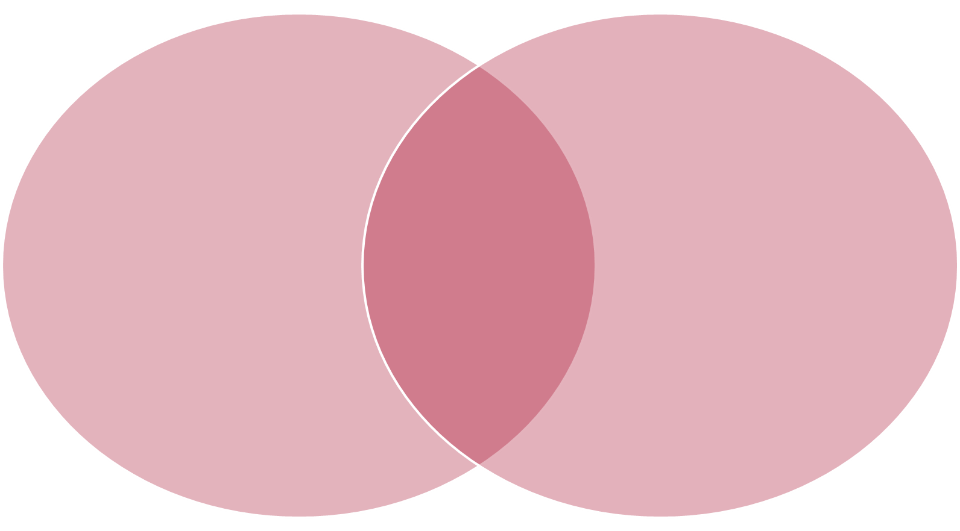
Overlap between UFE and PE
Key people take part
throughout the evaluation
process
UFE
PE
Notes:
Note to the presenter:
This Venn diagram appears four times (slide 20, slide 24, slide 30, and slide 34).
Each time, a different idea, which you may want to emphasize, is presented. Here we emphasize the common content in the overlap.
To the audience:
Here is a graphic representation of the overlap between UFE and PE.
The common idea in the highlighted area is that key people take part throughout the evaluation process.
In UFE, these key people are the primary intended users.
In PE, these key people are the participants who actively engage in planning and conducting the evaluation.

Slide 21
Utilization-focused Evaluation (UFE)
Evaluation done for and with specific, intended primary users
for specific, intended uses
-Patton (2008), Utilization-Focused Evaluation, 4th Edition
Notes:
To the audience:
This is the formal definition of utilization-focused evaluation, taken from the most recent edition of Michael Quinn Patton’s book of the same name.
Note that it emphasizes both the people who will use the evaluation and what they will actually do with the evaluation.

Slide 22

The PERSONAL FACTOR in Evaluation
"The presence of
an identifiable individual
or group of people
who personally care
about the evaluation
and the findings it generates"
Notes:
Note to the presenter:
You may want to explain the plug graphic, the idea that an individual or group can actively create energy around an evaluation process or its findings.
To the audience:
The personal factor, which came out of a research study conducted in the late 1970s, is another of Patton’s central ideas.
The point is straightforward: When the person or people who care about an evaluation are involved in its process, then good things, including use, are likely to happen.
The opposite is also true: If people are not engaged in an evaluation, then the likelihood of eventual use decreases.

Slide 23
Key Collaboration Points in UFE
Issues to examine (information primary intended users want/need)
Methods to use (credibility in context)
Analysis and interpretation of data
Recommendations that will be useful
Notes:
Note to the presenter:
People may not know the four points where interaction with primary intended users is critical. They are listed here.
To the audience:
UFE provides opportunity for the primary intended users to collaborate throughout the entire evaluation process.
According to Patton, there are four specific points where the evaluator and primary intended users need to connect: first, during the framing of the evaluation; second, during the identification of data-collection methods; third, during the analysis and interpretation of the data; and finally, during the recommendation development stage.
If evaluators interact effectively with primary intended users at these four points, the evaluation’s results will answer the primary intended users’ questions and the likelihood of use will be increased.

Slide 24
Overlap between UFE and PE
UFE
Primary intended users are involved in all key evaluation decisions
Key people take part
throughout the evaluation
process
PE
Notes:
Note to the presenter:
This is the second time this Venn diagram occurs, and this time it emphasizes the key characteristic of UFE.
To the audience:
To summarize, in UFE, primary intended users interact with the evaluator throughout the evaluation and are involved in all important decisions related to the evaluation.

Slide 25
Participatory Evaluation (PE)
Range of definitions
  Active participation throughout all phases in the evaluation process by those with a stake in the program (King,1998)
  Broadening decision-making and problem-solving through systematic inquiry; reallocating power in the production of knowledge and promoting social changes (Cousins & Whitmore,1998)
Notes:
Note to the presenter:
UFE was the first overarching concept. Participatory evaluation (PE) is the second.
To the audience:
PE is a broad concept with multiple meanings; people mean different things when they talk about participatory evaluation.
The definitions of participatory evaluation range from the more pragmatic definition of King to the more transformative definition of Cousins and Whitmore.

Slide 26
Principles of PE
Participants OWN the evaluation
The evaluator facilitates; participants plan and conduct the study
People learn evaluation logic and skills as part of the process
ALL aspects of the evaluation are understandable and meaningful
Internal self-accountability is valued
(Adapted from Patton, 1997)
Notes:
To the audience:
The principles of PE relate to:
Active participant ownership of the evaluation and its processes;
The roles played by the evaluator (facilitator) and by evaluation participants (program staff, clients, or community members who actually plan and implement the study);
What people learn as a result of participating (i.e., evaluation logic and skills);
The clarity of what happens during the evaluation; and
The importance of people being accountable for what happens during the evaluation.
The five principles listed here distinguish participatory evaluation from other forms.

Slide 27
Characteristics of PE
Control of the evaluation process ranges from evaluator to practitioners
Stakeholder selection for participation ranges from primary users to “all legitimate groups”
Depth of participation ranges from consultation to deep participation
(From Cousins & Whitmore, 1998)
Notes:
Note to the presenter:
In this slide we list and describe the three dimensions of Cousins and Whitmore’s 1998 framework. The next slide (slide 28) has the figure as it appeared in their seminal article. You may prefer to use the graphic version to discuss the dimensions.
To the audience:
Cousins and Whitmore published a framework in 1998 that identified three dimensions for analyzing collaborative inquiry like participatory evaluation.
Each of the dimensions represents a continuum with the extremes indicated.
The questions these dimensions ask are:
Who controls the evaluation process? ranging from the evaluator to practitioners;
Which stakeholders are selected to participate in the evaluation? ranging from primary intended users to everyone who has a right to participate;
How deeply are participants involved? ranging from simple consultation to in-depth participation.

Slide 28
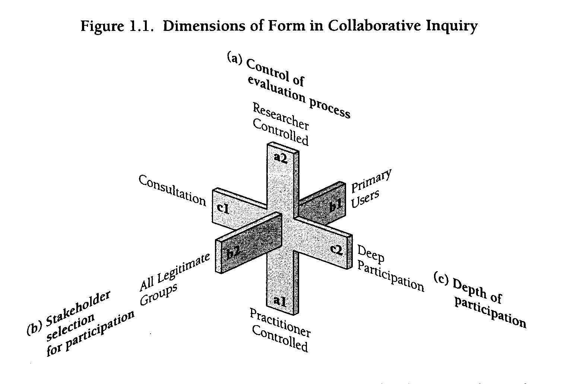
Cousins & Whitmore Framework
Notes:
To the audience:
This is one way to conceptualize and categorize participatory evaluation. You can take any participatory evaluation and plot it on this three-dimensional diagram with the characteristics we just outlined: control; depth of participation; and stakeholder selection.

Slide 29
Interactive Evaluation Quotient
PARTICIPATORY EVALUATION
HIGH
Evaluator
Involvement in decision making and implementation
Program
staff, clients, community
LOW
Evaluator-directed
Collaborative
Participant-directed
Notes:
Notes to the presenter:
The interactive evaluation quotient is a diagram of the relation between the evaluator and participants in the evaluation (program staff, clients, community members).
Again, there is a continuum marked by two extremes: the evaluator completely in charge receiving input from the participants, or the participants completely in charge receiving coaching from the evaluator.
To the audience:
Some find it easier to envision participatory evaluation using this diagram.
Every evaluation needs to be planned (decision making) and conducted (implementation).
You see that the two columns to the right symbolize two forms of PE: (1) collaborative, where evaluator and participants work together equally; and (2) participant-directed, where the evaluator plays a coaching role.
The lines that cross in the middle show the potential range of roles and involvement of evaluators and participants in the evaluation process. There are many different ways for evaluators and participants to engage in the evaluation process.

Slide 30
Overlap between UFE and PE
PE
Participants help to plan and implement the evaluation
UFE
Primary intended users
are involved in all key evaluation decisions
Key people take part
throughout the evaluation
process
Notes:
Note to the presenter:
This is the third appearance of the Venn diagram. This time the emphasis is on the content specific to participatory evaluation.
To the audience:
To summarize, participants in a participatory evaluation are actively involved in planning and implementing the evaluation.
These two ideas (UFE and PE), then, provide a means for examining evaluation use and participation when they are applied to a large, multisite setting.

Slide 31
Multi-site evaluations
What happens when there are many sites involved in one study?
Notes:
Note to the presenter:
The next slides (slides 31-34) describe the special features of multi-site evaluations.
To the audience:
Let’s turn now to the special characteristics of evaluations that involve many different sites.

Slide 32
Challenges of UFE/PE in Multisite Settings
Projects vary
  Activities – Goals –
  Budgets -- Stakeholders
Projects may be geographically diverse
  Distance -- Cost
Programs each have multiple stakeholders so the “project” becomes a key stakeholder (Lawrenz & Huffman, 2003)
Notes:
Note to the presenter:
The first two points on this slide are straightforward, but the third point may confuse the audience. The idea is that because multi-site settings are likely to include large numbers of stakeholders, the best way for the overarching program evaluation to proceed is by counting each project as a single stakeholder, not worrying about the multiple stakeholders who are part of the project’s constituency.
To the audience:
What happens when we take ideas from UFE and PE and apply them in a multi-site setting?
Multiple challenges emerge:
Projects vary – activities may vary, goals may vary, budgets are not equivalent, and many stakeholders exist for local projects and for the larger program.
Projects’ geographical diversity may create problems of distance, and it may become expensive to connect and encourage participation.
Programs typically have a large and complex set of stakeholders. In large multi-site evaluations, each individual project becomes one key stakeholder, rather than having the multiple stakeholders within each project as program stakeholders.

Slide 33
Prediction
How might
UFE and PE play out
in multisite evaluations (MSE’s)?
Notes:
Note to the presenter:
Ask participants to call out predictions about how UFE and PE may differ in a multisite context, or have them turn to a neighbor to discuss possibilities before asking the group for ideas.
Examples:
Different indicators of success across different stakeholders
Sampling challenges
Differences in implementation across sites
The elusive common denominator across sites
Different lifecycles across project implementations
Dealing with multiple – multiples: complexity of multiple agencies in multiple places dealing with multiple problems that align with similar goals
Feeling alienation from program evaluation but feeling ownership of the local project evaluation
Challenges with aggregation of data across sites

Slide 34
The Focus of Our Research
Secondary potential users at multiple sites are involved
throughout evaluation
process
PE
Participants help to plan and implement the evaluation design
UFE
Primary intended users (PIU’s) are involved in all key evaluation decisions
Notes:
Note to the presenter:
This is the fourth time the Venn diagram has appeared. This time note that the content in the overlap is different from the first time, indicating what our research project studied.
To the audience:
People (practitioners and researchers alike) often assume that the evaluation process for local projects will be the same as those for larger-scale multi-site evaluations, and we have found that this is not necessarily true.
The focus of our multi-site research was on the overlap in this diagram: studying the secondary potential users who were involved in the program evaluation process at the various sites making up the multi-site evaluation.
It differed from UFE because we studied the secondary users, rather than the primary.
It differed from PE because these participants were not actively engaged in making program evaluation decisions.

Slide 35
What did we find out?
After five years. . . so what?
Notes:
Note to the presenter:
Now we move to the results of the research.

Slide 36
What Our Research Found
Secondary potential users did sometimes feel involved in the program evaluation and did sometimes use results
What fostered feelings of involvement:
  Meetings of all types; face-to-face best
  Planning for use
  The mere act of providing or collecting data
Notes:
Note to the presenter:
This slide summarizes our results in the broadest terms. You may want to link these findings back to the comments participants made in either the prior prediction activity or in the three-step interview.
To the audience:
The research documented that these secondary potential users did sometimes feel involved in the larger program evaluation and did sometimes use its results. Three things fostered their feelings of involvement:
Meetings (face-to-face) link back to Patton’s idea of the personal factor.
Making plans that intentionally address use smacks of both UFE and PE.
Being asked to provide data made people feel involved in the evaluation process.

Slide 37
What Fostered Use
Perception of a high quality evaluation
Convenience, practicality, and alignment of evaluation materials (e.g., instruments)
Feeling membership in a community
Notes:
To the audience:
Project staff were more likely to use the evaluation process and its results when they believed the multi-site evaluators had good reputations and when they felt that the evaluation used rigorous procedures.
Not surprisingly, project staff were more likely to use evaluation materials that were practical and easily transferable to other settings and that fit their own perceived needs.
Project staff were more likely to use materials that they felt had been developed by a professional community to which they belonged. Developing a feeling of a community of projects appeared to encourage project staff to use the evaluation processes and materials.

Slide 38
Remember the three-step interview results?
Notes:
Note to the presenter:
This is another opportunity to revisit the results from the interview explicitly which may help the audience to better see how the implications slides relate to them.

Slide 39
Implications for Practice
Set reasonable expectations for project staff
  Consider different levels of involvement (depth OR breadth, not both necessarily)
  Have projects serve as advisors or consultants
  Have detail work completed by others/ outsiders
2. Address evaluation data concerns
  Verify understanding of data definitions
  Check accuracy (Does it make sense?)
  Consider multiple analyses and interpretations
Notes:
Note to the presenter:
The implications are fairly straightforward, and the examples provided will help people understand how they worked in the cases from our research. You may also want to ask people to generate examples from their own multi-site experiences.
Examples for implication #1:
LSC had a small, select group of PIs help develop instruments and directions for scoring classroom observations.
ATE had a special evaluation advisory committee of evaluation specialists to suggest how best to conduct the evaluation.
CETP did all the detail work on developing items and formatting surveys after the projects suggested topics.
Examples for implication #2:
ATE conducted site visits where the site visitors had the survey data and could verify that the data provided in the survey matched the reality of the site.
LSC had electronic data input forms that required ratings and justifications. LSC staff went through all of the ratings and made sure the rating matched the justifications.
CETP sent data out to the projects and asked what analyses they would recommend, allowing for multiple interpretations.

Slide 40
Implications for Practice (cont.)
3. Communicate, communicate,
communicate
-- Personal contact matters
4. Interface regularly with the funder
  Understand the various contexts
  Garner support for the program evaluation
  Obtain help to promote involvement and use
  Represent the projects back to the funder
Notes:
Note to the presenter:
Examples for implication #3:
MSP RETA PI made personal site visits to several projects.
All four evaluations provided presentations at meetings that the project PIs attended.
LSC and CETP held meetings focused specifically on the program evaluation.
Examples for implication #4:
LSC program evaluators made regular trips to NSF every other month or so to meet with the group of NSF-assigned program managers.
CETP evaluators interacted via the Internet with CETP project PIs and NSF CETP program managers to provide regular updates about evaluation progress.
ATE evaluators organized regular conversations with NSF through a lead ATE program officer, which encouraged local communication among all the ATE program and program evaluation managers.

Slide 41
Implications for Practice (cont.)
5. Recognize life cycles of people, projects, and the program
  Involve more than one person per project
  Understand the politics of projects
6. Expect tensions and conflict
  Between project and program evaluation
  Among projects (competition)
  About how best to use resources
Notes:
Note to the presenter:
Examples for implication #5:
ATE coped with new projects joining the program by having special face-to-face sessions at the yearly PI meetings where the evaluation was explained to new PIs.
CETP developed a set of primary and secondary contacts for each project.
MSP RETA provided individualized help to each project.
Examples for implication #6:
CETP projects didn’t want to have project staff gather core data because it took them away from the local evaluation and didn’t represent the uniqueness of their projects, so the CETP evaluation offered incentives for participation and allowed local projects to add their own items to the core surveys.
MSP RETA had difficulty providing free consulting services for projects because project staff didn’t believe they had time to work with the consultants. As a result MSP RETA allowed the free consultants to also develop ongoing paid consultantships with the projects. This provided more continuous contact and more in-depth help.
LSC projects felt the core evaluation took resources away from local evaluations and didn’t represent the uniqueness of their projects, so the LSC evaluation lobbied with NSF to have the amount of money given to each project the same (since all had to do the same evaluation activities) rather than a percentage of the amount awarded.

Slide 42
Implications for Practice (cont.)
7. Work to build community among projects and between projects/funder
  Face-to-face interactions
  Continuous communication
  Asynchronous electronic communication
  Be credible to project staff
    Recognized expertise
    “Guide on the side” not “sage on the stage”
Notes:
Note to the presenter:
Examples for implication #7:
The PIs for all four of the evaluations were careful to not present themselves as if they had all of the answers, to listen carefully to the projects and to structure interactions that facilitated group interactions and self learning. In other words, knowledge and progress emerged from group consensus and discussion rather than from lectures.
CETP maintained a list serve of all of the projects and posted content regularly.
LSC held yearly meetings to discuss how to rate classroom observations and a strong espirit de corps was formed.

Slide 43
Application practice
Now what?
Notes:
Note to the presenter:
In the Presenter’s toolkit, you will find several vignettes for participants to discuss. Ask participants to divide into small groups to read and discuss one or more vignettes. They should consider questions like the following: If they were an evaluator with this program, how might they involve people? How might they plan for use? What could they tweak to help the many projects feel a stake in the process? Participants can use the Making the Most of Multi-site evaluation Checklist in the Toolkit to structure their discussion.

Slide 44
Application Activity
Work in teams
to discuss
the assigned vignette.
[Try the checklist.]
Notes:
Note to the presenter:
Vignettes are included in the trainer packet of materials and summary slides are included in this PowerPoint presentation. Use all 4 if you have a large group, or select 1 or 2 if you have a smaller group (remember to use the summary slides only for the vignettes you have selected for use with your group). Depending on time constraints, all of the vignettes may be discussed as a large group afterward. For the discussion, assign attendees to groups of 3-5 and give them about 8 minutes to read through the short vignette assigned to their group, and then discuss how the lessons presented in this presentation could be used to improve the given situation.

Slide 45
Vignette #1 Summary
Health Technician Training Program: HTTP
  Training to increase healthcare technicians
  Issue: Program-level evaluation not relevant to project-level evaluation
Notes:
Note to the presenter:
The following 4 summaries will help the groups that did not read a particular vignette to understand the issues up for discussion.

Slide 46
Vignette #2 Summary
Medical Communication Collaboration: MCC
  Development of communications curricula for medical professional students
  Issue: Projects do not use program-created evaluation tools and analysis

Slide 47
Vignette #3 Summary
Professional Development for Districts: PDD
  Funding for professional development projects in primary education
  Issue: Local evaluators asked to provide program evaluation data one year after beginning project-level evaluation which took time away from the local evaluation

Slide 48
Vignette #4 Summary
Foundation for Fostering Urban Renewal: FFUR
  Evaluation technical assistance and consultative services program launched by grantor to provide direct technical assistance to any of their grantees.
  Issue: Few grantees taking advantage of the assistance and consultation.

Slide 49
As you think about these ideas. . .
Questions?
Notes:
Note to the presenter:
This is the participants’ chance to raise any questions they may have. You may want people to turn to a neighbor to discuss possible questions and then ask each pair or small group to raise one question they discussed.

Slide 50
Summary
Involvement in MSEs is different from participation in single site evaluations
Involvement does promote use
There are several ways to foster participants’ feelings of involvement
Communication with participants and funders is critical
Notes:
Note to the presenter:
These statements essentially speak for themselves.
To the audience:
MSEs are often more complex than single site evaluations and require that mechanisms for management, communication, and trust building have to be explicit.
Our survey and interview results indicated that being involved in an evaluation in some way did tend to increase use for unintended secondary users.
It appears that almost any type of involvement will foster feelings of being involved, but promoting the development of a community appeared to lead to the most use.
It will probably come as no surprise—and our data documented--that there can never be too much communication.

Slide 51
For Further Information
Online - http://cehd.umn.edu/projects/beu/default.html
E-mail – Lawrenz@umn.edu
PowerPoint developers:
  Dr. Jean A. King
  Dr. Frances Lawrenz
  Dr. Stacie Toal
  Kelli Johnson
  Denise Roseland
  Gina Johnson
Notes:
To the audience:
Here is contact information for the “Beyond Evaluation Use” research project.
We welcome questions and comments.

