Slide 1

Minnesota’s Teacher Preparation Policy Landscape: Seeking a Path Forward
#cehdteach
wifi network = Commons Conventions
wifi password = cehd15

Slide 2
Challenges and Opportunities in Educator Preparation
Federal Update and
Bridging the Gap with Partnerships
Mark LaCelle-Peterson
Senior Vice President
October 2, 2015

Slide 3
Part 1: Federal Update

Slide 4
Legislation (think ‘molasses in January’)
ESEA (possible thaw)
—House and Senate versions passed
—Conferees yet to be appointed
—pre-post-Boehner, advantage Senate version
HEA (no thaw in sight)
—Whole bill unlikely; ‘piecemeal’ possible
—Bill or riders to prevent Title II regs likely

Slide 5
Teacher Preparation Regulations
Hot mess anticipated…..
OMB to review regarding economic ‘significance’
If Will be released prior to Nov 1,
and become effective July 2016
If released later, effective date July 2017
Per prior slide, Congress may make moot
—ESEA may prevent the testing foreseen in regs
—Subsequent legislation may explicitly prohibit

Slide 6
Issues in the proposed regulations—1
Legislative ‘hook’ is weak— & could disappear in HEA
Aspirational data—weak measures, weaker systems
Grain size might be right (25,000 programs rather
than 2,300 providers), but cost will be significant
Cost estimates vary widely: USDE’s estimate is 41m
over 10 years; CA estimates 500m annually for CA
Impacts on financial aid for candidates uncertain
Strategies are untested (e.g., the premium on
placing new teachers in challenged schools)

Slide 7
Issues in the proposed regulations—2
Major issue: Federal over-reach vis-à-vis States
Share submitted comments with your
Representative and Senators
Discuss your concerns to inform their views on
legislation, including re: regulation
Help shape the narrative around teacher
preparation with your members
See resources at http://aacte.org/resources/regulations

Slide 8
Part 2: Mind the Gap, or
Teacher Preparation as Policy Bridge

Slide 9
Bridging Two Policy Ecologies
Student
Teacher
Higher Education/
Teacher Preparation
Policy Realm
P12 Policy Realm

Slide 10
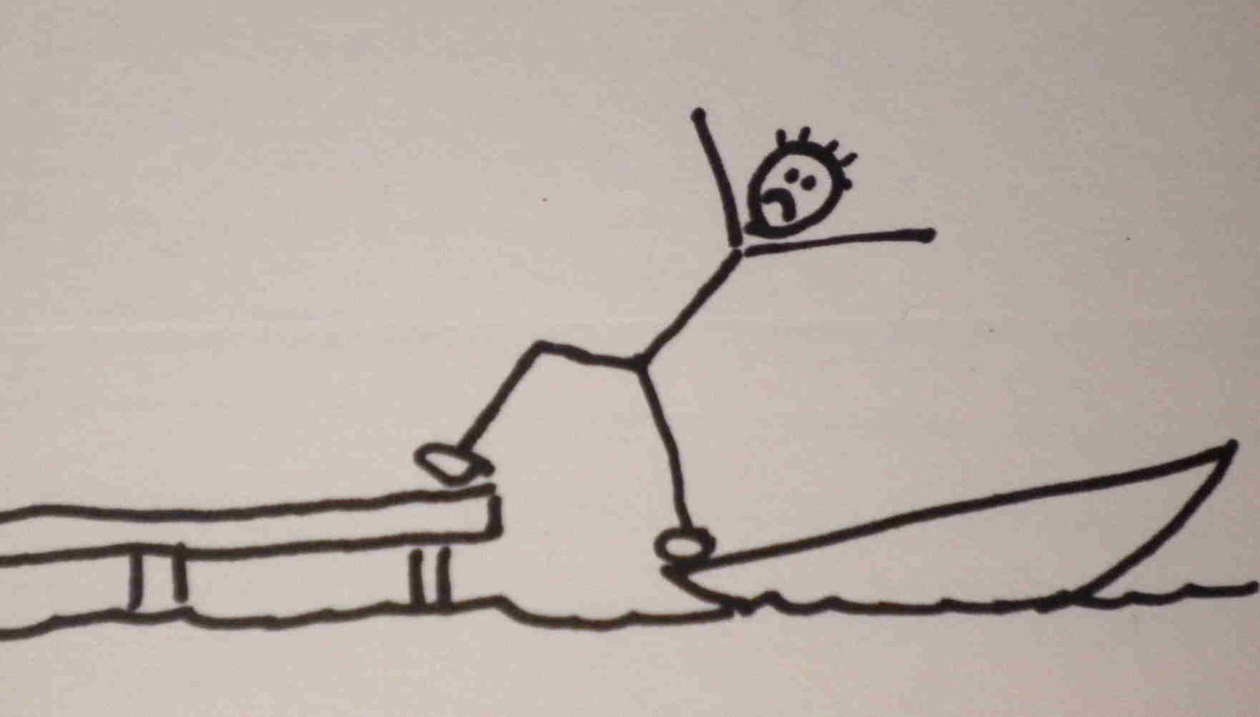
It feels more like this…
Educator Preparation Program P12 Clinical Placement/Internship

Slide 11
a policy what?...
Policy ecology: the multi-level, multi-faceted, integrated, coherent network of policies (including legislation, regulation, and policies at multiple levels—state, district, local, including collective bargaining agreements) that support a valued outcome (in education). These policy networks establish incentives, priorities, and limits on action for individuals and institutions in the system. They establish boundaries that constrain cooperation with other parties in the system.
Notes:
Frame the clinical issue as an example – we have policy gaps around distribution of talent to match opportunities as well…

Slide 12
Practice can’t sustain what policy won’t support.
What we truly value in education,
we make impossible not to do.
Consider algebra v. clinical placements

Slide 13
Algebra is inevitable
Notes:
How many of you studied algebra? Why did you decide to do it?
How many teachers take student teachers? How many school districts engage in helping build the very best clinical experiences for candidates/

Slide 14
Good clinical placements for aspiring teachers of algebra are not
Notes:
How many of you studied algebra? Why did you decide to do it?
How many teachers take student teachers? How many school districts engage in helping build the very best clinical experiences for candidates/

Slide 15
Policy ecology for algebra
Algebra is “inevitable”
—no one can say no.

Slide 16
Policy ecology for clinical preparation
Algebra is “inevitable”—no one can say no.
Clinical Placements for prospective algebra teachers are negotiated individually, indirectly, contingently. Anybody and everybody can say no.

Slide 17
Policy ecology for algebra
Algebra’s inevitability is over-determined by policy
How many aspects of policy support algebra?
• curriculum rules • teacher licensure
• union contracts • graduation req.s
• fiscal policies • assessment policies
• license testing • prep program req.s

Slide 18
Policy ecology for clinical preparation
What policies support strong clinical preparation?
+ Mandate on preparation programs
+ Requirement for candidate licensure/cert.
What policy levers offer no support or incentive?
√ State school policies, incl. financial formulae
√ Teacher evaluation polices and
√ Assessment policies create headwinds
√ Teacher expectations and contracts
√ Resources (constrain what’s possible)

Slide 19
Practice can’t solve policy’s problems
The ‘rule’ has been to bank on exceptions—exceptional efforts by exceptional individuals with exceptional support of limited duration.
Policy could reset what’s ‘normal’ and make the exceptions the rule. For example, policy makes PDS s the rule in Maryland; practice works to perfect them.

Slide 20
Policy ecology for clinical preparation
What policy levers need to be crafted/refined?
+ licensure requirements (for teachers & leaders)
+ teacher contracts/rewards (predictable ones)
+ preparation requirements and funding
+ funding/resource streams for BOTH P12, EPPs
+ P12 district rules/guidelines expectations

Slide 21
The News is Better than the Headlines
Programs eager for access to more, better data
Credible performance assessment now a reality
Candidates growing stronger (GPAs > 3.0)
Clinical experiences stronger, longer
New teachers increasingly feel well-prepared
Partnerships among EPPs, P12, SEAs improving
(…but let’s build a bridge ‘beyond partnership’)

Slide 22

We’ve got some bridge-building to do

Slide 24

Partners in Opportunity
Minneapolis Public Schools and Teacher Prep Programs
CEHD Policy Breakfast
October 2nd, 2015

Slide 25
Our Context
Achievement: MPS faces a wide achievement gap between white students and students of color.
  An African American student living in poverty in an MPS school:
    Is only half as likely to become proficient or advanced in reading and math as his or her white peers
    Is about half as likely to graduate high school
    Is 3 times more likely to drop out of school
Diversity: 86% of MPS teachers are white, while only 33% percent of students are
Retention: In 2012-13, almost 25% of 1st year teachers left MPS during or after their first year

Slide 26
Partnership Strategy
MPS strongly believes that we can improve the quality, diversity and retention of our teachers through our continued two-way partnership with higher education.
These deep and sustained partnerships are a foundational aspect of our strategy to achieve equitable results for the students of Minneapolis.

Slide 27
Preparation Challenges
MPS views teacher preparation as a partnership with higher education partners and as a process that continues after a teacher candidate graduates.
Challenges preparing teachers during preparation and after hiring include:
  Ensuring that teachers are highly skilled and knowledgeable around the complexities of urban education
  Ensuring that our highest quality student teachers get hired in MPS
  Providing adequate support and ongoing professional development for new teachers as they enter our schools
  Supporting the many new teachers who often end up at our highest needs schools in their first years

Slide 28
Human Capital Strategy
From student teaching through the career continuum, MPS is focused on creating robust and aligned systems to support its teachers:
  Strong student teaching experiences
  Strategic recruitment and hiring of high quality teachers
  Effective onboarding for new teachers
  Robust first year mentoring program
  Ongoing support and development through the district's observation and feedback channels (observations, student surveys, student academic data)

Slide 29
The Talent Pool
MPS wants to be able to hire from the broadest possible and best prepared talent pool in order to:
  Increase the likelihood of identifying and hiring the highest quality teachers
  Address shortages, particularly in hard-to-staff licensure areas
  Increase the diversity of our workforce to more closely reflect our student community
Our data show that much of our greatest talent are prepared in lcoal preparation institutions, highlighting the importance of strong partnerships with local prep programs

Slide 30
Higher Education Partnerships
Current Programs:
  Traditional teacher preparation programs and student teacher placement (total of 20)
  Minneapolis Residency Program: Licensure program based on deep clinical experience and tailored curriculum for highly-qualified, unlicensed MPS staff to become teachers
  EBD residency: A partnership between the University of Minnesota and five MN school districts to prepare current special education assistants to become licensed EBD teachers
  TC2: STEM focused residency for highly qualified individuals who are prepared through a year-long residency in either SPPS or MPS schools
  Alternative pathways: Teach for America
MPS will continue to partner with the Board of Teaching and Higher Ed partners to develop innovative models of teacher preparation

Slide 31
Success Stories
Student teacher tracking: MPS now systematically understands who its student teachers are and where they are working (400 student teachers in 2014-15)
Student Teacher Observations: Assessing quality as a signal for hiring
Developed cluster sites and a site-based liaison role that supports university partnerships and placements of student teachers
  Supports selection of teacher candidates and matches with effective cooperating teachers
  Supports teacher candidate and cooperating teachers on-site
Research partnership with St. Kate’s and the University of Minnesota
  Studying effectiveness of our current teacher screening model
  Exploring methods to better understand quality of student teachers as hiring signals
Data Sharing:
  MPS provides information on probationary teacher quality back to prep programs to inform preparation programming
  Get feedback from programs that help us align
Established cooperating teacher as teacher leader role, developed CT criteria with university partners and provide Foundations of Co-Teaching training for CTs

Slide 32
Feedback from Higher Ed
We receive feedback from our partners in order to provide high quality experiences for teacher candidates:
  Surveys of student teachers- learning about candidate experience in MPS and provide to MPS
  Feedback on hiring practices
  Feedback on specific schools and how MPS can set up student teachers for success

Slide 33
Summary
Over the last several years, MPS and higher education institutions have greatly strengthened their partnership in order to strengthen the teacher preparation experience.
This success of these partnerships represent a critical strategy in addressing the achievement gap in Minneapolis.
MPS is committed to continuing and strengthening these partnerships, and exploring new and innovative ways that we can work with the institutions that prepare our teachers.

Slide 34
Opportunities Ahead
Improve how we strategically identify and hire talented student teachers
Continue to identify and develop innovative, high quality preparation partnerships
Strengthen alignment between student teaching and the realities of working in MPS
Strengthening feedback channels between higher education partners about what it takes to be successful in MPS
Work with higher education partners to align the language of effective instruction
  Continue to train higher education partners in the MPS observation rubric
  Deepen the pre-service experience through the implementation of additional cluster sites and more co-teaching training for cooperating teachers
  Crosswalk the MPS standards of effective instruction with tools used in preparation programs

Slide 35
Panel Discussion
Mark LaCelle-Peterson, Senior Vice President, American Association of Colleges for Teacher Education
Erin Doan, Executive Director, Minnesota Board on Teaching
Daniel Glass, School and District Leadership Coordinator, Minneapolis Public Schools

