Slide 1


Cluster Analysis on Perceived Effects of Scholarships on STEM Majors’ Commitment to Becoming Teachers versus Teaching in High Needs Schools
Pey-Yan Liou
Christopher Desjardins
Frances Lawrenz
University of Minnesota
Educational Psychology-Quantitative Methods in Education
Acknowledgement:
This project was funded by National Science Foundation (Grant#REC0514884)

Slide 2
Presentation Outline
Introduction
Context
Methods
Results
Discussion

Slide 3
Introduction
Highly qualified STEM teachers imperative to maintaining the economic and security interests of the United States
  Positive relationships between STEM teacher quality and student achievement
  Economists claim America’s competitive edge depends on STEM education
Highly Strategies to recruit and retain qualified teachers Results
  Used by
    federal and state agencies
    teacher preparation institutions
  Alternative certification
  Financial incentives
→ Little research on the effects of scholarships, especially for high needs settings

Slide 4
Research Goal
The goal was to examine the influence of scholarships on STEM teacher recruitment and retention, focusing specifically on categorizing the characteristics of scholarship recipients that were related to differing perceptions regarding the effect of the scholarship on their decision to become STEM teachers and teach in high needs schools.

Slide 5
Noyce Scholarship Program
NSF funded program, in operation at 77 institutions nationally
Scholars commit to two years of teaching in high needs settings for each year of scholarship support
Teacher preparation programs use similar screening criteria to select Noyce scholars:
  GPA (98.5%)
  personal statement (97%)
  letters of recommendation (91%)
  upper level undergraduate status in science or mathematics major (82%)
  structured interviews (73%)
  bachelor’s degree in the candidate’s subject area (73%)
  previous work experience (69%)
Most programs provide opportunities for interactions with children from different cultures such as mentoring or tutoring, coursework relating to diverse cultures, and specific instruction about practicing in high needs schools

Slide 6
Principal Investigators’ Perceptions about the Influence of the Noyce Scholarship Program (N=66)
    Principal investigators=faculty in teacher preparation programs responsible for the operation of the NSP at their school
Noyce funding greatly increased their ability to recruit a variety of students
  Noyce funding somewhat enhanced relationships with community, districts, STEM faculty, and industry

Slide 7
Survey
Evaluation Scholar Survey administered online during the summer of 2007 http://www2.cehd.umn.edu/EdPsy/NoyceSurvey/NoyceScholar/surveySample.asp
Participants were asked to respond to a variety of items regarding their perceptions of and experiences with Noyce
(a) project overview
(b) program characteristics and organization
(c) teaching environment and experience
(d) the decision to become a teacher
(e) background and experience
(f) overall experience

Slide 8
Analyses
Two-stage hierarchical cluster analysis (TSHCA, with SPSS)
  TSHCA statistically groups similar individuals together.
  categorized STEM scholars’ on their perceptions of the Noyce scholarship.
Descriptive statistics
ANOVA and Chi-Square Statistics

Slide 9


Four Variables as Basis for Clustering
Two Continuous Variables
Factor | Item content | Item option
“Influence of scholarship on becoming a teacher” | “How influential is the Noyce Scholarship money in your commitment to:” (a) become a teacher (b) complete the certification program (c) take a teaching job | 1) not at all influential, 2) not very influential, 3) somewhat influential, 4) very influential
“Influence of scholarship on becoming a high needs school teacher” | (d) teach in a high needs school (e) remain teaching in a high needs school for the full term of your commitment (f) remain teaching in a high needs school beyond the full term of your commitment
Two Categorical Variables
 | Would you have become a teacher if you had not received the Noyce scholarship? | 1) no, 2) possibly, 3) yes
 | Would you have decided to teach in a high needs school if you had not participated in the Noyce Scholarship Program? | 1) no/I have not taught in a high needs school, 2) possibly, 3) yes

Slide 10
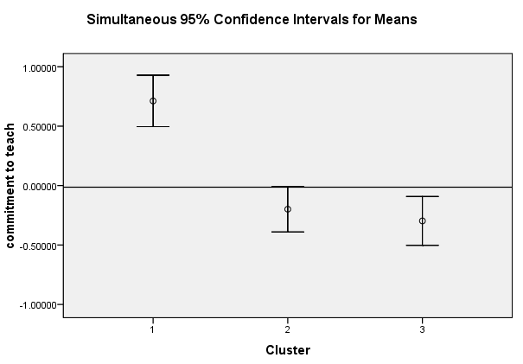
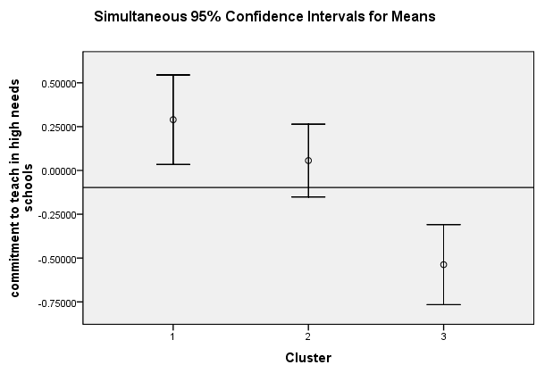
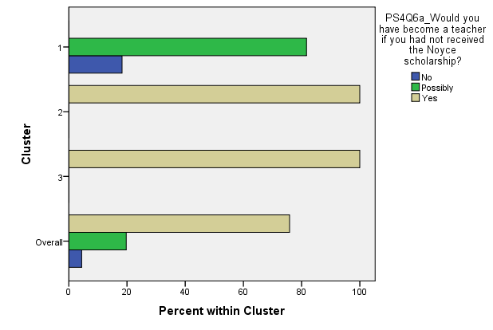
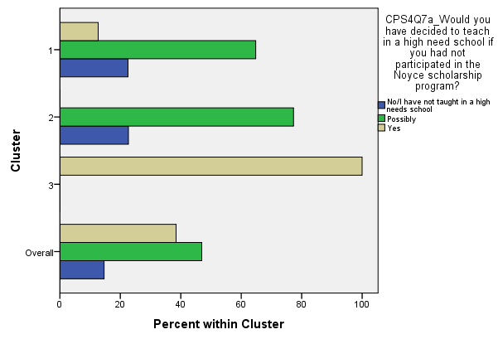
Three Distinct Clusters Emerged
F(2,293)=35.818, p<0.001
F(2,293)=19.474, p<0.001

Slide 11
Cluster Composition as a Function of Demographic Characteristics--1
Demographic characteristics | Less committed to becoming a teacher and teaching in a high needs school (N=71) | Highly committed to becoming a teacher but not to teaching in a high needs school (N=119) | Highly committed to becoming a teacher and teaching in a high needs school (N=104) | Total (N=294)
Gender *Female *Male | 49 22 | 82 37 | 64 40 | 195 99 294
Race *White *Non-White | 46 23 | 91 22 | 58 39 | 195 84 279
Highest degree * Bachelor’s *Master’s *Doctorate’s | 27 4 5 | 44 5 1 | 41 6 1 | 112 15 7 134

Slide 12
Cluster Composition as a Function of Demographic Characteristics--2
Demographic characteristics | Less committed to becoming a teacher and teaching in a high needs school (N=71) | Highly committed to becoming a teacher but not to teaching in a high needs school (N=119) | Highly committed to becoming a teacher and teaching in a high needs school (N=104) | Total (N=294)
Intention to teach math *Yes *No | 22 49 | 45 74 | 45 59 | 112 182 294
The average age at the end of 2007 | 32.21(1.20) | 29.83 (0.71) | 31.2 (0.82) | 294
The average cumulative GPA | 3.53 (0.06) | 3.50 (0.04) | 3.37 (0.05) | 160

Slide 13
Relationships among the Three Clusters and Race
 | Race
 | Non-White | White
Less committed to becoming a teacher and teaching in a high needs school | 23 27% | 46 23%
Highly committed to becoming a teacher but not to teaching in a high needs school | 22 26% | 91 47%
Highly committed to becoming a teacher and teaching in a high needs school | 39 47% | 58 30%
Total | 84 | 195
Chi-Square(2, N=279) = 7.6, p=0.04

Slide 14
Relationships among the Three Clusters and Did you first learn about the Noyce scholarship before or after you decided to become a teacher?
 | Did you first learn about the Noyce scholarship before or after you decided to become a teacher?
 | Before | After
Less committed to becoming a teacher and teaching in a high needs school | 22 51% | 49 19%
Highly committed to becoming a teacher but not to teaching in a high needs school | 12 28% | 107 43%
Highly committed to becoming a teacher and teaching in a high needs school | 9 21% | 95 38%
Total | 43 | 251
Chi-Square(2, N=294) = 20.16, p<0.001

Slide 15
Relationships among the Three Clusters and Career Changer
 | In becoming a teacher, do you consider yourself to have made a “career change”?
 | No | Yes
Less committed to becoming a teacher and teaching in a high needs school | 26 19% | 44 30%
Highly committed to becoming a teacher but not to teaching in a high needs school | 63 45% | 52 35%
Highly committed to becoming a teacher and teaching in a high needs school | 50 36% | 51 35%
Total | 139 | 147
Chi-Square(2, N=286) = 5.47, p=0.065

Slide 16
Conclusions
Clustering on perceived Effect of the Noyce scholarship resulted in three distinct groups
― (1) Less committed to becoming a teacher and teaching in a high needs
school
― (2) Highly committed to becoming a teacher but not to teaching in a
high needs school
― (3) Highly committed to becoming a teacher and teaching in a high
needs school
Clusters differed in their demographic makeup but not markedly

Slide 17
Suggestions for Future Research
More data needs to be collected to determine whether these teachers actually stay in high needs schools beyond their initial commitments (long-term retention)
Recruitment strategies need to be considered when giving this kind of scholarship
  Strategies should seek to determine and award those most committed to high needs settings

Slide 18
Questions
Thank you!

