Slide 1
“Using Data-Based Program Modification to Frame Research on Problem Solving”
Stan Deno
RIPS Brown Bag
12/5/2010

Slide 2
DBPM Manual
Purpose
  To Provide a manual of procedures for special education resource teachers to take a data-based approach the “problems” presented to them through referral
Rationale
  Easy to get lost in responding to many, often conflicting, demands
  A systematic approach enables problem solver to remain focused and precise and outside the problem
  Data creates the empirical evidence to support the problem solvers decisions
Organization

Slide 3
Data-based Problem Solving Conceptual Framework
First: The decisions & the data

Slide 4
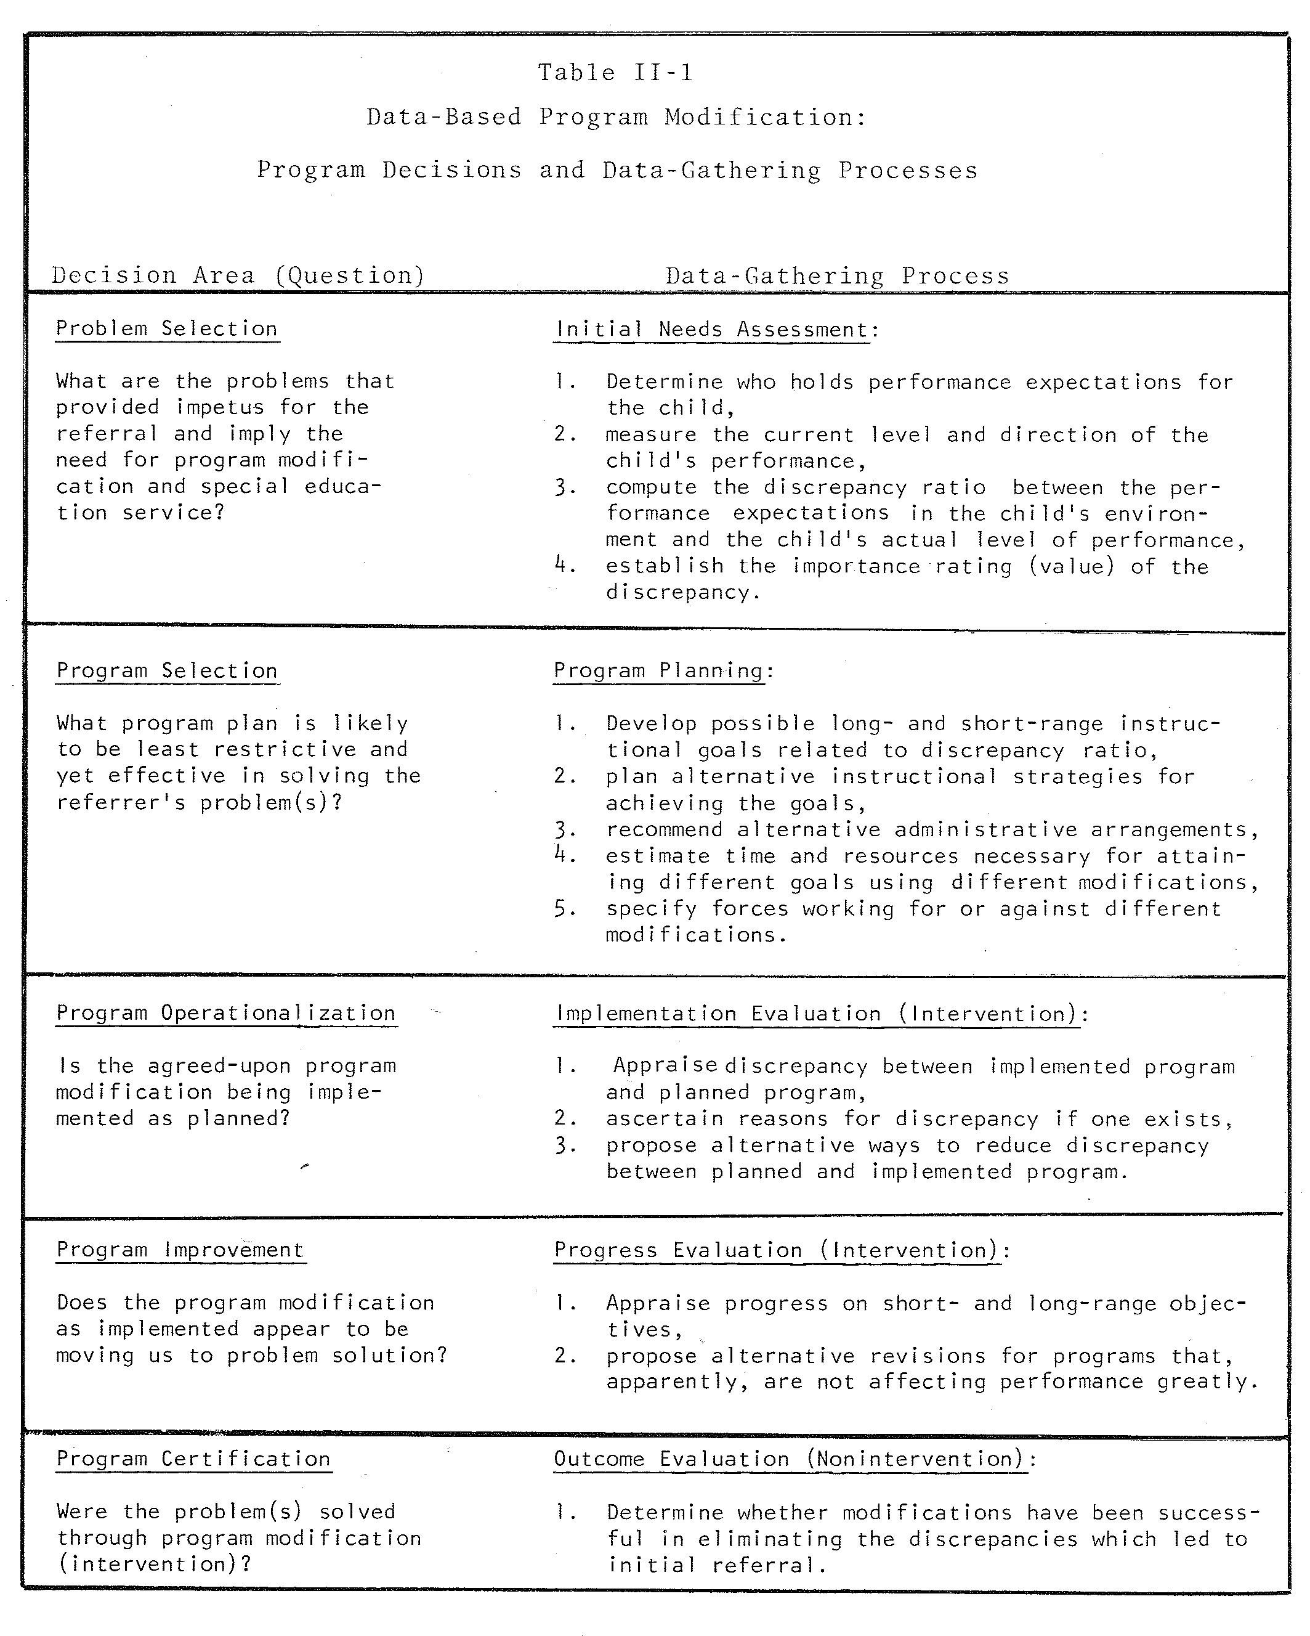

Slide 5
Processes Integral to Each Problem Solving Decision
The focus of those processes

Slide 6
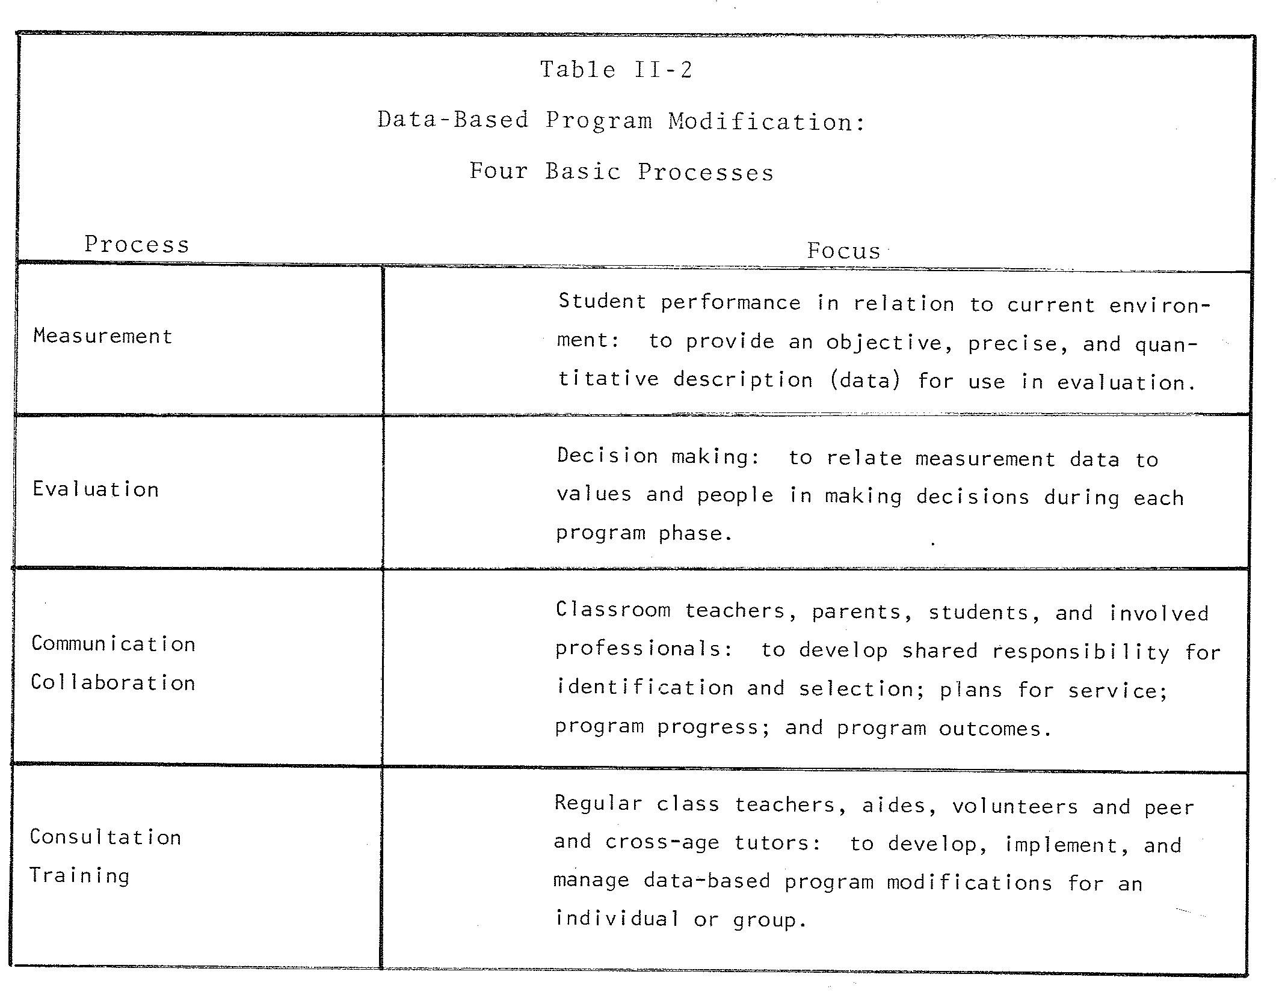

Slide 7
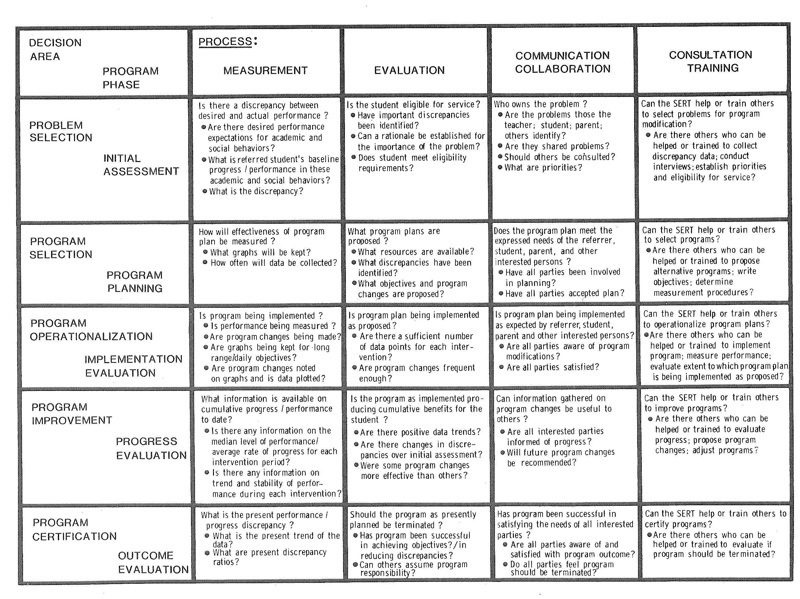

Slide 8
The Flow Diagrams
Outlining the sequence of steps & decisions required during each problem solving step

Slide 9
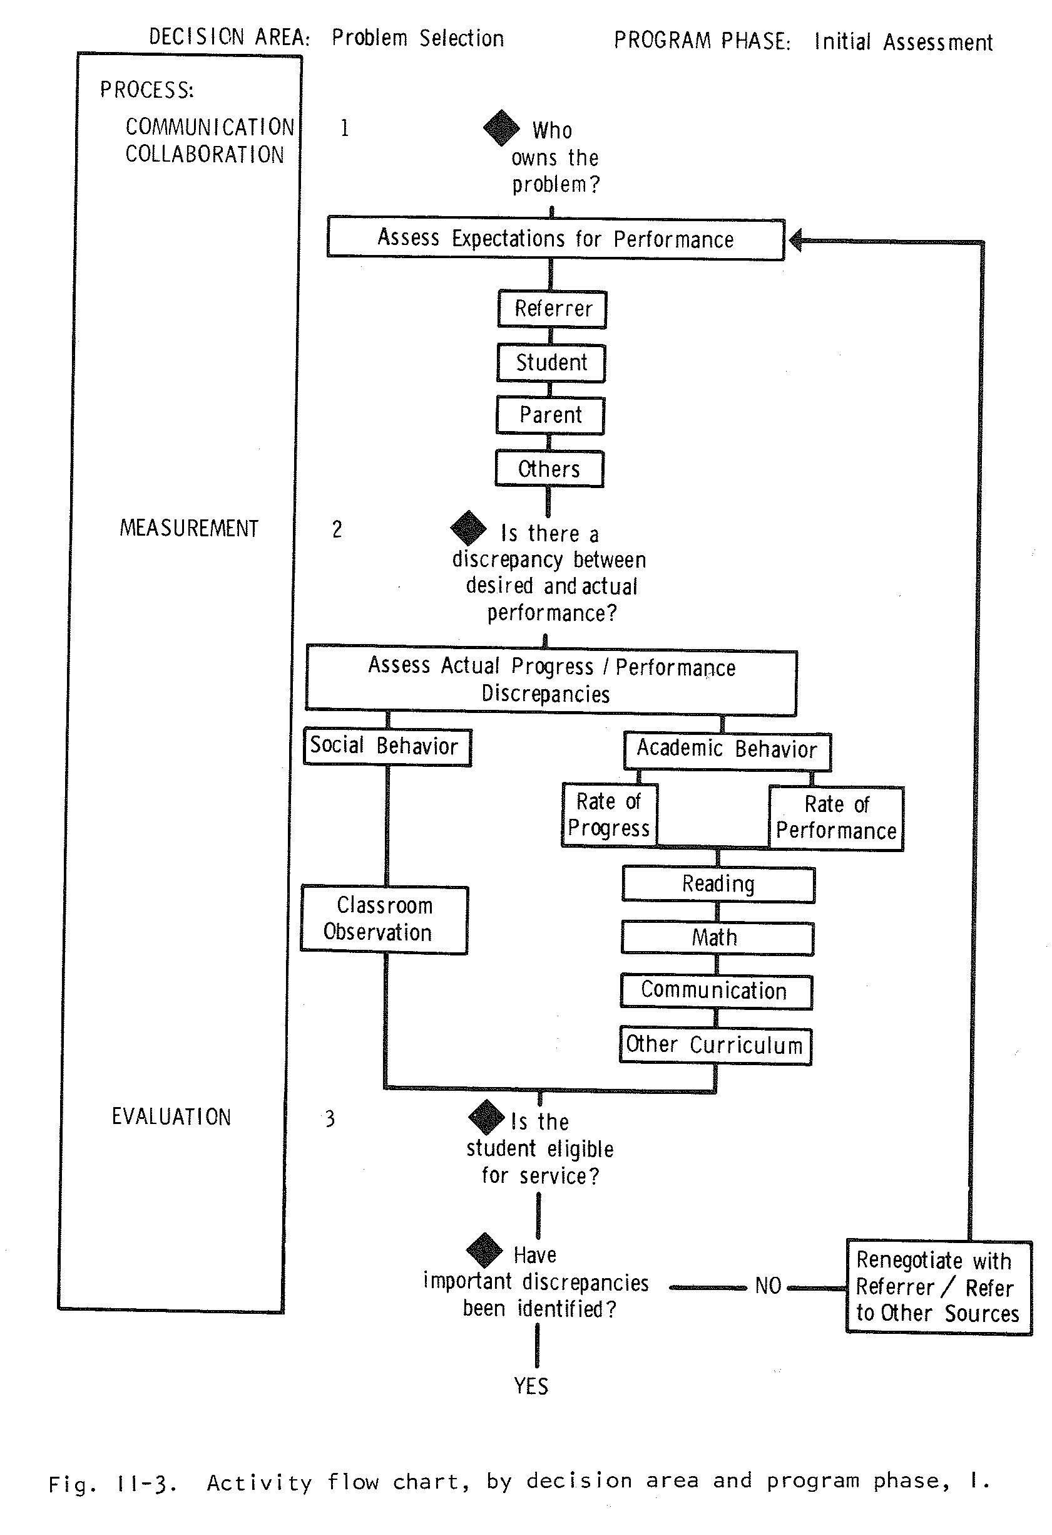

Slide 10
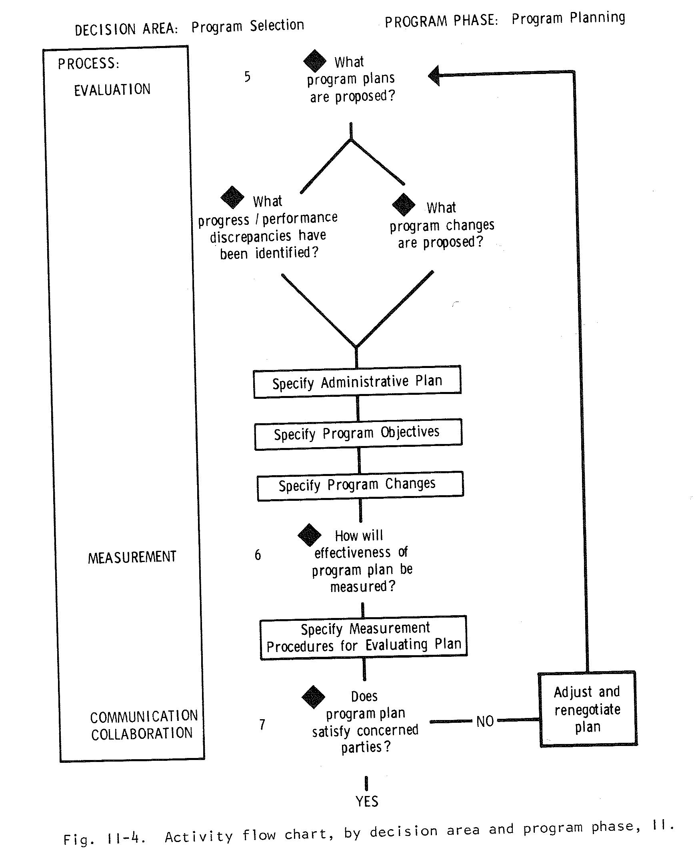

Slide 11
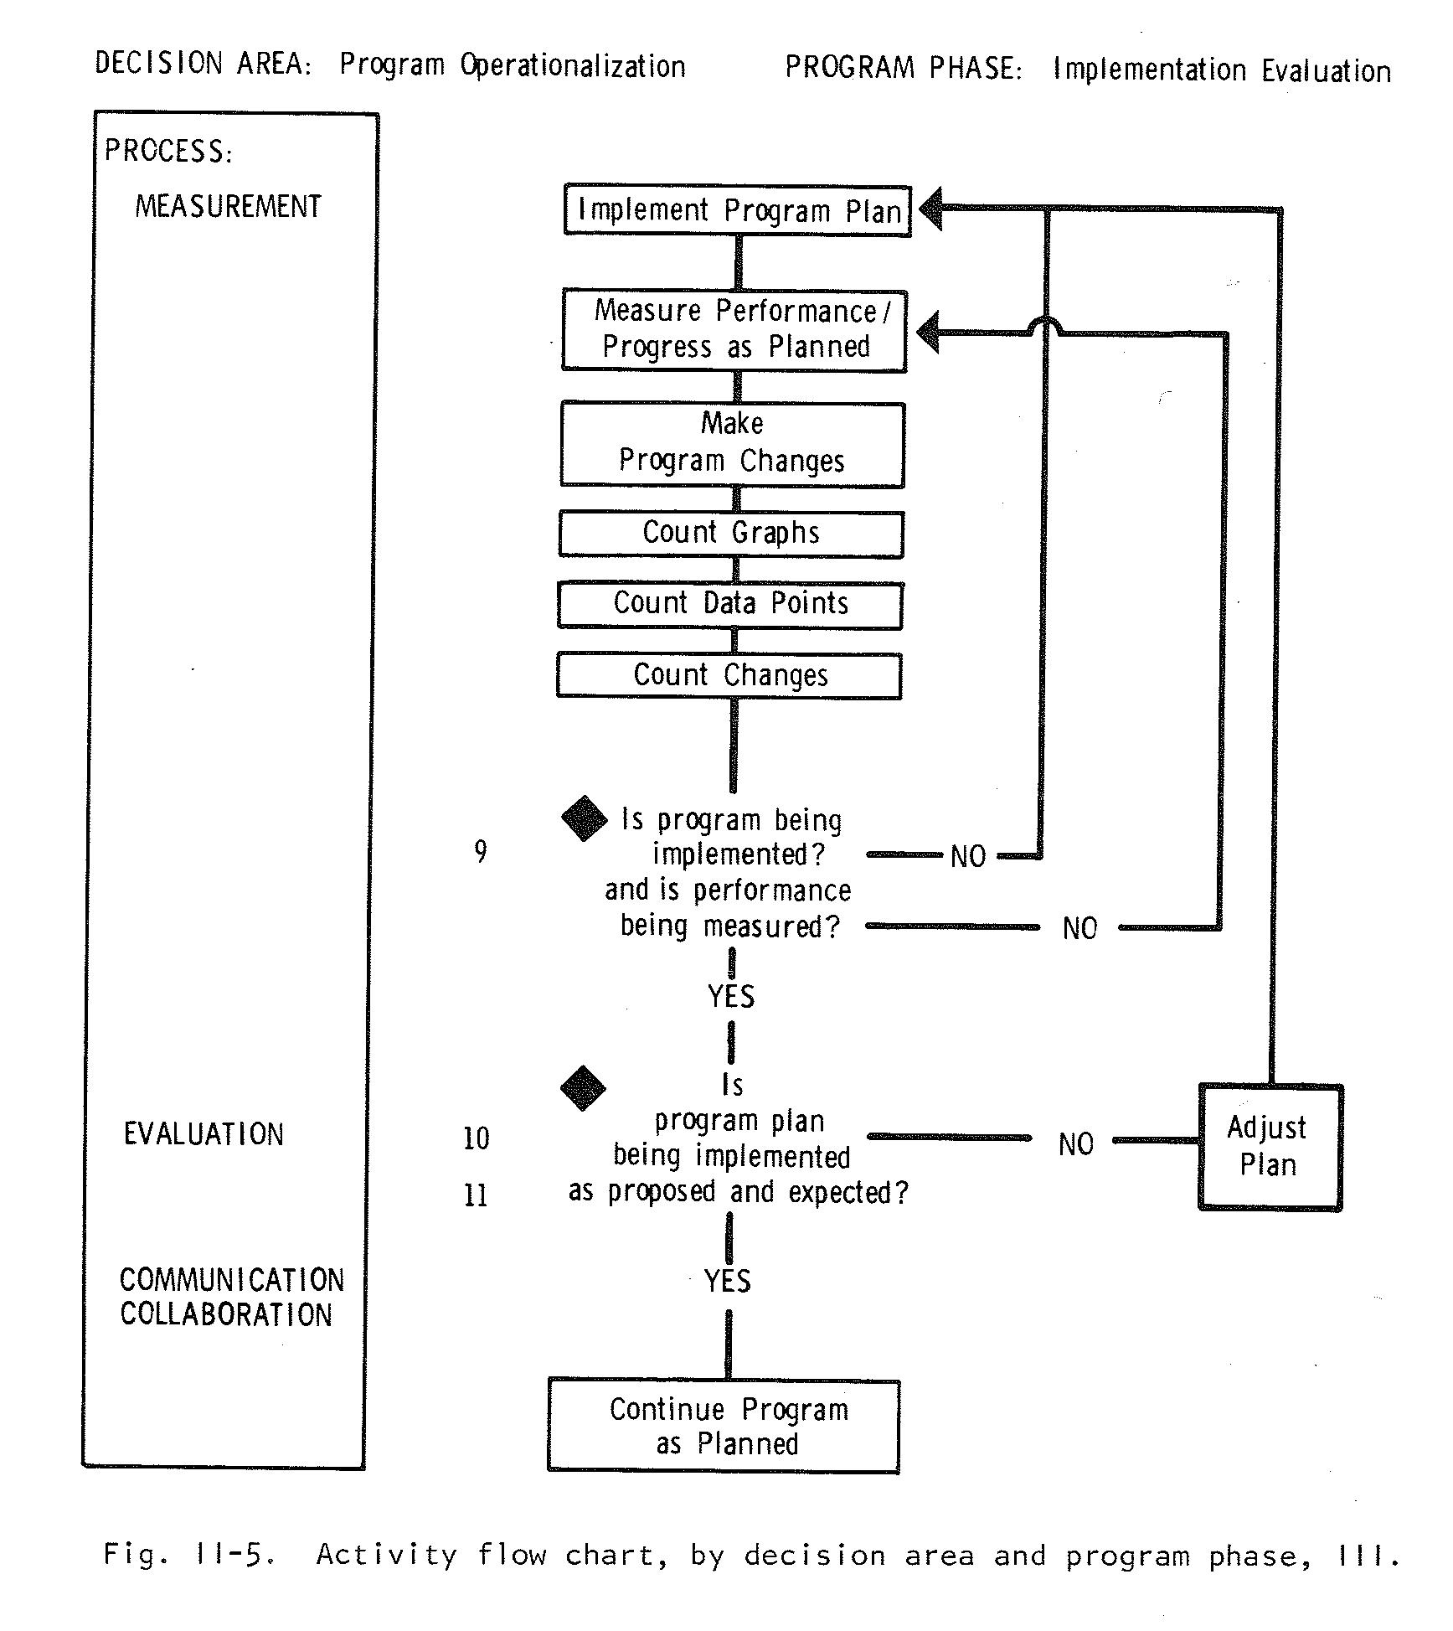

Slide 12
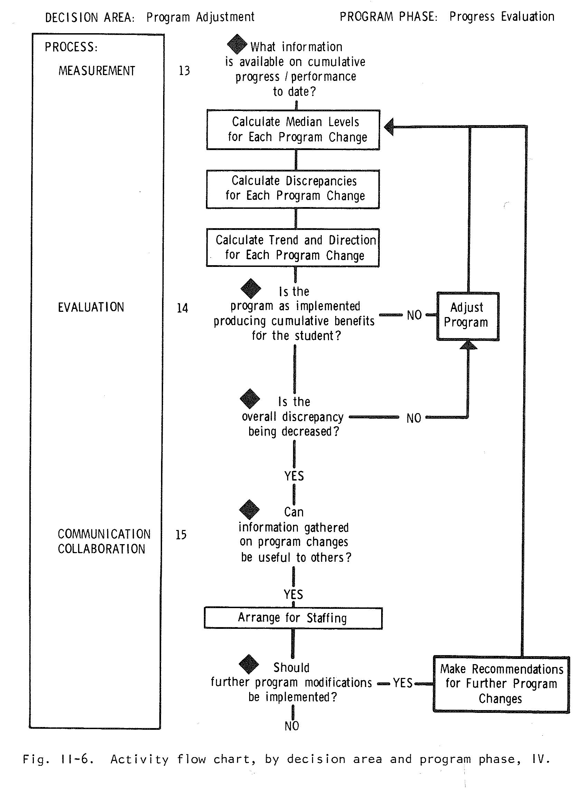

Slide 13
Using Matrix to Identify Questions:
Problem Selection, e.g.
Measurement (Cell 1.1):
  Do questions exist regarding desired performance for academic and social behaviors?
  Do we know how to reliably &validly measure actual performance for academic & social behaviors?
  Do we know to reliably and validly express the difference between desired & actual performance?

Slide 14
Using Matrix to Identify Questions:
Problem Selection, e.g.
Evaluation (Cell 1.2)
    Do we know the implications of different discrepancies (i.e. When is the magnitude important?)
    How should decisions be made (e.g. clinically vs statistically)?
    Do we have empirically based decision rules?

Slide 15
Using Matrix to Identify Questions:
Problem Selection, e.g.
Communication/Collaboration(Cell 1.3)
  Is the importance of a discrepancy to be based on policy or empirically tested theory?
  How are decisions to be made regarding the technology used to measure performance?
  Whose values should be brought to bear in the making the decisions?

Slide 16
Using Matrix to Identify Questions:
Problem Selection, e.g.
Consultation & Training (Cell 1.4)
  Who should manage the process of Problem Selection & what procedural & declarative knowledge does that person require?
  Who should conduct measurement during Problem Selection & when should it be conducted?
  What training & support are required for problem selection & who will provide it?

Slide 17
The Research Questions
Can be generated regarding:
  Competencies required in problem solving
  (Focus on the Problem Solver)
  Technology used in problem solving
  (Methods and Materials)
  Principles involved in problem solving
  (Theoretical, conceptual & empirical)
The questions generated are only examples

