Slide 1


FEM for Vibration Isolation System
Leslie Xu
09/09/2020
xkx5055@psu.edu

Slide 2
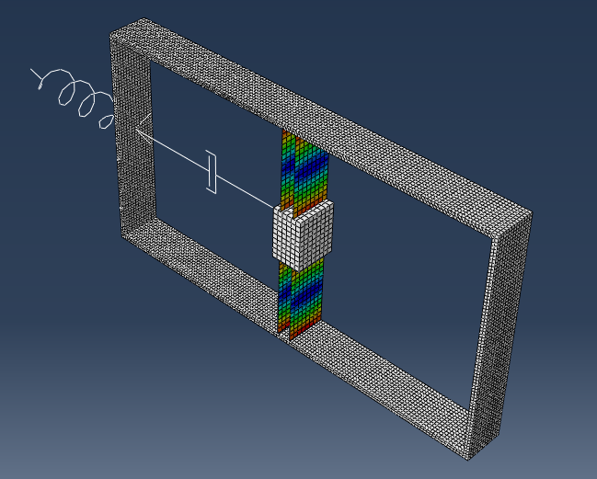


Description
FEM
FEM Setting
Free Vibration in frequency domain
Forced Vibration in time domain
Model Calibration
Problem Definition
Targeted Feature

Slide 3
FEM Setting
6
# | Name | Material
1 | Frame | M=7.2 kg
2 | Beam | --
3 | Mass Oscillator | m=0.7853kg
4 | Spring | Stiffness, k=284.47 N/m
5 | Damper | d, N*s/m
6 | Gain | ga, N*s/m
5
1
4
2
3

Slide 4
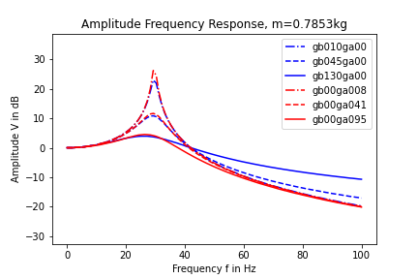
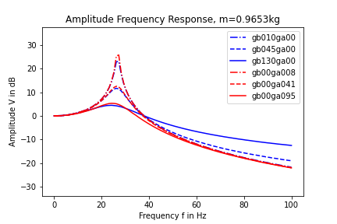
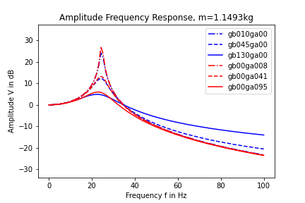
Free Vibration
Simulation response in frequency domain

Slide 5
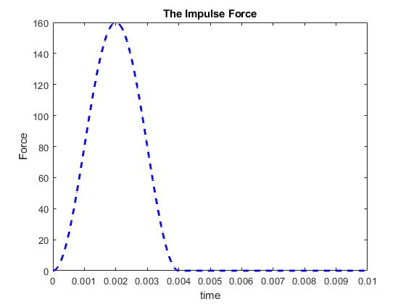
Forced Vibration
Impulse excitation
Parametric study setting
Case | Damping Coefficient d N*s/m | Gain factor ga N*s/m
1 | 1.8 | 8
2 | 1.8 | 41
3 | 1.8 | 95
4 | 10 | 0
5 | 45 | 0
6 | 130 | 0

Slide 6
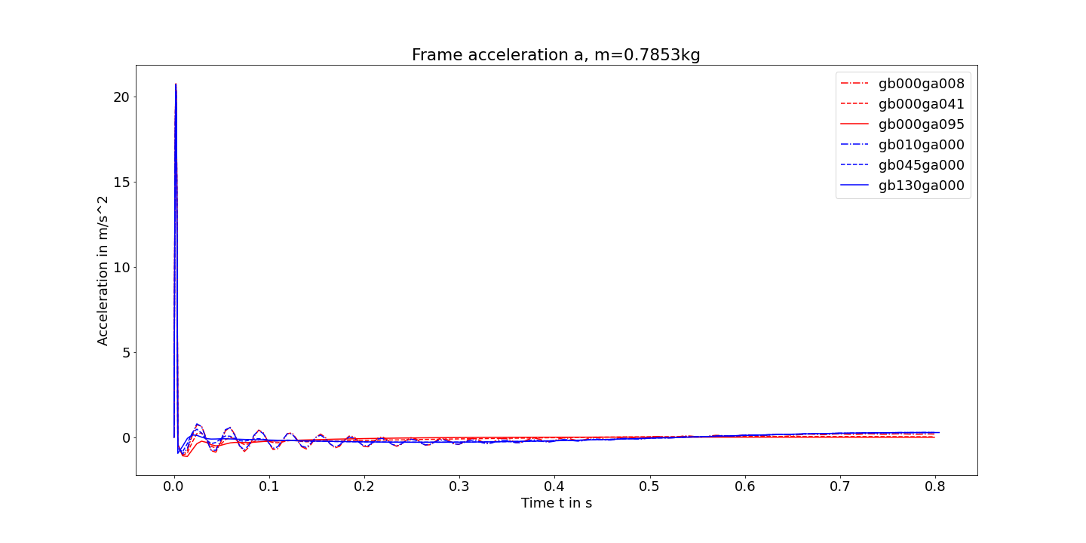
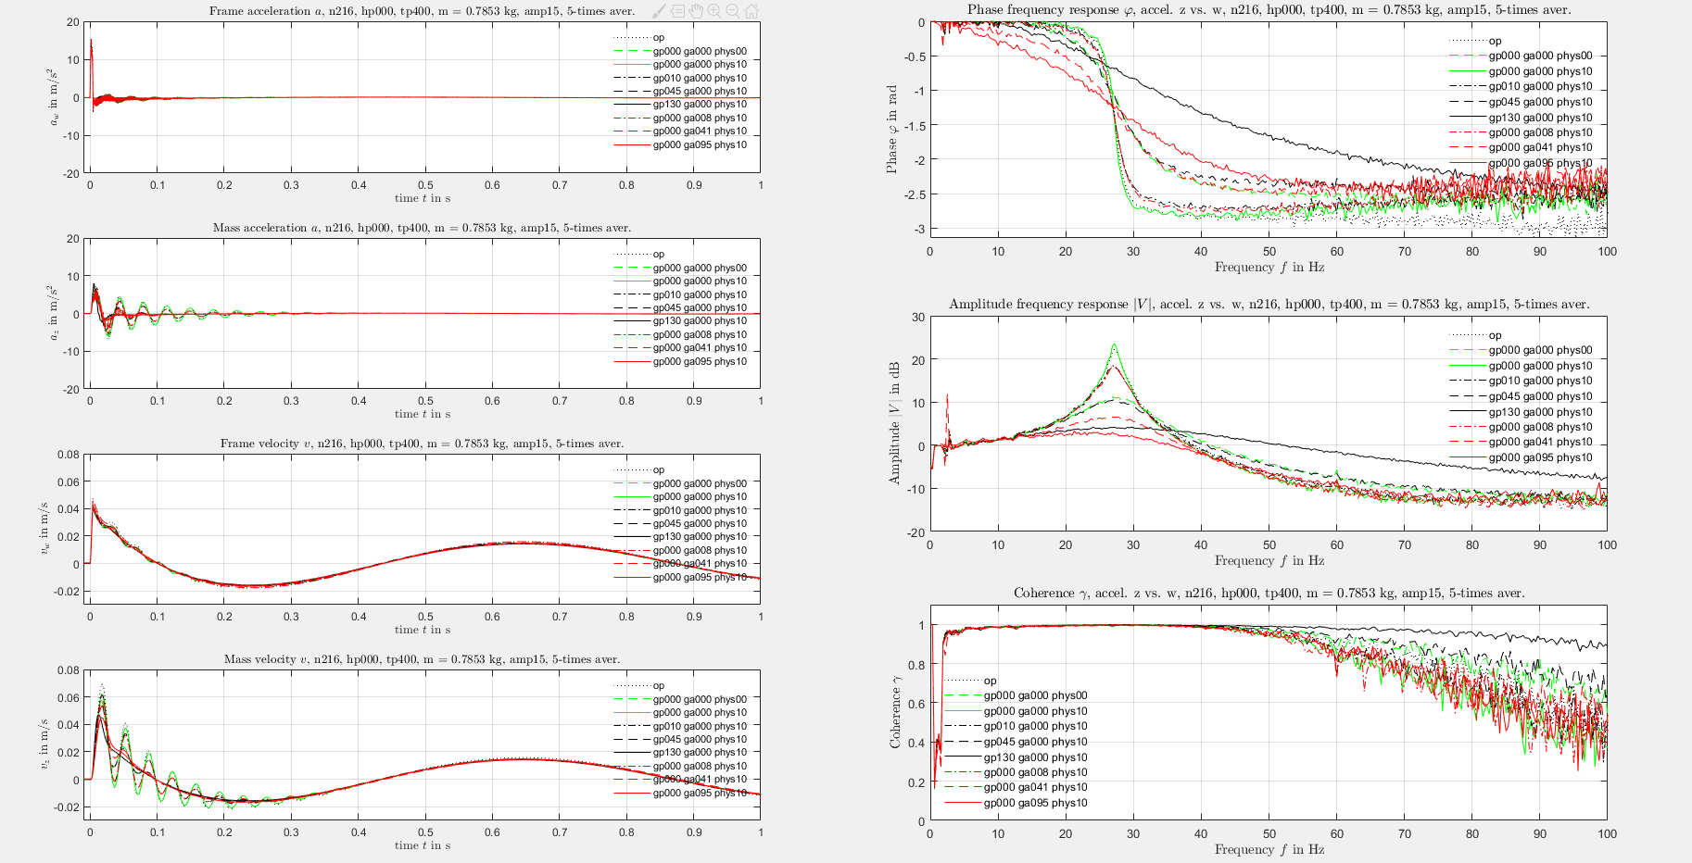
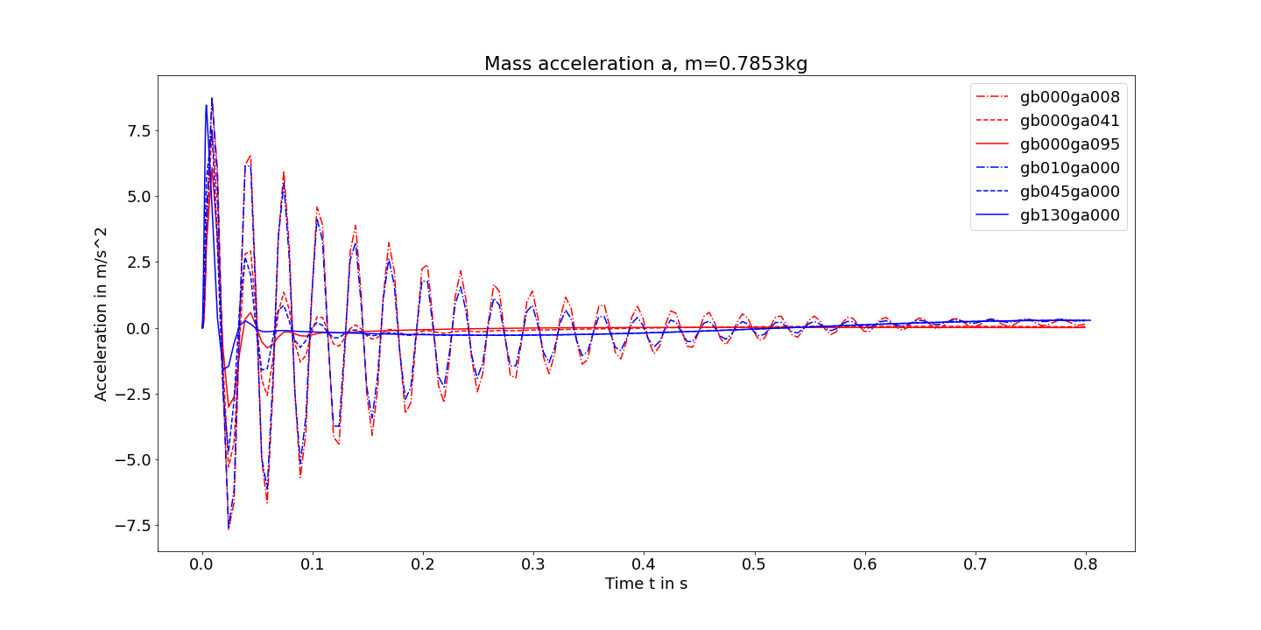
Forced Vibration
Simulation response in time domain VS Experimental response in time domain

Slide 7
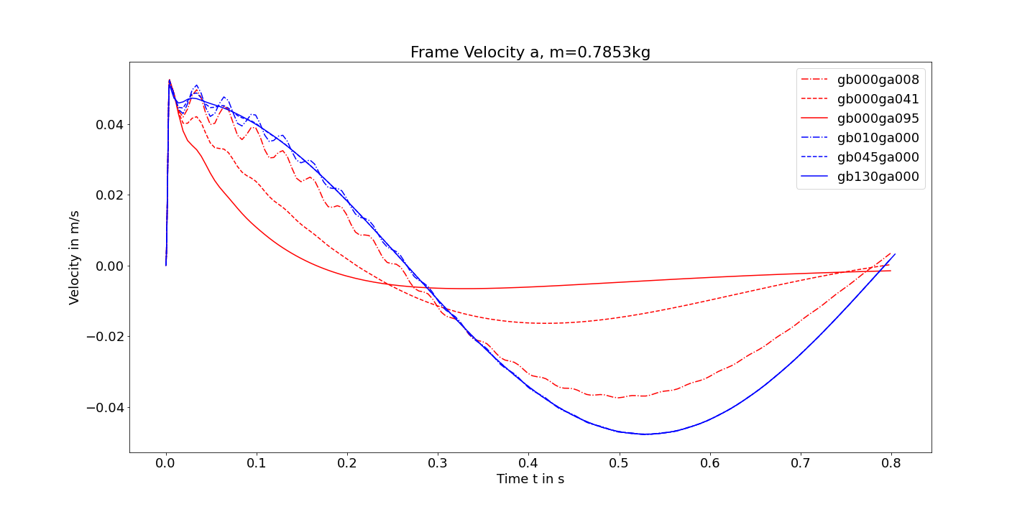
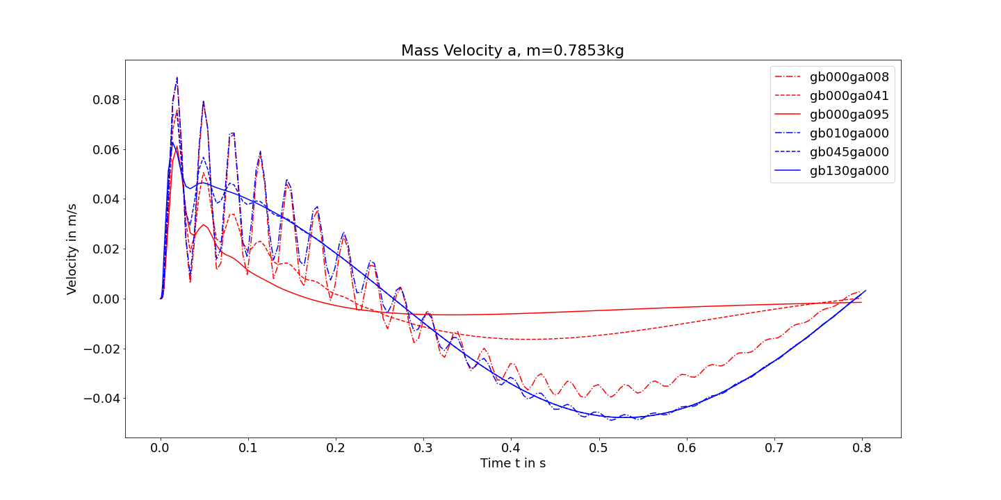
Forced Vibration
Simulation response in time domain VS Experimental response in time domain

Slide 8
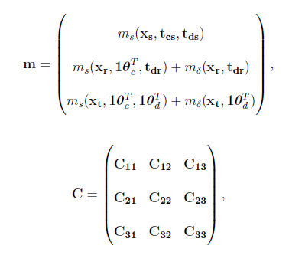


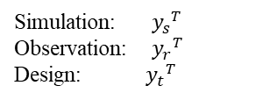

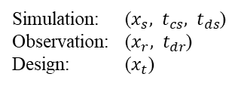

Model Calibration
Simulation: ($x_{s}, t_{cs},{ t}_{ds}$)
Observation: ($x_{r}, { t}_{dr}$)
Design: ($x_{t}$)
Gaussian Process: $y \sim N(m,C)$
Simulation: ${y_{s}}^{T}$
Observation: ${y_{r}}^{T}$
Design: ${y_{t}}^{T}$
Mathematical Formula
Control Parameter: $m$
Calibration: depends on cases
Outputs: $z,\dot{z}, \ddot{z},w,\dot{w}$
Where:
m: mass (kg)
b: passive damping coefficient (Ns/m)
g: active gain factor (Ns/m)
k: stiffness (N/m)
z(t): displacement of the one mass oscillator (m)
w(t): displacement of the frame (m)

Slide 9




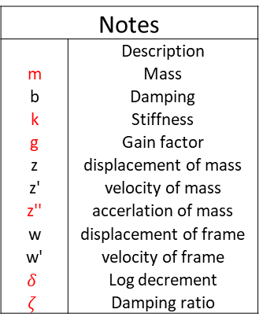
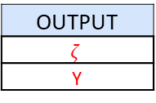

Data Structure
Notes
 | Description
m | Mass
b | Damping
k | Stiffness
g | Gain factor
z | displacement of mass
z' | velocity of mass
z'' | accerlation of mass
w | displacement of frame
w' | velocity of frame
$$δ$$ | Log decrement
$$ζ$$ | Damping ratio
INPUT
m | k | g
X1 | Theta1 | Design1
881.495 | 201792 | 40.3568
939.575 | 80845.8 | 43.8008
870.605 | 131390 | 78.2408
1077.51 | 199987 | 79.9627
859.715 | 160273 | 53.2718
997.655 | 37521.7 | 50.6888
946.835 | 71819.9 | 75.6578
1142.86 | 59183.7 | 64.4648
961.355 | 82650.9 | 44.6618
885.125 | 84456.1 | 68.3393
1070.25 | 133196 | 65.7563
… | … | …
848.825 | 154858 | 54.1328
1073.88 | 111534 | 69.6308
1059.37 | 26690.7 | 73.0748
1048.47 | 113339 | 81.2543
790.745 | 88066.4 | 69.2003
1004.91 | 48352.7 | 46.8143
1117.44 | 192766 | 56.2853
1106.55 | 136806 | 62.3123
801.635 | 196377 | 67.0478
1008.54 | 30301 | 79.1018
1030.33 | 198182 | 67.9087
816.155 | 57378.6 | 70.4917
892.385 | 32106.2 | 72.6442
812.525 | 125975 | 52.4108
OUTPUT
z''
Y1
Output.Size: (100,30,1)
Where, 30 is the number of selected time steps
Extract damping ratio as output:
$${\ddot{z}}_{1}$$
Example
$${\ddot{z}}_{2}$$
$${\ddot{z}}_{n}$$
OUTPUT
$$ζ$$
Y
Output: (100,1)
Input.Size: (100,3)

