Slide 1
_ _ _ ____ ___ ____ _ _ _ _ _ _
/ \ | \ | / ___|_ _| / ___|___ __| | ___ ___ __ _ _ __ __| | | | | |_ __ (_) ___ ___ __| | ___
/ _ \ | \| \___ \| | | | / _ \ / _` |/ _ \/ __| / _` | '_ \ / _` | | | | | '_ \| |/ __/ _ \ / _` |/ _ \
/ ___ \| |\ |___) | | | |__| (_) | (_| | __/\__ \ | (_| | | | | (_| | | |_| | | | | | (_| (_) | (_| | __/
/_/ \_\_| \_|____/___| \____\___/ \__,_|\___||___/ \__,_|_| |_|\__,_| \___/|_| |_|_|\___\___/ \__,_|\___|
THE REAL POTENTIAL BEHIND MODERN TEXT TERMINALS
Artur Twardowski
CEHUG 2026-10-07

Slide 2
About the author
Artur Twardowski
- programming since 2001
- working for Mobica (also known as Cognizant)
- C/C++, embedded, electronics, the lower, the better
(but also Python)
Notes:
Po przedstawieniu się przełączenie na terminal:
- kolorowanie tekstu w ls
- zdjęcie

Slide 3
Table of Contents
0. Introduction
1. Control Sequences
2. Beyond basic ASCII
3. State of the Art
Notes:
Po przedstawieniu się przełączenie na terminal:
- kolorowanie tekstu w ls
- zdjęcie

Slide 4
Why terminals?
- easy automation of tasks
- easy prototyping and development of tools
- low bandwidth required
- low hardware requirements (both sides)
Notes:
Po przedstawieniu się przełączenie na terminal:
- kolorowanie tekstu w ls
- zdjęcie

Slide 5
PART I: CONTROL SEQUENCES

Slide 6
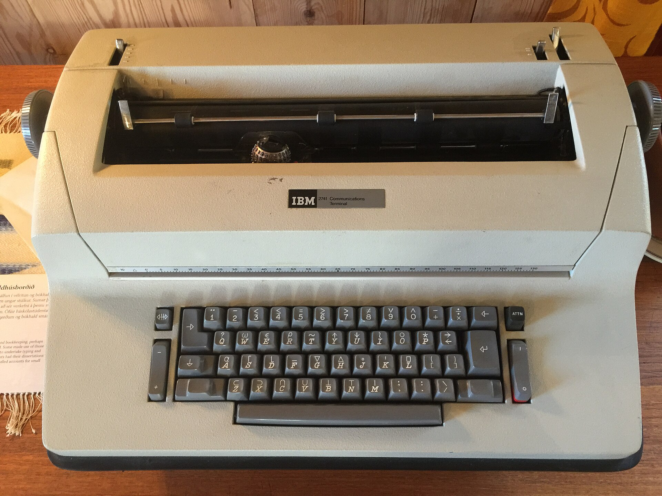
Typewriters?
IBM 2741 (1965)
Photo by: Oscar.nierstrasz
https://en.wikipedia.org/wiki/Computer_terminal#/media/File:IBM_2741_Communications_Terminal.jpg

Slide 7
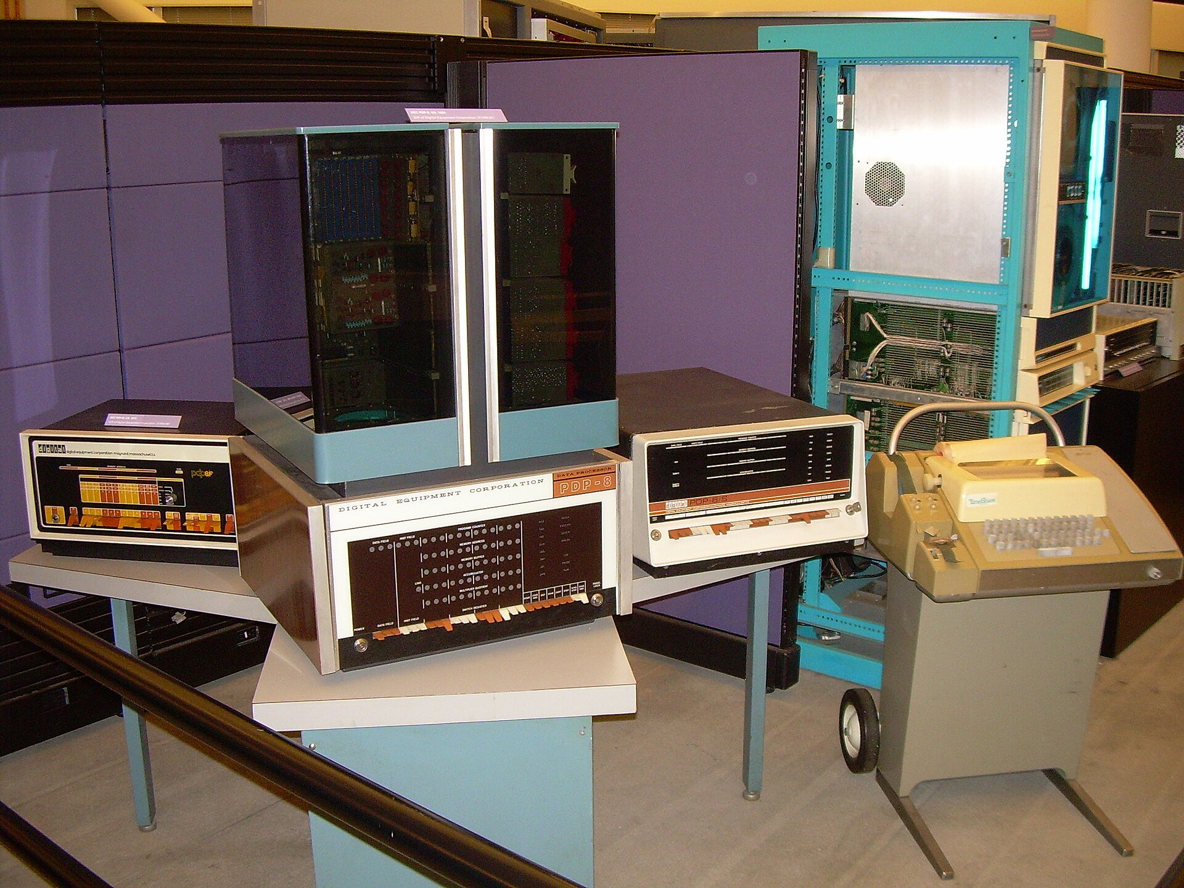
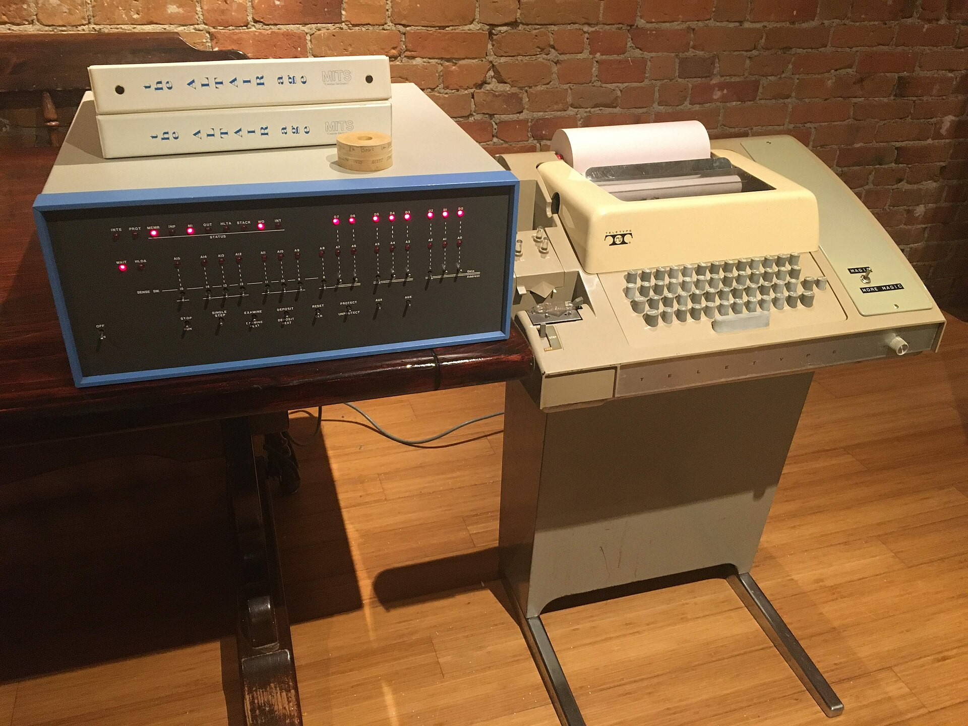
Typewriters?
Teletype Corporation Model 33 (1963)
DEC PDP-8 Altair 8800
Photo by: Carlo Nardone
https://upload.wikimedia.org/wikipedia/commons/2/25/DEC_PDP-8_family_-_PDP-8F_%281972%29%2C_PDP-8_%281965%29%2C_PDP-8S_%28c.1966%29_-_and_Teletype_ASR-33_%281964%29%2C_on_the_side_of_Data_General_Eclips_%281974%29_%26_Nova_%281969%29_-_Computer_History_Museum_%282007-11-10_23.08.07_by_Carlo_Nardone%29.jpg
Photo by: Tim Colegrove
https://en.wikipedia.org/wiki/Teletype_Model_33#/media/File:Altair_8800_and_Model_33_ASR_Teletype.jpg

Slide 8
Typewriters?
Teletype encoding standards
Baudot code (5-bit, since 1870)
ITA1, ITA2 (5-bit, since 1932)
ASCII (7-bit, since 1963)
EBCDIC (8-bit, since 1963)

Slide 9
ASCII standard
ASCII (ANSI_X3.4, ISO-646):
00X XXXX 0x00..0x1F control codes
011 XXXX 0x30..0x3A digits
10X XXXX 0x40..0x5A uppercase letters
11X XXXX 0x60..0x7A lowercase letters
111 1111 0x7F DEL (RUB OUT)
Some control codes:
7 (0x07) – bell (literally)
8 (0x08) – backspace
10 (0x0a) – line feed
13 (0x0d) – carriage return
27 (0x1b) – Escape (like ‘\’)
0x00 s s s s s s s s s s s s s s s s s s s s s s s s s s s s s s s s
0x20 ! " # $ % & ' ( ) * + , - . / 0 1 2 3 4 5 6 7 8 9 : ; < = > ?
0x40 @ A B C D E F G H I J K L M N O P Q R S T U V W X Y Z [ \ ] ^ _
0x60 ` a b c d e f g h i j k l m n o p q r s t u v w x y z { | } ~ s

Slide 10
ASCII Art
######
# # ## # # # # ###### #####
# # # # ## # ## # # # #
###### # # # # # # # # ##### # #
# # ###### # # # # # # # #####
# # # # # ## # ## # # #
###### # # # # # # ###### # #
_____ _ __ _____ ___ ____ _ _ _ _
| ____|_ ____ _ _ __ ___ _ __ | | ___ ___ / _| | ___|_ _/ ___| | ___| |_ ___ _ _| |_ _ __ _ _| |_
| _| \ \/ / _` | '_ ` _ \| '_ \| |/ _ \ / _ \| |_ | |_ | | | _| |/ _ \ __| / _ \| | | | __| '_ \| | | | __|
| |___ > < (_| | | | | | | |_) | | __/ | (_) | _| | _| | | |_| | | __/ |_ | (_) | |_| | |_| |_) | |_| | |_
|_____/_/\_\__,_|_| |_| |_| .__/|_|\___| \___/|_| |_| |___\____|_|\___|\__| \___/ \__,_|\__| .__/ \__,_|\__|
|_| |_|

Slide 11
Typewriters?
Legacy:
TTY – Teletype / Teletypewriter
CR – Carriage Return
LF – Line Feed
Baud, baudrate
ed - editor for immortals :)

Slide 12
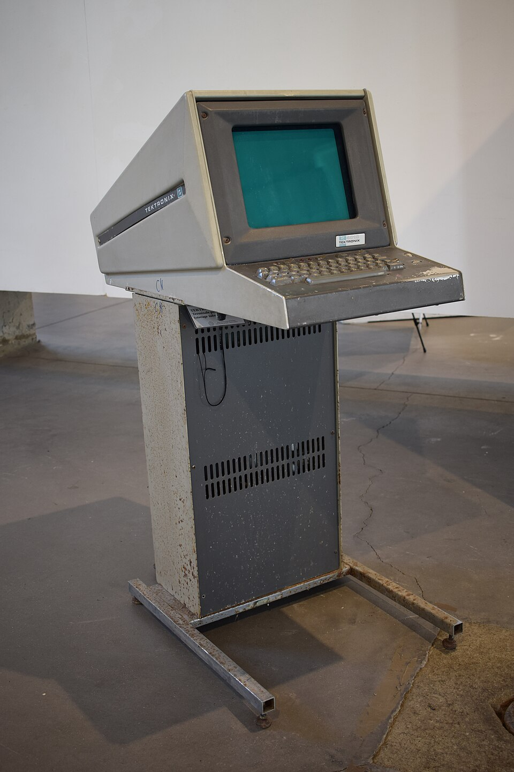
Why don’t use a CRT?
Tektronix 4014 (1972)
Photo by: Piergiovanna Grossi
https://en.wikipedia.org/wiki/Tektronix_4010#/media/File:Tektronix_4010_DSC_0056.jpg

Slide 13
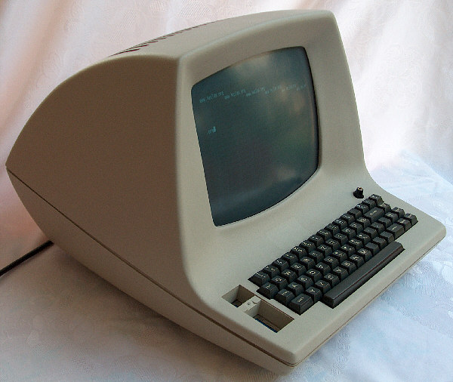
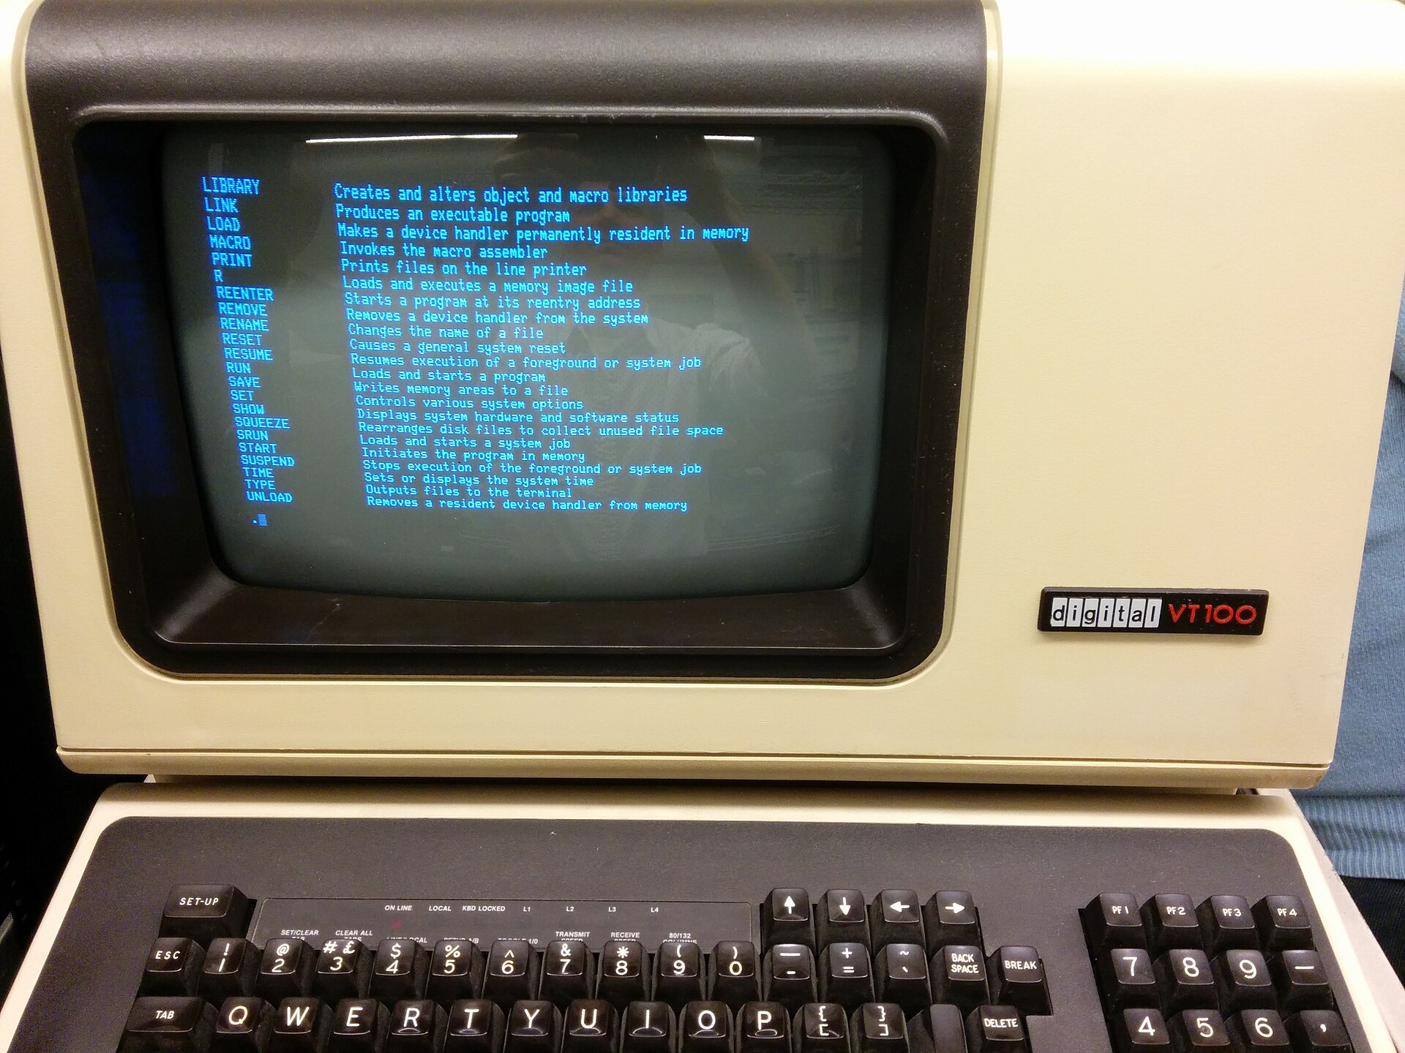
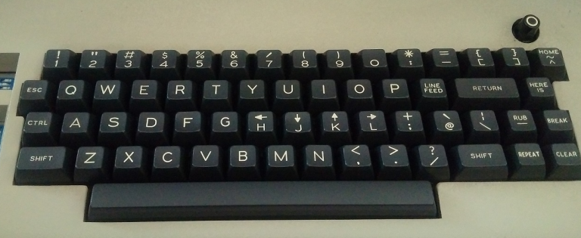
Video Display Units
Lear Siegler ADM-3A (1976)
DEC VT-100 (1978)
Photo by: Autopilot (Wikipedia user)
https://en.wikipedia.org/wiki/Computer_terminal#/media/File:RT-11_help.jpg
Photo by: Daniel Sancho
https://en.wikipedia.org/wiki/Computer_terminal#/media/File:ADM_3A_(82481457).jpg
Photo by: Santo Nucifora
https://vintagecomputer.ca/lear-siegler-adm-3a-terminal/

Slide 14
ANSI X3.64 (Escape Codes)
\x1b[...
Clear...
ESC[2J – entire screen
ESC[0K – current line from the cursor
ESC[2K – current line, entirely
Move cursor n characters...
ESC[nA – ...up
ESC[nB – ...down
ESC[nC – ...right
ESC[nD – ...left
Place cursor...
ESC[row;colH
Notes:
Po omówieniu sekwencji przełączenie na terminal:
- demonstracja przesuwania kursora i czyszczenia linii/ekranu

Slide 15
ANSI X3.64 (Escape Codes)
\x1b[...
Select Graphic Rendition
ESC[param1;param2;param3;...;m
0 – reset
1 | 22 - bold on/off
3 | 23 - italic on/off
4 | 24 - underline on/off
21 - double underline
9 | 29 - strikethrough on/off
5 | 25 - blink on/off
30..37
90..97 - foreground color
38
40..47
100..107 – background color
48
Notes:
Demonstracja w terminalu – pokazać pogrubienie i podkreślenie, opcjonalnie w Konsole/Yakuake pokazać miganie tekstu.

Slide 16
ANSI X3.64 - Colors
Example:
ESC[1;31m → bright red text (bold)
30: --- black
31: --R red
32: -G- green
33: -GR yellow
34: B-- blue
35: B-R magenta
36: BG- cyan
37: BGR white
(actually gray)
1;30 | 90: --- bright black (!)
1;31 | 91: --R bright red
1;32 | 92: -G- bright green
1;33 | 93: -GR bright yellow
1;34 | 94: B-- bright blue
1;35 | 95: B-R bright magenta
1;36 | 96: BG- bright cyan
1;37 | 97: BGR bright white
(really)

Slide 17
ANSI X3.64 - Colors
Example:
ESC[97;41m → white text on red background
40: --- black
41: --R red
42: -G- green
43: -GR yellow
44: B-- blue
45: B-R magenta
46: BG- cyan
47: BGR white
100: --- bright black
101: --R bright red
102: -G- bright green
103: -GR bright yellow
104: B-- bright blue
105: B-R bright magenta
106: BG- bright cyan
107: BGR bright white
Notes:
Pokazać w terminalu podstawowe kody kolorów

Slide 18
PART II: BEYOND BASIC ASCII

Slide 19
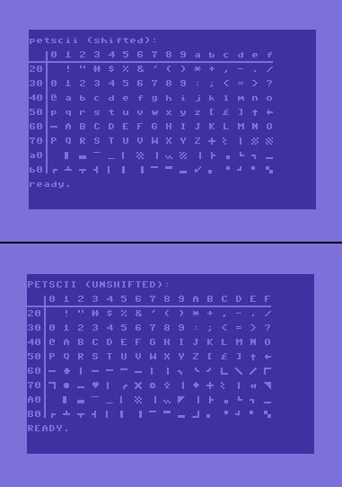
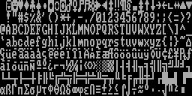
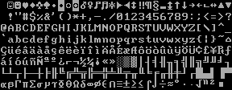
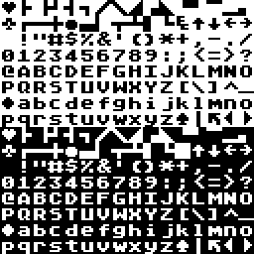
Semigraphics
CGA character set (1981)
MDA character set (1981)
PETSCII character set (1977)
in Commodore 64
ATASCII character set (1979)

Slide 20
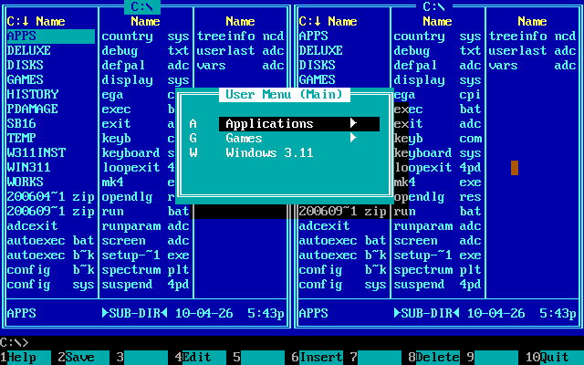
Semigraphics
Norton Commander 5.5 (1995)

Slide 21
Unicode – subsets
U+0000..U+007F – ASCII (Basic Latin) Aa Bb Cc Dd … [/]~
U+0080..U+00FF – Latin-1 Supplement Ááåāőűýñ …
U+0100..U+01FF – Latin Extended-A/-B Āā Ăă Ąą Ćć Ĉĉ Ċċ …
…
U+0370..U+03FF – Greek and Coptic Αα Ββ Γγ Δδ … Ωω
U+0400..U+04FF – Cyrillic Аа Бб Вв Гг Дд … Яя
U+0530..U+058F – Armenian Ա Բ Գ Դ Ե Զ Է Ը Թ Ժ Ի …
U+0590..U+05FF – Hebrew ן נ ס ע ף פ ץ צ ק ר ש ת
…
U+AC00..U+D7AF – Hangul Syllables 가 각 갂 갃 간 갅 갆 갇 갈
(over 11000 chars)
…
U+4E00..U+9FFF – CJK Unified Ideographs (almost 21000 chars!)

Slide 22
Unicode – interesting subsets
U+2500..U+257F – box drawing characters
─ ━ │ ┃ ┄ ┅ ┆ ┇ ┈ ┉ ┊ ┋ ┌ ┍ ┎ ┏
┐ ┑ ┒ ┓ └ ┕ ┖ ┗ ┘ ┙ ┚ ┛ ├ ┝ ┞ ┟
┠ ┡ ┢ ┣ ┤ ┥ ┦ ┧ ┨ ┩ ┪ ┫ ┬ ┭ ┮ ┯
┰ ┱ ┲ ┳ ┴ ┵ ┶ ┷ ┸ ┹ ┺ ┻ ┼ ┽ ┾ ┿
╀ ╁ ╂ ╃ ╄ ╅ ╆ ╇ ╈ ╉ ╊ ╋ ╌ ╍ ╎ ╏
═ ║ ╒ ╓ ╔ ╕ ╖ ╗ ╘ ╙ ╚ ╛ ╜ ╝ ╞ ╟
╠ ╡ ╢ ╣ ╤ ╥ ╦ ╧ ╨ ╩ ╪ ╫ ╬ ╭ ╮ ╯
╰ ╱ ╲ ╳ ╴ ╵ ╶ ╷ ╸ ╹ ╺ ╻ ╼ ╽ ╾ ╿

Slide 23
Unicode – interesting subsets
U+2580..U+259F – block elements
▀ ▁ ▂ ▃ ▄ ▅ ▆ ▇ █ ▉ ▊ ▋ ▌ ▍ ▎ ▏ ▐ ░ ▒ ▓ ▔ ▕ ▖ ▗ ▘ ▙ ▚ ▛ ▜ ▝ ▞ ▟
U+2800..U+28FF – Braille Patterns (version >= 3.0)
⠀⠁⠂⠃⠄⠅⠆⠇⠈⠉⠊⠋⠌⠍⠎⠏⠐⠑⠒⠓⠔⠕⠖⠗⠘⠙⠚⠛⠜⠝⠞⠟⠠⠡⠢⠣⠤⠥⠦⠧⠨⠩⠪⠫⠬⠭⠮⠯⠰⠱⠲⠳⠴⠵⠶⠷⠸⠹⠺⠻⠼⠽⠾⠿
⡀⡁⡂⡃⡄⡅⡆⡇⡈⡉⡊⡋⡌⡍⡎⡏⡐⡑⡒⡓⡔⡕⡖⡗⡘⡙⡚⡛⡜⡝⡞⡟⡠⡡⡢⡣⡤⡥⡦⡧⡨⡩⡪⡫⡬⡭⡮⡯⡰⡱⡲⡳⡴⡵⡶⡷⡸⡹⡺⡻⡼⡽⡾⡿
⢀⢁⢂⢃⢄⢅⢆⢇⢈⢉⢊⢋⢌⢍⢎⢏⢐⢑⢒⢓⢔⢕⢖⢗⢘⢙⢚⢛⢜⢝⢞⢟⢠⢡⢢⢣⢤⢥⢦⢧⢨⢩⢪⢫⢬⢭⢮⢯⢰⢱⢲⢳⢴⢵⢶⢷⢸⢹⢺⢻⢼⢽⢾⢿
⣀⣁⣂⣃⣄⣅⣆⣇⣈⣉⣊⣋⣌⣍⣎⣏⣐⣑⣒⣓⣔⣕⣖⣗⣘⣙⣚⣛⣜⣝⣞⣟⣠⣡⣢⣣⣤⣥⣦⣧⣨⣩⣪⣫⣬⣭⣮⣯⣰⣱⣲⣳⣴⣵⣶⣷⣸⣹⣺⣻⣼⣽⣾⣿
Notes:
Pokazać w terminalu xtdraw, rysowanie w trybach 2x2, 2x3, 2x4

Slide 24
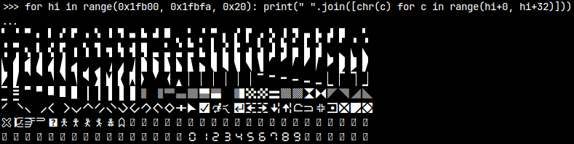
Unicode – interesting subsets
U+1FB00..U+1FBFA – Symbols for Legacy Computing (version >= 13.0, since 2020)
Teletext semigraphics
(remember Telegazeta?)
Notes:
Pokazać w terminalu xtdraw, rysowanie w trybach 2x2, 2x3, 2x4

Slide 25
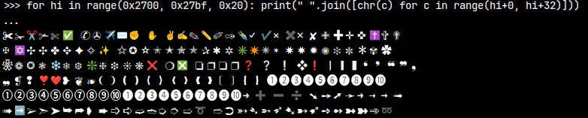
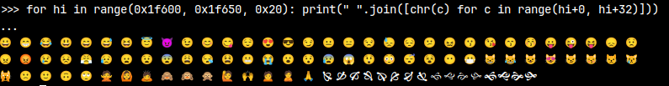
Unicode – interesting subsets
U+2700..U+27bf – Basic emojis (versions 1.0.0 to 7.0, latest 2014)
U+1F600..U+1F64F – Basic emojis (version >= 6.0, since 2010)
Notes:
Pokazać w terminalu xtdraw, rysowanie w trybach 2x2, 2x3, 2x4

Slide 26
PART III: STATE OF THE ART

Slide 27
ANSI X3.64 – More colors (xterm-256)
ESC[38;5;nnnm
ESC[48;5;nnnm
0..7 – standard colors (as for 30..37, 40..47)
8..15 – bright colors (as for 90..97, 100..107)
16..231 – 6x6x6 colors
color(r,g,b) = 36*r + 6*g + b + 16
0 <= r,g,b <= 5
232..255 – 24 shades of gray
„256 colors mode” – actually less, probably 234
e. g. #0 == #16 == #232 (black)
#15 == #231 == #255 (white)

Slide 28
ANSI X3.64 – Even more colors (Tc)
ESC[38;2;red;green;bluem
ESC[48;2;red;green;bluem
red, green and blue: 0..255
„True Color mode” – all 16 777 216 combinations available
Notes:
Po omówieniu slajdu pokazać w konsoli kod prezentujący gradient

Slide 29
ANSI codes and terminal emulators
Text mode 16/8 color mode :( (but understands everything)
Konsole, Yakuake full support
Alacritty full support, except blinking
PuTTY full support
CoolRetroTerm full support (!)
Xterm full support (!)

Slide 30
ANSI codes and extra characters
Box drawing characters, blocks 2x2: Unicode 1.0, all systems
Braille 2x4: Unicode 3.0, all systems
Blocks 2x3, blocks for legacy Unicode 13.0, not available on Windows
systems: (all versions), no problem on Ubuntu
Appropriate font required

Slide 31
TrueColor in tmux
Full support, but tmux tries to be clever…
\x1b[38;2;0;0;255m → \x1b[38;5;21m
Solution: add to tmux.conf:
set -ga terminal-overrides ",original_TERM*:RGB"
set -ga terminal-overrides ",alacritty*:RGB"

Slide 32
Useful tools
banner, figlet – generation of text banners in ASCII Art
chafa, jp2a – convert images to text
DurDraw - drawing tool
https://github.com/durdraw/durdraw
PetDraw - drawing tool for Commodore PET, C64, C64 + BI-80, Plus/4
www.the8bitguy.com/download-davids-software/
XTDraw - my own tool inspired by DurDraw and PetDraw
https://github.com/artur-twardowski/xtdraw
lolcat - rainbow colors of any output

Slide 33
\0
(questions?)

