Slide 1

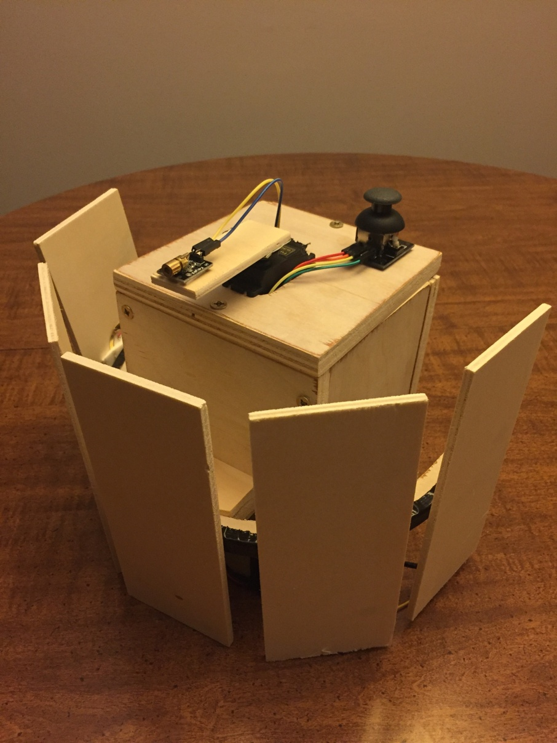
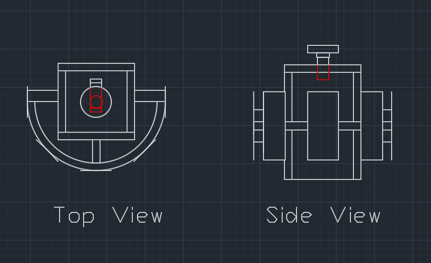
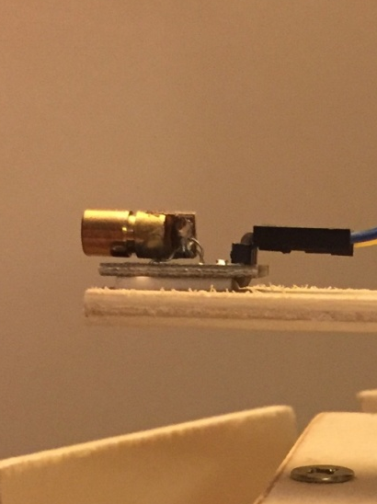
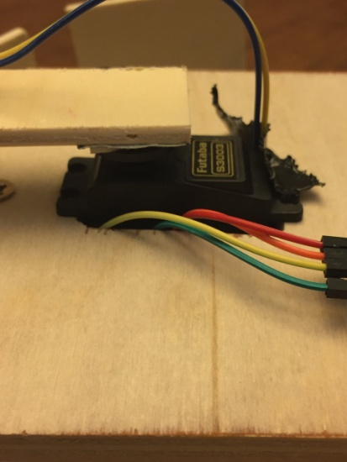
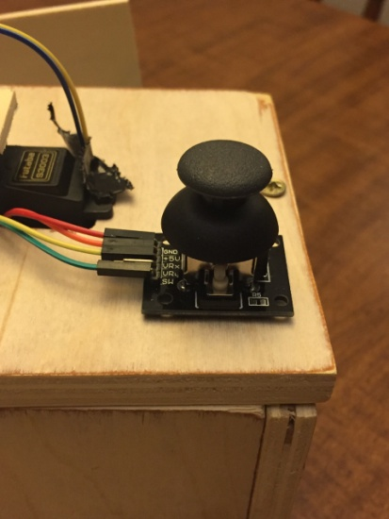
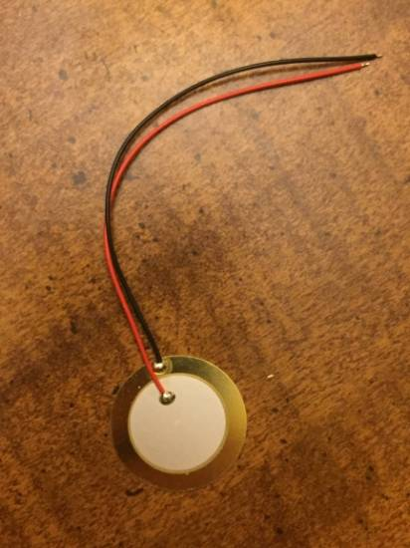
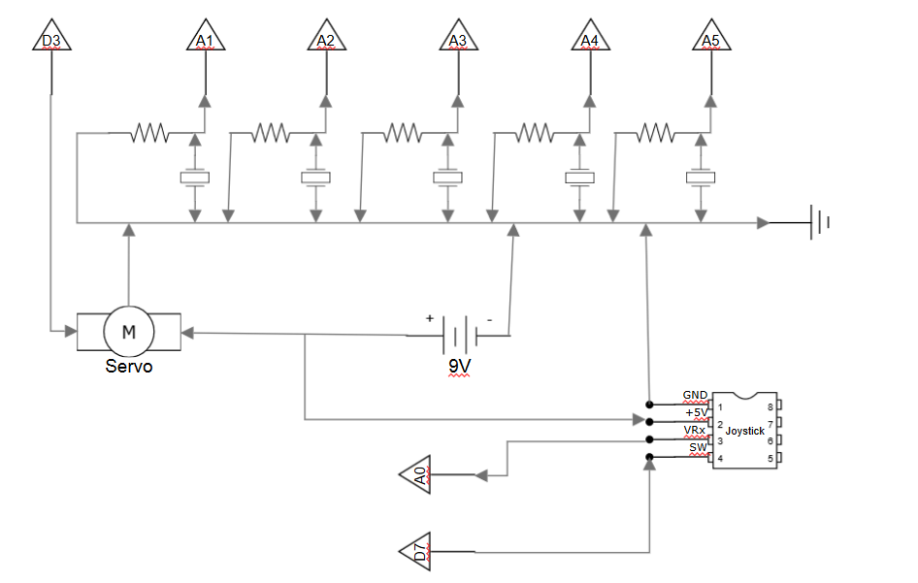
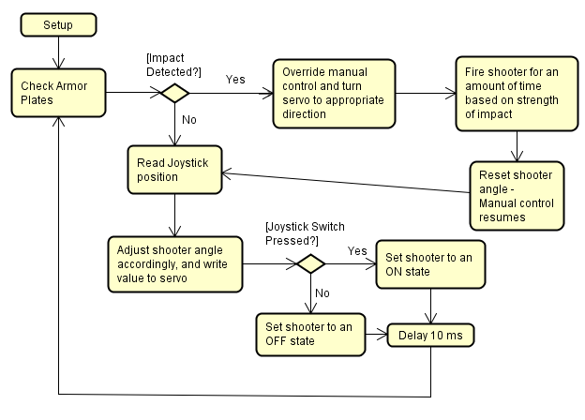

Unmanned Automated Turret: Proving the Concept of Automated Defense Weaponry
J. DiTrapani, R. Fecteau, C. Husted
EGR280 Final Project – Fall 2016
School of Engineering and Computer Science, Oakland University
Instructors: Prof. O. Rawashdeh and Prof. D. Schall
Introduction
As technology improves, the desire for automated defense weaponry grows as well. This is evident by the increased use of unmanned vehicles and weapons by the United States military. This Unmanned Automated Turret (UAT) serves to prove the concept of autonomous defense weaponry.
The goal of the turret is to achieve an autonomous response to an attack. When struck, the turret will be able to detect which direction the impact came from. It will then respond by pointing the barrel in the direction of the attack and firing a laser. User control will also be implemented, which allows the user to aim the barrel and shoot in any given direction. This not only keeps the user out of harms way, but allows the automated turret to think and respond to an attack.
Results
The following will review the finished unmanned turret concept. The turret functions as expected, and is capable of “returning fire” when struck on 1 of the 5 “shield” panels
Figure 4: Overview of Finished Turret.
The 5 wooden panels, or “shields”, are attached to the turret system by the Turret Arc, as shown above in Figure 4. The other components of the turret system are shown below
Figure 5: Laser Pointer (a), Servo (b), Joystick (c), Piezo Elements (d).
The above images in Figure 5 are the main components of the turret system. (A) is the laser pointer which is responsible for “returning fire”. (B) is the servo motor, used to turn the laser pointer arm on a 180⁰ field. (C) is the joystick used for manual control of the turret, and (D) is the piezo element which is attached to the “shields” and responsible for sensing “incoming fire”, or contact.
A torque analysis was ran on the laser pointer arm once the turret was built:
τ=F•r•sinΘ
τ = (8.5xN) (0.508m) (sin(90))
τ = 4.318xNm
Figure 6: Torque analysis on laser pointer arm
Figure 6: Blah blah blah blah blah.
Blah, blah, blah. Blah, blah, blah. Blah, blah, blah. Blah, blah, blah. Blah, blah, blah. Blah, blah, blah. In Figure 6 blah blah blah blah blah blah blah blah blah blah. Blah, blah, blah. Blah, blah, blah. Blah, blah, blah. Blah, blah, blah. Blah, blah, blah. Blah, blah, blah.
A
B
C
D
Design
The UAT is designed to be fairly simple. It has a wooden turret base that supports five armor plates with a servo-controlled laser-pointer “shooter” mounted on top. The range of the shooter covers 180 degrees of vision, and the armor plates are mounted on the base evenly across this range. A top-view and side-view drawing is displayed in Figure 1, illustrating the basic concept and design of the UAT.
Figure 1: UAT Design Drawings
The shooter is manually controllable via a joystick, but the user control is overridden when the one of the armor plates detects an impact, or “detects incoming fire”. A piezo sensor lies behind each armor plate, which is an element that measures vibration. Figure 2 is electrical schematic of the UAT showing how the piezo sensors along with the other electrical elements are connected to the Arduino microcontroller.
Figure 2: Electrical Schematic Figure 3: Software Flow Chart
When an impact is detected, the system takes over and automatically swivels the shooter toward the plate that detected the hit. The system then fires the laser for an amount of time proportionate to the strength of the impact, then returning the shooter direction to the center afterward, where manual control resumes. Figure 3 illustrates the essentials of the software logic, including the fact that there is a 10 millisecond delay between every loop. The reason for this is that a vibration from an impact will only last so long, so the condition of the armor plates has to be checked frequently.
Turret Arc
(a)
(b)
(c)
(d)
Where τ is torque, F is force, and r is the distance from the middle of the servo disc to the middle of the laser pointer, as shown in figure 6
r
F
Conclusion
This should not simply be a summary of what you did. Why should anyone care? What is the broader significance? Refer to the objective/purpose you stated in your first section somewhere in the conclusion.
Remember that a poster has two purposes. First, It should be meaningful standing alone without you explaining it or demoing your project. Someone walking by an going through it should get a clear and complete overview of your project without you having to explain or demo anything (i.e., include a description of what you produced and how well it worked it the poster). Secondly, a poster should serve as aid to you when presenting your work. You using figures, block diagrams, and/ flow graphs can make your oral presentation much more effective.

