Slide 1


Slide 2

Healthcare : COVID-19: Trends, Impact, and Vaccination
Project Subject : Healthcare Analysis
College: St. Clair College, Mississauga, Canada
Team Members:
Vijay Lathwal
Amrit Saini
Karishma Kundal

Slide 3
Table of Content
Introduction
Overview of the Project
Objectives and Goals
Business Problems
Trend Analysis
Geographic Analysis
Economic Analysis
Population Analysis
Vaccination Analysis
Weekly Progress
Week 1: Data Cleaning and Integration
Week 2: Business Problems Identification and Visualization
Week 3: In-Depth Business Problem Analysis and Visualization
Week 4: Dashboard Improvement and Machine Learning Planning
Week 5: Machine Learning Implementation and Evaluation
Week 6: Advanced Data Analysis and Model Evaluation
Machine Learning:
Algorithms
Report
Graph
THANK YOU

Slide 4
Overview of Our Project:
Our project is focused on analyzing COVID-19 data to uncover valuable insights into the pandemic's trends and impacts. We utilized a combination of Tableau for data visualization, SQL for efficient data management, and advanced machine learning techniques for in-depth analysis.
In the initial stages, our primary task was to clean and prepare the data, ensuring it was accurate and suitable for analysis. Once the data was ready, we employed Tableau to create interactive and informative visualizations. These visuals helped us understand the initial patterns and trends within the data.
Simultaneously, we used SQL to effectively manage and query our large datasets, facilitating smoother data handling and analysis. The integration of SQL was crucial in supporting the robust data processes required for our project.

Slide 5
The core of our project involved applying machine learning algorithms. These algorithms allowed us to delve deeper into the data, uncovering more complex patterns and predictions about the pandemic. Through this approach, we aimed to provide a comprehensive view of COVID-19's impact, backed by data-driven insights.
Overall, this project demonstrates the integration of various technical tools and methods to tackle the complexities of pandemic data, offering a clearer picture of COVID-19's global footprint.

Slide 6
Workflow and Progress
Week 1: Data Cleaning and Integration Week 2: Business Problems and Visualization Week 3: Business Problem Analysis and Visualization
Week 4: Dashboard Improvement and Machine Learning Planning
Week 5: Machine Learning Implementation and Evaluation
Week 6 : Advanced Data Analysis and Model Evaluation

Slide 7
Business Problems Analysis
Trend Analysis:
How have the total cases and vaccinations trended over time?
Are there any noticeable trends or patterns in the data?
Geographic Analysis:
How do the total cases and vaccinations vary by continent?
Are there certain locations that are more heavily affected?
Economic Analysis:
Is there a correlation between the GDP per capita and vaccinations?
How does the economic status of a location affect its COVID-19 situation?
Population Analysis: 1. How does the population size affect the total number of cases and vaccinations? Vaccination Analysis: 1. What percentage of the population has been vaccinated or fully vaccinated in different locations?

Slide 8
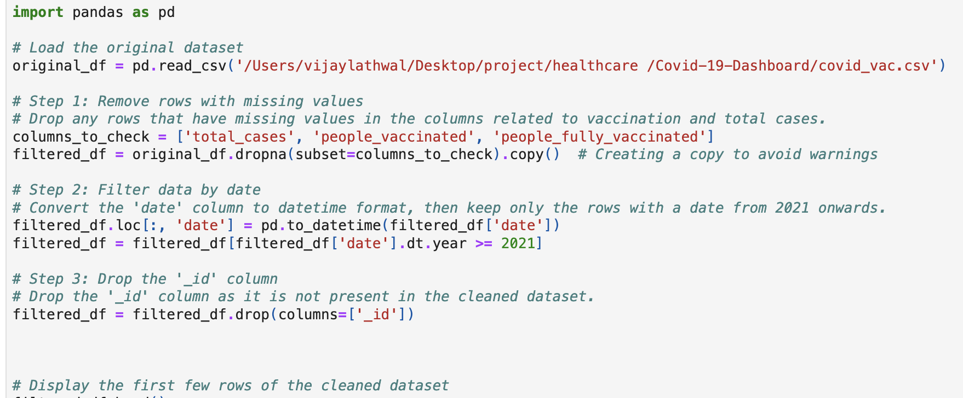
Week 1: Data Cleaning
In the first week,
we cleaned our covid_vac.csv dataset using Python to ensure its accuracy and consistency for analysis. ­After cleaning, we integrated the dataset with an SQL database, facilitating efficient data storage, management, and retrieval.
We then connected the SQL database to Tableau for visualization, enabling interactive and insightful visual representations of our data.
This stage prepared us well for addressing and solving the identified business problems in our project.

Slide 9
Week 2: Business Problem Analysis and Visualization
This week, we focused on addressing various business problems outlined in our project. Utilizing the cleaned and integrated dataset, we dove deep into analyzing trends, geographic distributions, economic impacts, and population-based analyses concerning healthcare data.
Our primary tool for visualization was Tableau, which enabled us to create intuitive, interactive, and insightful visual representations of our data. We specifically leveraged Tableau’s powerful visualization capabilities to solve business problems, making it easier to interpret complex datasets and uncover meaningful insights. These visualizations aided in understanding the trends, patterns, and correlations within the data, allowing for a more comprehensive and informed analysis.
Through Tableau, we were able to present our findings clearly and concisely, facilitating better communication and understanding of the results of our analysis. This approach allowed us to effectively address the business problems, providing valuable insights and conclusions based on the visualized data.

Slide 10
Week 3: Business Problem Solving and Dashboard Creation
Activities:
Analysis of Business Problems: Identified key business questions related to the COVID-19 pandemic, focusing on case spread, vaccination rates, and economic impact.
Data Preparation: Cleaned and prepared a dataset for analysis, ensuring data quality and relevance to the business problems.
Dashboard Creation: Developed an initial Tableau dashboard to visualize the data, providing insights into COVID-19 trends and patterns.
Insights Gathered: Used the dashboard to draw preliminary insights, which helped in understanding the progression of the pandemic and its impact on different regions.
Outcomes:
A functional dashboard providing real-time insights into COVID-19 data.
A clear understanding of the business problems related to the pandemic's spread and vaccination efforts.

Slide 11
Week 4: Dashboard Improvement and Machine Learning Planning
Activities:
Dashboard Refinement: Improved the existing Tableau dashboard based on feedback, enhancing usability and the depth of insights.
Machine Learning Strategy: Evaluated various machine learning algorithms to determine which could provide the best accuracy for predicting COVID-19 cases.
Algorithm Selection: Narrowed down the potential algorithms to Decision Trees, Logistic Regression, and K-Means Clustering.
Preparation for Machine Learning: Performed further data preprocessing to prepare for machine learning, including feature selection and data splitting.
Outcomes:
An enhanced dashboard with improved visualizations and functionality.
A strategic plan outlining the machine learning approach and the selected algorithms to be tested.

Slide 12
Week 5: Machine Learning Implementation and Evaluation
Activities:
Machine Learning Execution:
Applied ARIMA (AutoRegressive Integrated Moving Average) for time series forecasting of COVID-19 total cases.
Utilized Principal Component Analysis (PCA) to reduce dimensionality and identify key patterns in COVID-19 data.
Employed K-Means Clustering to segment the dataset, identifying distinct groups or patterns.
Model Training and Analysis:
ARIMA: Model trained on historical COVID-19 case data to forecast future trends.
PCA: Transformation applied on key indicators (like total cases per million, people vaccinated per hundred) to simplify data analysis.
K-Means Clustering: Analyzed the PCA-transformed data to find optimal clustering of data points.

Slide 13
Week 6: Advanced Data Analysis and Model Evaluation
Performance Evaluation:
Evaluated ARIMA's forecasting accuracy for a 30-day period.
Assessed the variance explained by PCA components to ensure significant data patterns are retained.
Determined the optimal number of clusters in K-Means using the Elbow method.
Analysis of Results:
Conducted a comprehensive analysis to understand the trends, patterns, and groupings in the COVID-19 dataset.
Comparison of methods revealed ARIMA's strength in forecasting, PCA's effectiveness in pattern discovery, and K-Means' utility in data segmentation.

Slide 14
Outcomes:
Developed three distinct models (ARIMA, PCA, K-Means Clustering) for diverse analytical perspectives on COVID-19 data.
Found ARIMA to be highly effective for short-term forecasting of case trends.
Identified PCA as a powerful tool for simplifying complex data while retaining essential information.
K-Means Clustering proved useful for segmenting the data into meaningful groups, aiding in nuanced analysis.

Slide 15
Machine Learning Techniques in COVID-19 Data Analysis
ARIMA for Time Series Forecasting
Purpose: To predict future values of total COVID-19 cases.
Methodology:
- Data Preparation: The dataset is grouped by date, summing the total cases.
- Model: Used the 'auto_arima' function to automatically select the best ARIMA model.
- Forecasting: The model predicts the next 30 days of total cases.
Reason for Choice: ARIMA is effective for time series forecasting, especially when data shows a clear trend or seasonality, which is common in pandemic data.

Slide 16
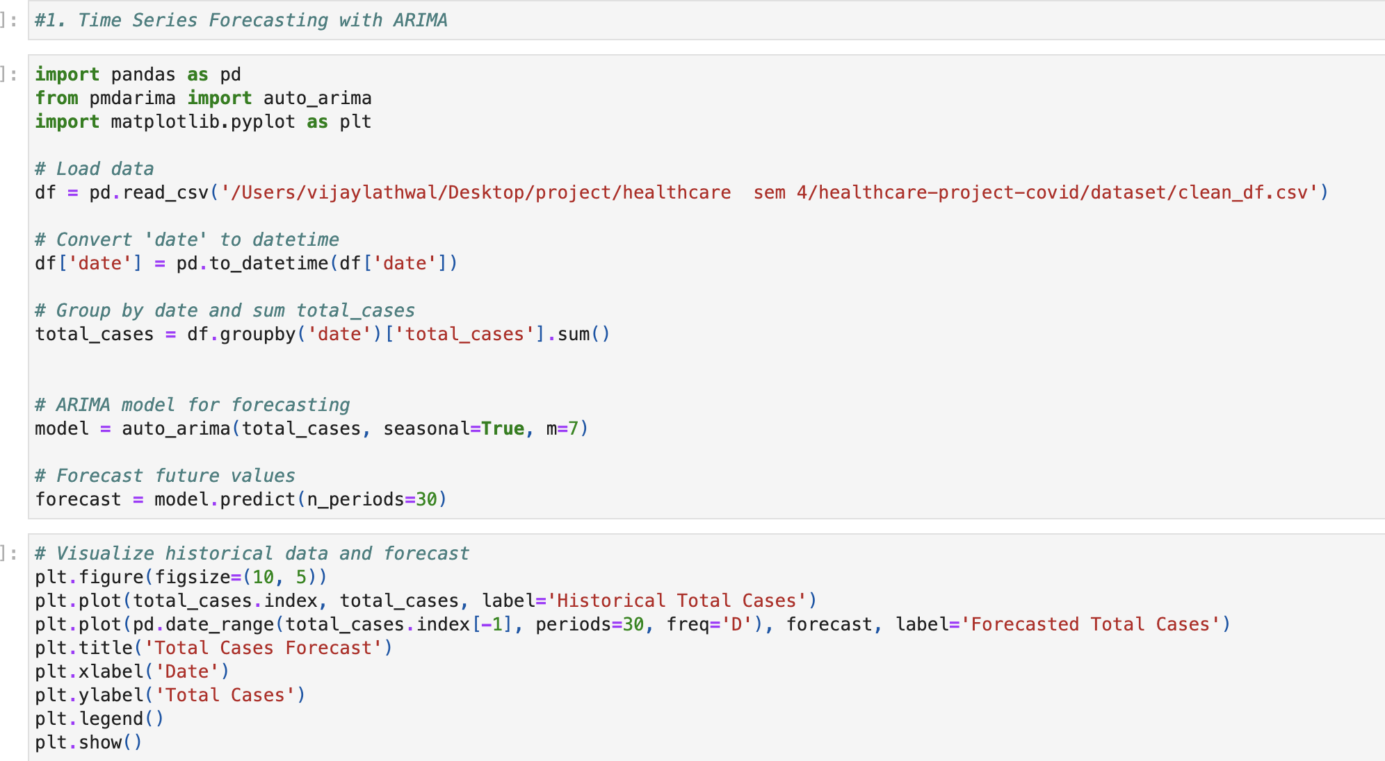
ML : Time Series Forecasting with ARIMA

Slide 17
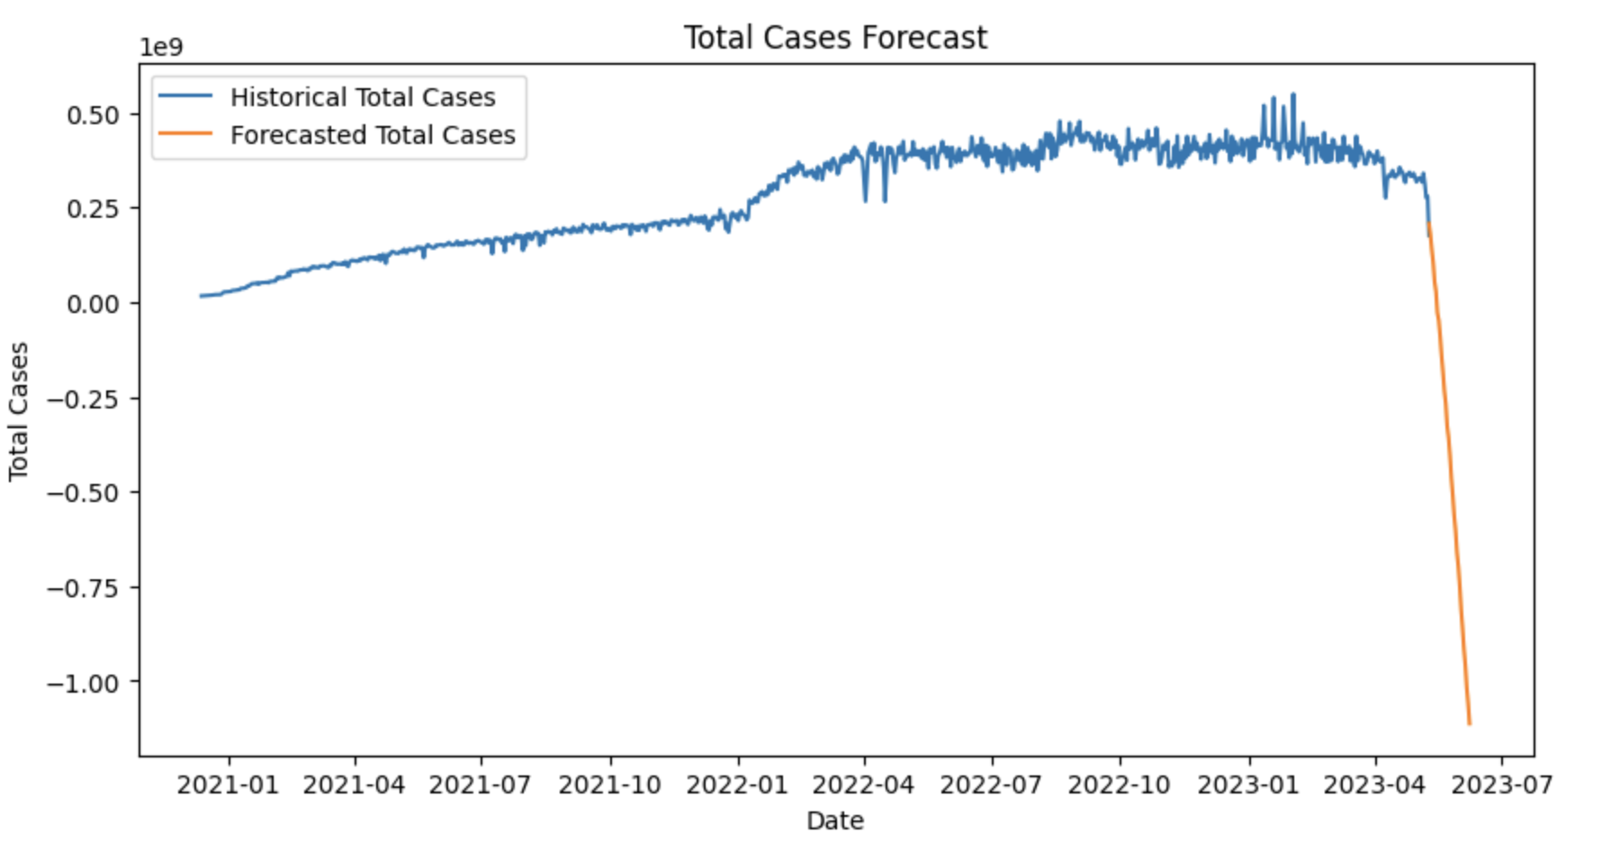
Graph: Time Series Forecasting with ARIMA

Slide 18
Machine Learning Techniques in COVID-19 Data Analysis
2. PCA (Principal Component Analysis)
Purpose: To reduce the dimensionality of the dataset while retaining most of the variance. It simplifies the complexity in high-dimensional data while retaining trends and patterns.
Methodology:
- Data Selection: Chose 'total_cases_per_million' and 'people_vaccinated_per_hundred' for PCA.
- Standardization: Used 'StandardScaler' to standardize the data.
- PCA Application: Applied PCA to reduce dimensions to 2 principal components.
- Explained Variance: The proportion of dataset's variance that lies along each principal component.
Reason for Choice: PCA helps in visualizing high-dimensional data and can uncover hidden patterns.

Slide 19
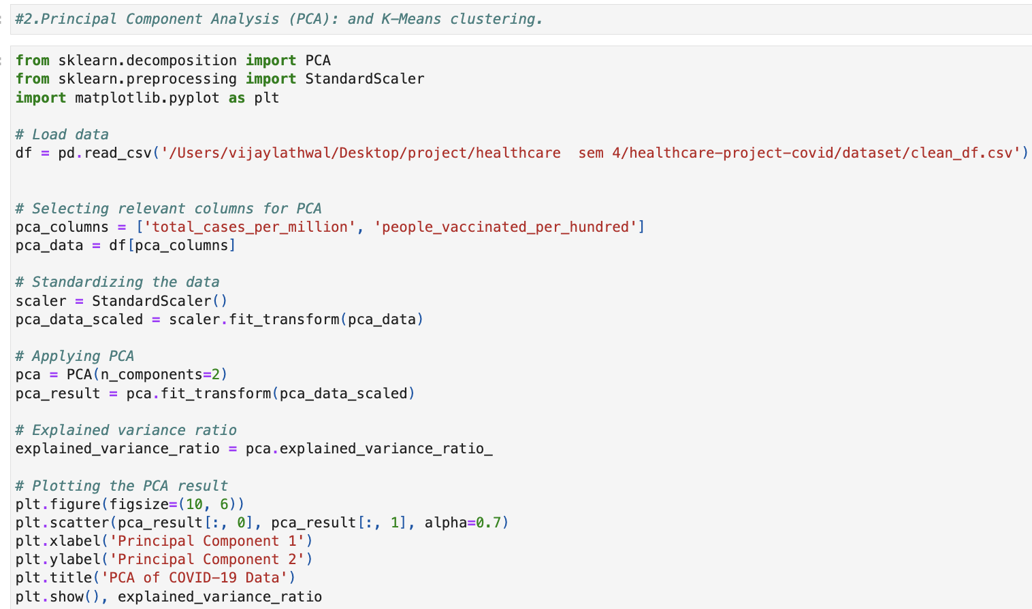
ML: PCA (Principal Component Analysis)

Slide 20
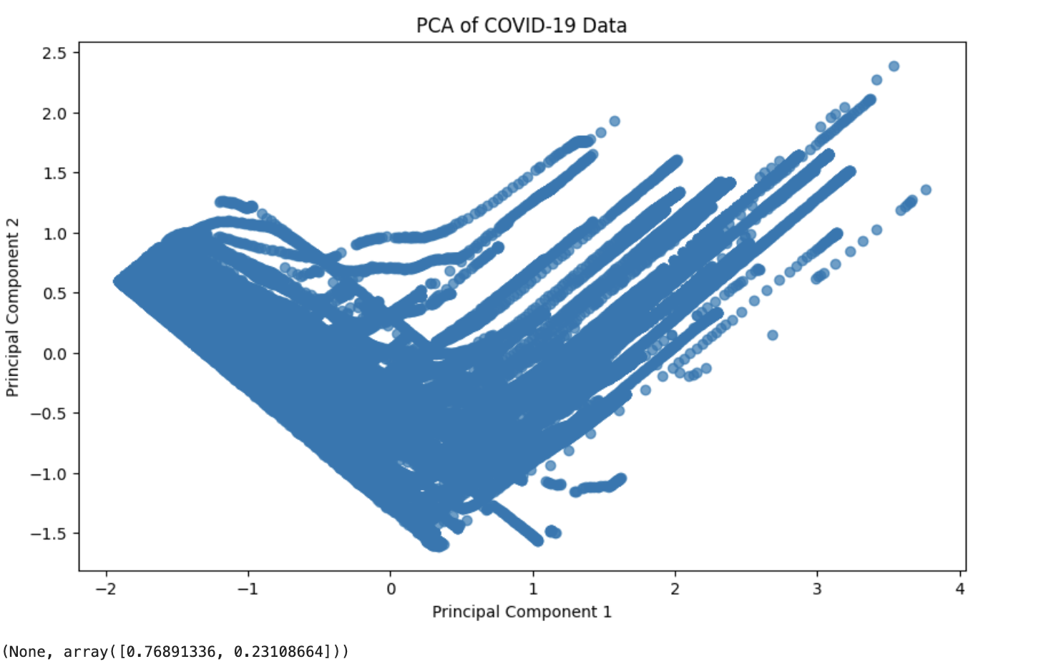
Plotting the PCA result

Slide 21
Machine Learning Techniques in COVID-19 Data Analysis
3. K-Means Clustering
Purpose: To segment the data into clusters for further analysis.
Methodology:
- Optimal Clusters: Used the Elbow method to find the optimal number of clusters.
- Clustering: Applied K-Means clustering on the PCA results.
Reason for Choice: K-Means is a widely-used clustering technique that is efficient and effective for identifying distinct groups in the data.

Slide 22
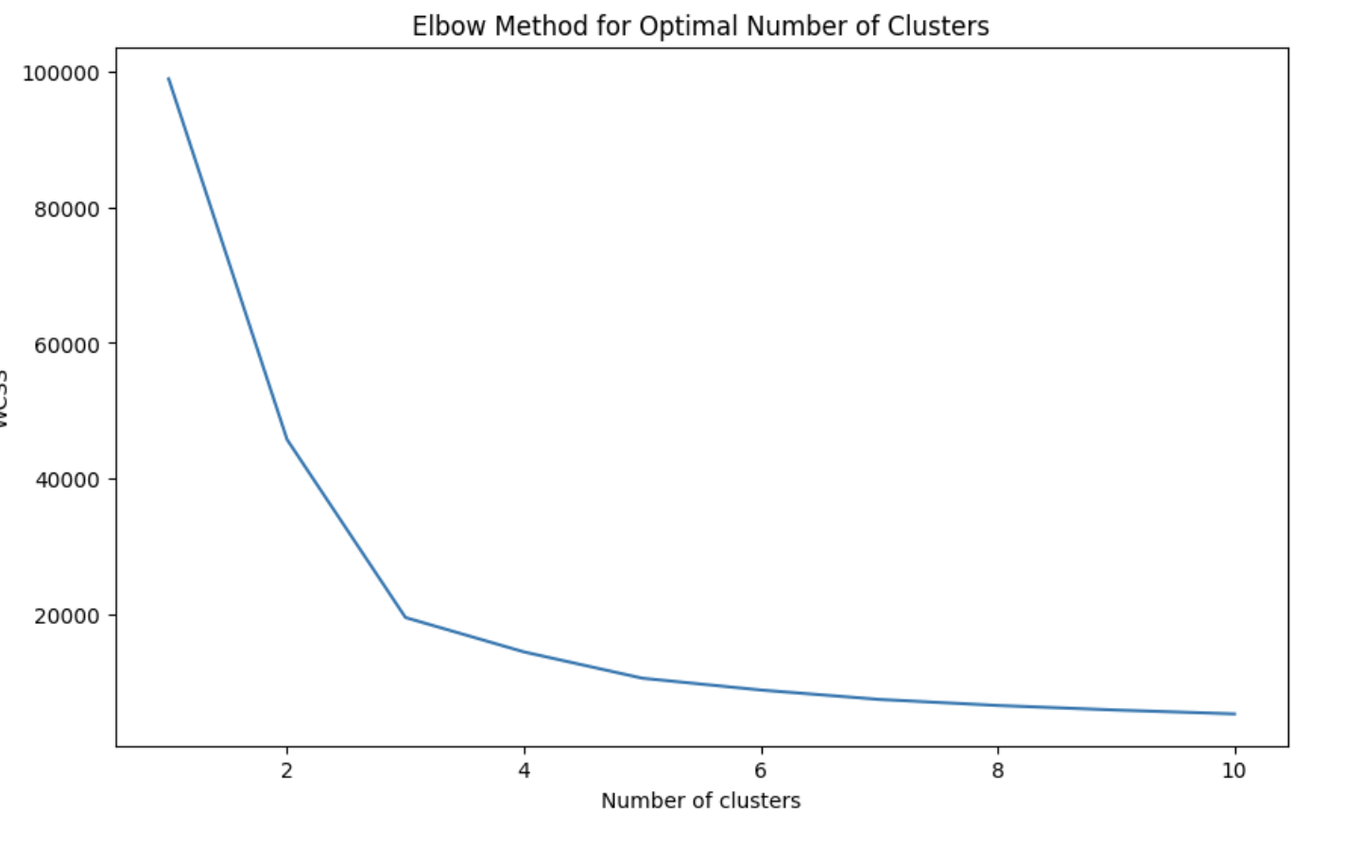
Plotting the results onto a line graph to observe the 'elbow'

Slide 23


