Slide 1
Finance E-commerce Project
Team Members:
- Vijay Lathwal
- Suraj Jain
- Amrit Saini
- Karishma Kundal
- Baljinder Kaur

Slide 2
Business Problems
1. Understanding customer preferences and buying behavior to improve sales.
2. Enhancing product recommendations based on customer reviews and purchasing history.
3. Optimizing the supply chain and logistics for better delivery times and lower costs.
4. Analyzing the performance of sellers to maintain a high-quality marketplace.
5. Identifying potential areas of expansion based on geographical sales data.
action?

Slide 3
Questions and Tool Selection
Tools
Python: For data cleaning, preprocessing, analysis, and machine learning tasks.
SQL: For querying and managing the data efficiently.
PowerBI: For visualizing the data and gaining insights.
Questions:
1. What are the top selling products and categories?
2. How does the price and freight value affect customer satisfaction (review score)?
3. Which sellers are performing well, and which ones are not? How does their performance impact customer satisfaction.
4. How does the delivery time (actual vs estimated) impact customer satisfaction?
5. What are the trends in sales over time? Are there any seasonal patterns?

Slide 4
Week 1-2: Data Integration and Cleaning
Objectives:
- Ingest multiple datasets related to e-commerce transactions.
- Utilize Python libraries and tools to preprocess and clean the datasets.
- Migrate the cleaned datasets to an SQL database for structured storage and efficient querying.
Achievements:
- Successfully integrated various datasets ranging from customer information to product categories.
- Removed anomalies, handled missing data, and ensured data consistency using Python.
- Set up an SQL database, enabling seamless data retrieval for future analysis.

Slide 5
Week 3-4: Data Modeling and Business Intelligence
Objectives:
- Create a comprehensive ER diagram detailing the relationships between different datasets.
- Leverage PowerBI for creating interactive visualizations to gain insights from the data.
- Address specific business questions using the visualizations.
Achievements:
- Developed a detailed ER diagram that provides a blueprint of our dataset's structure.
- Crafted insightful visualizations in PowerBI.
- Successfully addressed multiple business challenges using the insights derived from the data visualizations.

Slide 6
Week 5-6: Advanced Dashboard Development
Objectives:
Improve PowerBI Dashboards:
Add interactive elements and enhance user interface for better usability.
Implement advanced analytical features like time-series analysis and AI-driven forecasts.
Deep-Dive into Customer Analysis:
Segment customers using clustering techniques based on their behavior and preferences.
Develop predictive models for customer churn and high-value customer identification.
Achievements:
Updated dashboards with interactive features and an intuitive design.
Conducted in-depth customer segmentation and implemented predictive analytics.

Slide 7
Week 7-8: Dashboard Optimization and Strategic Alignment
Objectives:
Finalize and Optimize Dashboards:
Perform user testing for feedback and optimize dashboard performance.
Align dashboards with company's strategic goals and KPIs.
Training and Documentation:
Create user guides and conduct staff training sessions for effective dashboard use.
Establish a feedback loop for continuous improvement.
Achievements:
Completed and optimized PowerBI dashboards, ensuring strategic alignment.
Provided training and documentation for staff, and set up a system for ongoing dashboard enhancement.

Slide 8
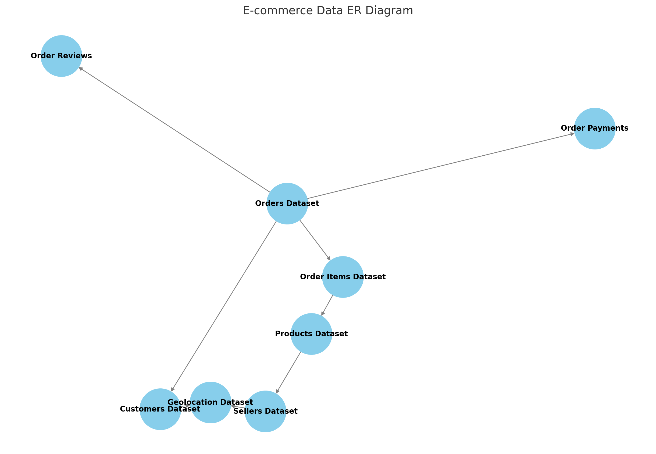
ER-DIAGRAM

Slide 9
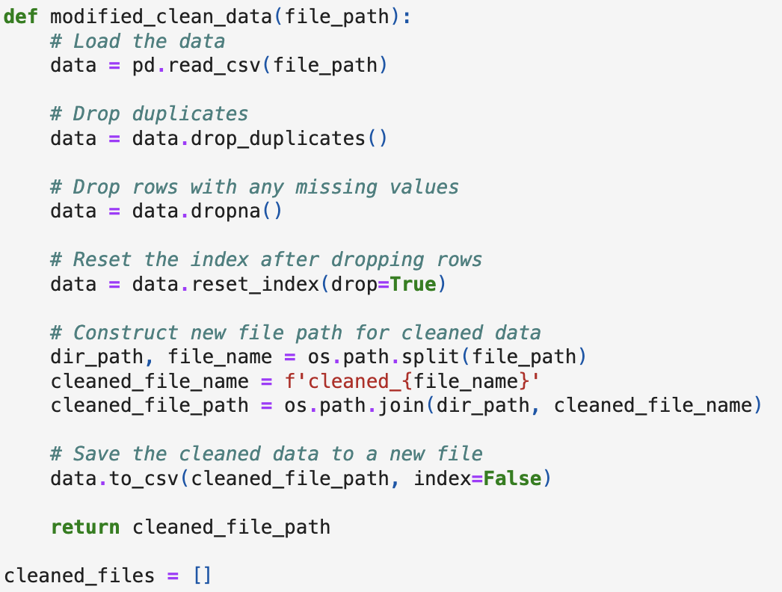
Python Cleaning Data Code
Key Steps:
Load Data: Import data from given file path.
Remove Duplicates: Eliminate duplicate entries.
Handle Missing Values
Index Reset: Reset index post row removal for consistency.
Save Cleaned Data

Slide 10
Thank You

