Slide 1
University of Patras
Msc Biomedical Engineering
Finite Element Analysis of Femoral Neck Fractures
Associate Pr. K. Moustakas
Phd candidate D. Stanev
Student: Elissaios Petrai

Slide 2
Requirements
Develop of FE model of the femur
Joint Reaction Analysis on OpenSim
Boundary conditions
Perform dynamic analysis

Slide 3
Femur

Slide 4
Young Modulus - Age
Young's modulus is a measure of the ability of a material to withstand changes in length when under lengthwise tension or compression. Sometimes referred to as the modulus of elasticity.

Slide 5
Joint Reaction Analysis on OpenSim

Slide 6
Develop FE models
Developing FE models
Boundary conditions

Slide 7
Develop FE models: Boundary conditions
Joint reaction forces applied throught Curve Editor on Preview

Slide 8
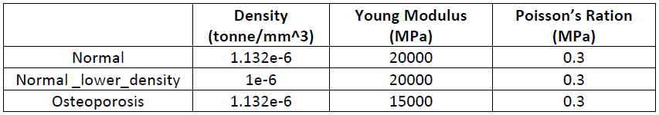
Develop FE models: Material properties applied
Most of the research at domestic and abroad considers bone materials as rigid materials, linear-elastic materials and nonlinear-elastic materials, and most studies assume that the whole bone tissue is an isotropic material. Although bone is known to be anisotropic biomaterial, the number of elastic constants is too much, generally it is simplified as orthotropy.
In this study femur was defined as a linear Neo-Hookean material, homogenous and isotropic

Slide 9
Methods Workflow

Slide 10
Results: Initial approach and problems encountered
a bibliography demonstrating the accuracy of program results
Directly comparing the results
Instead, compering results proportional

Slide 11
Results: Displacement on YZ axis
Another study implies that displacement of femoral head it depends to density conditions

Slide 12
Results: Maximal Stress

Slide 13
Results: Maximal Stress (2)

Slide 14
Results: Pressure

Slide 15
Thank you!

