Slide 1
Application Layer
Infrastructure Layer
Controller
Form
RepositoryImpl
O/R Mapper
View
Helper
Integration System Connector
depends
depends
Domain Layer
Service
Repository
DomainObject

Slide 2
Application Layer
Infrastructure Layer
Integration
System
Connector
Controller
O/R Mapper
use
use
use
Helper
use
RepositoryImpl
use
Domain Layer
use
Service
ServiceImpl
Repository
instantiate
use
DomainObject

Slide 3
YyyService
ZzzRepository
Web Browser
XxxController
YyyService
Impl
ZzzRepository
Impl
DB
instantiate
instantiate
create
DI Container
inject
inject

Slide 4
Transaction Boundary
10
View1
Helper1
9
2
1
8
3
4
Controller1
ServiceA
RepositoryA
5
7
O/R Mapper
Controller2
ServiceB
RepositoryB
6
View2
Helper2
・・・Form/
HTTP Request/
HTTP Response
・・・Interface
・・・Implementation
・・・DomainObject/
DTO

Slide 5
Transaction Boundary
View1
Helper1
Controller1
ServiceA
O/R Mapper
Controller2
ServiceB
View2
Helper2
・・・Form/
HTTP Request/
HTTP Response
・・・Interface
・・・Implementation
・・・DomainObject/
DTO

Slide 6
Application Layer
Infrastructure Layer
Integration
System
Connector
Controller
O/R Mapper
use
use
テスト対象
use
Helper
use
RepositoryImpl
use
Domain Layer
use
Service
ServiceImpl
Repository
instantiate
use
DomainObject

Slide 7
テスト対象
Application Layer
Infrastructure Layer
Integration
System
Connector
Controller
O/R Mapper
use
use
use
Helper
use
RepositoryImpl
use
Domain Layer
use
Service
ServiceImpl
Repository
instantiate
use
DomainObject

Slide 8
Application Layer
Infrastructure Layer
Integration
System
Connector
Controller
O/R Mapper
use
use
use
Helper
use
RepositoryImpl
use
テスト対象
Domain Layer
use
Service
ServiceImpl
Repository
instantiate
use
DomainObject

Slide 9
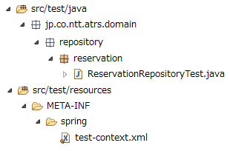

Slide 10
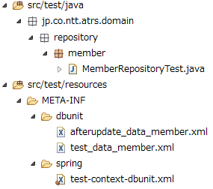


Slide 11
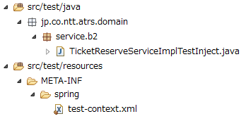

Slide 12
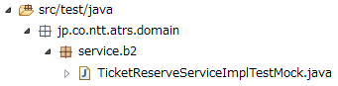

Slide 13
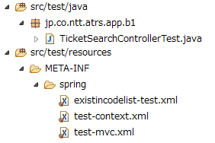

Slide 15


Slide 16
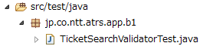

Slide 17
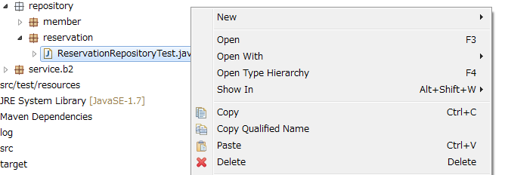

Slide 18
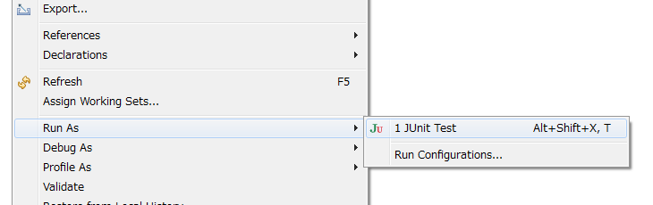

Slide 19
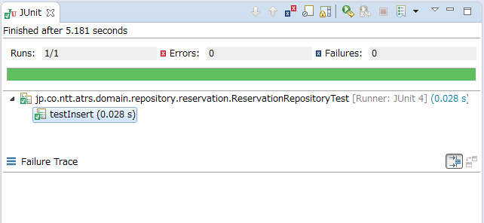

Slide 20
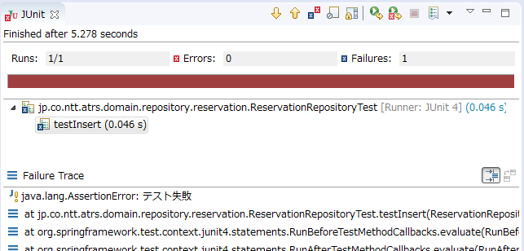

Slide 21
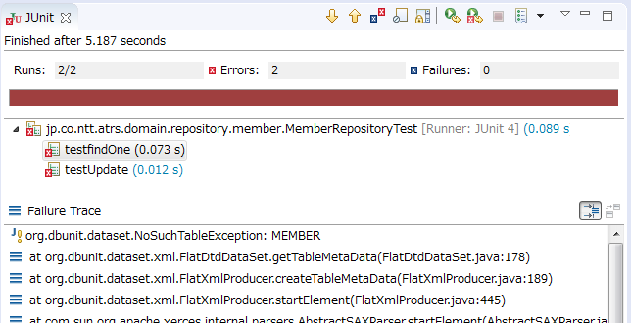

Slide 22
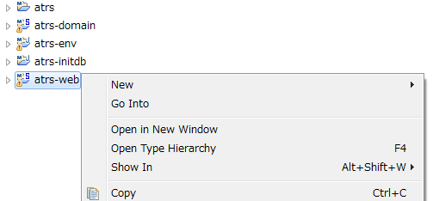

Slide 23
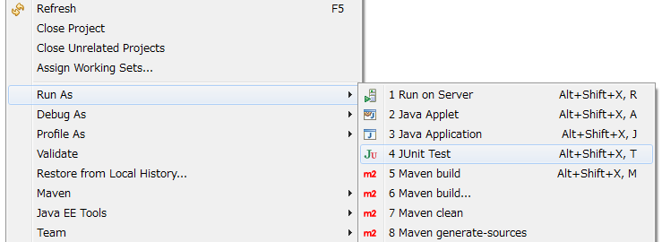

Slide 24
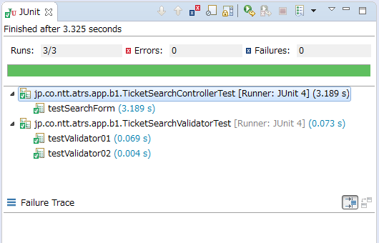

Slide 25
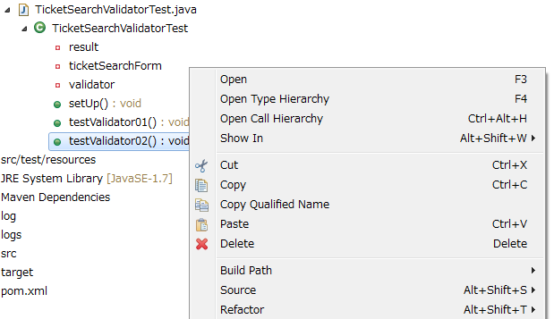

Slide 27
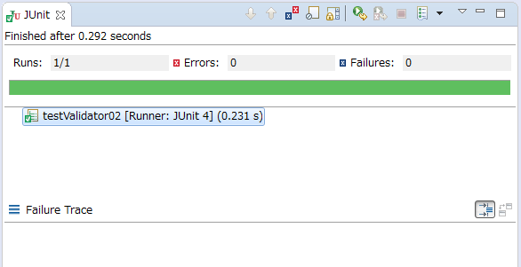

Slide 28
