Slide 1
Smart Pulse Oximeter

Slide 2
Disturbance
Team Members
Adwaith K S
Arathy Sadan
Liyons Varghese
Libin Koruth Varkey

Slide 3
Problem Statement
Area : Education
Problem : During covid-19 lot of people lost their life due to breathing difficulty. This is due to the oxygen saturation in blood decreases. The person undergo treatment at home or in quarantine can use pulse oximeter to identify the oxygen saturation level in his/her blood. But if he/she suddenly collapse due to breathing difficulty and if there is no one nearby him rescue is difficult.
Solution : The smart pulse oximeter designed by us is connected to an android phone via bluetooth. If the oxygen saturation in their blood suddenly drop a warning message is send to the hospital software. Thus the rescue team can save this person

Slide 4
Abstract
The whole World is greatly affected by the current COVID-19 pandemic caused due to emerging novel Coronavirus which specifically attacks on the respiratory system and reduces oxygen carrying capacity to develop hypoxia/dyspnoea. The severely affected COVID-19 patients require ventilators to survive and to fulfil the need of oxygen. Pulse oximeter can be significantly used to observe the oxygen saturation in quarantine or hospitalised patients. Thus, pulse oximeter has become a game-changer in COVID-19 pandemic to detect the oxygen requirement in patients.
So a person met with COVID-19 treating himself at home or person is under quarantine at home can use bluetooth pulse oximeter designed by us .This bluetooth pulse oximeter is connected to an android application, if oxygen saturation level decreases a warning message to the nearby hospital through the android application. Thus we can rescue that person.

Slide 5
Working
Pulse
oximeter
Android
Application
Hospital-side
software
Bluetooth

Slide 6
Components(pulse oximeter)
Hardware Specification
Red LED | Maximum current allowed = 30 mA Power supply = 9 V Current limiting resistor = 330Ω
Infrared LED | Maximum current allowed = 50 mA Power supply = 9 V Current limiting resistor = 220Ω
Non-inverting amplifier | Gain ~ 85 Single supply amplifier used Power supply +9 V
Low pass filter | Cut off frequency = 15 Hz
Sensor Specification
Effective measuring range | Pulse rate: 35 –250 bpm Oxygen saturation: 0 –100%
Accuracy | Pulse rate: ±3%Oxygen saturation: ±3%

Slide 7
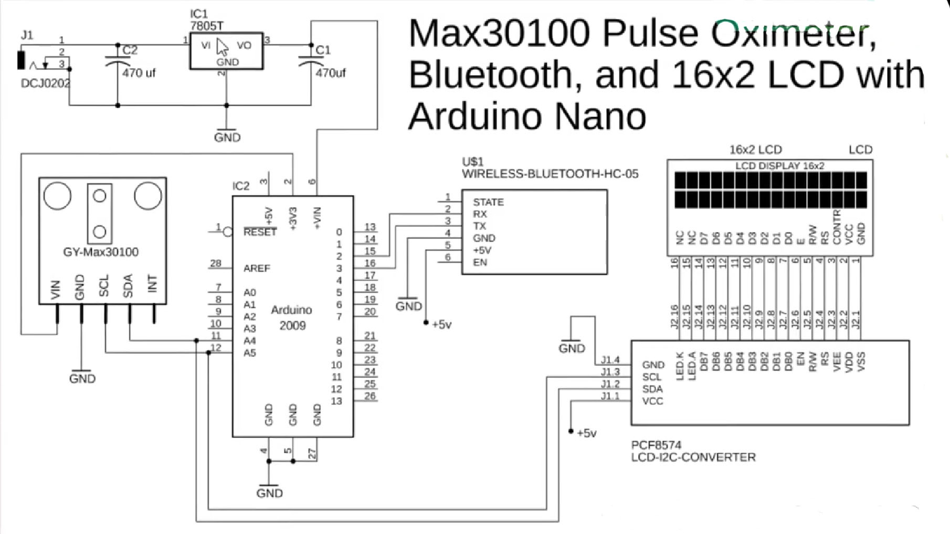
Diagram

Slide 8
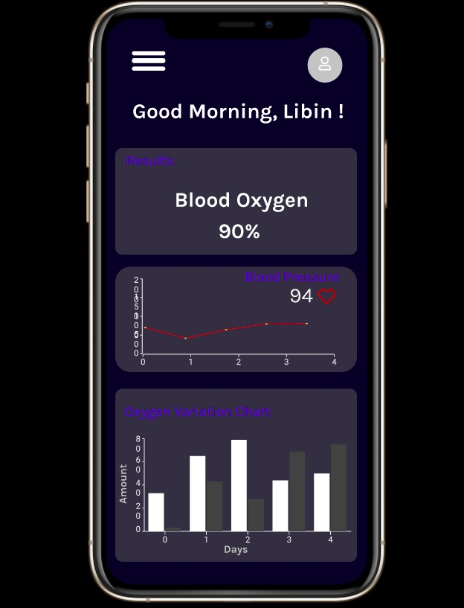
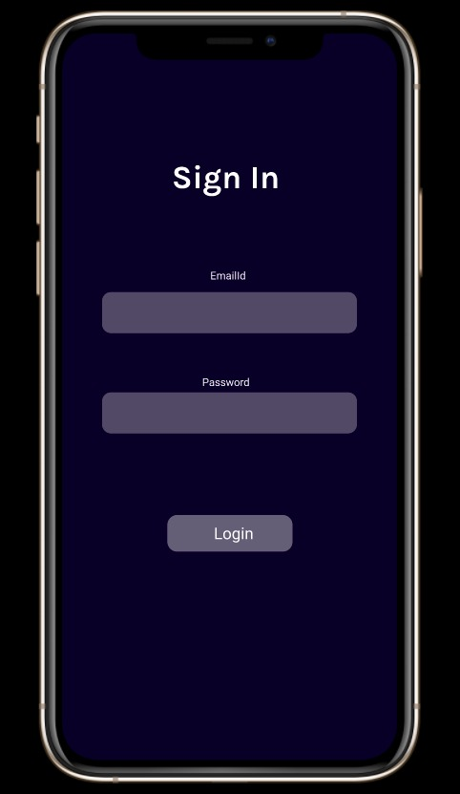
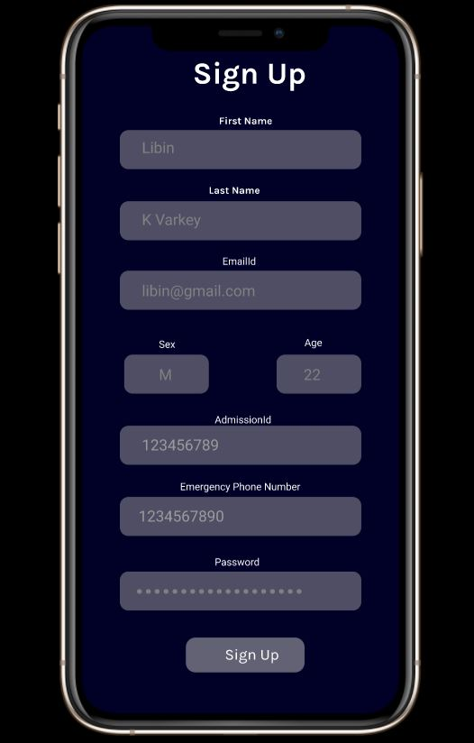
Mobile Interface

Slide 9
Software Specification
IDE : Android Studio
Programming language : Java
Arduino Board (nano 2009 ~Rs. 2000 )

