Slide 1
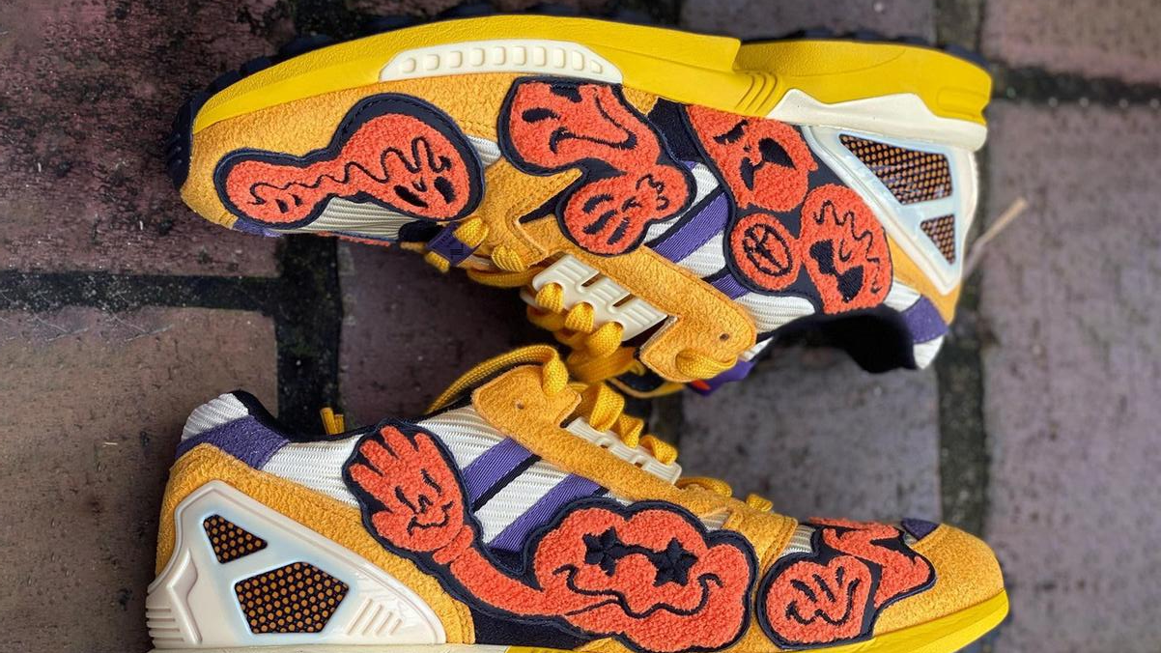
Requirements
High Performance
Scalable
Robust
Reliable
Customer Experience & Satisfaction

Slide 2
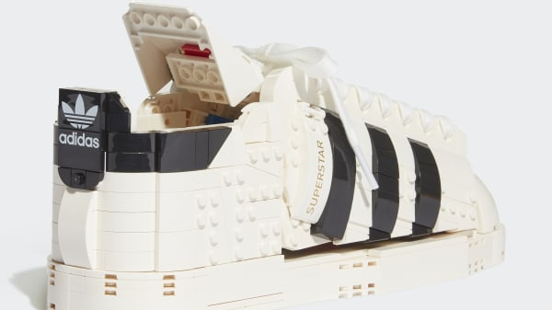
Choosing Tech Stack?!
Language
Framework
Database
Communication
Other Tech??

Slide 3
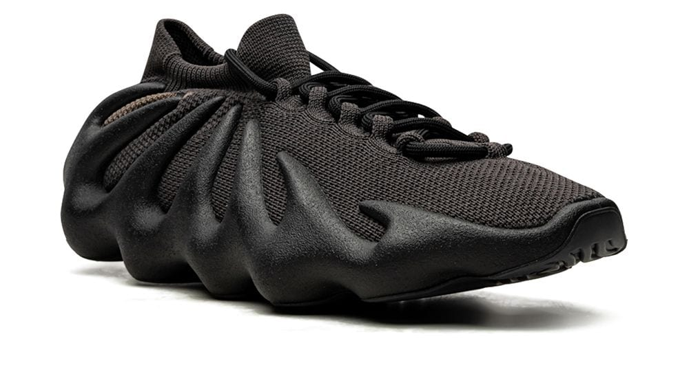
Language & Frameworks
Java 11
Gradle
SpringBoot
Junit5
TestContainers
PS: longest way round is the nearest way home

Slide 4
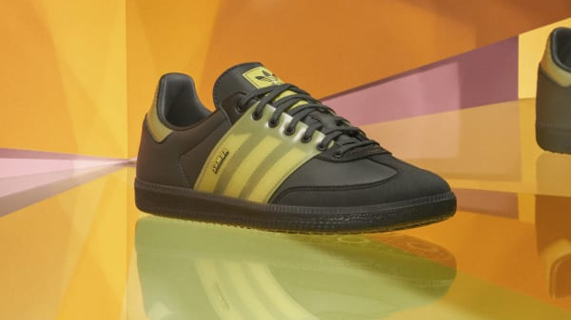
Database
Redis
Do we need long persistence?
How fast it should be?
Easy to maintain?
Is it ok to remove from Infrastructure?

Slide 5
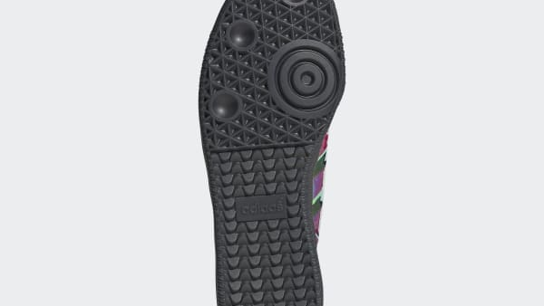
Challenge!! Is good old DB lock still enough?
Race Condition!
WATCH with Redis?
Unneccassary exceptions
Unsatisfied customers
DB shold not the place that we can develop business logic. DB is DB. Store the data, not much not less.
What will be the solution then, can be Event Messages?

Slide 6
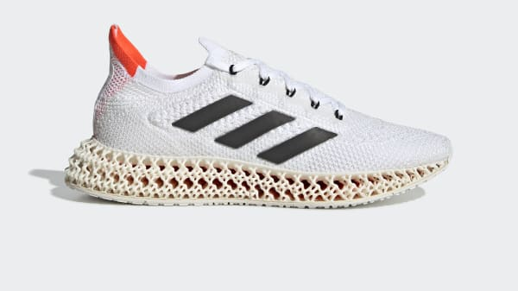
KAFKA
Scalable
Requests come sequentially with KEY(productId)
No Race Condition
No DB? No problem, messages safe in the KAFKA.

Slide 7
How does it look like?

Slide 8
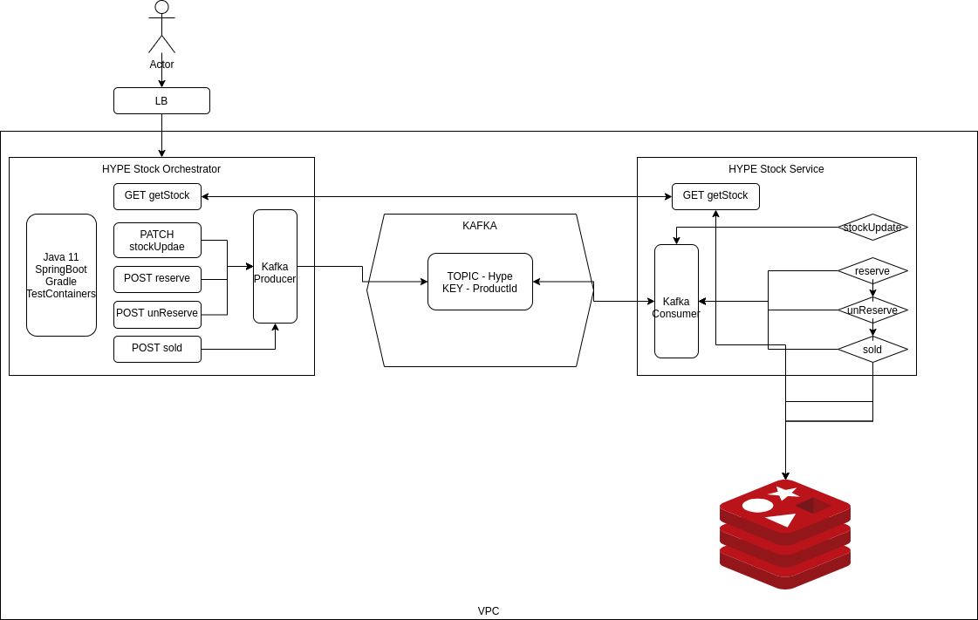

Slide 9

What is missing? Improvements…
Test (all of them)
Support client libraries for duplicated codes.
Implement Synchronous Kafka for better exception handling.
Service App‘s docker images.
What should I do?
Api first design
TTD approach

