Slide 1
Introduction to the GUM
(International Guidelines for calculating and expressing uncertainty in measurement)
Prepared by Les Kirkup and Bob Frenkel

Slide 2

Measurement
Measurement is key to research and development. It allows us, for example, to rigorously test and evaluate new and established scientific theories.
An essential ingredient of measurement is uncertainty. We need to be able to define, calculate and express uncertainty in ways that provide consistency and clarity when we communicate the results of experiments carried out, say, in an undergraduate laboratory.

Slide 3

Need for consistency when calculating and expressing uncertainty
Until comparatively recently, inconsistencies existed worldwide in the way uncertainties were calculated, combined, and expressed.
Unless international consensus exists on these matters it is difficult to compare values obtained through measurement in different laboratories around the world.

Slide 4

Creation of guidelines
The Comite International des Poids et Mesures (CIPM) initiated the development of a guide that would establish and promote general rules for calculating and expressing uncertainty.

Slide 5

Enter the ‘GUM’
This influential guide, first published in 1993, is entitled Guide to the Expression of Uncertainty in Measurement. The guide is more usually referred to by the acronym, ‘GUM’.

Slide 6
Why do we need the GUM?
The guidelines given in the GUM are intended to be applicable to measurements carried out for the following purposes:
maintaining quality control and quality assurance in production
complying with and enforcing laws and regulations
conducting basic research, and applied research and development, in science and engineering

Slide 7
Need for the GUM, continued
Purpose of the GUM:
calibrating standards and instruments and performing tests throughout a national measurement system in order to achieve traceability to national standards
developing, maintaining, and comparing international and national physical reference standards, including reference materials.

Slide 8
Standards are traceable through a chain of comparisons
SI
Units
International Primary Standards, set by
International Committee of Weights and Measures
(CIPM) (Paris)
Primary
standards
Maintained by National
Measurement Institutes
Used by industry and checked periodically against Primary standards
Industrial reference standards
Industrial working standards
Balances, thermometers, pressure gauges etc found in (for example) undergraduate laboratories

Slide 9

The terms error and uncertainty are used regularly when discussing measurement, but they should not be used interchangeably
Definition of measurement error:
error = measured value – true value
As the true value can never be known, the error too must remain unknown.
It is not very helpful to say (for example) that: ‘the mass of the block of steel is 3.25 kg with an unknown error’.
It is much more helpful to introduce a parameter that can be calculated, and that parameter is the uncertainty.

Slide 10

What does the GUM say about uncertainty?
The GUM states that an uncertainty of measurement is a:
…parameter, associated with the result of a measurement that characterises the dispersion of the values that could reasonably be attributed to the measurand*.
*The measurand is the particular quantity of interest that is to be determined through the process of measurement.

Slide 11
What else does the GUM say about uncertainty?
The GUM advises:
value = best estimate of value ± uncertainty
For example, the mean
This is sometimes referred to as the ‘true value’. The GUM avoids the use of the word ‘true’, arguing that it is superfluous.

Slide 12
Type A and Type B uncertainties
According to the the GUM, uncertainties come in two ‘flavours’ – Type A and Type B.
Strictly, we should speak of ‘Type A and Type B evaluations of uncertainty’.

Slide 13

Type A evaluations of uncertainty
Type A evaluations of uncertainty are based on the statistical analysis of a series of measurements.

Slide 14

Type B evaluations of uncertainty
Type B evaluations of uncertainty are based on other sources of information such as an instrument manufacturer's specifications, a calibration certificate or values published in a data book.

Slide 15
There are familiar and unfamiliar elements in the GUM
For each value there is an associated standard uncertainty, u.
In the case of repeat measurements of a single quantity and where there is no correlation between successive values obtained through measurement, that uncertainty is equivalent to the standard error of the mean*.
Where the standard uncertainty is established by a Type B evaluation, it is obtained, for example, from a calibration certificate, a manufacturer’s handbook or a data book.
The term ‘Standard error’ is a not used in the GUM, but is found routinely in statistics texts. The term ‘standard uncertainty’ is preferred by the GUM.

Slide 16
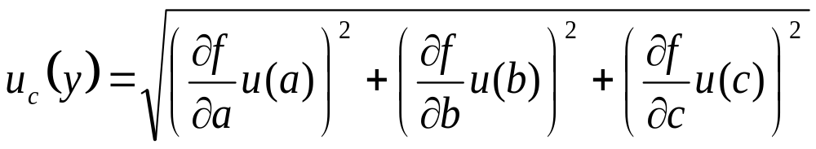
Combined Standard Uncertainty, u_{c}
The relationship between the measurand, Y, and A, B and C is written most generally as Y = f(A,B,C).
u(a), u(b) and u(c) are the standard uncertainties of best estimates a, b and c respectively obtained through Type A or Type B evaluations.

Slide 17
Example of reporting uncertainty the value of a nominal 100 g standard of mass, m_{s}
m_{s}= 100.035 21 g with a combined standard uncertainty of u_{c} = 0.44 mg.
It is assumed that the possible values of the standard are approximately normally distributed with an approximate standard deviation, u_{c}.

Slide 18
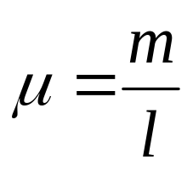
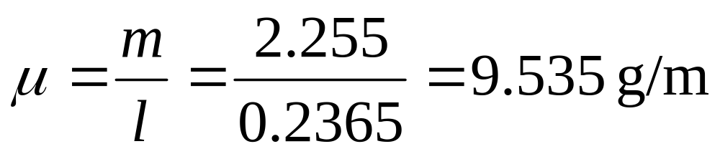
Worked example
The mass, m, of a wire is found to be 2.255 g with a standard uncertainty of 0.032 g. The length, l, of the wire is 0.2365 m with a standard uncertainty of 0.0035 m. The mass per unit length, μ, is given by:
Determine the,
a) best estimate of μ,
b) standard uncertainty in μ.

Slide 19
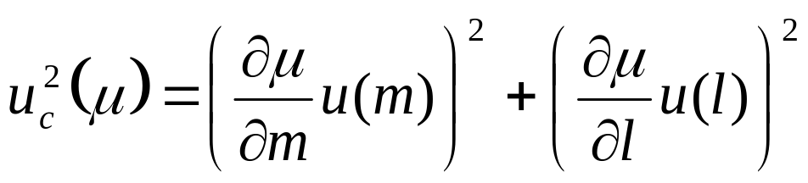
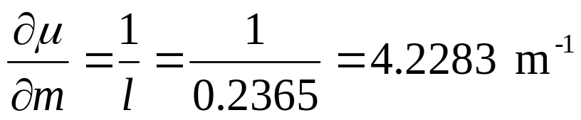
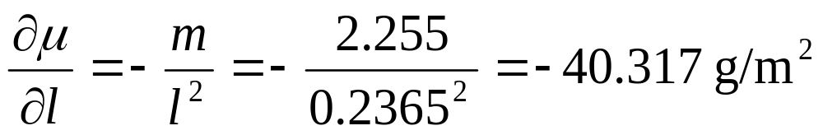
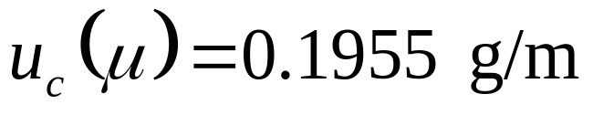
Worked example continued
Adapting the equation on slide 16:

Slide 20
We can also quote an Expanded Uncertainty, U – what is the Expanded Uncertainty?
The Expanded Uncertainty, U, is a simple multiple of the standard uncertainty, given by
U = ku_{c}(y)
k is referred to as the coverage factor.
So we can write:
Y = y ± U

Slide 21
Coverage Factor, k
How sure do we want to be that the true value lies between ±U of the best estimate ?
This is set using the coverage factor and is based on the t probability distribution (which is closely related to the normal or Gaussian distribution).
If we want the probability to be 0.95 that the true value lies between ±U of the best estimate, the coverage factor, k, would be approximately equal to 2.

Slide 22
Advantages of adopting the GUM
Internationally credited/accepted approach to calculating and expressing uncertainties.
Allows everyone to ‘speak the same language’.
Allows the term ‘uncertainty’ to be interpreted in a consistent manner.
A ‘must’ for everyone working in standards/ calibrations laboratories and growing in importance in industrial laboratories – key phrase is that it will ‘increase competitiveness’.
Becoming essential knowledge in many other fields including forensic, medical and biomedical.
Likely to be around for some time to come.

Slide 23
Disadvantages
Strange/unfamiliar terms (e.g. standard uncertainty and coverage factor).
Likely to conflict with approaches to uncertainty already encountered by students.
Comparatively little material available to assist the teaching of this topic.
Will take some time before the GUM becomes widely known beyond the metrology community.
Currently few academics know of its existence.

Slide 24
Bibliography and acknowledgement
ISO (1993) Guide to the Expression of Uncertainty in Measurement (Geneva, Switzerland: International Organisation for Standardisation).
NIST Technical Note 1297 (1994) Guidelines for Evaluating and Expressing the Uncertainty of NIST Measurement Results.
An Introduction to Uncertainty in Measurement by Les Kirkup and Bob Frenkel (2006) published by Cambridge University Press.
All images in this slide show were taken from Microsoft ClipArt.

